Slide 1


Examining Differences in the Shared-Flat (WG) Market in various cities using the online platform WG-Gesucht
For:
Computational Social Sciences Lab
Supervised by: Prof. Dr. Florian Lemmerich
Summer Term 2021
Created by:
Fariha Hossain
Umme Rabab
Artiola Kuke

Slide 2
Agenda
Road map of the Project
Introduction
- Problem statement
- Motivation
- Methods
- Results
Overview of Data
Methodology
Possible Issues with Data Collection
Research Questions
2

Slide 3
Road map of the project
Data collection
1 week
Data Preprocessing
2 weeks
Implementation
2 weeks
Report writing
2 weeks
3

Slide 4

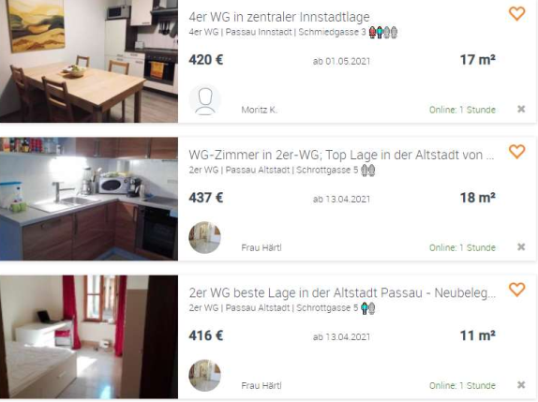
Introduction (About the Project)
Problem statement
Flat sharing is a better and cheaper method of stay especially for students but looking for the right apartment and friendlier flat mates is very difficult since there is a lot of differences based on age and gender especially among young adults.
Motivation
This study will help to examine the statements offered by those engaged in selecting housemates in WG Gesucht to make better decision on selecting the right people and place.
Method
Specific data will be drawn from avaialbe ads published in WG Gesucht such as details on age groups and gender by students or landlords seeking for renters in share flats and evaluated based on the text.
Results
Results will be presented involving presence or absence of differences in advertisement between men and women.
5

Slide 5
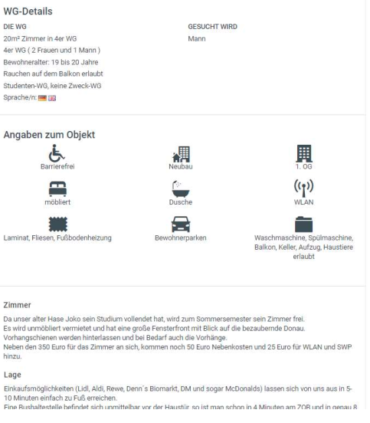
Data Collection
In particular, the following tool automatically saves all offers presented on http://www.wg-gesucht.de for Passau district. Collected data includes
the room's size
total size of the flat
number of available roommates
their gender
their age
their occupation (student, working, person, communal)
Languages spoken
Gender required for the new roommate
Metadata for each ad include their unique ID as well as the link to the source and the offer's title description. Moreover, timestamps for activating as well as deactivating the ad are created, allowing to estimate the duration of each ad being active.

Slide 6
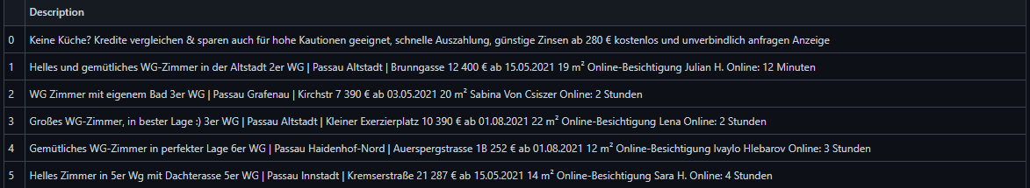
Data Collection
The scraped and cleaned data does have a structure like the following:

Slide 7
Data Collection
.
This collection of data is achieved by several processes:
Setting up a webserver which automatically runs the necessary script regularly
Creating an environment and data structure to work on
Scraping the data
Parsing the retrieved html-documents into a usable format and clean that
Combining the new data with the earlier saved

Slide 8
Methodology
Data collection
Data Preprocessing
Application of Sentiment Analysis
Evaluation
Target Research
Question
Decision
Making
8

Slide 9
Possible issues with the data collection:
Context of data collection. (some text lost in translation)
Insufficient information identifying for WG post
Inconsistent data collected
Lack of guidance for collecting the data.

Slide 10
Research Questions:
We designed three possible studies to answer these research questions:
Research question 1: Statements (e.g. more friendly words) in advertisements between men and women.
Research question 2: How many WGs add gender and age preference in their ads?
(how many WGs add LGBTQ + as part of the description?)
Research question 3: If age preference added, what is the minimum and maximum age stated on an average?
4

Slide 11
Discussion!
4

