Slide 1


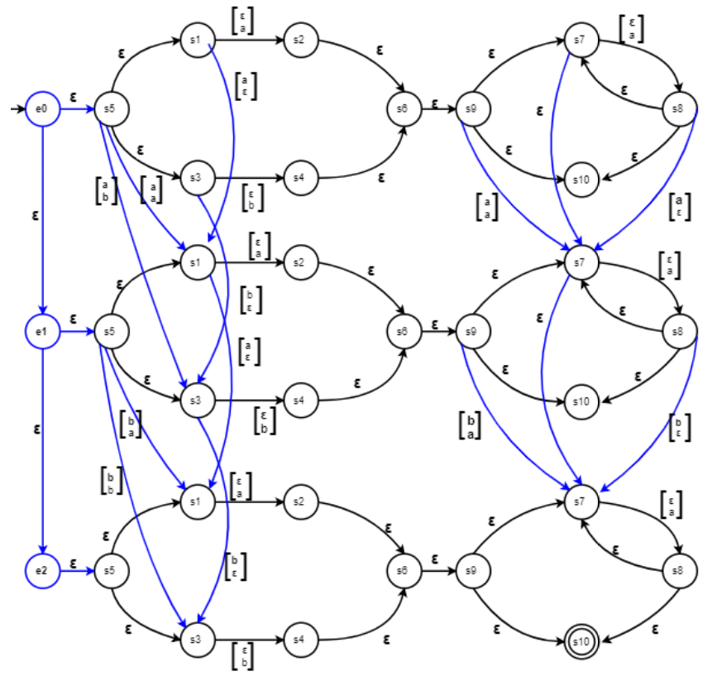
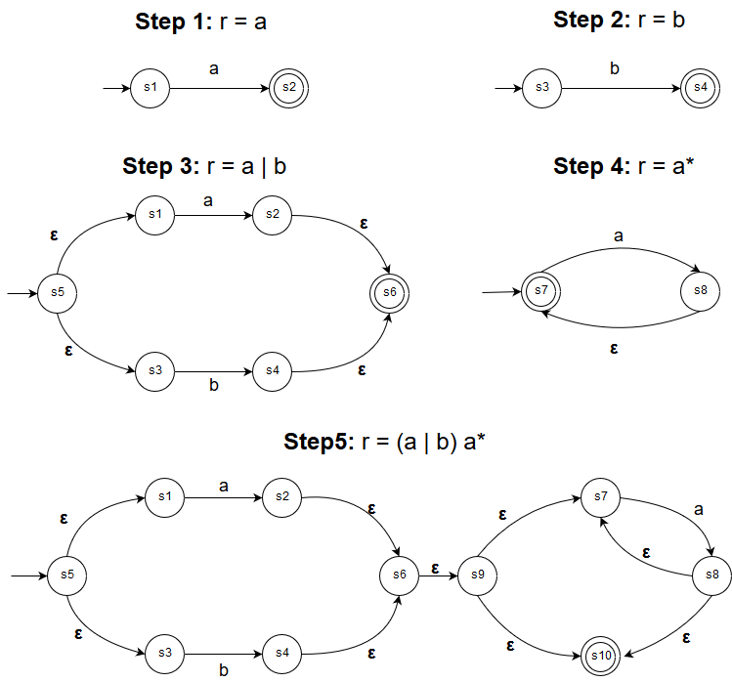
Approximate Regular Expressions: A Comparison of Exact and Approximate Matching Algorithms
Umme Salma Gadriwala, Tasnim Noshin, Rumsha Siddiqui
{gadriwau, noshint, siddiqur}@mcmaster.ca
April 2019
MOTIVATION, PROBLEM, SOLUTION
APPROXIMATE MATCHING:
MYERS and miller’s CONSTRUCTION
PERFORMANCE TESTS
MOTIVATION: In bioinformatics, approximate matching is vital to compare and contrast DNA and protein sequences. The length of sequences involved in these applications reach billions. Thus, efficient string matching algorithms are needed to optimize time and cost of resources.
PROBLEM: This project explores whether an implementation of exact regular expression matching can be replaced with one of approximate matching, where the error value for an exact match request would be set to zero.
SOLUTION: A Python implementation of exact regular expression matching using Thompson’s NFA is compared with that of Myers and Miller's approximate matching algorithm built on Thompson’s construction. Matches between string and regular expressions of various lengths are used for testing. The testing methodology compares the time each algorithm takes for the same samples.
INPUT: Regular expression, r over Σ; string, s; and error value, k
OUTPUT: True, if s satisfies r after at most k errors
METHOD:
Construct a Myers and Millers NFA by combining |s|+1 instances of Thompson’s NFA construction of r by adding: deletion, insertion, and substitution edges based on s.
Traverse the NFA for s, incrementing a counter for each error.
Return true if k ≤ counter.
COMPLEXITY: NFA construction: O(|r|+|s|) steps,
O(|r|·|s|) memory;
String traversal: O(|r|·|s|) steps
Myer’s & Miller’s NFA with r = (a|b)a*, s = “ab”
EXACT MATCHING:
Thompson's Construction
INPUT: Regular expression, r over Σ; and string, s
OUTPUT: True, if s satisfies r
METHOD:
Construct a Thompson’s NFA by recursively applying ε, symbol, union, concatenation and Kleene closure rules over r.
Traverse the NFA for s.
Return true if traversal ends at a terminating state.
COMPLEXITY: NFA construction: O(|r|) steps, O(|r|) memory;
String traversal: O(|r|·|s|) steps
conclusions
Thompson’s NFA with r = (a|b)a*
Conclusion 1
Conclusion 2
Conclusion 3
Notes:
To change this poster, replace our sample content with your own. Or, if you'd rather start from a clean slate, use the New Slide button on the Home tab to insert a new page, then enter your text and content in the empty placeholders. If you need more placeholders for titles, subtitles or body text, copy any of the existing placeholders, then drag the new one into place.

