Slide 1


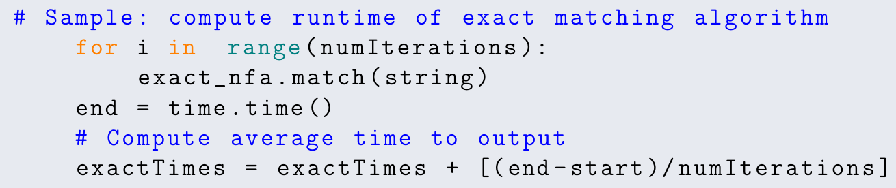
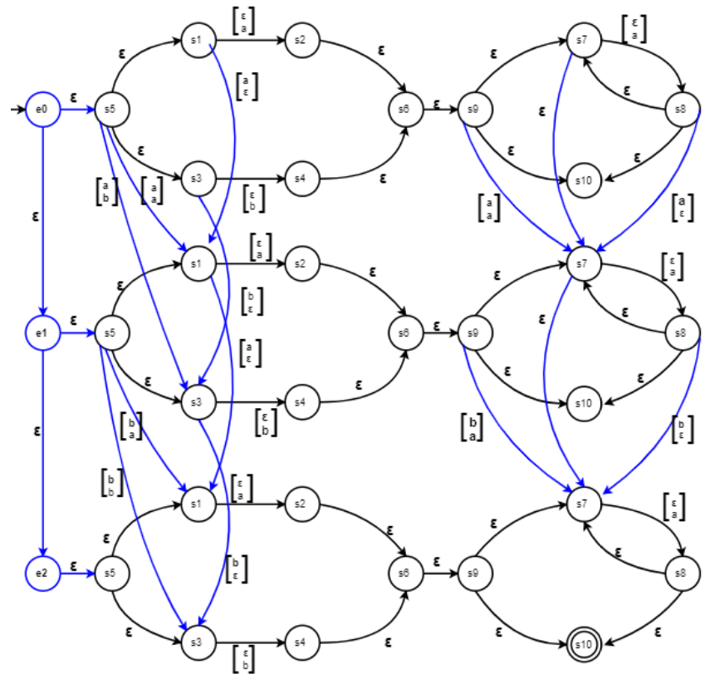
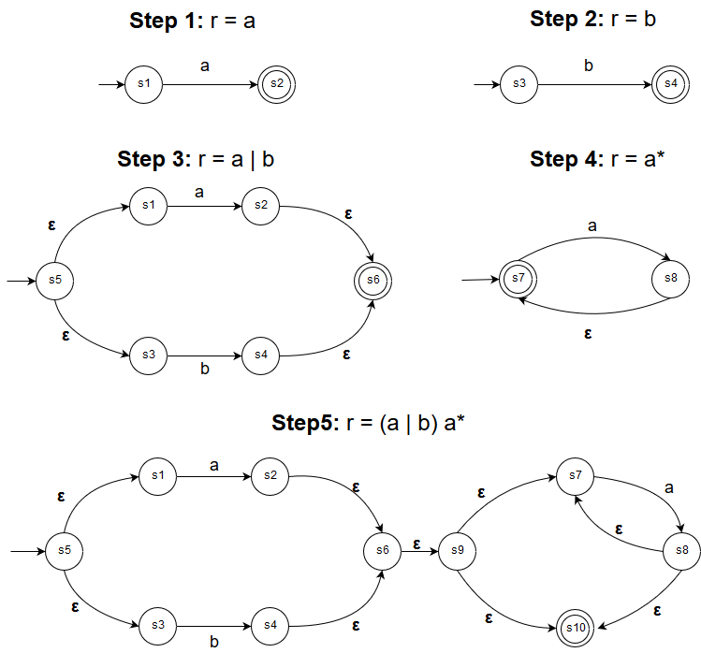
Approximate Regular Expressions: A Comparison of Exact and Approximate Matching Algorithms
Umme Salma Gadriwala, Tasnim Noshin, Rumsha Siddiqui
{gadriwau, noshint, siddiqur}@mcmaster.ca
April 2019
MOTIVATION, PROBLEM, SOLUTION
APPROXIMATE MATCHING:
MYERS and miller’s CONSTRUCTION
PERFORMANCE TESTS
MOTIVATION
DNA sequences are often represented by regular expressions to capture different variations of the same structure.
Efficient approximate string matching would allow us to capture more longer sequences, and optimize time and cost of resources.
PROBLEM
To evaluate the costs and benefits of replacing an implementation of exact regular expression matching with one of approximate matching for added functionality
SOLUTION
A comparison of the running times of exact matching using Thompson’s NFA to the Myers and Miller's approximate matching construction.
INPUT: Regular expression, r over Σ; string, s; and error value, k
OUTPUT: True, if s satisfies r after at most k errors
METHOD:
Construct a Myers and Millers NFA by combining |s|+1 instances of Thompson’s NFA construction of r by adding: deletion, insertion, and substitution edges based on s.
Traverse the NFA for s, incrementing a counter for each error.
Return true if k ≤ counter.
r1 = "CGA(A|G|C|T)(A|G|C|T)(A|G|C|T)(A|G|C|T)(A|G|C|T)(A|G|C|T)TGC"
r2 = "AC(A|G|C|T)(A|G|C|T)(A|G|C|T)(A|G|C|T)GTA(A|G)C"
r3 = "(A|G|C|T)*C(A|G|C|T)(A|G|C|T)(A|G|C|T)(A|G|C|T)(A|G|C|T)G(A|G|C|T)*“
s1 = "CGAAGCTATTGC"
s2 = "ACAAAAGTAGC"
s3 = "AAACAAAAAGTTTT"
s3’ = "TCGCTCGCTCGCTCGCTAAACAAAAAGTTTTTCGTCGTCGCTCG"
EXACT MATCHING:
Thompson's Construction
(r1, s1) (r2, s2) (r3, s3) (r3, s3’)
INPUT: Regular expression, r over Σ; and string, s
OUTPUT: True, if s satisfies r
METHOD: Traverse the NFA for s.
Return true if traversal ends at a terminal state.
imate
HARDWARE SPECIFICATIONS
Processor | Intel Core™ i7-5500U CPU @ 2.40Ghz 2.39 GHz | OS | Windows 10 (64-bit)
RAM | 8.00 GB | Software | Python 3.5 (32-bit)
Myers’ & Miller’s NFA with r = (a|b)a*, s = “ab”
conclusion
ANALYSIS
Myers and Miller's approximate string matching takes more than 50% of the time Thompson's exact matching does for the given test cases.
It is not worth the cost to use approximate matching where k = 0.
This is inline with the algorithmic time complexities of string traversal.
THOMPSON’S:
NFA construction: O(|r|) steps, O(|r|) space;
String traversal: O(|r|·|s|) steps;
Lines of code: 235
MYERS’ & MILLER’S:
NFA construction: O(|r|·|s|+|s|) steps, O(|r|·|s| + 2^{k}) space;
String traversal: O(|r|·|s|·|s|) steps;
Lines of code: 295
REFERENCES
[1] D. Belazzougui, M. Raffinot, Approximate regular expression matching with multi-strings, Journal of Discrete Algorithms, Volume 18, Pages 14-21, 2013.
[2] E. W. Myers, W. Miller, Approximate Matching of Regular Expressions, Bulletin of Mathematical Biology, 1989.
Thompson’s NFA with r = (a|b)a*
Notes:
To change this poster, replace our sample content with your own. Or, if you'd rather start from a clean slate, use the New Slide button on the Home tab to insert a new page, then enter your text and content in the empty placeholders. If you need more placeholders for titles, subtitles or body text, copy any of the existing placeholders, then drag the new one into place.

