Slide 1


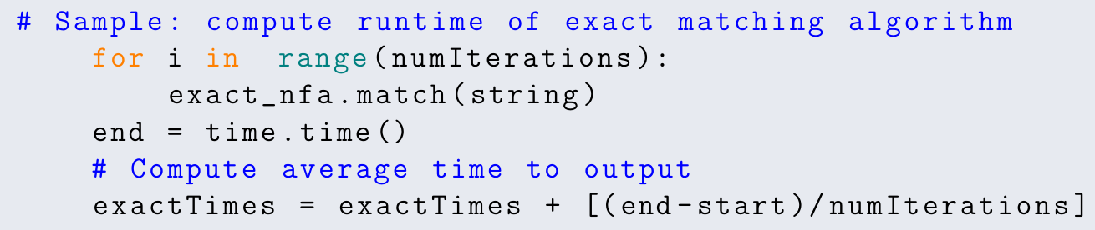
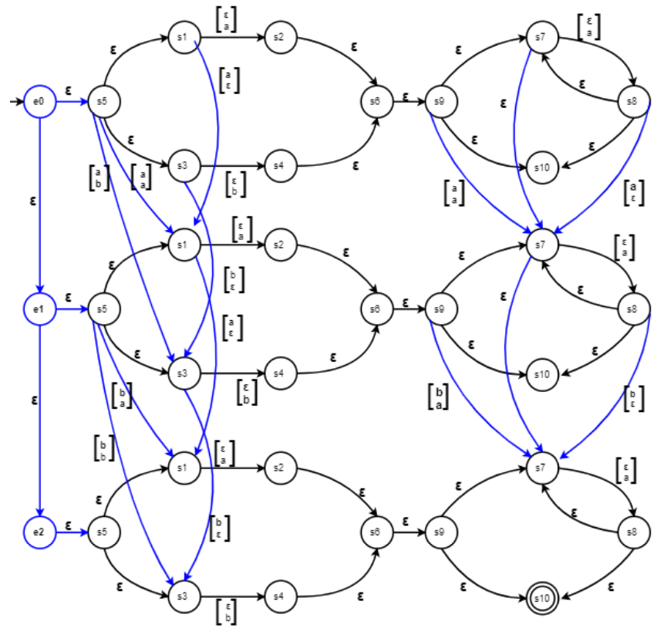
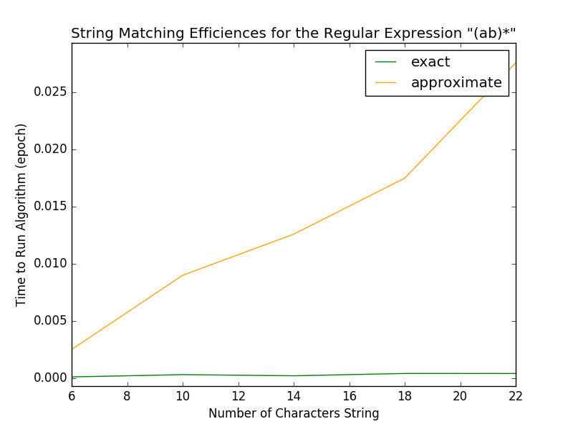
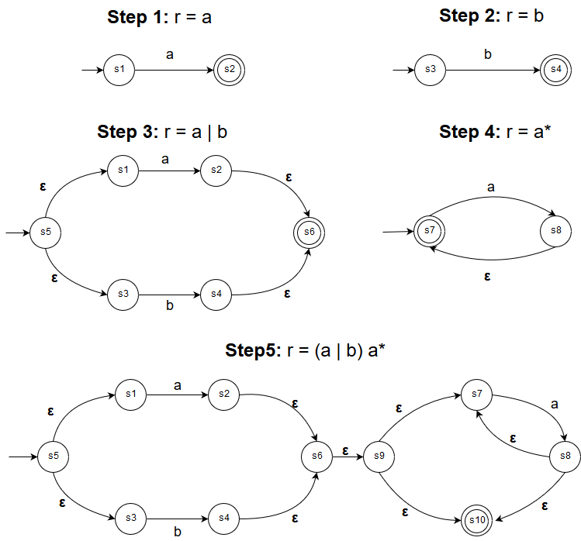
Approximate Regular Expressions: A Comparison of Exact and Approximate Matching Algorithms
Umme Salma Gadriwala, Tasnim Noshin, Rumsha Siddiqui
{gadriwau, noshint, siddiqur}@mcmaster.ca
April 2019
MOTIVATION, PROBLEM, SOLUTION
APPROXIMATE MATCHING:
MYERS and miller’s CONSTRUCTION
PERFORMANCE TESTS
MOTIVATION
DNA sequences are often represented by regular expressions to capture different variations of the same structure.
Efficient approximate string matching would allow us to capture more longer sequences, and optimize time and cost of resources.
PROBLEM
To evaluate the costs and benefits of replacing an implementation of exact regular expression matching with one of approximate matching for added functionality
SOLUTION
A comparison of the running times of exact matching using Thompson’s NFA to the Myers and Miller's approximate matching construction.
Performance tests compare the run times for both algorithm using different types of sequences and regular expressions
INPUT: Regular expression, r over Σ; string, s; and error value, k
OUTPUT: True, if s satisfies r after at most k errors
METHOD:
Construct a Myers and Millers NFA by combining |s|+1 instances of Thompson’s NFA construction of r by adding: deletion, insertion, and substitution edges based on s.
Traverse the NFA for s, incrementing a counter for each error.
Return true if k ≤ counter.
COMPLEXITY: NFA construction: O(|r|+|s|) steps,
O(|r|·|s|) memory;
String traversal: O(|r|·|s|) steps
r1 = "CGA(A|G|C|T)(A|G|C|T)(A|G|C|T)(A|G|C|T)(A|G|C|T)(A|G|C|T)TGC"
r2 = "AC(A|G|C|T)(A|G|C|T)(A|G|C|T)(A|G|C|T)GTA(A|G)C"
r3 = "(A|G|C|T)*C(A|G|C|T)(A|G|C|T)(A|G|C|T)(A|G|C|T)(A|G|C|T)G(A|G|C|T)*“
s1 = "CGAAGCTATTGC"
s2 = "ACAAAAGTAGC"
s3 = "AAACAAAAAGTTTT"
s33 = "TCGCTCGCTCGCTCGCTAAACAAAAAGTTTTTCGTCGTCGCTCG"
Myer’s & Miller’s NFA with r = (a|b)a*, s = “ab”
EXACT MATCHING:
Thompson's Construction
(r1, s1) (r2, s2) (r3, s3) (r3, s33)
INPUT: Regular expression, r over Σ; and string, s
OUTPUT: True, if s satisfies r
METHOD:
Construct a Thompson’s NFA by recursively applying ε, symbol, union, concatenation and Kleene closure rules over r.
Traverse the NFA for s.
Return true if traversal ends at a terminating state.
COMPLEXITY: NFA construction: O(|r|) steps, O(|r|) memory;
String traversal: O(|r|·|s|) steps
imate
HARDWARE SPECIFICATIONS
Processor | Intel Core™ i7-5500U CPU @ 2.40Ghz 2.39 GHz
RAM | 8.00 GB
OS | Windows 10
Software | Python 3.5 (32-bit)
conclusions
Thompson’s NFA with r = (a|b)a*
Conclusion 1
Conclusion 2
Conclusion 3
Notes:
To change this poster, replace our sample content with your own. Or, if you'd rather start from a clean slate, use the New Slide button on the Home tab to insert a new page, then enter your text and content in the empty placeholders. If you need more placeholders for titles, subtitles or body text, copy any of the existing placeholders, then drag the new one into place.

