Slide 1
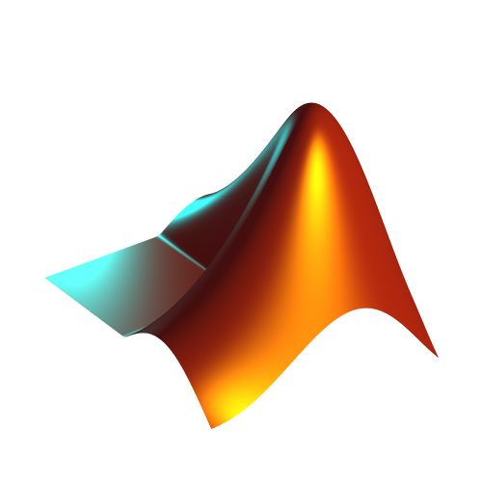


Real-Time Digital Implementation of a Moog Ladder Filter Using MATLAB and Juce

Slide 2
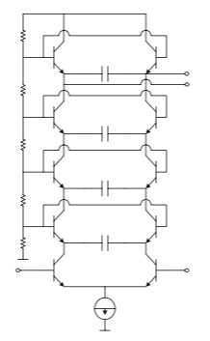
Moog ladder circuit
A transistor ladder circuit consists of four stages:
Each stage has two transistors and a capacitor
The differential transistor pair creates non-linearities which gives the
Moog filter its characteristic “warm” sound
The capacitor is responsible for the control current, which drives the current
at the bottom of the ladder at each stage
Each stage is connected in series
The output of the previous stage drives the input of the next stage
The differential transistor pair creates a buffer in each stage
Resonance is produced by routing the output in the last stage to a high impedance differential amplifier in the first stage
This feedback path is inverted with a phase shift of 180 degrees
Each stage produces a phase shift of 45 degrees
The combined phase shift and inverted output causes feedback to be positive in turn causes frequencies to be emphasized at the cutoff
Moog ladder circuit

Slide 3
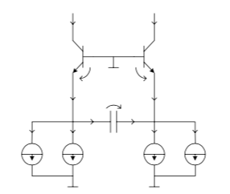
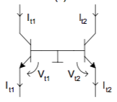
Moog ladder circuit
The ladder circuit can be modeled by using four one-pole IIR filters in cascade with imbedded non-linearities
The imbedded non-linearities are due to the differential transistor pair found at each stage
Analyzing the voltage and current at each stage of the filter produces an equation for each stage
These equations can be solved using Euler’s method
The resulting differential equations are similar to that of a one-pole IIR lowpass filter
Current and voltage through a differential pair
A single stage of the Moog circuit

Slide 4
MATLAB
Audio System Toolbox
Create real-time audio plugins
Test audio plugins with audioTestBench
Generate VSTs with generateAudioPlugin
Moog class
Inherets the audioPlugin class
Contains all the functionality that’s necessary for running a real-time plugin
Handles input/output audio buffers
Uses the process() callback function for processing audio

Slide 5
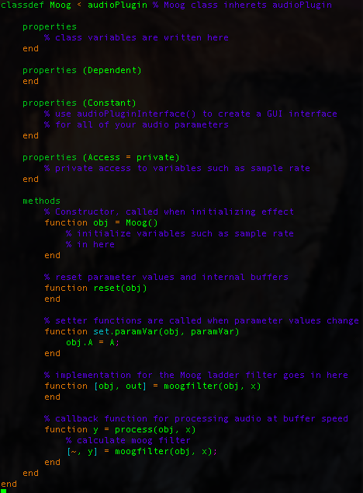
Moog class structure in MATLAB

Slide 6
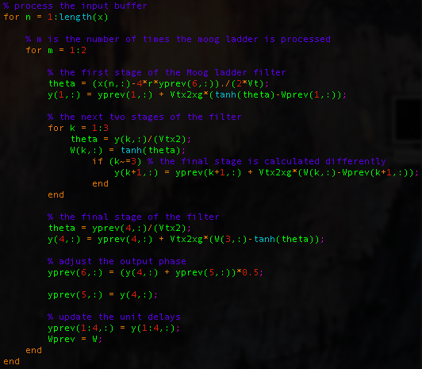




moogfilter implementation
Intermediate formulas:
Stage 1:
Stage 2 and 3:
Stage 4:
Adjust phase:

Slide 7
Problems with MATLAB implementation
Exporting audio plugin as VST
MATLAB generates mex files (C/C++ source files)
MATLAB files become bug prone (cannot generate dynamic arrays)
Forced to program against the MATLAB language
Slow and inefficient
CPU usage at %13 in Ableton
Clipping and distortion

Slide 8
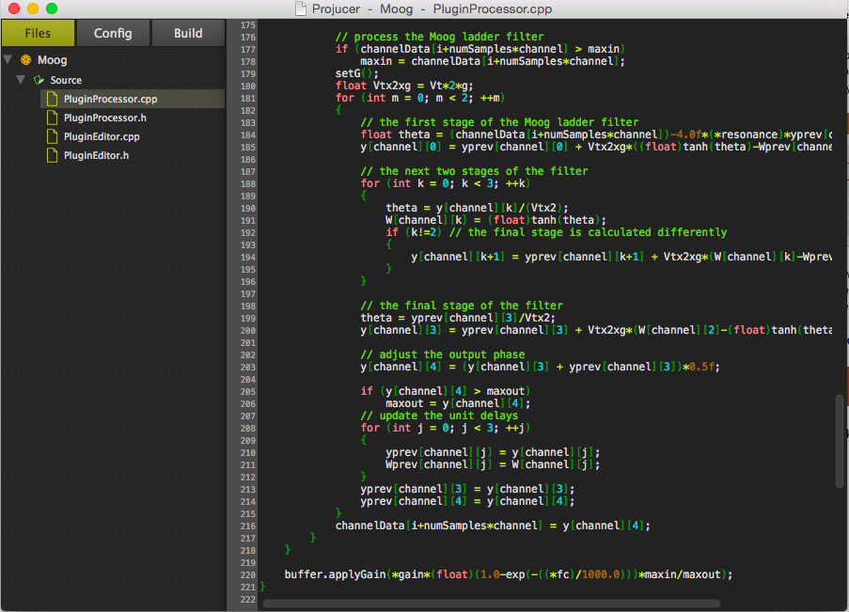
Juce

Slide 9
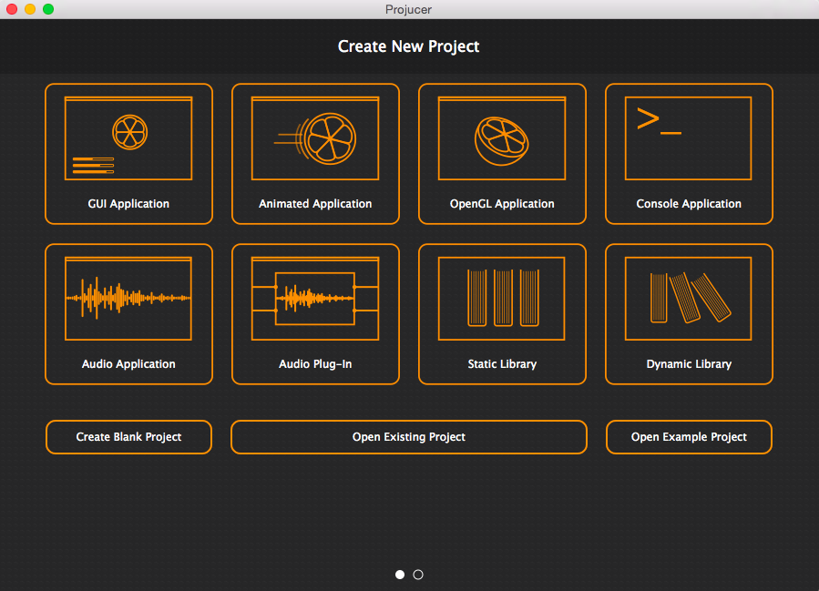
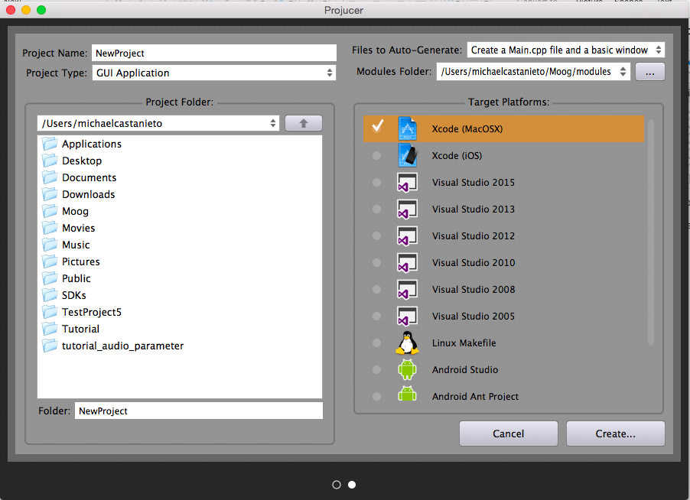
Why Juce?
Develop audio programs and plugins
for a variety of different platforms
using the Projucer
Very powerful and robust API for real-time
audio and graphical programming
Programs are written in C++
Finely tune your algorithms for greater efficiency
Generating VSTs become much easier

Slide 10
Problems solved with Juce
Better CPU efficiency
CPU usage decreased from %13 to %10 in Ableton
Plugin generation is much easier
Able to implement an algorithm that is more faithful to the 2004 Huovilainen paper: Vt, the thermal voltage, is at a more realistic value
of 25mV rather than 2MV

Slide 11
Problems not solved with Juce
Ten percent CPU usage is still too high
The implementation uses 5 tanh calculations, once for the first three stages
of the Moog ladder circuit and twice for the last stage
The Moog filter algorithm is calculated twice for each sample
Clipping and distortion is still present

Slide 12
And now to demonstrate…

