Slide 1
LECTURE SURVEY FORM
Usman Moazzam
CSDS 285 Project 2

Slide 2
INTRODUCTION
Bridging the gap between the student and the professor
Students POV
How do I send a message that won’t get lost in the professor’s inbox?
Professor POV
How do I sort out student’s messages to ensure I can respond?

Slide 3
CONCEPT
“Feedback” form website for each lecture
Students POV
Can submit questions, thank you’s, feedback, other sentiments
Professor POV
All messages come from a dedicated mail server that can be sorted into its own mail folder

Slide 4
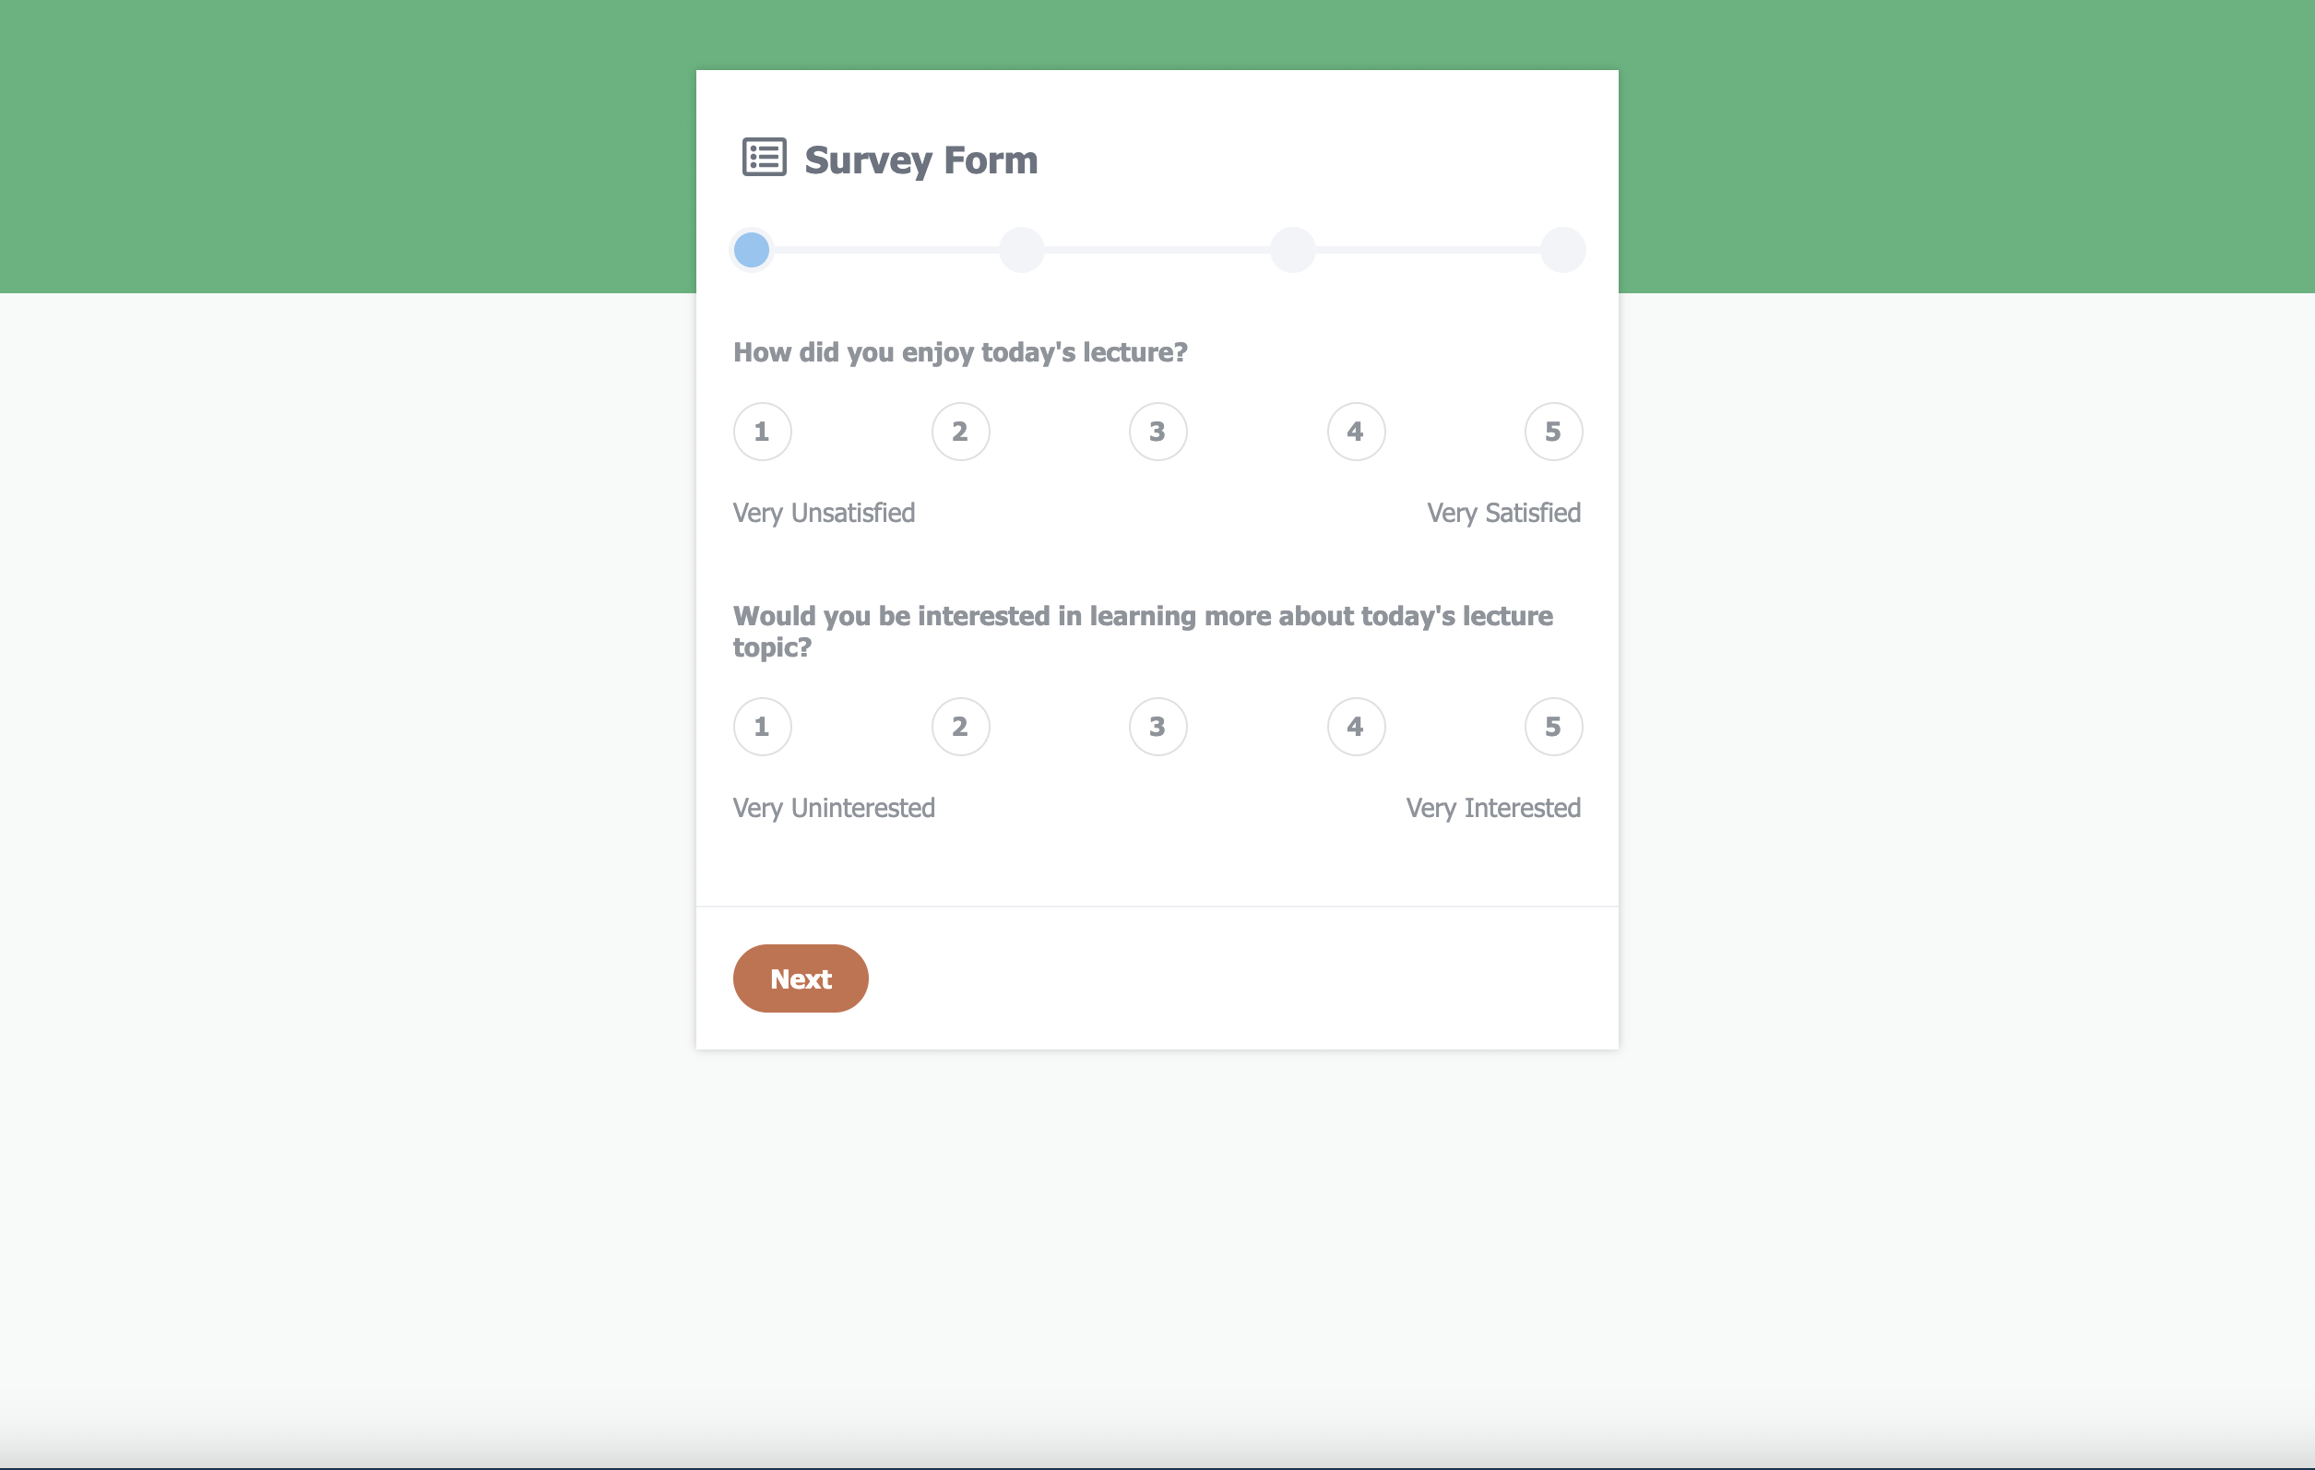
RESULT:
LECTURE SURVEY FORM

Slide 5
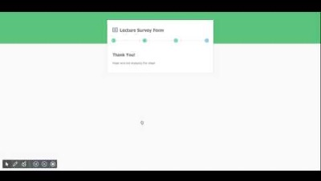
PROJECT DEMO

Slide 6
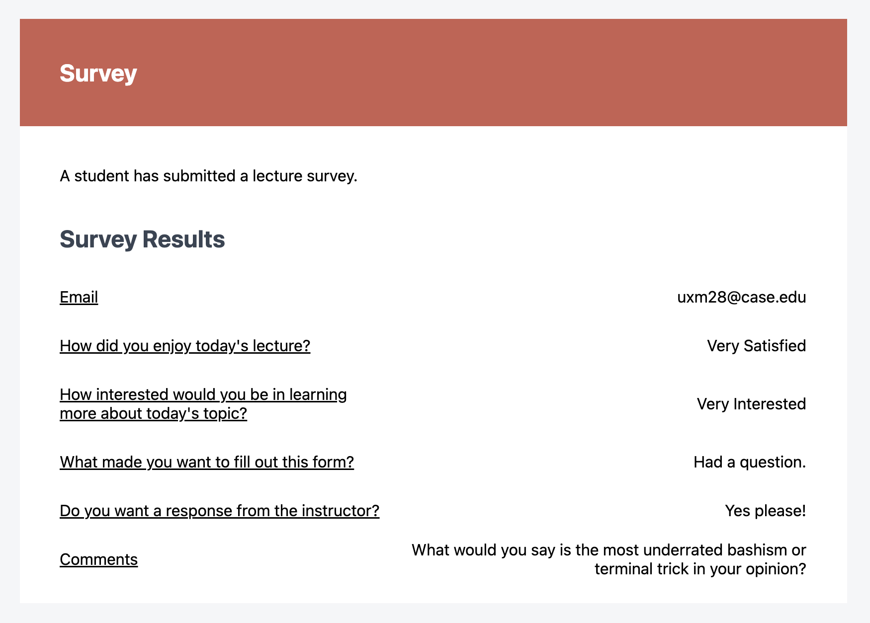
EMAIL: requires mail server

Slide 7
CODE EXPLANATION
SURVEY.PHP
Generates the survey form on multiple pages
Wraps student’s information and message and sends in email to professor
Contains PHP, JS, and HTML code to help survey operate
EMAIL-TEMPLATE.PHP
Generates the template for the email sent to the professor
Contains student’s personal information and message
STYLE.CSS
Structures the survey form and makes it look more appealing

Slide 8
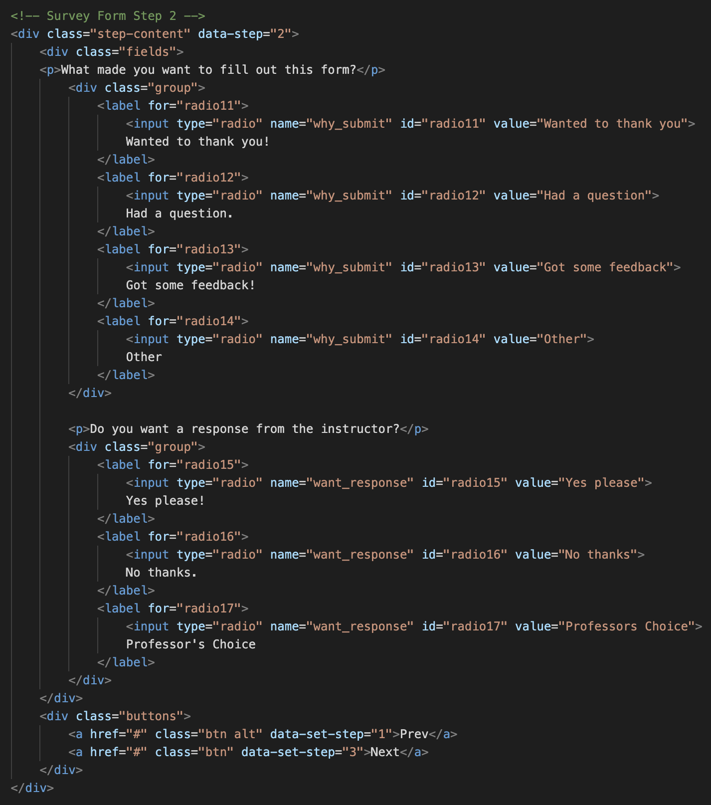
SURVEY.PHP
HTML for each page of the form
Ex: Survey form page 2

Slide 9
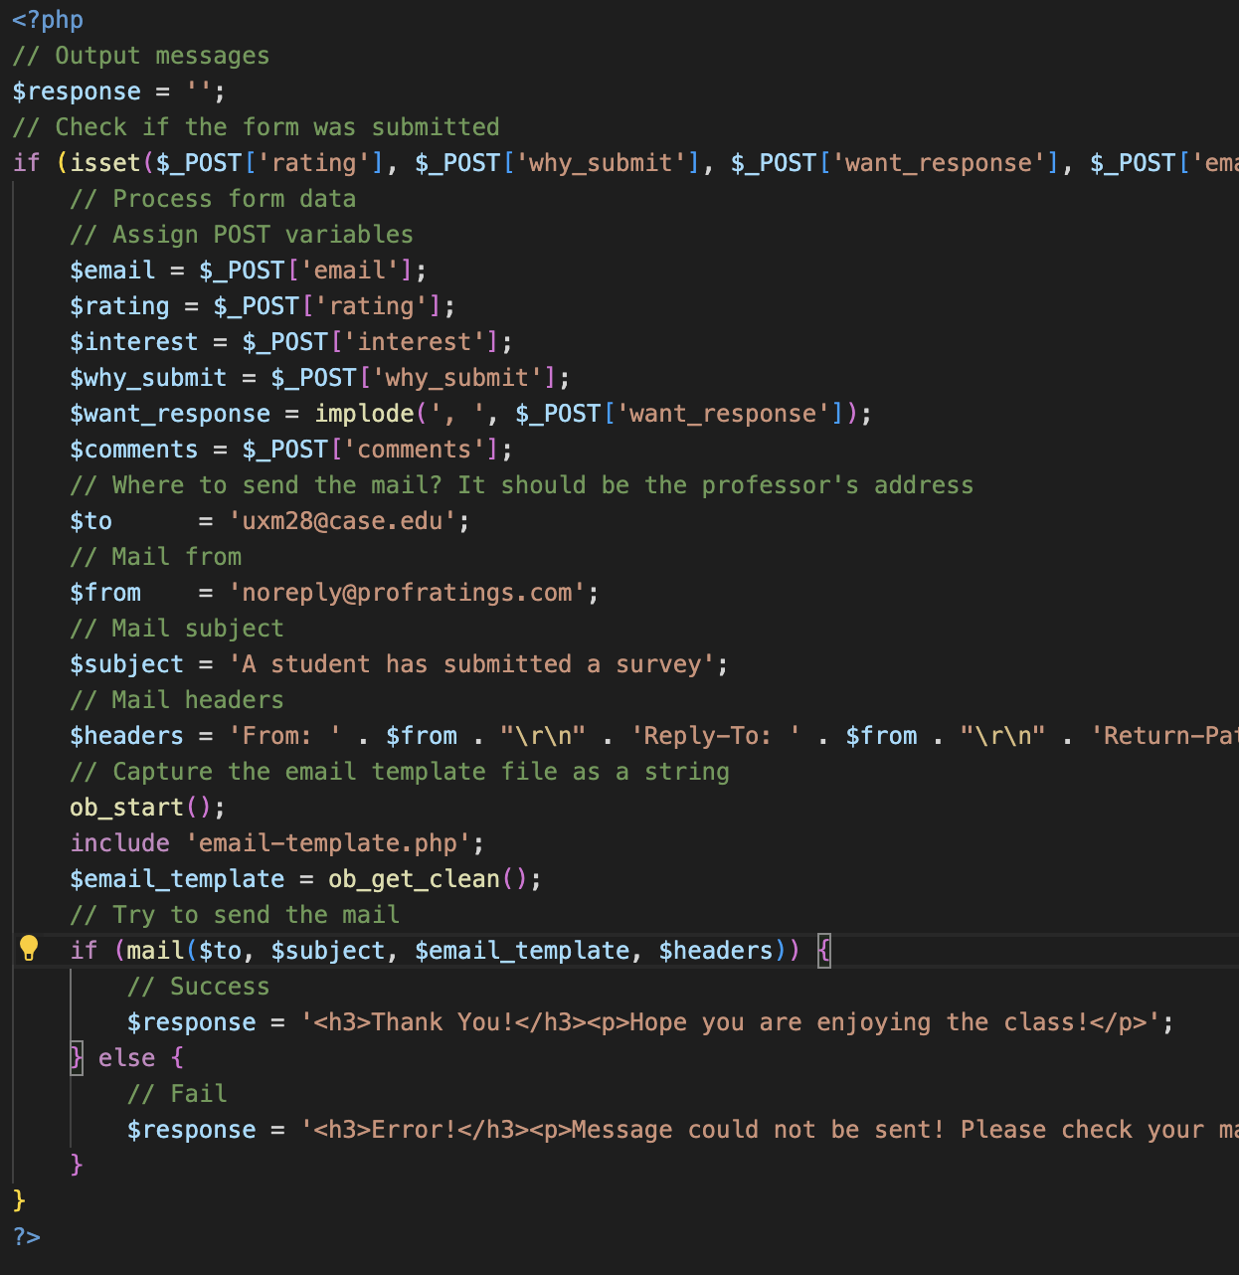
SURVEY.PHP cont
PHP for sending email

Slide 10
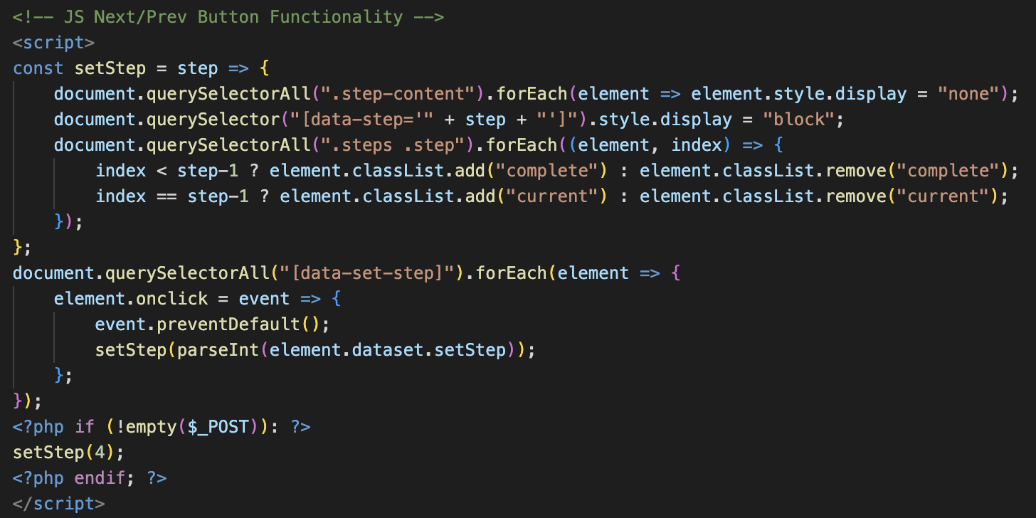
SURVEY.PHP cont
JS for Next/Prev button functionality

Slide 11
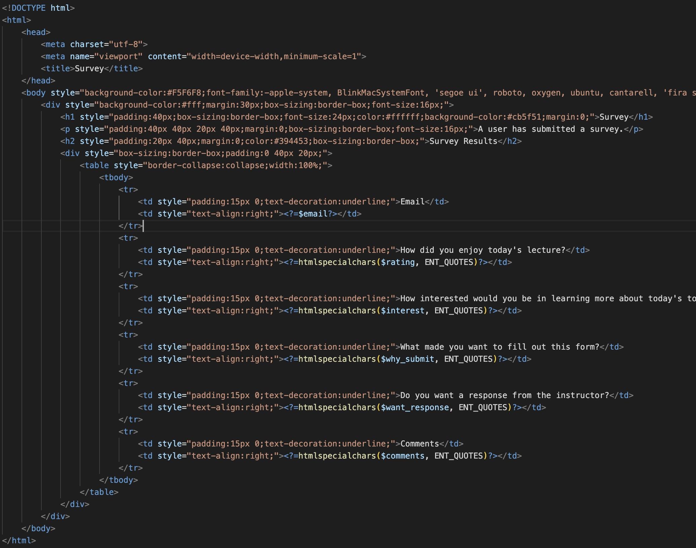
EMAIL-TEMPLATE.PHP
HTML for email template

Slide 12
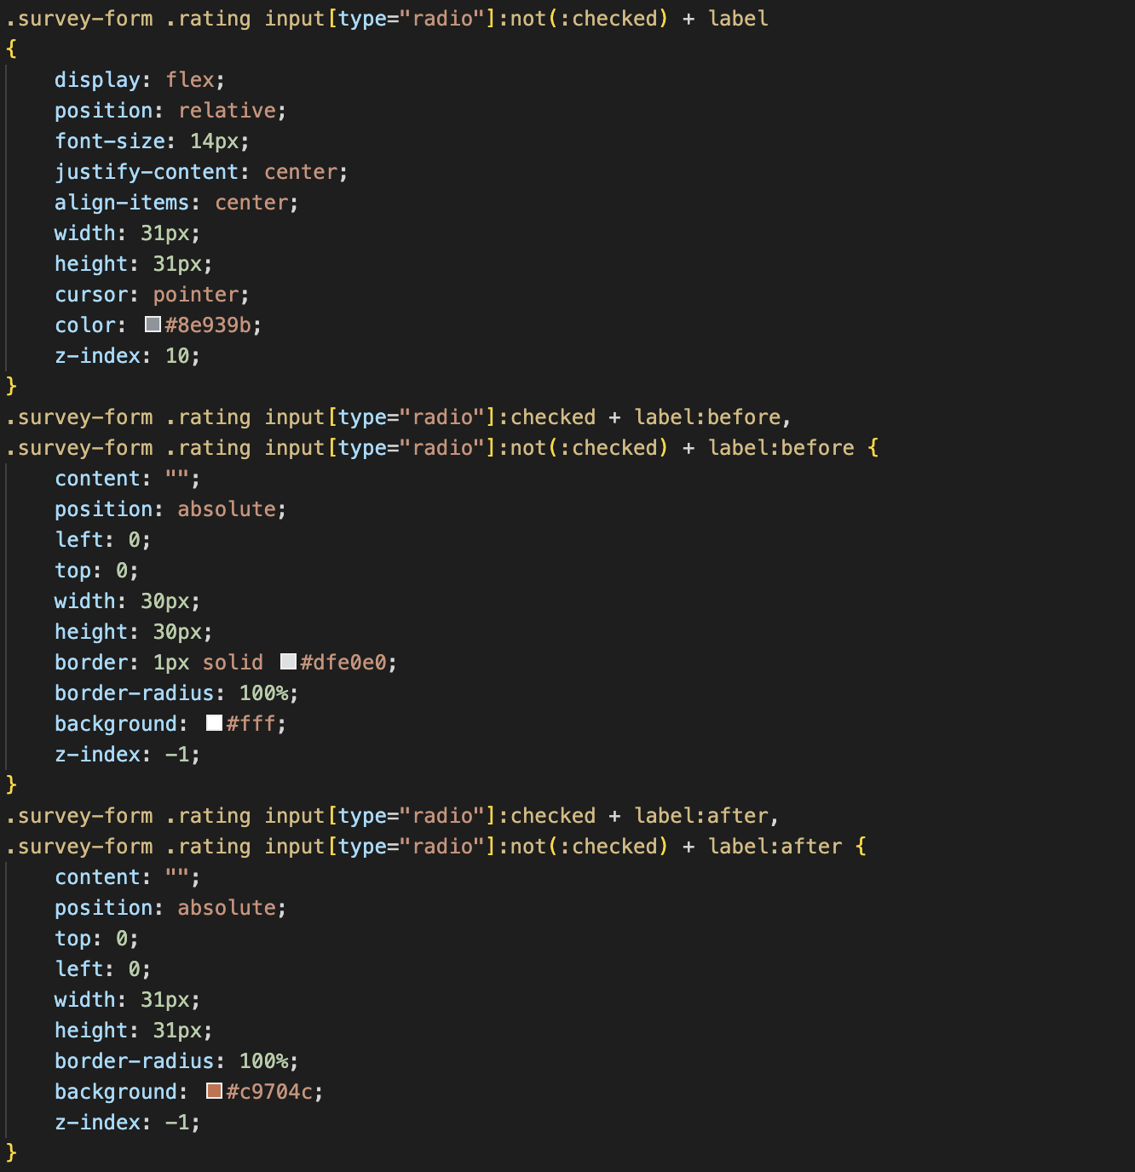
STYLE.CSS
CSS style/formatting of survey
Ex: CSS for 1st survey question

Slide 13
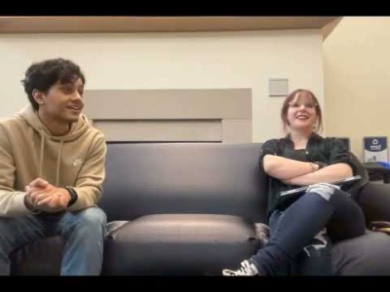
BTS: Brainstorming

Slide 14

WHY NOT CONTINUE PROJECT 1?
Better real-life application
Cleaner and more involved UI
Easier on the eyes ☺
Standardized styling
More place for user input
Includes more learnings from class

Slide 15
THANKS!
Any questions?
More information about project:
General: README attached to Canvas submission
Code: GitHub
Email: uxm28@case.edu

