Slide 1
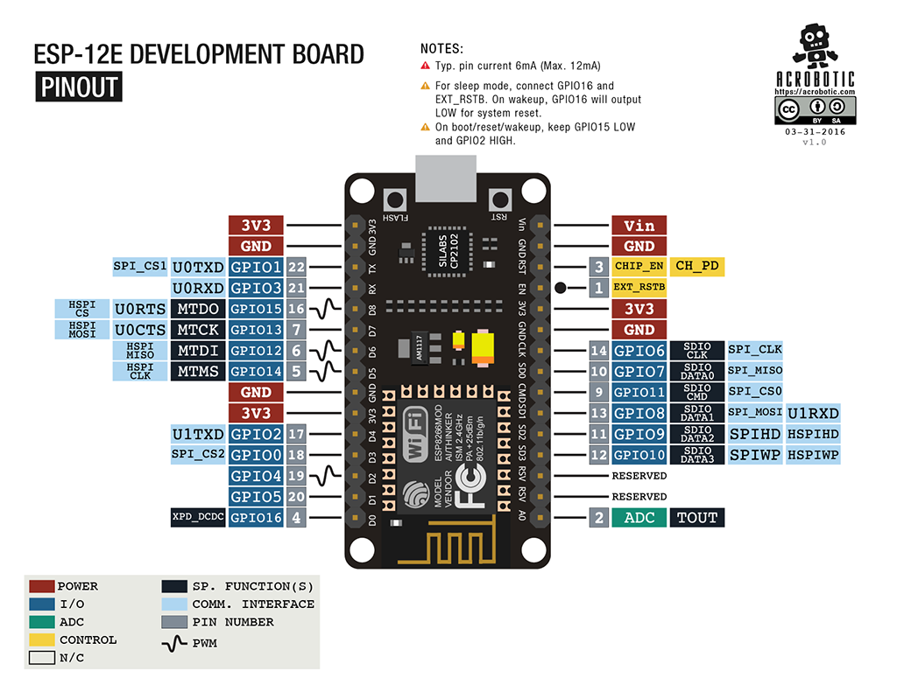
Processor: L106 32-bit RISC microprocessor core based on the Tensilica Xtensa Diamond Standard 106Micro running at 80 MHz
64 KiB of instruction RAM, 96 KiB of data RAM
External QSPI flash: 512 KiB to 4 MiB* (up to 16 MiB is supported)
IEEE 802.11 b/g/n Wi-Fi
Integrated TR switch, balun, LNA, power amplifier and matching network
WEP or WPA/WPA2 authentication, or open networks
16 GPIO pins
SPI
I²C (software implementation)
I²S interfaces with DMA (sharing pins with GPIO)
UART on dedicated pins, plus a transmit-only UART can be enabled on GPIO2
10-bit ADC (successive approximation ADC)

