Slide 1
IPL Score Predictor Using Deep Learning & Flask
Omor Faruque Tanim
ID:0562210005101004
7th Sem

Slide 2
Problem Statement
Accurately predicting team scores in IPL matches is challenging.
Useful for fantasy leagues, match analysis, and broadcasters.
Need for a fast, real-time, and web-accessible predictive tool.

Slide 3
Objective
Build a machine learning model to predict IPL innings scores.
Use player, team, and venue data as inputs.
Deploy the model as a Flask web app for easy user interaction.

Slide 4
Dataset Used
Source: Geeksforgeeks(ipl_data.csv)
Columns used:
Venue, Batting Team, Bowling Team
Batsman, Bowler
Total runs (target variable)
Columns dropped:
['date', 'runs', 'wickets', 'overs', 'runs_last_5', 'wickets_last_5', 'mid', 'striker', 'non-striker']

Slide 5
Data Preprocessing
Label Encoding for:
Venue
Batting Team
Bowling Team
Batsman
Bowler
Feature Scaling using MinMaxScaler
Train-Test Split (70%-30%)

Slide 6
Model Architecture
Framework: TensorFlow + Keras
Input Layer: 5 features
Hidden Layers:
Dense (512 neurons, ReLU)
Dense (216 neurons, ReLU)
Output Layer: 1 neuron (Linear Activation)
Loss Function: Huber Loss
Optimizer: Adam

Slide 7
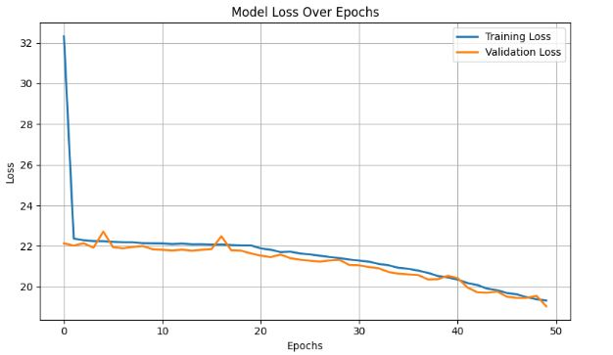
Model Training
Epochs: 50
Batch Size: 64
Evaluation on validation set (30% split)
Monitoring performance using loss values.

Slide 8
Flask Web App
Flask used for building web server.
HTML form for user inputs:
Venue, Batting Team, Bowling Team, Batsman, Bowler
Encodes input using saved LabelEncoders and Scaler.
Predicts score using trained model.

Slide 9
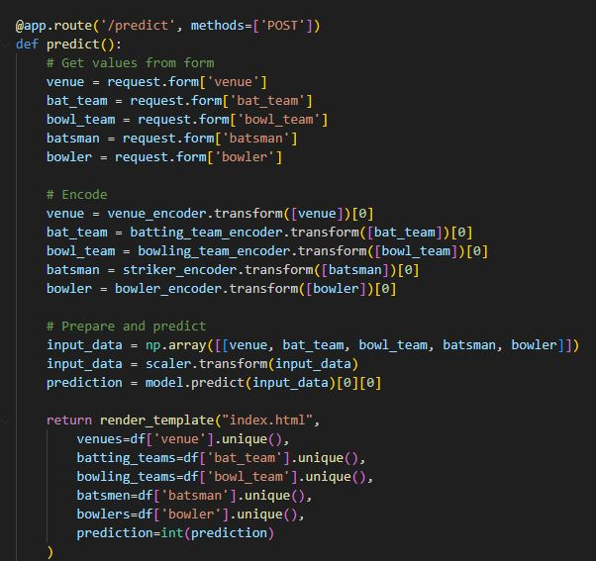
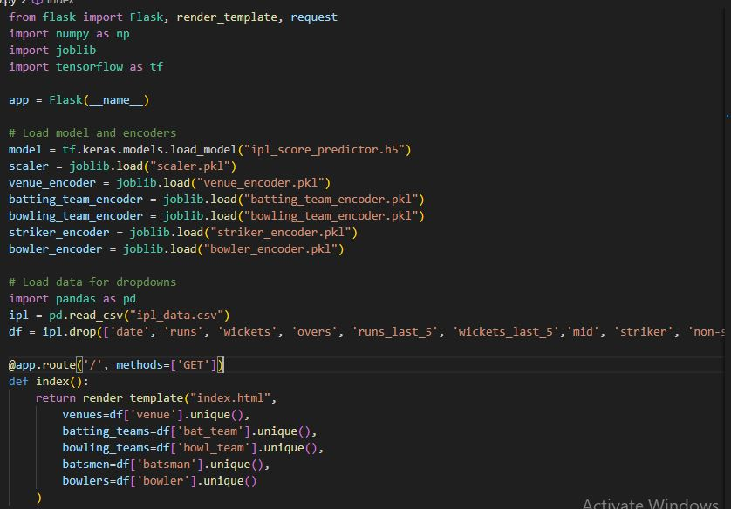
Backend
Loads trained model and encoders.
Handles GET (form load) and POST (form submit).
Predicts and returns result to template.

Slide 10
Deployment
Model saved as .h5 file
Flask app deployed locally (can also be hosted on platforms like Render or Heroku)
All encoders and scaler saved using joblib

Slide 11
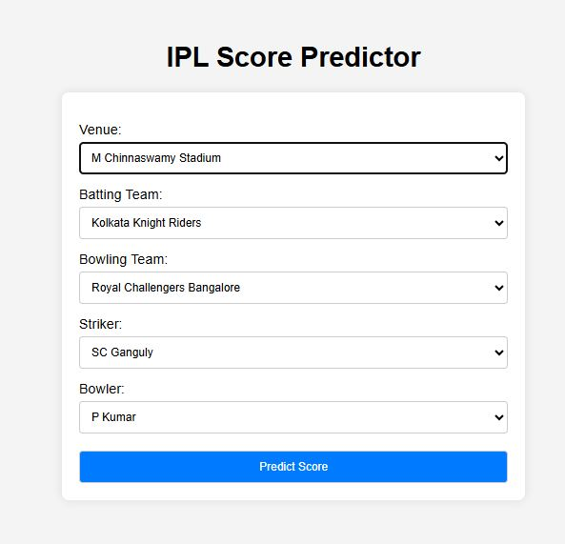
UI Demonstration
Dropdowns auto-populated from dataset
Submit form → Predicts innings score
Prediction displayed dynamically

Slide 12
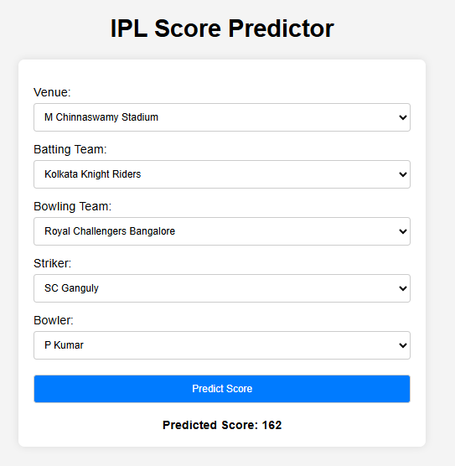
Results

Slide 13
Limitation
Encoding categorical features accurately.
Overfitting in early experiments.
Integrating ML model into Flask app smoothly.
User input validation in the UI.

Slide 14
Future Improvements
Use LSTM or RNN for sequential ball-by-ball predictions.
Include more features like overs, current score, wickets.
Deploy on cloud (Render, Heroku, AWS).
Add user authentication for profile-based prediction tracking.

Slide 15
END

