Slide 1

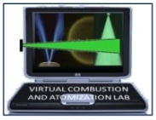
EXPERIMENT - 9
Measurement of Droplet Size for an Air-Assist Atomizer
Prof. D. P. Mishra
Department of Aerospace Engineering
Indian Institute of Technology Kanpur
Kanpur (UP) 208016, India
E-mail: mishra@iitk.ac.in
Sponsored by : Ministry of Human Resource Development, Government of India

Slide 2
Aim of the experiment

Slide 3
Aim of the experiment
To characterize the performance of air-assist atomizer in terms of droplet diameter and droplet size distribution.
Investigate the effects of gas and liquid mass flow rates on the droplet size.
Measure the average droplet size achieved in an air-assisted spray.
Study the droplet size distribution downstream of the atomizer orifice.

Slide 4
Introduction

Slide 5
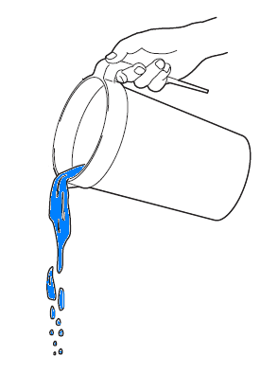
Introduction
Surface Tension
Density
Liquid properties affecting atomization process
Viscosity
BULK LIQUID
PRIMARY ATOMIZATION
LIGAMENT(S)
SECONDARY ATOMIZATION
DROP(S)
DROPLET(S)

Slide 6
Introduction
Editing instruction: text for the figure on previous slide
Atomization: Generation of droplets through bulk liquid breakup
Atomizer: A kind of nozzle for achieving breakup of bulk liquid into spray.
Spray: Two-phase flow with liquid as discrete phase (droplets) and gas as continuous phase

Slide 7
Theory

Slide 8
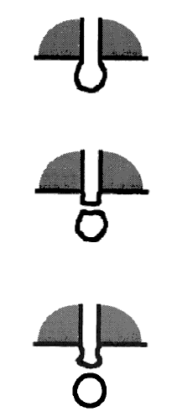

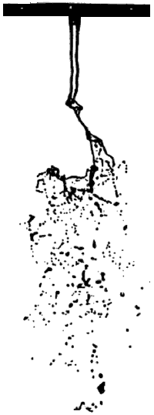
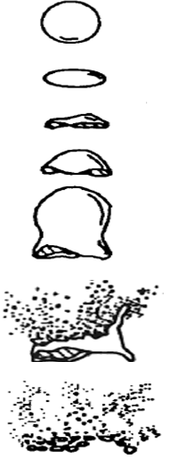
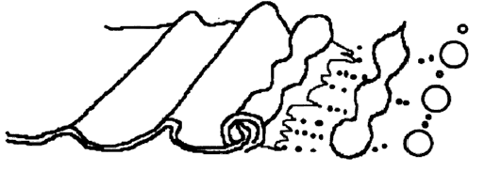
Elements of atomization
TYPES OF BREAKUP
LIQUID DRIPPING
LIQUID COLUMN/ JET BREAKUP
LIQUID LIGAMENT BREAKUP
LIQUID SHEET/FILM BREAKUP
LIQUID FREE-SURFACE BREAKUP

Slide 9
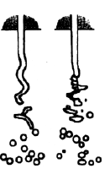
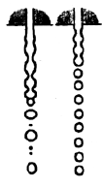
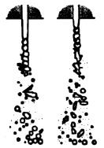
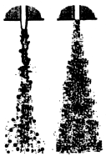
Elements of atomization
STAGES OF ATOMIZATION
RAYLEIGH JET BREAKUP
FIRST WIND - INDUCED BREAKUP
SECOND WIND - INDUCED BREAKUP
ATOMIZATION

Slide 10
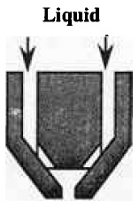
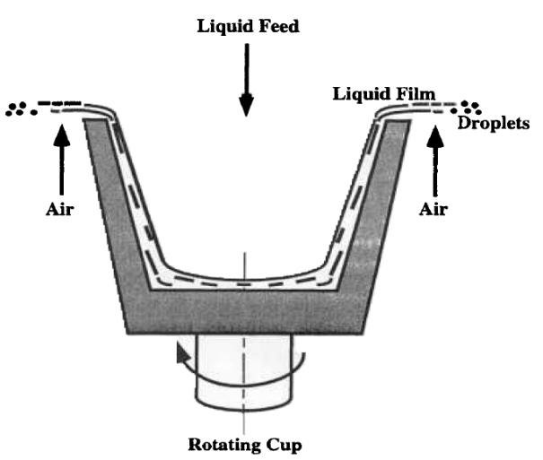
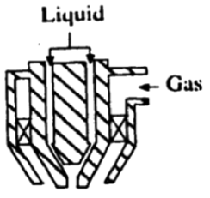
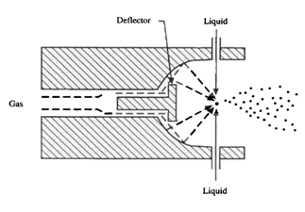
Atomizer classification
TYPES OF ATOMIZERS
High velocity liquid discharged to still or slow moving air
Low velocity liquid exposed to high velocity air
EXAMPLES
EXAMPLES
Pressure jet atomization
Rotary atomization
Twin-fluid atomization
Whistle atomization

Slide 11
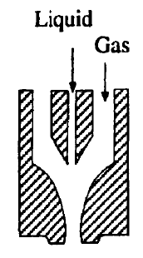
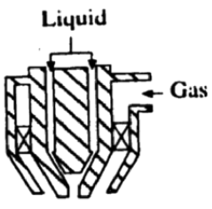
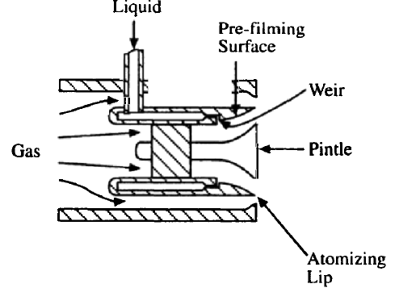
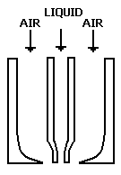
Atomizer classification
TYPES OF Twin-fluid AtomizerS
AIR-ASSIST ATOMIZER
AIR-BLAST ATOMIZER
Low amount of air at high-velocity
High amount of air at limited-velocity
INTERNALLY MIXED
EXTERNALLY MIXED
PLAIN-JET
PRE-FILMING

Slide 12
Advantages of air-assist atomizer
Air-assist atomizer
Air-assist atomizer: Twin-fluid spray nozzle that employs air along with liquid for obtaining spray.
Simple design
Produces nearly homogeneous spray
Fine droplets can be produced at low liquid injection pressures.
Ensures thorough mixing of air and droplets.
Very low soot production during combustion; reduction in flame radiation and exhaust smoke

Slide 13
Some definitions
Sauter Mean Diameter (SMD)
Gas-to-liquid ratio (GLR)
Importance of SMD: Consumption of reactant mass is a volumetric process and evaporation is a surface phenomenon.

Slide 14
About experiments

Slide 15
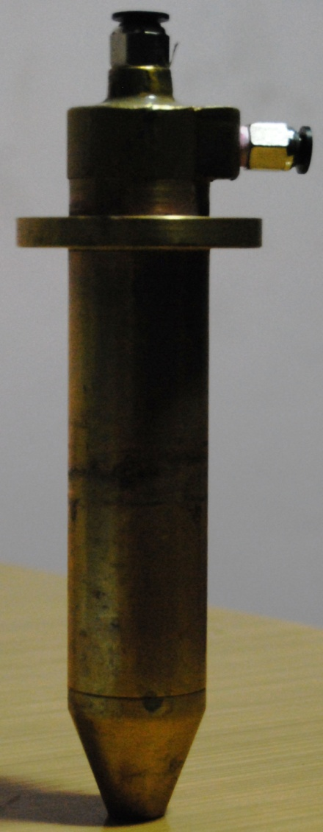
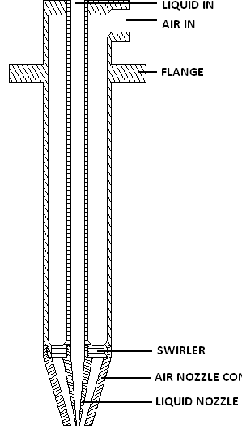
Atomizer used for experiment
Liquid inlet
Air inlet
Photograph of air-assist atomizer
Internal details of the air-assist atomizer

Slide 16
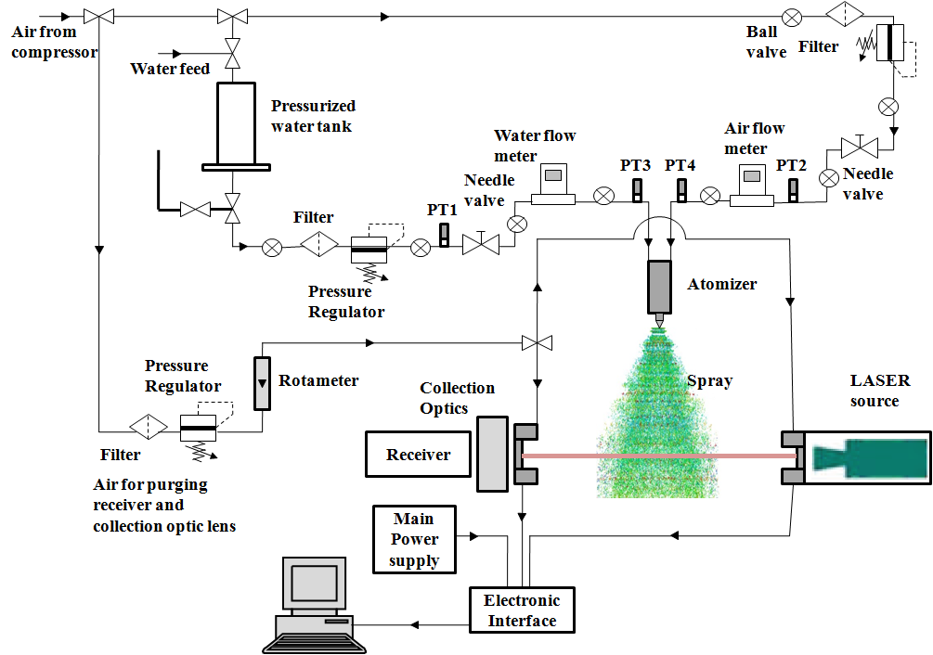
Experimental setup
Experimental setup for droplet size measurement

Slide 17
Malvern Spraytec Analyzer
Experimental setup
Working principle: Fraunhofer diffraction; line-of-sight measurement
Purging air is supplied at the transmitter and receiver ends to ensure dust-free collection of data, leading to reduction of errors.
A 670 nm LASER beam from the transmitter to receiver end (containing rings), undergoes scattering when interrupted by spray particles.
Droplet diameters (1 to 1000 μm) are determined based on the optical scattering pattern observed at the receiver end.

Slide 18
Analysis of results

Slide 19
Spray visualization
Development stages of a spray
2D view of a well developed spray
Editing instruction: movie file “dev_stages”
Editing instruction: movie file “dev_spray”

Slide 20
SMD variation with GLR
Z_{R}

Slide 21
SMD variation with GLR
Editing instruction: text for the figure on previous slide
SMD decreased with GLR for a given axial distance (Z_{R}) downstream of orifice.
SMD at a given GLR decreased with Z_{R}.
At higher GLR, increased momentum of air caused more turbulence, due to which SMD decreased drastically by collision and breakup of larger drops..
Secondary atomization results in decreased droplet size at Z_{R} = 150 mm as compared to Z_{R} = 100 mm.

Slide 22
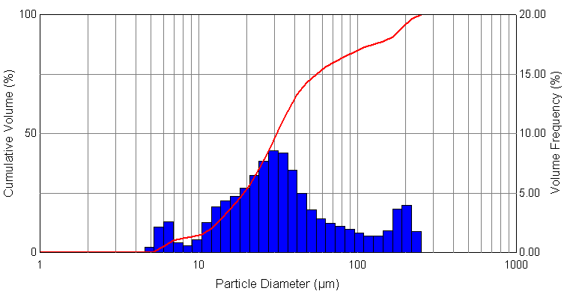
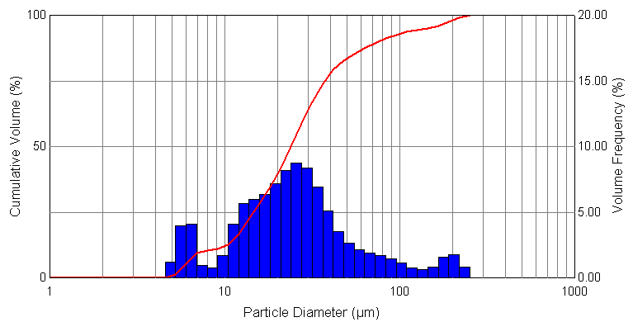
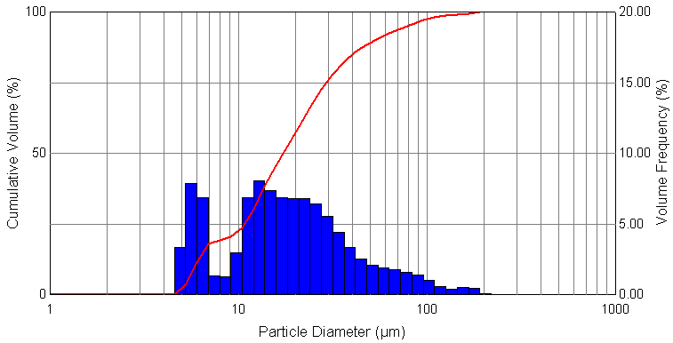
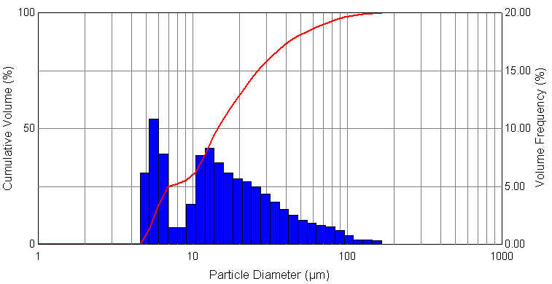
Droplet size distribution at Z_{R} = 150 mm
GLR = 0.8
GLR = 1.2
GLR = 1.6
GLR = 2

Slide 23
Droplet size distribution at Z_{R} = 150 mm
Editing instruction: text for the figure on previous slide
Increase in the volume fraction occupied by particles of smaller SMD at higher GLR.
Size distribution is increasingly skewed towards lower SMD as GLR increases.
Earlier secondary atomization at higher GLR due to increased turbulence.

Slide 24
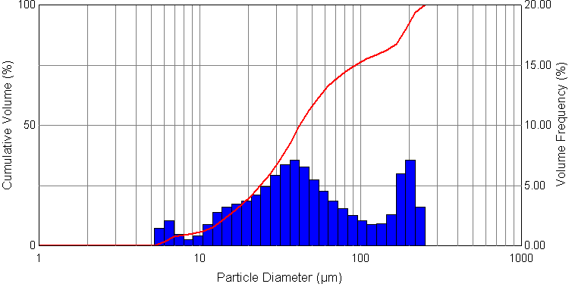
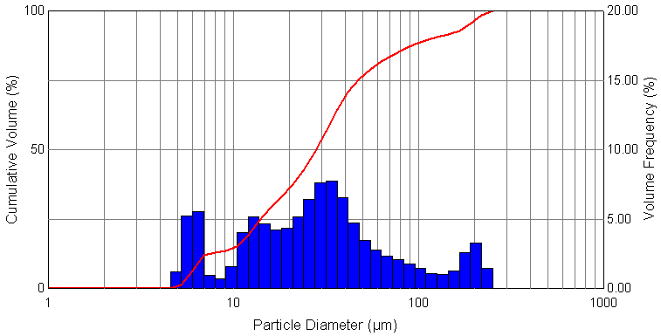
Effect of GLR on size distribution
Z_{R} = 100 mm
GLR = 0.8
Z_{R} = 150 mm
Z_{R} = 100 mm
GLR = 1.6
Z_{R} = 150 mm

Slide 25
Effect of GLR on size distribution
Editing instruction: text for the figure on previous slide
At a given GLR, increased secondary atomization at Z_{R} = 150 mm decreased the volume fraction of the largest droplet size.
Higher GLR operation is able to reduce the volume fraction of largest droplet size more effectively.

Slide 26
Conclusions

Slide 27
Conclusions
SMD decreases with increase in GLR accompanied by increased air momentum.
For same GLR, droplet size decreases due to secondary atomization downstream of the atomizer.
Droplet distribution is continuous but it is a resultant of many unimodal distributions.

Slide 28
References
Huimin Liu, ‘Science and Engineering of Droplets’, Noyes Publication, Park Ridge, U.S.A
William A. Sirignano, ‘Fluid dynamics and transport of droplets and sprays’, University of California, Irvine
‘Handbook of Atomization and sprays – Theory and Applications’, Springer
A. H. Lefebvre, ‘Air-blast atomization’, Progress in Energy and Combustion Science, Volume 6, Issue 3, 1980.
K.U. Reddy & D.P.Mishra , ‘ Studies of Spray Behavior of a Pressure Swirl Atomizer in Transition Regime’, Journal of Propulsion and Power, 2007.

Slide 29
FAQs

Slide 30
FAQs
Where and why do we need atomizers?
What are the different stages of atomization?
What are the different ways to achieve atomization?
What are the fluid parameters that affect atomization?
What is a twin-fluid atomizer?
On what basis can an atomizer be characterized?
Can these performance parameters be used to analyze any atomizer?
Which performance parameter will aid better to infer a fine atomization, SMD or droplet size distribution?
Why do we prefer SMD over other representative diameters?

