Slide 1


Observations on Flame height of Laminar Jet Diffusion Flame
EXPERIMENT 2
Prof. D. P. Mishra
Department of Aerospace Engineering
Indian Institute of Technology Kanpur
Kanpur (UP) 208016, India
E-mail: mishra@iitk.ac.in
Virtual Combustion and Atomization Laboratory
Virtual Combustion and Atomization Laboratory

Slide 2
Aim of Experiment
To have an appreciation of Jet Diffusion Flame.
To understand the concept of Diffusion Flame Height.
To derive a relation between laminar diffusion flame height and volumetric fuel flow rate through phenomenological analysis.
To observe the effect of volumetric fuel flow rate on laminar diffusion flame height through experiments and compare with phenomenological analysis.
To study the variation of flame height with Froude number and Reynolds number.
To compare the experimental result with Roper’s empirical formula.

Slide 3
Introduction

Slide 4
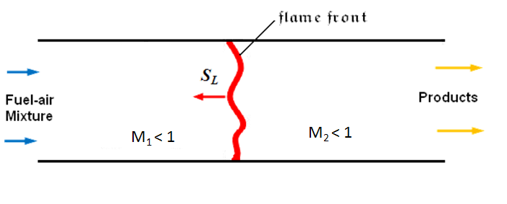
Definitions
What is Flame ?
Flame is a self sustained combustion (deflagration) wave with a thin zone where rapid exothermic reaction takes place.
What is deflagration wave?
It is a combustion wave travelling at subsonic speed into unburnt fuel-air mixture.
S_{L} – Flame speed , M – Mach Number = V/a , M < 1 (Subsonic),
M₁ – Mach Number ahead of the flame front, M₁ – Mach Number behind of the flame front .

Slide 5
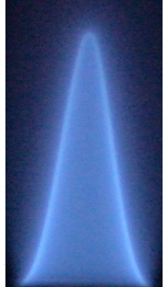



Classification of Flame
PF
Premixed Flame (PF)
NPF
PPF
Fuel - Oxidizer mixing
Non premixed Flame (NPF)
Fuel + Oxidizer mixture
Partially Premixed Flame (PPF)
Classification of Flame
Air
Air
Fuel
Laminar
Air
Air
Flow characteristics of reactants
Fuel + Oxidizer
mixture
Turbulent

Slide 6
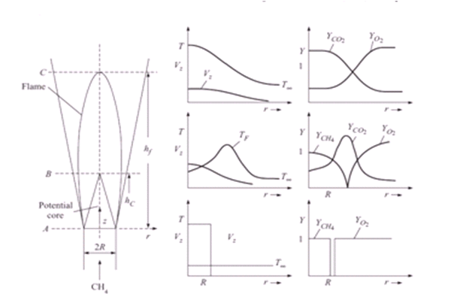
Diffusion Flame Structure
In diffusion flame, the fuel and oxidizer are initially seperate before combustion.
The seperated fuel and oxidizer are brought to a narrow region through molecular diffusion and bulk convective motion where they mix and react simultaneously.
Laminar Diffusion Flame Structure [1]

Slide 7

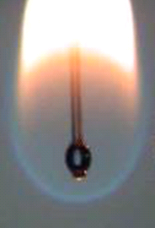
Examples of Diffusion Flame
Candle Flame
Droplet Flame
Jet Diffusion Flame
Candle Flame
Droplet Flame under Normal Gravity
Jet Diffusion Flame
Applications
Flame inside furnaces
Gas turbine engines
Rocket combustors

Slide 8
Theory

Slide 9
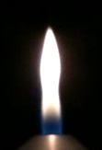
Theory - Laminar Jet Diffusion Flame
The simple diffusion flame is established by the ignition of fuel jet exiting into the ambient atmosphere and it is termed as Jet Diffusion Flame or Jet Flame.
The flame height of Jet Diffusion Flame is defined as the distance from the flame base near the tube rim to the highest point along the jet axis where the flame is visible.
z
Flame tip
Diffusion flame
H_{f}
H_{f}
Flame base
r
Burner rim
V_{F}

Slide 10
Phenomenological Analysis
Physically, flame height of Jet Diffusion Flame specifies the maximum distance taken by the fuel along the centerline to diffuse into oxidizer and get consumed completely.
The time taken (t_{d} ) by the fuel jet to diffuse into ambient air and burn completely is given by
(1)
where H_{f} – flame height , V_{F} – velocity of fuel jet at the tube exit
The average square displacement (r ² ) due to oxidizer-fuel
inter-diffusion ( D_{FO} ) as per Einstein Diffusion equation is
(2)
At the flame tip, the average depth of oxidizer-fuel inter-diffusion
is approximately equal to tube radius R .Hence r ~ R
(3)
H_{f}
Ambient air
V_{F}

Slide 11
Phenomenological Analysis
Multiplying numerator and denominator of Eq. (3) by л, we get
(4)
Multiplying numerator and denominator of Eq. (4) by density of fuel (ρ_{F}), we get
(5)
But
It can be observed clearly that the laminar Jet Flame height is proportional to volumetric fuel flow rate.

Slide 12
Theory - Laminar Jet Diffusion Flame
The simple diffusion flame is established by the ignition of fuel jet exiting into the ambient atmosphere and it is termed as Jet Diffusion Flame or Jet Flame.
The flame height of Jet Diffusion Flame is defined as the distance from the flame base near the tube rim to the highest point along the jet axis where the flame is visible.
z
Flame tip
Diffusion flame
H_{f}
H_{f}
Flame base
r
Burner rim
V_{F}

Slide 13
About Experiment

Slide 14



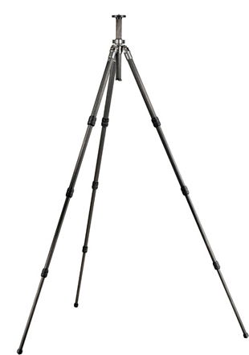
Experimental Setup
Hood for exhaust gas removal
Rotameter
Digital Camera fitted in tripod
Diffusion flame
Needle valve
Burner
CNG

Slide 15
Experimental Procedure
From the phenomenological analysis, the laminar Jet Diffusion Flame height is found to be proportional to fuel jet velocity. Hence the CCD camera has to be positioned at a distance where the flame of maximum height can be captured.
The camera should be aligned perpendicular to the front plane of the flame.
Once the camera position is fixed, it should not be disturbed or moved to new position in order to avoid variable magnification.

Slide 16
Experimental Procedure
4. The fuel is set to the desired flow rate using calibrated rotameter and ignited at the tube exit.
5. At a particular fuel flow rate, video of the flame should be taken for certain time.
6. This procedure is repeated for different fuel flow rates.
7. The time period of video for each flame should be kept constant in order to extract equal number of frames from the videos.

Slide 17
Precautions
Ensure that the fuel line is leak proof.
Experiments should be conducted in a ventilated room.
Keep a fire extinguisher near the experimental setup.
Switch on the exhaust fan before conducting experiments.
Ensure that the control valves are functioning properly.
The fuel flow rate has to be set to a minimum value initially using the control valve and ignited at the burner exit with the help of naked flame.
The fuel supply has to be stopped when the fuel jet is not getting ignited for a longer time. Then the burner has to be purged with nitrogen to avoid accumulation of unburnt fuel getting ignited in an uncontrolled way.

Slide 18
Analysis of Results

Slide 19

DOUBLE CLICK INSIDE THE BLUE BOX

Slide 20
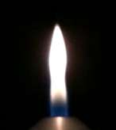


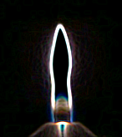
Image processing
The flame videos obtained are converted to frames using free software.
The frames are analyzed using open source image processing software called ImageJ.
The still images of the flame is processed by various techniques such as Smoothing, Sharpening, Enhance contrast and Edge detection for exact identification of flame tip from the nozzle rim.
The number of pixels of the flame image along the flame centerline from the burner rim is counted and is scaled with the known dimension, say, burner rim diameter to obtain the jet flame height.
H_{f}
Actual Image Smoothing Sharpening Enhance Edge
Contrast Detection
d

Slide 21
Variation of Flame Height at Different Volumetric Fuel Flow Rates
21 mm

Slide 22
Comparison with Roper’s Empirical Formula
Roper’s empirical formula
where
T_{o} - ambient temperature
T_{f} - characteristic temperature for calculating diffusivity (1500 K)
Q_{F} - volumetric flow rate of fuel
S - volume of air to volume of fuel ratio for complete combustion
The experimental flame height is observed to be higher than the value predicted by Roper’s empirical formula.
Higher uncertainty is observed when the Q_{F} is increased. This is due to the increase in buoyancy around the flame front which makes the flame tip to oscillate.

Slide 23
Variation of flame height with Froude number
Where
Fr – Froude number
V_{F} - Fuel jet velocity
g - Acceleration due to gravity
( 9.81 m/s ² )
d_{F} - Diameter of the burner exit

Slide 24
Variation of Flame Height with Reynolds Number
Where
Re – Reynolds number
V_{F} - Fuel jet velocity
ν - Kinematic viscosity of fuel
d_{F} - Diameter of the burner exit

Slide 25
Conclusions

Slide 26
Conclusions
A phenomenological analysis for relating the flame height with fuel flow rate is derived.
The variation of flame height of laminar CNG diffusion flame with fuel flow rate is studied experimentally.
The present experimental trend is compared with the empirical formula developed by Roper et al. [2].
The variation of flame height with Fr, Re is reported.
The present demonstration will be helpful in understanding the basic characteristics of commonly observed diffusion flame through a simple experiment.

Slide 27
References

Slide 28
References
Mishra D.P. Fundamentals of Combustion. Prentice Hall of India private Ltd;2008.
Roper F.G,Smith C,Cunnigham A.C. The prediction of laminar jet diffusion flame sizes: Part II. Experimental verification. Combust Flame 1977; (29): 227-234.
http://www.absoluteastronomy.com/topics/Diffusion_flame
http://www.1st-digitalcamera.com/camera-tripod/
http://www.eng.cam.ac.uk/~sh372/facilities/index-facilities.html
ImageJ software : http://rsbweb.nih.gov/ij/

Slide 29
FAQ

Slide 30
Feedback

