Slide 1
Team name- DUPLICATE ANONYMOUS Submitted by:- Rishabh Umrao Mohammad Bilal Submitted to :- Astitva singh Internity Foundation Yash chaudhary
Fake Alert
We tell you What’s Fake and What’s Real

Slide 2
Value proposition
Fake news is a serious issue which can distract public from reality and it’s makers can manipulate public
actions & behavior for their benefit. Here we come ,
for the rescue. Our service will help to differentiate
between Real and Fake news.
So that nobody can fool public anymore.

Slide 3
Problem
Fake News
Stories that look like real news stories but are hoaxes ,
propaganda and disinformation.
Stories have outrageous headlines to get people to click.
Stories typically appear on topics and people who are
trending on Google and Facebook.
Sometimes people engage in violent and illegal activity as
a result of believing a Fake story.

Slide 4
Solution
We are building a machine learning predictor model that uses power of neural networks along with some vectorizations techniques(Bow-TF, TF-IDF) to predict the sanity of the news article.
We scrape articles from many Reliable (Reuters, BBC, CNN, etc.) and Unreliable (Before it’s news, Raw Story, Infowars, etc.) Sources and generate a Corpus.
Model simply takes input for headline and content text and classify the stance of the content text into one of the categories:
Agrees : The content agrees with head line
Disagrees : The content disagrees with the head line
Discusses : the body text discusses the same topic as Head line, but does not take a position.
Unrelated : The body text discusses a different topic than the headline.

Slide 5
Impact of our Service
2.34 billion people are on social media platforms and for
most of them it is the main source of news .
According to Reuters institute digital news report(2017) -
Social media sites | % of Social media user(any purpose) | % of Social media user for news
Facebook | 70 % | 47 %
youtube | 61% | 22%
instagram | 24% | 6%
Twitter | 20% | 10%
LinkedIn | 14% | 3%

Slide 6
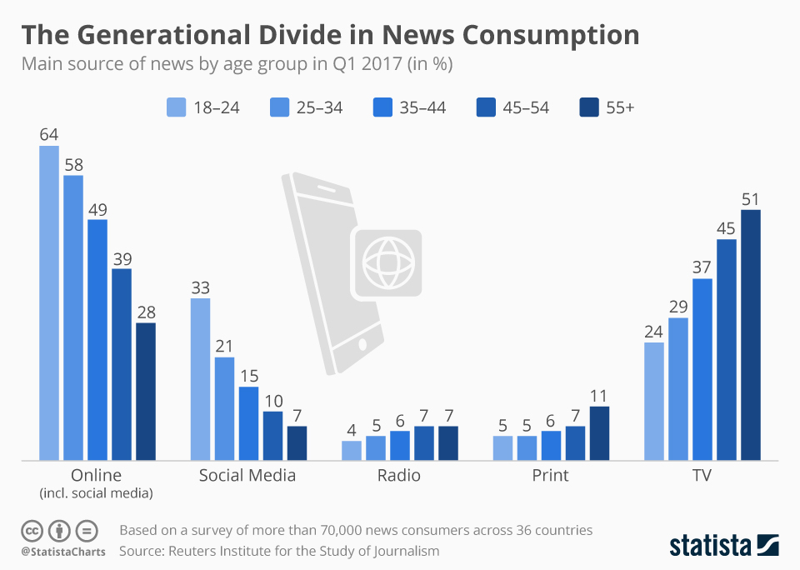
Statistics showing majority of news is read online nowadays which is creating Big impact on public.

Slide 7
Advantages
Large number of clients(news websites & Social media sites)
Our software is the need of the hour due to rapid increase in number of fake news publishing.
Our model improve with usage . So it means quality of model improves over time.

Slide 8
Revenue Model
Transaction Model Subscription Model

Slide 9
Future Aspects:
The fully developed product will be a Decentralized fake news detector.
That includes a decentralized network that takes data from different sources( Facebook, twitter, news sites, etc.) and trains itself using Bi-LSTM model. That will increase its efficiency to prediction and reduce the maintenance.
Another approach to achieve this is to implement a semantic analysis looking at object:description parts for contradictions with the top of initial deep syntax analysis.

Slide 10

Rishabh umrao Astitva singh
Team Members
I have deep knowledge of Linux, I am a software developer . I currently
Data Structure & Algorithm. I am make software in Java . I have deep
an IoT enthusiast and machine interest in graphic designing. I love to
Learning field really excites me a design graphics especially for games.
lot. I am currently working on Currently I am focused on strengthening
Machine learning Projects. my java skills.

Slide 11
Mohammad Bilal Yash Chaudhary
I love to design websites . I have I have interest in both business
Knowledge of html , css, JavaScript, and technology. I have knowledge
Bootstrap. I am currently learning of Inbound Marketing and basics
PHP, MySql for back-end development. of Digital Marketing. I love to make
I am currently building webpages with business strategies. Currently working
Angular JS framework also. on data science.

Slide 12
Thank you
Team Name- Duplicate Anonymous

