Slide 1

Building a Contractor‘s Database
Tim Donders, Krzysztof Latecki, Umair Rashid, Nikola Strobel

Slide 2
What is a contractor?
Independent entity
Person or company that performs work on a contract basis
Creates new products and new knowledge
Provides certain personnel and services to project owner/contratee
i. e: EllisDon, PCL Constructors Inc.

Slide 3
Describing the Company
The company takes on client’s projects and assign them contractors
Each client can have multiple locations.
Each project is supervised by a supervisor. The supervisor handles the communication between the clients and the contractors
The company can request materials and has list of materials provided by certain suppliers
Each project cost consists of what the company pays to the contractor and what the company pays for the material that’s if there is a material involved in the project. So Project Cost = Material Cost + Contractors Cost

Slide 4
Goals
Database development
Adherence to a time limit
Solve data isolation problem
Remove data redundancy and inconsistency
Security management

Slide 5
Purpose of a database for a contractor
Central database system for contractor
Data Consistency
Data Integrity
Data Security
Efficient Storage of Data: Minimal repetition of data
Ease of use
Better overview of the data and effective data searching
The chances of entering incorrect data will be reduced

Slide 6
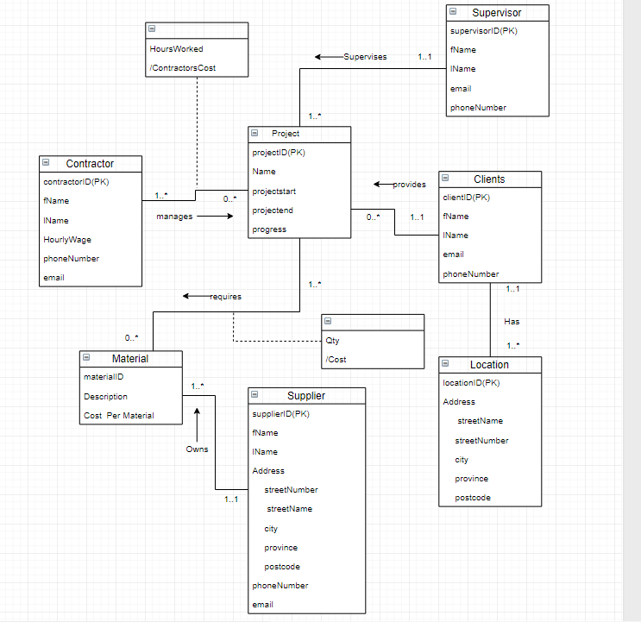
ER Diagram

Slide 7
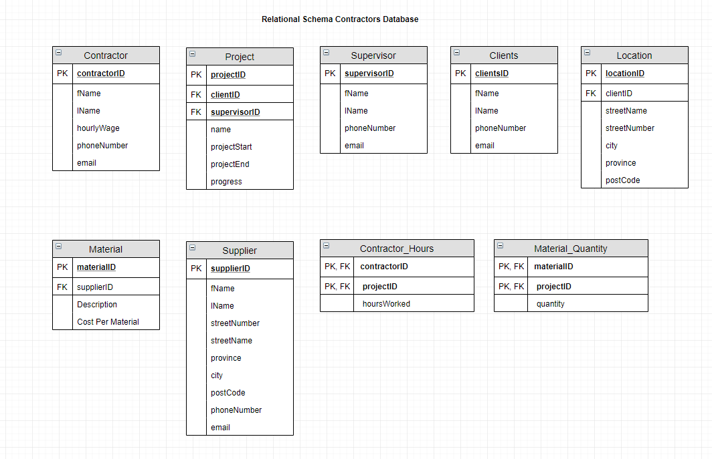
Relational Schema

Slide 8
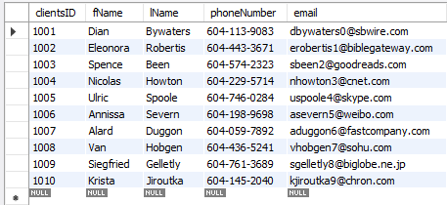
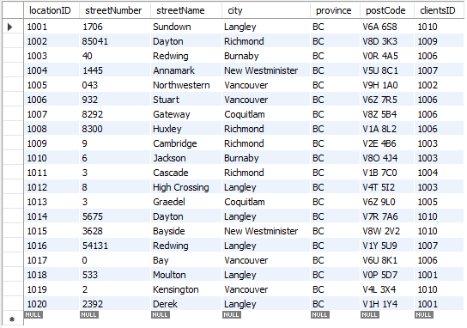
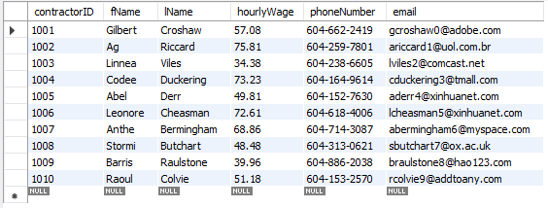
Project Contractor Database
Clients
Location
Contractors

Slide 9
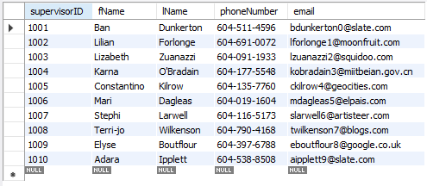
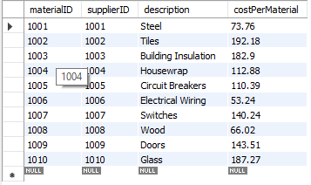
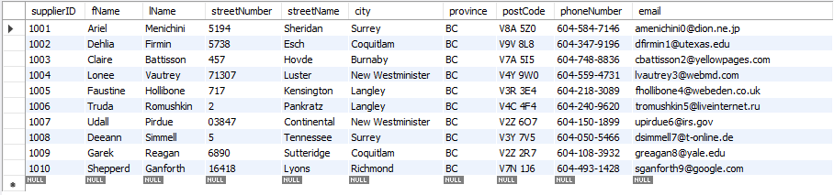
Project Contractor Database
Supervisor
Material
Supplier

Slide 10
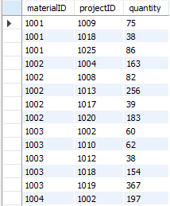
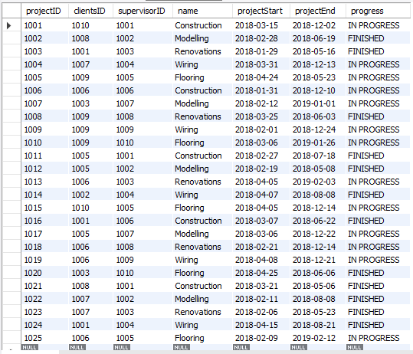
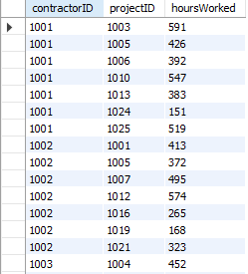
Project Contractor Database
Material_Quantity
Project
Contractor_Hours

Slide 11
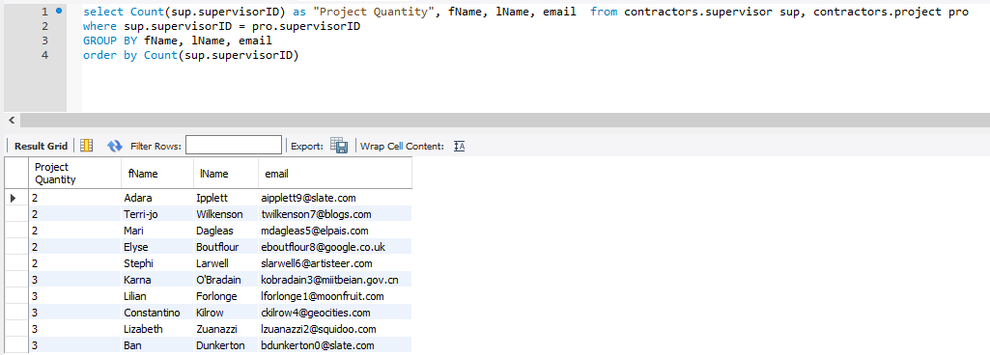
Sample Queries: Number 1 Show the amount project each supervisor has been assigned in ascending order

Slide 12
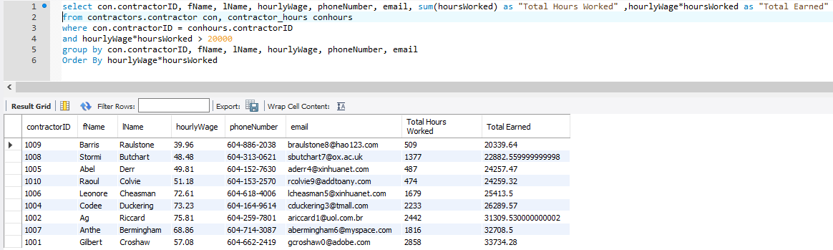
Sample Queries: Number 2 Show the contractors who have charged more than $20000

Slide 13
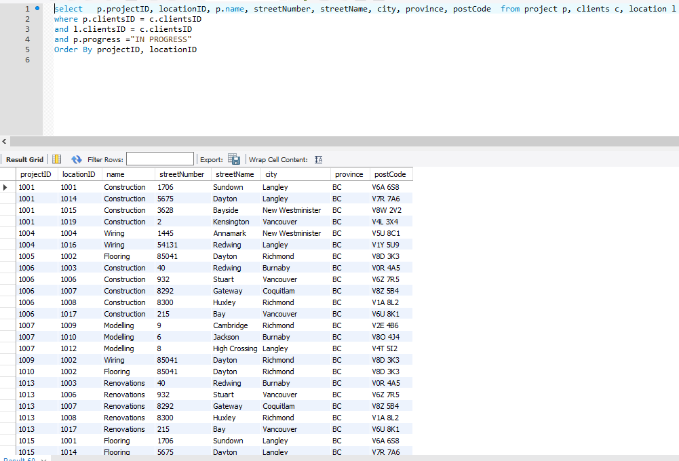
Sample Queries: Number 3 List the on going Projects with their respective locations

Slide 14
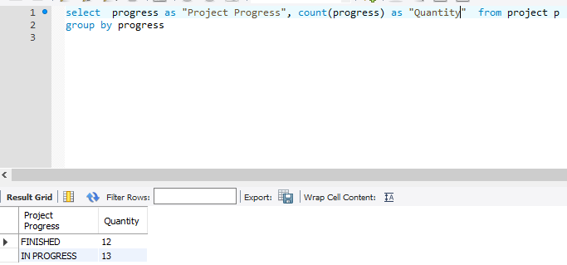
Sample Queries: Number 4 Which project are finished and which are on-going?

Slide 15
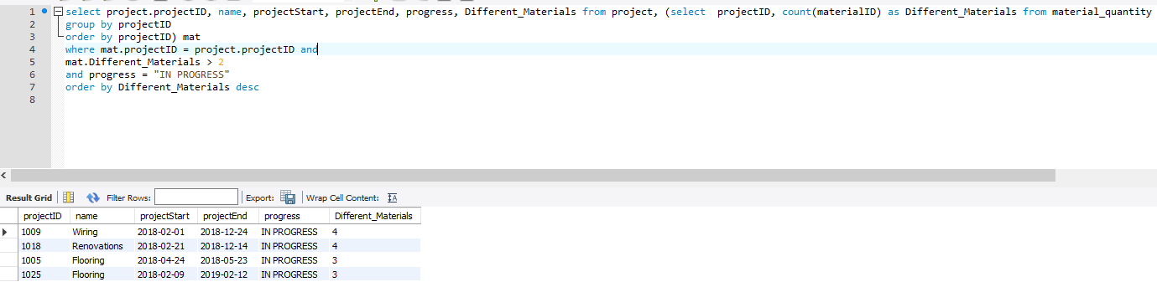
Sample Queries: Number 5 Project using the more than 2 materials of different types

Slide 16
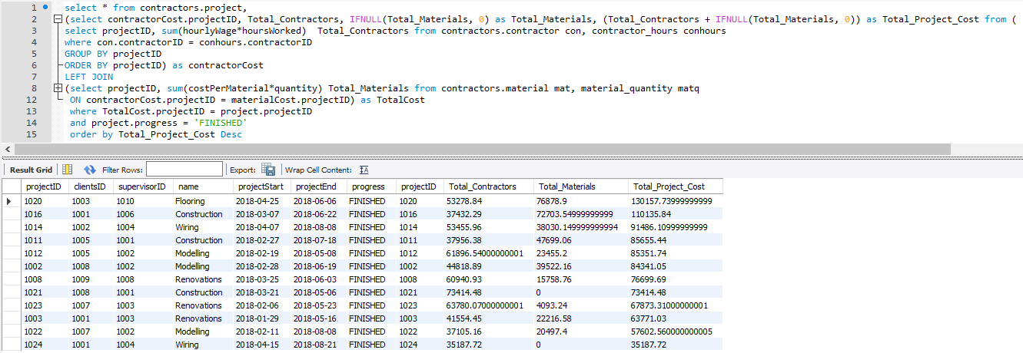
Sample Queries: Number 6 Show the cost of the Project from most to the least that are finished

Slide 17
Risks and Issues
Risks
Issues
Hardware Failure
Software Failure
Time Management
Team Conflicts
Staff Co-operation
Poor Organization of existing data
Tim‘s computer crashed
Inconvenient class times

