Slide 1
Cloud IDEs
By: Aaron Hinton

Slide 2
Cloud Integrated Development Environments
Allow for teams to collaborate on programming tasks live without physical interaction or proximity
Can offer operation that is similar to Google Docs except with IDE functionality
Range of features from simple notepad like editors to full fledge development environments that mimic virtual machines.
Many are free or offer low-cost introductory plans

Slide 3
Popular Uses
Software development
Facilitate coding exercises during remote interviews
Sharing of programming problems online (Stackoverflow)
Programming education/instruction
Live viewing of application programming

Slide 4
Benefits
Multiple team members can work on the same files at the same time and see each other code.
Standardized and pre-setup virtual machine like configurations can be maintained for multiple developers.
Processor intensive builds and Unit tests can be run on servers in the cloud
You can have access to “Your” IDE environment from any computer and any platform

Slide 5
CollabEdit
Website: http://collabedit.com
Free
Simple easy to use interface
Offers basic notepad like functionality
Multiple users can edit files live
Often used in the remote interview process
Useful for sending quick code snippets between developers

Slide 6
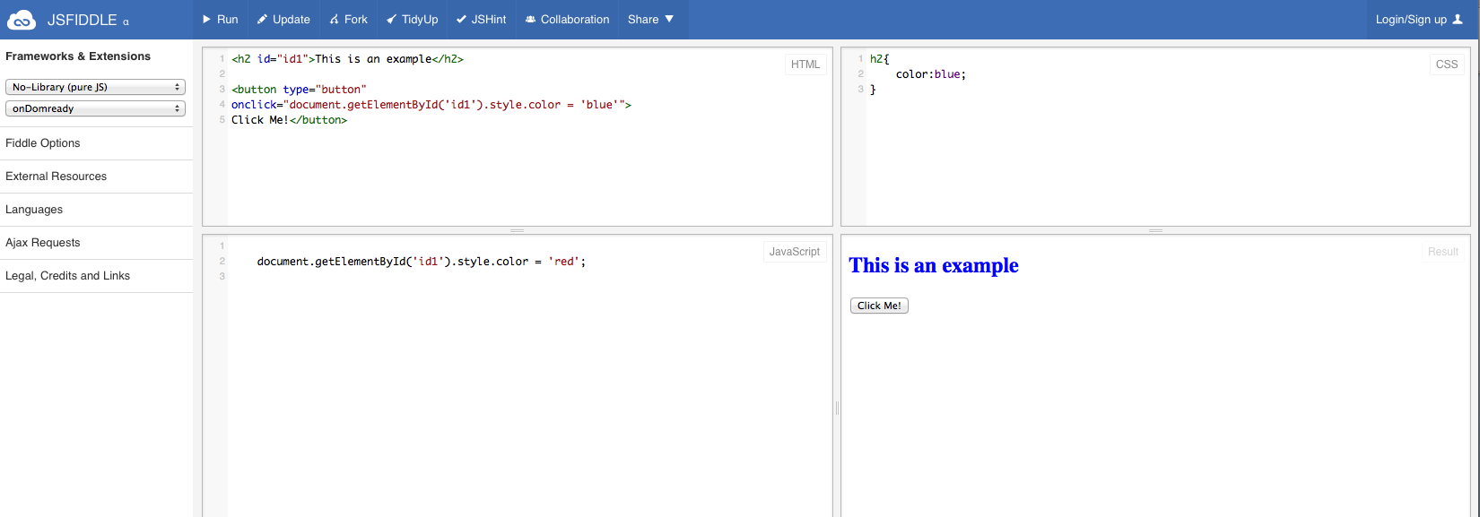
JSFiddle
Website: http://jsfiddle.net
Example @: http://jsfiddle.net/ue8aj8uq/
Free
Allows for the quick prototyping of JavaScript, HTML, CSS snippets
Snippets, also known as fiddles, can be run in browser
Popular to showcase issues or problems to other developers
Keeps examples small, easy to share, and manage
Popular for stackoverflow questions

Slide 7
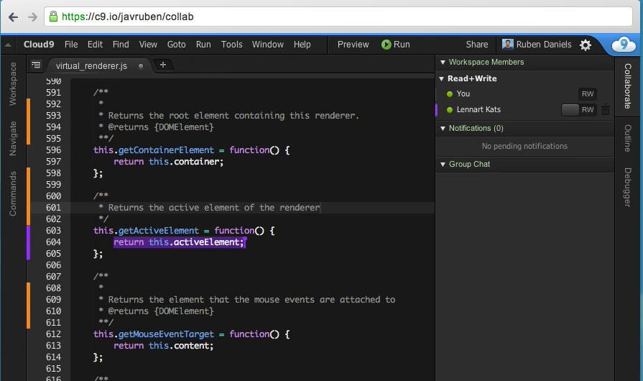
CLOUD9 IDE
Website: https://c9.io
Free basic plan
Allows for collaborative editing
Ubuntu based VM
Terminal for command-line operations
Other similar alternatives are:
https://codenvy.com
https://www.nitrous.io
https://codio.com

Slide 8
Questions

