Slide 1


Microsoft .NET Overview
.NET Framework Topics
Dave Schmitt
Principal Technology Specialist
Microsoft Corporation dschmitt@microsoft.com

Slide 2



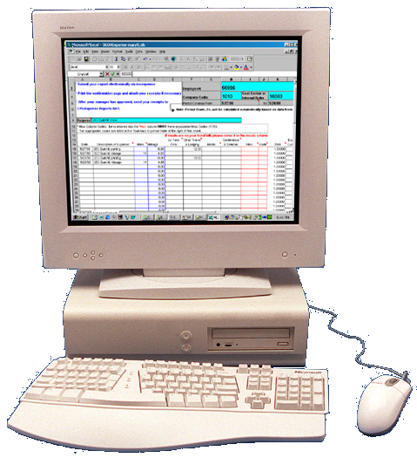










.NET Enterprise Vision
Users
Any device,
Any place,
Any time
Roles/Experiences
Get the right info
To the right user
At the right time
Customer
Operations
Sales
Supply
Engineering
XML Web Services
Integrate and orchestrate business applications and processes
Scheduling
Authentication
Notification
Back Office
Heterogeneous application and server infrastructure
Customer
Service
Plant
Operations
ERP & Billing

Slide 3
What is .NET?
A generic term for the MS vision
  The successor to WinDNA
  Sometimes applied to product names
    Such as Windows .NET Server
A specific software framework
  Includes a common runtime
    Common across OS and dev language
  Includes baseline dev tools in an SDK
  Includes powerful dev environment
    Visual Studio .NET

Slide 4
.NET Framework
Standard programming platform
Common programming language
  C# aka “C Sharp”
  Standardized as ECMA-334 → ISO
  Similar to Java (simplified C++)
Common Language Infrastructure (CLI)
  Standardized as ECMA-335 → ISO
  Defines classes, types, and techniques
  Internationalization (I18N) support
For more info…
  http://msdn.microsoft.com/net/ecma
  http://www.ecma.ch/

Slide 5
.NET Framework
Standard source code availability
The Rotor Project
  Shared source license from Microsoft
  ECMA implementation for Windows & FreeBSD
  See msdn.microsoft.com, search for “Rotor”
The Mono Project
  Open source license from Ximian
  ECMA implementation for Linux
  Also implements some Windows classes
  See www.go-mono.com

Slide 6
.NET Framework
Microsoft extensions
Windows-specific classes
  GUI, A/D, WMI, MSMQ, SQL Server, …
  COM and COM+ interoperation
  Extended internationalization support
Classic MS languages
  VB – gains many OO features
  VC++ – gains managed code features
  VJ# – replaces VJ++ (not J2EE)
  JScript – aka JavaScript & ECMAScript

Slide 7
What is the CLR?
CLR = Common Language Runtime
  Microsoft’s implementation of CLI (ECMA 335)
    For Windows environments
  Plus extensions for Windows
    Wintel PC, Wintel server, WinCE, WinXPE, …
  Most extensions are in the class library
    CLI-compliant code runs on CLR
CLR mimics will probably emerge
  As follow-on to ECMA ports
  Legal situation not yet clear

Slide 8
.NET Framework
Business value
Lower development cost
  Ingrained OO enables clearer designs
  Powerful CLR enables fewer source lines
  Difficult OS services now have OO wrappers
  OO + CLR reduces testing and QA time
Lower administration cost
  CLR enables “no touch” auto-deployment
    No more “DLL hell” or “registry blues”
    “The return of the smart client”
  CLR reduces version and security problems
  XML reduces network configuration problems

Slide 9


CLR Internals
Base Class Library
Thread Manager
COM Marshaler
Type Checker
Exception Manager
Security Services
Debug Services
IL to Native
Compilers
Code
Manager
Garbage
Collector
Class Loader
Notes:
The Common Language Runtime
Internals
This slide gives an idea of what the CLR incorporates. It isn’t necessary to understand what these components do since you may never see them, but below is a brief description of the CLR internals.
Support for Base Class Libraries: Reflection, Root Object type, Floating Point, etc.
The .NET Framework provides a run-time environment called the CLR, which manages the execution of code and provides services that make the development process easier. Compilers and tools expose the runtime's functionality and enable you to write code that benefits from this managed execution environment. Code developed with a language compiler that targets the runtime is called managed code and it benefits from features such as cross-language integration, cross-language exception handling, enhanced security, versioning and deployment support, a simplified model for component interaction as well as debugging and profiling services. It interacts with COM and supports COM Marshaling and multi-threading.
You can use a custom Marshaler to precisely control the way in which a managed type is exposed to COM or an unmanaged type is exposed to the .NET Framework. You also can use it in place of the Interop Marshaler to manipulate the marshaling process.
The Marshaler provides a bridge between the functionality of old and new interfaces. Custom marshaling enables clients you designed to work with an old interface to also work with servers that only implement a new interface and it enables clients built to work with a new interface to work with servers that expose the old interface.
Class Loader - At the bottom is the Class Loader, which manages the loading of classes and metadata.
In addition to the Class Loader, CLR involves CPU independent IL to native code compilers, the Code Manager that controls execution and the Garbage Collector that provides automatic memory management for all objects.
Note: Deterministic Finalization refers to the termination behavior of objects in Visual Basic/COM, or even C++ classes for that matter. When the last reference to a COM object is released, the object is immediately terminated. The Class_Terminate procedure is called in Visual Basic classes, and all resources that it has are released. However in the .NET world, after objects are released they don't get "cleaned up" until the garbage collector runs and finds them. The time it takes for the garbage collector to run depends on a lot of factors like current load, memory usage, etc. Some developers relied on deterministic finalization to automatically clean up their resources after they release their reference. You could set a data object to Nothing and all of its open database connections and RecordSets would be released without having to explicitly call Close on them. In .NET, developers should remember to call Dispose (or Close) on objects that hold expensive resources before releasing the object reference.
More info on COM Marshaler is available at:
http://msdn.microsoft.com/library/default.asp?url=/library/en-us/cpguidnf/html/cpconcustommarshaling.asp

Slide 10

CLR and Win32 Services
C#
VB
J#...
Same class library across all programming languages
Enterprise Services
Connects .NET to COM+ for transactional components and other enterprise services
ASP.NET
ADO.NET
CLR
Connects .NET to data providers, including XML documents
MSMQ
COM+
Active
Directory
IIS
WMI
Win32
Provides WebForms for thin clients, plus web services via HTTP
Notes:
Inside the .NET Framework
Win32 and the .NET Framework
The .Net Framework is an environment for building, deploying and running XML Web services and other applications. This illustration shows how the .NET Framework (shown in orange) fits into the .NET Platform.
The CLR makes it easy to design components and applications whose objects interact across languages. Objects written in different languages can communicate and their behaviors can be tightly integrated. For example, you can define a class and then use a different language to derive a class from your original class or call a method on the original class. You also can pass an instance of a class to a method on a class written in a different language. This cross-language integration is possible because language compilers and tools that target the Runtime use a common type system defined by the Runtime, and they follow the Runtime's rules for defining new types as well as for creating, using, persisting and binding to types.

Slide 11
.NET Framework Namespaces (Full)
System.Web
System.WinForms
Services
UI
Design
ComponentModel
Description
HtmlControls
Discovery
WebControls
Protocols
System.Drawing
Drawing
Caching
Security
Drawing2D
Printing
Configuration
SessionState
Imaging
Text
System.Data
System.Xml
DOM
Data (Dataset)
SQL
XSLT
Serialization
Design
SQLTypes
XPath
Reader/Writers
System
Collections
IO
Configuration
Runtime
Security
Net
ServiceProcess
InteropServices
Text
Reflection
Diagnostics
Remoting
Globalization
Resources
Threading
Serialization

Slide 12
.NET Framework Namespaces (Compact)
System.Web
System.Windows.Forms
Services
UI
Design
ComponentModel
Description
HtmlControls
Run Time
Discovery
WebControls
Protocols
System.Drawing
Drawing (subset)
Caching
Security
Drawing2D
Printing
Configuration
SessionState
Imaging
Text
System.Data
System.Xml
DOM
Data (Dataset)
SQL
XSLT
Serialization
Design
SQLTypes
XPath
Reader/Writers
System
Collections
IO
Configuration
Runtime
Security
Net
ServiceProcess
InteropServices
Text
Reflection
Diagnostics
Remoting
Globalization
Resources
Threading
Serialization

Slide 13
.NET Framework Namespaces (Windows CE)
System.Web
System.Windows.Forms
Services
UI
Design
ComponentModel
Description
HtmlControls
Run Time
Discovery
WebControls
Protocols
System.Drawing
Drawing
Caching
Security
Drawing2D
Printing
Configuration
SessionState
Imaging
Text
System.Data
System.Xml
DOM
Data (Dataset)
SQL
XSLT
Serialization
Design
SQLTypes
XPath
Reader/Writers
System
Collections
IO
Configuration
Runtime
Security
Net
ServiceProcess
InteropServices
Text
Reflection
Diagnostics
Remoting
Globalization
Resources
Threading
Serialization

Slide 14
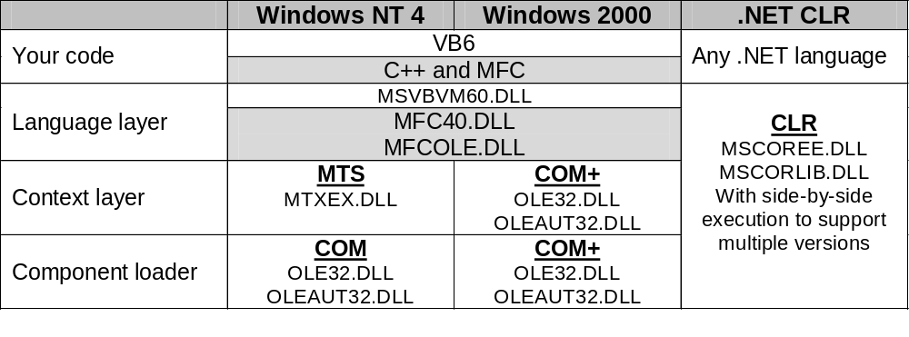
CLR vs Classic Runtimes

Slide 15
CLR Features
All code is compiled, not interpreted
  Assemblies are deployed in intermediate language (IL, also called CIL or MSIL)
  Converted to native machine code at install time (via NGEN) or run time (via JIT compiler)
Static code management
  Versioning, localizing, and signing
  Configurable assembly resolver
  Global assembly cache (GAC)
Dynamic code management
  Memory allocation with garbage collection
  Lifecycle management via reference tracking
  Thread pooling
Notes:
The Common Language Runtime
Features
The Common Language Runtime (CLR) is the execution engine for .NET Framework applications.
It provides a number of services including:
Code management (loading and execution)
Application memory isolation
Verification of type safety
Conversion of IL to native code
Access to metadata (enhanced type information)
Managing memory for managed objects
Enforcement of Code Access Security
Exception handling including cross-language exceptions
Interoperation between managed code, COM objects and pre-existing DLLs (unmanaged code and data)
Automation of object layout
Support for developer services (profiling, debugging, etc.)
Native Code is code compiled to processor-specific machine code.
Managed Code runs under a "contract of cooperation" with the CLR and it must supply the metadata necessary for the CLR to provide services such as memory management, cross-language integration, Code Access Security and automatic lifetime control of objects. All code based on Microsoft Intermediate Language (MSIL) executes as managed code.
Microsoft Intermediate Language (MSIL) is used as the output of a number of compilers and as the input to a Just-In-Time (JIT) compiler. The CLR includes several JIT compilers for converting MSIL to native code.

Slide 16
CLR Features
Fine-grained code access security
  Augments OS security (user credentials)
  Ensures that code only performs operations allowed by policies set by user or administrator
  Based on code source, publisher signature, and other evidence
Flexible deployment
  Simple XCOPY
  Windows installer
  Auto-deploy (aka no-touch or zero-impact)
Flexible remoting
  Includes XML/SOAP and binary
  Remoting model is easily extended
  Integrates with web services
Notes:
The Common Language Runtime
Features
The Common Language Runtime (CLR) is the execution engine for .NET Framework applications.
It provides a number of services including:
Code management (loading and execution)
Application memory isolation
Verification of type safety
Conversion of IL to native code
Access to metadata (enhanced type information)
Managing memory for managed objects
Enforcement of Code Access Security
Exception handling including cross-language exceptions
Interoperation between managed code, COM objects and pre-existing DLLs (unmanaged code and data)
Automation of object layout
Support for developer services (profiling, debugging, etc.)
Native Code is code compiled to processor-specific machine code.
Managed Code runs under a "contract of cooperation" with the CLR and it must supply the metadata necessary for the CLR to provide services such as memory management, cross-language integration, Code Access Security and automatic lifetime control of objects. All code based on Microsoft Intermediate Language (MSIL) executes as managed code.
Microsoft Intermediate Language (MSIL) is used as the output of a number of compilers and as the input to a Just-In-Time (JIT) compiler. The CLR includes several JIT compilers for converting MSIL to native code.

Slide 17
Global Assembly Cache
GAC = database of shared assemblies
Each assembly must have strong name
  Similar to GUID, but much more detailed
  Includes text name, version, culture, digital signature, and public key
  Keys created by SN (strong name) utility
  Nobody can usurp your names because they are based on your private key
GAC assemblies can only refer to other strong-named assemblies

Slide 18







Compilation & Execution
Assembly
Unit of deployment,
similar to DLL or EXE with added metadata
Compilation
Source Code
Language Compiler
Code
Metadata
Saved in cache
An assembly can also be pre-compiled as part of deployment
Before installation or the first time each method is called
Execution
Native
Code
JIT Compiler
Notes:
The Common Language Runtime
Compilation and Execution
The above diagram illustrates the process used to compile and execute managed code, or code that uses the CLR. Source code written in Visual C#, Visual Basic .NET or another language that targets the CLR is first transformed into MSIL by the appropriate language compiler. Before execution, this MSIL is compiled by the Just-in-Time (JIT) complier into native code for the processor on which the code will operate. The default is to JIT compile each method when it is first called, but it is also possible to “preJIT” MSIL code to native code at assembly install-time. With this option, all methods are compiled before the application is loaded so as to avoid the overhead of JIT compilation on each initial method call. You use the Native Image Generator (Ngen.exe) to create a native image from a managed assembly and install it into the native image cache. Once the code is compiled and cached, the CLR does not need to re-compile the MSIL code until the assembly is updated, the Just-In-Time compiled code is removed from the cache, or the machine is restarted.
A point worth noting is that all languages targeting the CLR should exhibit a similar performance. While some compilers may produce better MSIL code, large variations in execution speed are unlikely.

Slide 19

.NET Framework
Internet and Web Services
Framework Features
Other
Framework
Extensions
Windows
Framework Extensions
Standard .NET
Framework
Windows
Other OS
Application Reach across Devices

Slide 20
.NET Mobility Framework
Internet and Web Services
Framework Features
Device Vendor
Framework
Extensions
Windows CE
Framework Extensions
.NET Compact
Framework
Windows CE
Other OS
Application Reach across Devices

Slide 21
Summary
.NET Framework provides…
  Common platform for all .NET languages
  Sophisticated code management
  Fine-grained security
.NET Framework fixes…
  Object life-cycle problems, especially COM
  Weak support for enterprise features
    COM+, WMI, MSMQ, …
  DLL hell and other deployment problems

Slide 22
A Few Words About J2EE

Slide 23
A Tale of Two Technologies
J2EE – Java 2, Enterprise Edition
  Specifies 3-tier thin-client application architecture based on Java and libraries
  Defined by Sun with guidance by “Java Community Process” participants
Microsoft .NET
  Implements broad range of application architecture models, including multi-tier, client-server, desktop, and mobile
  Defined by Microsoft with guidance by ECMA, W3C, IETF, WS-I, and so on

Slide 24
Apples and Oranges
J2EE is a specification, while .NET is both a spec and an implementation
For full comparison, you must look at an actual J2EE implementation
  IBM WebSphere, BEA WebLogic, …
  Difficult to discern where J2EE ends and vendor-specific features begin
Java specs frequently change
  Often tracking Microsoft technologies
  Often as a result of J2EE implementations

Slide 25
Server Technology Timeline
JMS
EJB
JSP
MDB
JAXP
JDBC
JNDI
J2EE
???
J2EE
1996
1997
1998
1999
2000
2001
Microsoft
.NET
Mar 1992
ASP
MTS/COM+
QC
MSMQ
MSXML
LCE
ODBC
MMC
ADSI
WinDNA

Slide 26
Application Servers
An integration of the technologies needed to host applications that are entirely or substantially server-based
Java Application Server…
  J2EE + J2EE container + OS
  With appropriate hosted services
Microsoft .NET Application Server…
  .NET Framework + Windows Server
  With appropriate hosted services

Slide 27
Microsoft .NET & J2EE
Many comparisons being made
  Features, performance, tools, TCO, …
  MS wins some, loses some
    But mostly we win ☺
  Much comparative code freely available
Nonetheless…
  Both .NET and J2EE must co-exist
    Because of prior commitments
    Because of cross-platform issues
Therefore…
  MS is investing heavily in J2EE interoperability
  XML Web Service effort is just one example

Slide 28


