Slide 1
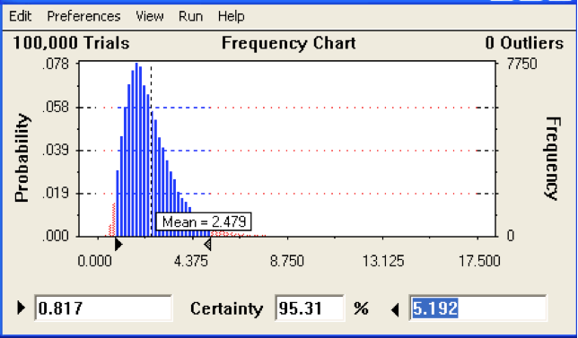
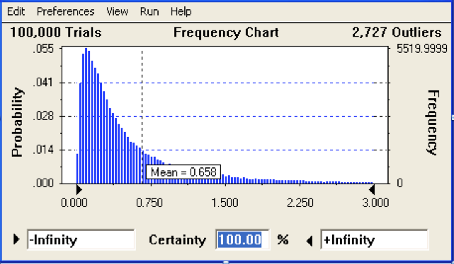
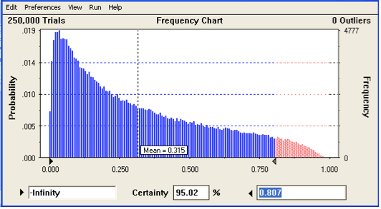
Lifetime Risk of Radiation-Induced Thyroid Disease Estimated for the Hanford Litigation Clients
Alexandre Klementiev Study Conducted for the Hanford Nuclear Reservation Litigation Office of Tom H. Foulds, Seattle, Washington.
INTRODUCTION
The purpose of this study was to assess the long-term health risks for the Hanford Litigation clients (downwinders) who were exposed to the radioactive releases at age under 19, and were later diagnosed with thyroid disease.
In this study, probability of causation (POC) was assessed and considered as the quantitative measure of the health risks associated with the radioactive exposure received by the Hanford Litigation clients. POC provides important evidence regarding whether radiation has a substantial effect on an individual’s health.
Estimated POC was intended to be used in court proceedings:
- As evidence to reflect facts of case, and
To be used as specific criteria for decisions on the compensability of the clients’ radiation-related thyroid disease.
METHOD
Input data used for estimating POC are inevitably not precise, their estimated values are uncertain. If dose as input is considered, “uncertainty” refers to the probability distribution of the possible errors, defined as the difference between the reported dose estimate and its true but unknown value.
Accounting for this uncertainty is important because it can have a large effect on the POC estimates for a specific individual. Therefore, this accounting is critical for a client’s eligibility for compensation.
Probability of Causation: Definition
The probability of causation is defined as
POC = ERR/(1+ERR), (1)
where ERR - excess relative risk. It is assumed in this study that ERR linearly depends on the dose D received by the thyroid glad of an individual:
ERR = βD. (2)
If the uncertainties in the input data are not negligible (case of this study), β and D in (2) should be considered as random variables. In this stochastic version of the model (1), (2) the probability distributions of β and D were assumed lognormal with known parameters.
Input Data
The input data used for POC estimating for each client with thyroid disease history were threefold:
Diagnostic information on client’s thyroid category. The following disease categories were considered:
Autoimmune Hashimoto thyroiditis;
Benign neoplasm;
Non-neoplastic nodules;
- Nodule;
Hyperthyroidism from thyroid nodule.
2) Excess relative risk per Gy (β) specific to the thyroid disease categories listed above. Uncertainty in estimates of β was accounted for in POC estimation by using its reported average value β* and confidence interval [β_{L} ; β_{U}]. The disease-specific estimates of β were compiled from (Lyon et al. 2006), (Zablotska et al. 2008).
3) Dose received by the thyroid gland (D) per each client. The Hanford Litigation experts provided client-specific data on estimated doses. Uncertainty in estimates of D was accounted for in POC estimation by using its reported mean (D*) and standard deviation.
Estimating Probability of Causation
The stochastic version of the model (1), (2) was exploited by Monte-Carlo simulation to estimate POC_{U} - the upper bound of the range of values within which, we believe, the true value of POC lies with high probability, called credibility level. The credibility level was suggested equal to 95% in this work.
The MS Excel application Oracle Crystal Ball software was used in this work to perform Monte Carlo simulations, during which the input values are sampled at random from the inputs’ probability distributions (a domain of possible input values for β and D, see Fig.1). Each set of these samples is then used for deterministic computation of the model (1), (2). The resulting outcome from that sample is recorded. Finally, Monte Carlo simulation produces distribution of possible outcome values of the probability of causation, from which POC_{U} is determined.
Fig. 1 Simulation steps
Yes
No
Fig. 2 Frequency chart for β
Fig. 2 gives an example of probability distribution of β used in this study. The distribution is specific to females exposed to radioactive iodine in their childhood and later diagnosed with “any thyroid disease”. The probability distribution
parameters compiled from (Lyon et al. 2006) are:
β* (95% CI) =2.48 (0.7–5.3) ERR/Gy; p-value=0.0018.
Fig. 3 Frequency chart for D
Fig. 3 shows a lognormal probability distribution used for dose sampling in Monte Carlo simulations for one of the clients. The distribution has the geometric mean=0.66 Gy and geometric st. dev. = 0.8 Gy. Typical means for doses were in
the range 0.1Gy - 1.0Gy. The standard deviations of the doses were usually larger than corresponding mean values.
Fig. 4 Frequency chart for POC
Probability distribution of POC specific to each Hanford Litigation client was generated as the result of Monte Carlo runs based on sampling β and D specific to each client.
Fig. 4 demonstrates an example of such distribution: it is a
histogram of the values generated during the 250,000 iterations.
It shows the interval of possible POC values within which the true (and unknown!) value of POC lies with probability 95%. In this case the estimated upper bound of the POC confidence interval POC_{U} = 80.7%.
RESULTS AND DISCUSSION
This study proposes a method to determine whether a thyroid disease diagnosed in a Hanford downwinder was induced by given exposures to ionizing radiation at age under 19. The method is based on the estimation of the 95th percentile of the range of uncertainty around the central estimate of POC. The decisions about granting claims for compensation for thyroid disease are to be made on the basis of the estimated 95th percentile. To give claimants more benefit of the doubt, a higher credibility level,
like 99%, can be suggested.
A more comprehensive, scientifically sound approach for estimating probability of causation of radiogenic disease is used in several web-based calculators, like IREP. Usage of these tools is limited to cancers, so they are not helpful when non-cancerous thyroid diseases are considered.
Example for a client diagnosed with “Any thyroid disease”
Inputs:
Excess relative risk per Gy: β* (95% CI) =2.48 (0.7–5.3) Gy⁻¹;
Dose: CT(95% CI UL)=0.255(0.35) Gy;
Results:
If the uncertainties in the input data were neglected, the POC calculated from (1), (2) would be equal to 38.7%, which does not meet the 50% criterion for causation.
If the benefit of the doubt is to be applied to decision about granting claim for compensation, the 95th percentile of the POC range of uncertainty should be considered. In this case
POC_{U} 95% CI=70.9% meets the criterion for causation, and the client is eligible for compensation.
Acknowlegements
Special thanks to Tom H. Foulds, the lead counsel in the Hanford Nuclear Reservation Litigation representing Hanford downwinders, who has initiated, supported, and participated in this study.
REFERENCES
Lyon J, Alder S, Stone M, Scholl A, Reading J, Holubkov R, Sheng X, White G, Hegmann K, Anspaugh L, Hoffman F, Simon S, Thomas B, Carroll R, Meikle. A Thyroid disease associated with exposure to the Nevada nuclear weapons test site radiation: A reevaluation based on corrected dosimetry and examination data. Epidemiol 17;604-614; 2006.
Zablotska L, Bogdanova T, Ron E, Epstein O. Robbins J, Likhtarev I, Hatch M, Markov V, Bouville A, Olijnyk V, McConnell R, Shpak V, Brenner A, Terekhova G, Greenebaum E, Tereshchenko V, Fink D, Brill A, Zamotayeva G, Masnyk I, Howe G, Tronko M. A cohort study of thyroid cancer and other thyroid diseases after the Chornobyl accident: dose-response analysis of thyroid follicular adenomas detected during first screening in Ukraine (1998-2000). Am J Epidemiol 167(3):305-312; 2008.
CONTACT
klementiev@gmail.com
Phone (253) 227-0341
1. Define a domain of possible input values for β and D.
2. Generate inputs randomly from the probability distributions over the domain.
Stop?
4. Aggregate results, build the probability distribution for POC.
3. Perform a deterministic computation of POC based on the selected inputs.

