Slide 1

Overcoming the Direct-Proportion Prejudice
HAYDEN, Howard University of Connecticut (Emeritus)
Now in Pueblo West, CO
corkhayden@comcast.net

Slide 2
The Direct Proportion Model (a.k.a. the LNT)
Response (cancer, …)
DOSE (Grays, Sieverts, rads, rems, Energy per unit mass)

Slide 3
This Presentation is about the Dose axis Experts will talk about the Response axis (I’m not one of them)
DOSE (Grays, Sieverts, rads, rems, Energy per unit mass)

Slide 4
Implications of LNT w.r.t. the Dose axis
Population Dose
Total Dose = sum of doses to all of (chosen) population
Cumulative dose to an individual
Total Dose = sum of all doses to that individual
HOWEVER
Dose is an intensive variable, and is not an additive quantity.
(proof follows)
My apologies to those for whom this fact is so obvious that it needs no elaboration

Slide 5
Extensive and Intensive Variables (in the language of thermodynamics)
Extensive variables are additive
Internal energy, entropy, enthalpy, …
Intensive variables are not additive
Temperature, pressure, specific heat, …
The sums (and averages, for that matter) have no thermodynamic meaning.
U₁ S₁ H₁ …
U₂ S₂ H₂ …
T₁ P₁ …
T₂ P₂ …

Slide 6

Definition of Radiation Dose
Dose = absorbed radiation energy per unit mass.
SI Unit: 1 gray = 1 joule per kg (1 Gy = 1 J/kg)
1 J
1 kg

Slide 7
Adding Doses?
Imaginary divider
0.5kg
0.5 J
0.5 J
0.5 kg
This kind of logic can turn a mGy into a MGy

Slide 8
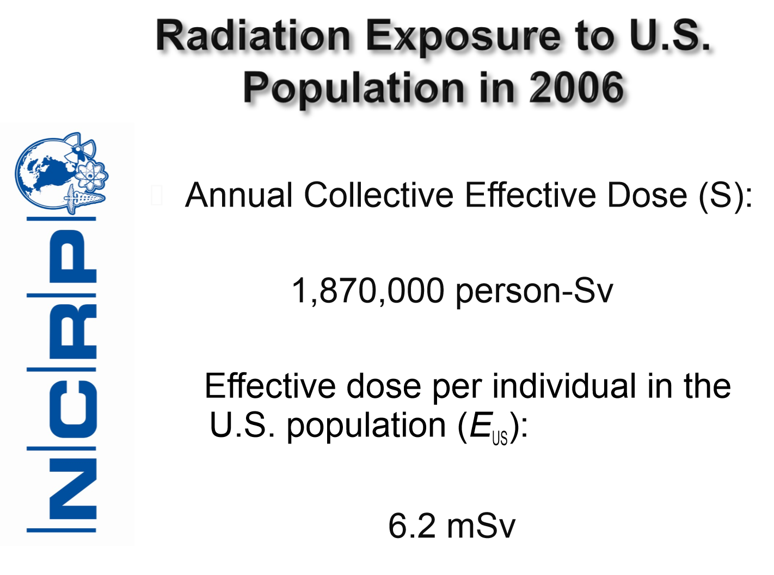

The Presumption of Additivity: Population Dose

Slide 9


The Presumption of Additivity: Cumulative Dose

Slide 10
Conclusion
Radiation Dose, by its very definition, is not an additive quantity
“Population dose” is a statistic, not a dose
“Cumulative dose” is a statistic, not a dose
Yet, there are obvious things to recognize
Somehow, more exposure to more people is probably associated with more hazard
The trick is to find out Why and How, without assuming that dose is additive.

Slide 11
Recommendations
Use the Dose axis with great care
There are discoveries to be made when researchers abandon the notion that dose is an additive quantity.

