Slide 1
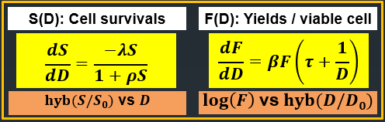
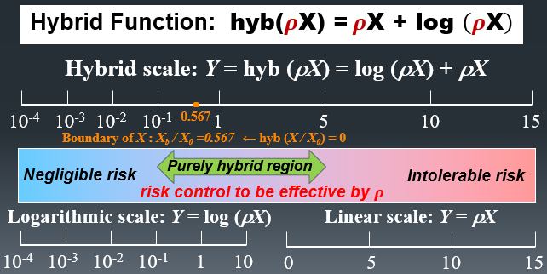
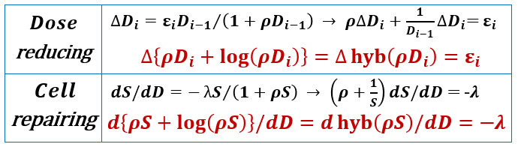
ON A HYBIRD SCALE MODEL OF DOSE-RESPONSE RELATIONSHIPS UNIVERSALLY APPLIED TO VARIOUS DATA OF IONIZING RADIATION EXPOSURE SHIGERU KUMAZAWA, Formerly JAERI
OBJECTIVE
To evaluate the low dose risk, this is to develop a universally applied method for dose-response data with a hybrid scale (HS) model that integrates multiplicative and additive reactions.
RESULTS-1 S_HS model applied to
data of Elkind and Sutton (1960)
HS model: hyb(ρS) = hyb(ρ) – λD
Fraction of surviving mammalian cells by split-dose of x-ray. The
fitting is all good and ρ is small for 2.5 h due to less repair.
RESULTS-2 F_HS model, GHS model
applied to Preston & Brewen (1973)
HS model: log[F(D)] = α+βhyb(τD)
Reciprocal translocations of mice spermatogonia by x-ray. The
fitting is good and a bio-system of F(D) is normal for D < D_{b}.
METHOD
Generalized Hybrid Scale (GHS) Model
Incidence log[I(D)] = log[F(D)] + log[S(D)]
HS Model of F(D) = I(D) / S(D)
log[F(D)] = α + β hyb(τD)
HS Model of S(D), cell survival
hyb[ρS(D)] = δ – λD , δ = hyb(ρ)
log[S(D)] = ρ[1-S(D)] – λD
α, β : model parameters
τ : effect modifier per dose
ρ : feedback factor of sublethal cell repair
λ : inactivation constant per dose
The concept of hybrid scale is important to identify the effective range of risk control for radiation protection and bio-defense system.
RESULTS-3 GHS model (Grant et al., 2017)
LSS solid cancer incidence (1956-2007) ERR for males and
females at attained age of 70 years after exposure at age 30 years.
The fitting is all good over the dose range of S(D), F(D) and I(D) with
a similar characteristics between males and females for extrapolating
the low dose-response. The GHS model is better than L or LQ model
due to using all available data.
CONCLUSION
1. The HS model of survival S(D)
was confirmed on data of Elkind
and Sutton (1960).
2. The GHS model was fitted
well to data of Preston and
Brewen (1973), Mole (1984) and
Majo et al. (1986), others.
3. The GHS model was fitted
well to LSS solid cancer
incidence ERR (Grant et al.
2017), better than L or L-Q
model fitted to data in the range
over 0.005 to 1 Gy or > 4 Gy.
REMARKS:
- Source: From Figure XVI, ANNEX B, UNSCEAR 1986 REPORT
- Data: Myeloid leukemia incidence of male CBA mice to
x-rays (Mole, 1984; Majo et al., 1986)
- Results: The GHS model fitting is good and it predicts a
smaller risk coefficient in the low dose range than the
model shown in Figure XVI of the UNSCEAR 1986 Report.
- Transformations per surviving cell (Borek, 1984) in Figure
VII of the ANNEX B is also fitted by HS model of F(D) well.

