Slide 1

Welcome to
Dr. Alan Waltar
General Chair

Slide 2
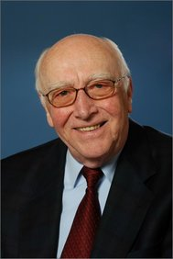
THANK YOU TO OUR PROGRAM PLANNING COMMITTEE
Dr. Ludwig Feinendegen
Honorary Chair

Slide 3
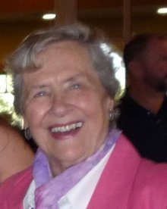
THANK YOU TO OUR PROGRAM PLANNING COMMITTEE
Wanda Munn
Assistant General Chair

Slide 4
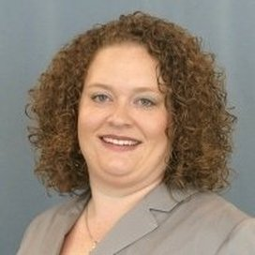
THANK YOU TO OUR PROGRAM PLANNING COMMITTEE
Virginia Cleary-Ivanoff
Assistant General Chair

Slide 5
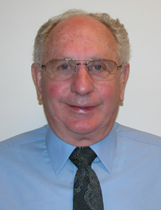
THANK YOU TO OUR PROGRAM PLANNING COMMITTEE
Dr. Tony Brooks
Technical Program Chair

Slide 6
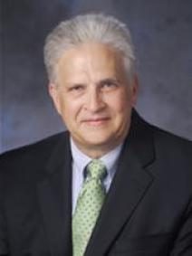
THANK YOU TO OUR PROGRAM PLANNING COMMITTEE
Dr. Nolan Hertel
Technical Program Chair

Slide 7
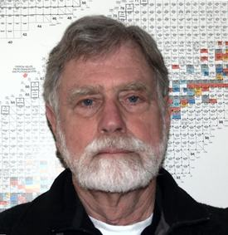
THANK YOU TO OUR PROGRAM PLANNING COMMITTEE
Dr. Steve Baker
Exhibits Chair
Key Assistant to Program Committee

Slide 8
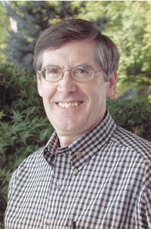
THANK YOU TO OUR PROGRAM PLANNING COMMITTEE
Bob Tibbatts
Finance Chair

Slide 9
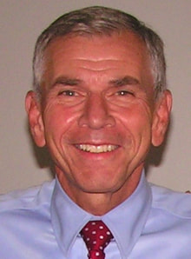
THANK YOU TO OUR PROGRAM PLANNING COMMITTEE
Mike Lawrence
International Chair

Slide 10
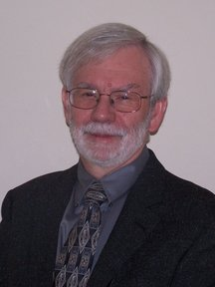
THANK YOU TO OUR PROGRAM PLANNING COMMITTEE
Wayne Glines
Publications Chair

Slide 11
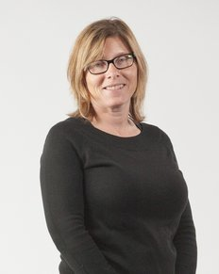
THANK YOU TO OUR PROGRAM PLANNING COMMITTEE
Anna Markham
Communications Chair

Slide 12
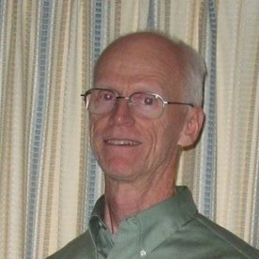
THANK YOU TO OUR PROGRAM PLANNING COMMITTEE
Dr. Paul Rittman
Registration Chair

Slide 13
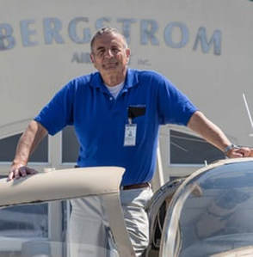
THANK YOU TO OUR PROGRAM PLANNING COMMITTEE
Gerald Woodcock
Arrangements Chair

Slide 14
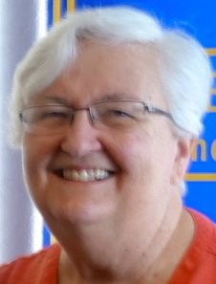
THANK YOU TO OUR PROGRAM PLANNING COMMITTEE
Kris Troyer
Tours Chair

Slide 15
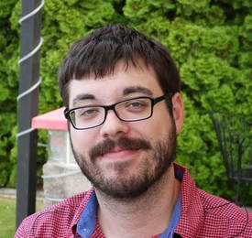
THANK YOU TO OUR PROGRAM PLANNING COMMITTEE
Mike Leimon
Scribe

Slide 16
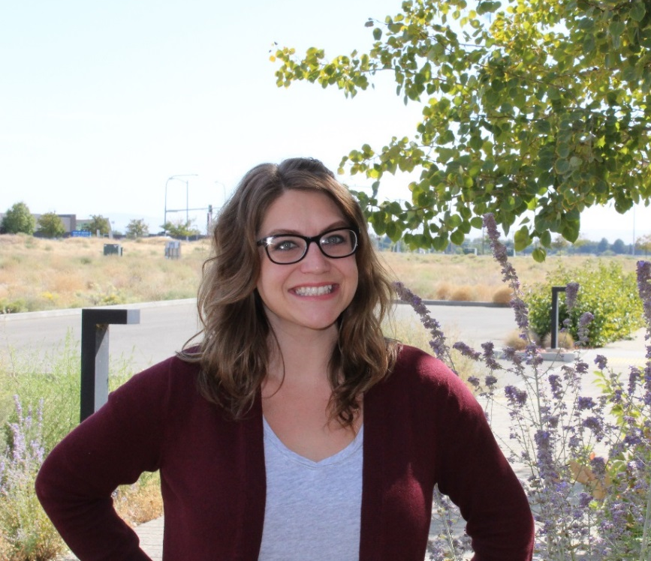
THANK YOU TO OUR PROGRAM PLANNING COMMITTEE
Jillian Gardner-Andrews
Director of Special Projects

Slide 17
THANK YOU TO OUR PROGRAM PLANNING COMMITTEE
Grant McCallum
Signage Director
Sharon Denchfield
Support Team Administrator

Slide 18
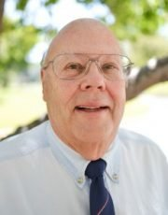
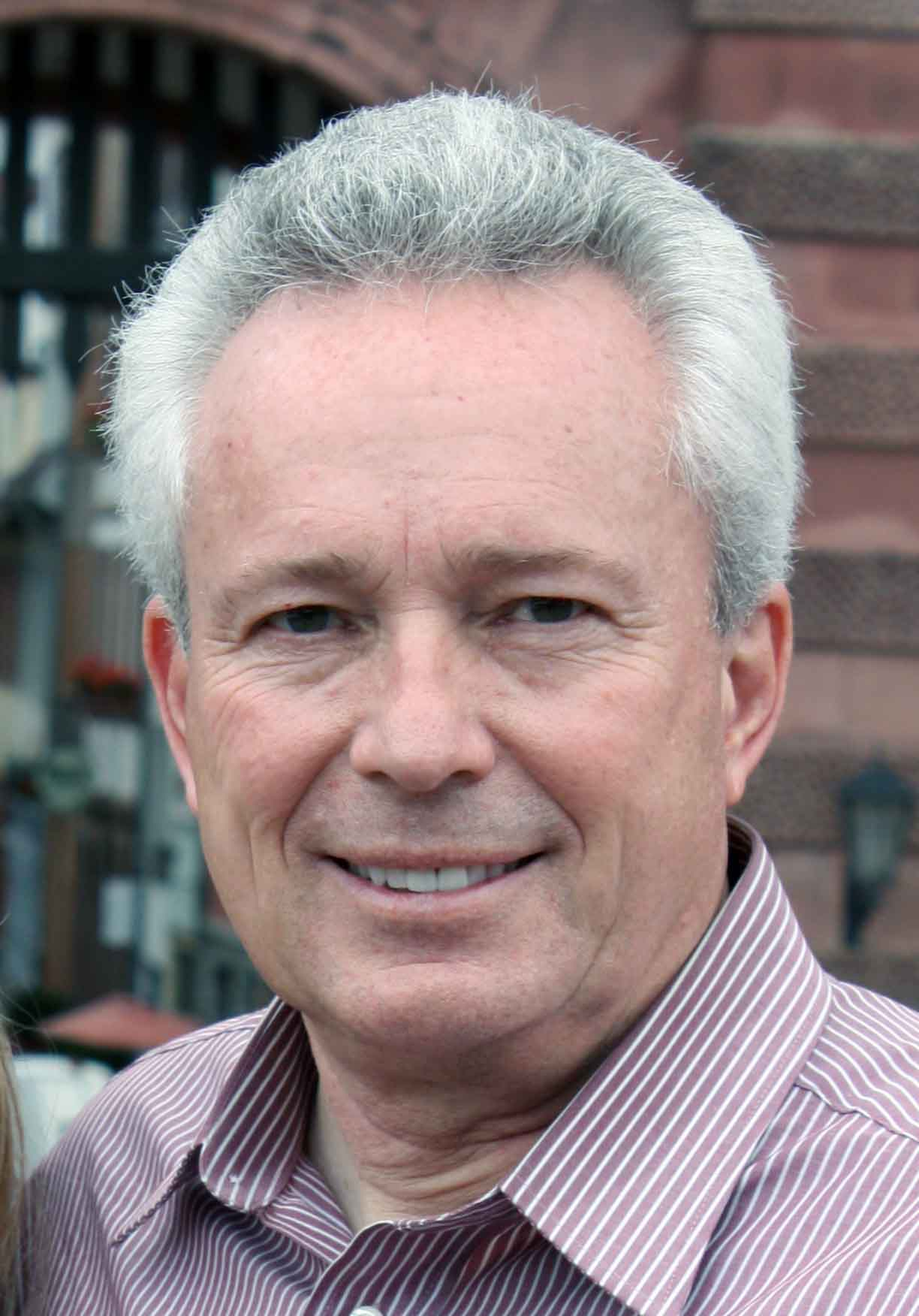
THANK YOU TO OUR FORMER TECHNICAL PROGRAM CHAIRS
Dr. Ron Kathren
Dr. Darrell Fisher

Slide 19
THANK YOU TO OUR
ORGANIZATIONAL SPONSORS
Eastern Washington Section, American Nuclear Society
Columbia Chapter, Health Physics Society
American Nuclear Society Nuclear Installations Safety Division
AND TO OUR CO-SPONSORS
ANS Biology and Medicine Division
ANS Radiation Protection and Shielding Division
International Atomic Energy Agency
European Nuclear Society
Japanese Nuclear Society
International Nuclear Energy Academy
Society of Nuclear Medicine and Molecular Imaging
Herbert M. Parker Foundation

Slide 20
A SPECIAL THANK YOU OUR FUNDING SPONSORS
Bruce Power
Terra Power
U.S. Department of Energy
Ray Rothrock and Family
Exelon
ANS Operations and Power Division
Health Physics Society
Citizens for Medical Isotopes
Kris Troyer
Ed Ray
Energy Northwest
Canadian Nuclear Laboratories
ORANO
NV5 (Dade Moeller)
Kiona Vineyards and Winery
Sleeping Dog Winery
Hanford History Project

Slide 21
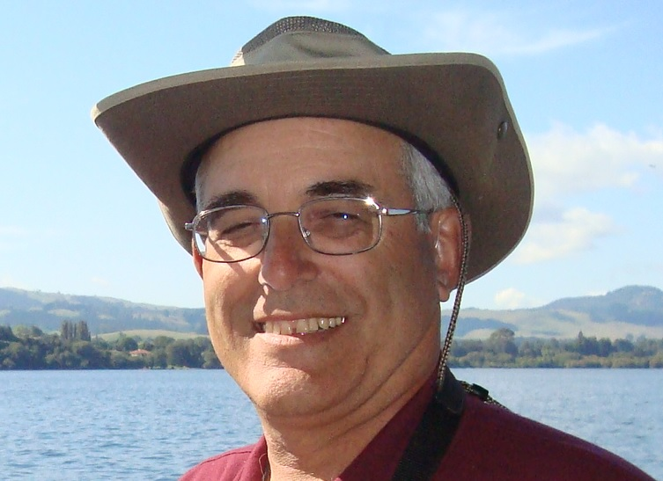
In Memory of Gary Troyer
1946-2014

Slide 22


