Slide 1
Strengths and weaknesses of the biophysical argument for a linear risk extrapolation to very low doses
David Brenner
Columbia University, New York
djb3@columbia.edu
Notes:
1

Slide 2
The main health effects associated with exposure to low doses of ionizing radiation
Radiation-induced cancer
Teratogenic effects
Hereditary effects
Other health effects?

Slide 3
Risk Estimation at Low Radiation Doses….
What is the problem?
?
?
Notes:
3

Slide 4
How low in dose can we currently go?
Studies of the Atomic Bomb survivors
Brown dots: Individuals exposed to between 5 and 100 mGy (~25,000)
Douple et al 2011

Slide 5
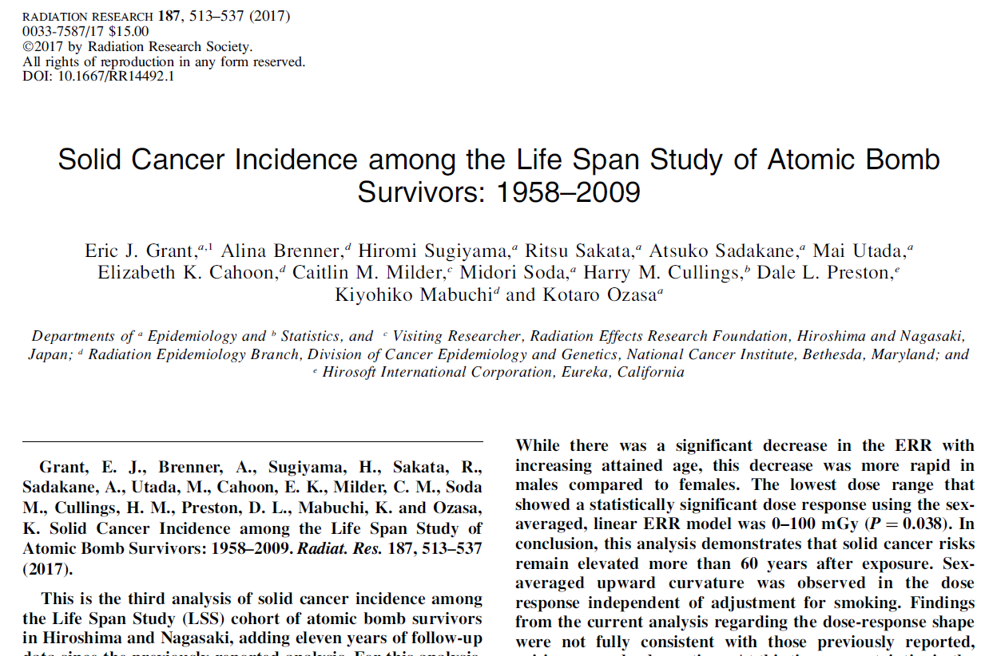

Slide 6
The UK CT Study: Leukemia
Pearce et al 2012

Slide 7
Why can’t we get useful information from epidemiological studies at still lower doses?
~40% of any study population will get cancer anyway
At very low doses, looking for very small excess risks on top of this 40% cancer background requires huge epidemiological studies
Notes:
7

Slide 8
Size of cohort required to detect significant increase in cancer mortality
From NRC 1995
Notes:
8

Slide 9
Three studies of mortality in radiologists
STUDY | Relative Risk
Matanowski (US) | 1.2 | Statistically significant increase
Berrington (UK) | 0.68 | Statistically significant decrease
Carpenter (UK) | 1.03 | No significant change
Notes:
9

Slide 10
For lower doses than we can assess epidemiologically, we do need to use models to extrapolate risks
Radiation-induced cancer risk
?
Dose

Slide 11
The Biophysical Argument leading to the linear no-threshold extrapolation
Radiation-induced cancer risk
Dose

Slide 12

Radiation-induced cancer risks at different doses
Photons per cell nucleus at different radiation doses
1000 mGy
10 mGy
1 mGy
?

Slide 13
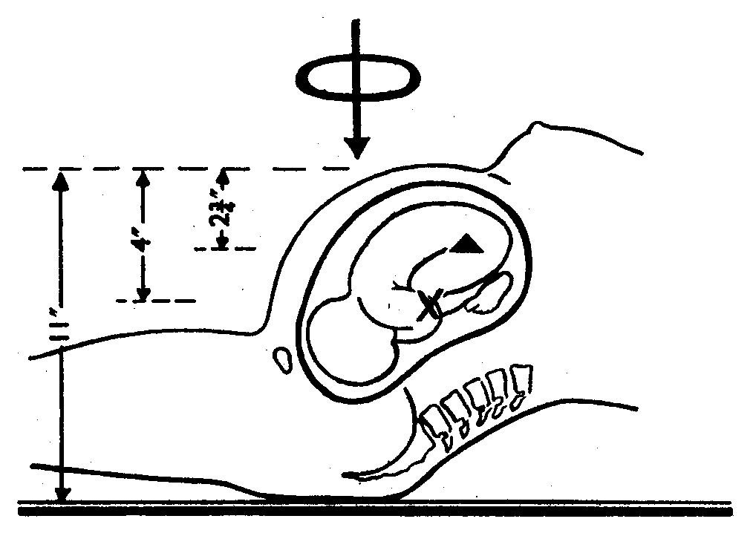
The Oxford Survey of Childhood Cancers
Significant increase in childhood cancer after in-utero x-ray exposure
Mean dose ~ 6 mGy
15,000 case control pairs
Doll and Wakeford 1997

Slide 14
Radiation-induced cancer risks at different doses
1000 mGy
10 mGy
1 mGy
?
LNT

Slide 15
The biophysical argument applies at low doses
Same mechanisms
Different mechanisms
Radiation-related cancer risk
Dose
Dose corresponding to mean of one photon / cell

Slide 16
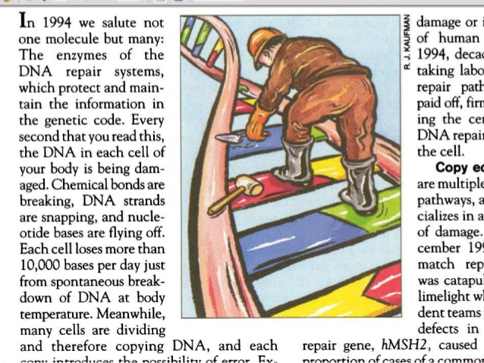
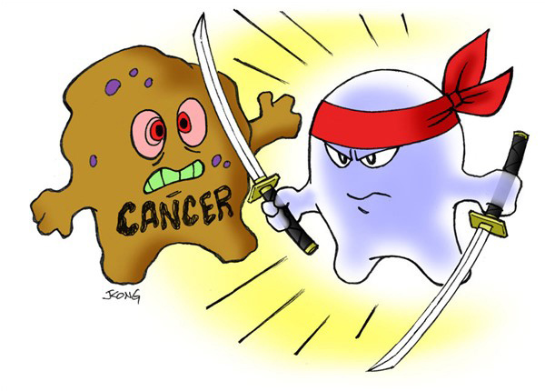
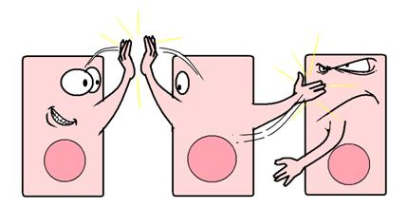
The biophysical argument makes a number of assumptions that can be questioned
DNA Repair
Immuno-surveillance
Cell-to-cell communication

Slide 17
DNA Repair
“We have been exposed to ionizing radiation for billions of years, and have developed exceedingly efficient DNA repair mechanisms”
But it is known that, along with DNA repair, there is always a small probability of DNA misrepair

Slide 18
Immuno-surveillance and the Biophysical Argument
If immunosurveillance or other processes could always “mop up” small numbers of pre-malignant cells, the biophysical argument would not hold
On the other hand, If immuno-surveillance or other processes could indeed always “mop up” small numbers of pre-malignant cells, would we ever get cancer?

Slide 19
“Sneaking Through” immune surveillance
Kölsch et al. 1973

Slide 20
Inter-Cellular Communication
The biophysical argument refers to the development of monoclonal tumors by independently developing cells
During carcinogenesis we know that cells talk to each other, and we know that the local microenvironment is important
Are radiation-carcinogenic processes counteracted / amplified by mechanisms at the inter-cellular, tissue or organism level?

Slide 21
The most quantified radiation-related inter-cellular response is the bystander effect
Cells in tissues do certainly talk to each other, but what are the implications for low-dose risks?
Measured mutations in bystander effect study
Where bystander responses have been quantitated, they have always shown saturation
Zhou et al 2000
In this scenario LNT might underestimate very low-dose risks

Slide 22
Cancer risks at very low doses.... the bottom line
The biophysical arguments that lead to a linear no-threshold model at doses below those amenable to epidemiology are plausible, but rely on assumptions about single cells acting autonomously, which we know are not fully correct
At this time we don’t know if deviations from the predictions of this linear approach will be large or small, or even whether they will increase or decrease low-dose cancer risk estimates

Slide 23
A straight line relationship between radiation dose and radiation risk….
The implication is that as you lower the dose, you proportionality lower the risk
So at very low doses the risks are correspondingly very low
But there is no dose where the risk is zero

Slide 24
The significance of very small doses?
Suppose some activity results in a risk of harm to an individual of (say) 1 chance in a million
Very small individual risk
Now suppose a group of 100 people are exposed to this activity
The chances of anyone in this group being harmed is essentially zero
Very small population risk / no public-health consequence
Now suppose a population of 100 million people are exposed to this same activity
Here it is certain that some people in the group will be harmed
Significant population risk / significant public-health consequence
❖

Slide 25


Individual Risks vs. Population Risks

Slide 26

My friend and colleague, Bill Morgan

