Slide 1
Science and Judgment in Setting Radiation Protection Standards: Over a Century of Experience
Roger O. McClellan¹, DVM (WSU-1960), MMS (UNM-1980), DSc, Honorary (OSU-2005)
Diplomate – American Board of Toxicology and American Board of Veterinary
Toxicology
Fellow – American Thoracic Society, Health Physics Society, Society for Risk
Analysis, American Association for Aerosol Research, International Aerosol
Research Assembly, American Thoracic Society, American Association for
Advancement of Science
Member – National Academy of Medicine
¹Independent Advisor, Toxicology
and Human Health Risk Analysis
Albuquerque, NM 87111
Tel: 505-296-7083
E-mail: roger.o.mcclellan@att.net
For presentation at the Conference:
“Applicability of Radiation-Response Models to Low Dose Protection Standards”
Pasco, WA
October 1, 2018

Slide 2
Policy and regulations should be informed by Science. However, science alone is not sufficient basis for policy and regulatory decisions.
Central Theme
Regulations
Legislation
Public
Policy Choices
Science
Scientists need to clearly communicate scientific information divorced from their own personal desired policy outcome.
Notes:
Figure 2 - McClellan

Slide 3
“In the United States and some other industrial democracies, where people and their governments tend to be risk averse, legislatures, courts, and administrative entities usually create a presumption favoring more safety rather than less. The definitions of risk in law are often vague (“reasonable certainty of no harm” or “adequate margin of safety”) and are likely to encourage an unrealistic belief that risks can be minimized or even eliminated altogether.
Donald Kennedy, Editor-in-Chief, Science 309: 2137 (30 September 2005)

Slide 4
Establishing and Using Radiation Protection Standards Involves Multiple Entities with Different Roles
Creating scientific knowledge (scientific community)
- epidemiological
- whole animal
- cellular and molecular studies
Synthesizing the knowledge base and advising on use of the science to set standards
(ICRP, NCRP, NAS/NRC, BEAR/BIER, HHS, UNSCEAR, WHO/IARC)
Setting standards and regulations based on statutory authority
(AEC/ERDA/DOE, NRC, EPA, FDA, others)
Implementation: State and local authorities, Medical community, Nuclear Power community, Nuclear Defense community, others

Slide 5
Chronology of Key Events Related to Evaluating Health Risks of Ionizing Radiation and Setting Standards
X-rays discovered and medical applications began, radiation-induced
dermatitis observed
Tolerance dose (Rollins) – “If a photographic plate is not fogged in 7
minutes, the radiation is not of harmful intensity”
1903-1904 Reproductive organ damaged
1904-1905 Hematopoietic tissue damage observed
Tolerance dose (Mutscheller) – 0.01 of an erythema dose/month
Mueller reports mutation rate increased by x-rays
Bone cancer observed in Radium Dial Painters
Lawrence invents cyclotron and creates transmutated elements and
isotopes
International x-ray and Radium Commission set tolerance dose of
0.2 Roentgen/day
Hahn and Strassman discover fission, Meitner and Frisch coin term –
“daughter products.” Physics and biology are joined!
1940 Seaborg team discovers plutonium and demonstrates it is fissionable

Slide 6
Chronology of Key Events Related to Evaluating Health Risks of Ionizing Radiation and Setting Standards
Henshaw describes two fundamental dose-response relationships:
(a) linear, no-threshold model (Stochastic or Probablistic)
(b) threshold model (Deterministic)
1942-1945 Manhattan Project (Groves) created to develop and produce atomic bomb
- University of Chicago – basic physics, chemistry, biology and medicine
- University of California (Berkeley) – basic physics, chemistry, biology and
medicine
- University of Rochester – Toxicity testing
- Oak Ridge – Produce uranium and Plutonium, basic biology
- Hanford – Produce Plutonium-239
- Los Alamos – Design, produce and test Atomic Bomb
1944-1945 Cantrill and Parker: Develop and Implement Hanford Radiation Protection
Program. Author NDDC-1100. “The Tolerance Dose”
July 1945 Trinity shot (Pu²³⁹) test in New Mexico
August 1945 Hiroshima bomb (U²³⁵) and Nagasaki bomb (Pu²³⁹)
Morbidity and Mortality related to blast, thermal and radiation effects
Beginning of Atomic Bomb Casualty Commission (Now Radiation Effects
Research Foundation)

Slide 7
Early History: Toxicity of Radiation and Radionuclides and Standards
Henshaw describes two fundamentally different radiation dose-response relationships (a) stochastic (linear, no threshold) and (b) deterministic (threshold)
1941 Three radiation tolerance levels to protect workers
- 0.1 roentgen per day for x- and gamma-rays
- 1 x 10⁻¹⁴ Curie radon/cc for radon in air
- 0.1 µg radium as maximum allowable amount deposited in body
All three based on “human misfortune”
Major Uncertainties
- effects of newly discovered radionuclides such as Pu²³⁹
- effects of protracted exposures
- uncertainties in human data bases
Notes:
Slide 12 - McClellan

Slide 8
Schematic Rendering of Two Fundamentally Different Dose-Effect Relationships for Radiation (Adapted from Henshaw 1941, Journal of National Cancer Institute, Vol. 1)
Stochastic: probability of occurrence increases with dose presumably without a threshold
Effect
A
Deterministic: Occurrence and severity is a function of dose with an identifiable threshold
B
Dose
Notes:
Slide 13 - McClellan

Slide 9
Health Effects of Radiation Exposure
Acute Radiation
Sickness
Acute
Effects
Erythema
Deterministic
Effects
Epilation
Somatic
Effects
Sterility
Cataract
Leukemia
Cancer
Late
Effects
Stochastic
Effects
Heritable
Effects
Manifest in
future generations
Notes:
Slide 14 - McClellan

Slide 10
Tolerance Dose Replaced by Focus on Risk
NAS/NCRP “Tolerance Dose” replaced by “Maximum Permissible Dose” with
concept emerging of “acceptable risk” at low levels of exposure
FRC presented LNT as approach to extrapolating to an upper limit for
recommending “acceptable risk”
Edward Lewis at Joint Committee on Atomic Energy Hearings advanced concept
of “As Low As Reasonably Achievable”
AEC advanced ALARA as operational concept
ICRP (1977) and NCRP (1987) advance “risk-based” approach using comparison
of radiation to fatal accident rate in safe industries. EPA (1987), DOE (1988)
and NRC (1991) followed.
1990 BEIR V proposes “Dose Rate Effectiveness Factor”

Slide 11
Impact of “Consequence Studies”*
1946 forward: Multiple studies of “nuclear war scenarios and space nuclear auxiliary
power systems utilizing reactors or radionuclides
1955: Parker and Healy, “Environmental Effects and Major Reactor Accident,” UN
Conference on Peaceful Uses of Atomic Energy
1957: WASH-740 Report – “Theoretical Possibilities and Consequences of Major
Accidents in Large Nuclear Power Plants” stimulated additional research to
reduce uncertainties
1960: NCRP endorses concepts of “population dose” and “population detriment”
1969: National Environmental Policy Act (NEPA) called for preparation of environmental
Impact Statements
Required quantitative estimates of consequences (i.e. risk). End of hand-waving
pronouncements – “our operations are safe!”
1975: Publication by Nuclear Regulatory Commission of Landmark Rasmussen Report –
“Reactor Safety Study. An Assessment of Accident Risks in U.S. Commercial
Nuclear Power Plants. WASH-1400.
1977: Lovelace ITRI publication -- Cuddihy et al., “Radiation Risks from Plutonium
Recycle.” Environmental Science and Technology. Comparison with emissions of
naturally-occurring radionuclides from coal-fired plant.
_________________
*All require estimates of exposure (dose) and potency to estimate risk to individuals and populations!

Slide 12
Radiation Protection Standards: Theory and Application Herbert M. Parker Atomic Energy Law Journal, Volume 2, Fall 1960 (Also at IAEA, September 1960)
Current Exposure Limits expressed as Rem (RBE dose) units
Application | Time Interval | NCRP | ICRP | FRC
Occupational
(a) Whole Body | N-Year 13 weeks | 5 (N-18) 3 | 5 (N-18) 3 | 5 (N-18) 3
(b) Extremity | Year 13 weeks | 75 25 | 75 20 | 75 25
(c) Skin | Year 13 weeks | 30 6 | 30 8 | 30 6
Non-Occupational
(a) Vicinity | Year | 0.5 | 1.5 (adults) 0.5 (children) | 0.5 (individual) 0.17 (group average)
(b) Population | 30 year (gonad dose) | Presently concur with ICRP | 5 | 5

Slide 13
Impact of U.S. Environmental Protection Agency on Risk Assessment
: Pieced together by President Nixon, the EPA brought together in one
federal agency regulatory programs dealing with water, drinking water,
pesticides, air and radiation. Later, toxic substances were added.
1970-1975: Interminable legal sparing over cancer as an endpoint for multiple
contaminants with polarization of scientific opinions.
May 26, 1976: EPA Carcinogen Assessment Group chaired by Roy Albert
developed “Interim Procedures and Guidelines for Health Risk
and Economic Impact Assessment of Suspected Carcinogens”
Multiple step decision-making:
(a) Does a substance constitute a carcinogenic hazard?
(b) What is the agents carcinogenic potency?
(c) What are the sources of exposure?
(d) What is the quantitative estimate of risk?
(e) What regulatory actions should be taken to reduce the risk?
EPA process built on Atomic Energy Commission experience with fallout I¹³¹ and Sr⁹⁰, related to Albert’s experience in Manhattan Project and as early AEC staffer

Slide 14
Radiation Protection Standards ARE Multi-faceted
Numerical Limit using low LET radiation as basic limit
Radiation Weighting Factor (W_{R}) for radiation quality based on Relative Biological Effectiveness (RBE) of the radiation of interest to the absorbed dose in an organ or tissue to derive equivalent dose
Dose Dose Rate Effectiveness Factor (DDREF)
To extend from acute exposures to protracted exposures
Over-Arching Optimization Guidance –
As Low As Reasonably Achievable (ALARA)

Slide 15
Role of Human and Animal Studies Informing Standard Setting
Epidemiological data (human misfortune) is cornerstone of risk estimates and radiation protection standards for people
Examples: Radium dial painters
Radon and daughter products: Uranium and other miners
External x-irradiation of thyroid
Brief external radiation exposure – Japanese A-bomb survivors: Early deaths due to blast, thermal injury and radiation
Soviet Mayak Pu²³⁹ Workers
Comparative kinetics studies with actinides and fission products (University of California-Berkeley and University of Chicago, Argonne National Laboratory)
Heritable effects in Mice (Oak Ridge National Laboratory)
Lifespan/cancer studies of external radiation and selected radionuclides (Argonne National Laboratory)
Major lifespan studies in laboratory animals with emphasis on Beagle Dogs to extend and complement findings in epidemiological studies
- Injected Ra²²⁶, Ru²²⁸, Th²³⁰, Sr⁹⁰ and Pu²³⁹ (University of Utah)
- Ingested I¹³¹ and Sr⁹⁰ (Hanford)
- Injected Ra²³⁶ and Ingested Sr⁹⁰ (University of California-Davis)
- Inhaled fission product radionuclides and Pu²³⁹ and Pu²³⁸ (Hanford and Lovelace Inhalation Toxicology Research Institute)
Notes:
Slide 24 - McClellan

Slide 16
Let’s Examine World’s Most Extensively Studied Toxicant-Radiation and Most Extensively Studied Irradiated Population
Japanese A-Bomb Survivors
- 86,611 individuals
- Born prior to August 1945
- Instantaneous radiation exposure from nuclear detonation
- Enrolled in Lifespan Cohort in 1950
- Radiation dose estimated for each individual
- High quality medical care provided and cause of death
established for each decedent
- End of 2003 (58 year post-exposure)
Dead – 46,614 (54%)
Alive – 39,997 (46%)
Notes:
Slide 16 - McClellan

Slide 17
Observed and Estimated Excess Deaths in Cancer and Non-cancer Diseases in the ABCC/RERF Life Span Study (LSS) Cohort (Ozasa et al. 2012)
Notes:
Slide 17 - McClellan

Slide 18
A-Bomb Survivors: Dose Dependent Increase in Solid Cancer (ERR – 47% per Gy, 95% C.I.: 38, 56%
Notes:
Slide 18 - McClellan

Slide 19
A-Bomb Survivors: Dose Dependent Increase in Heart Disease Mortality (Shimizu et al. 2010)
Notes:
Slide 19 - McClellan

Slide 20
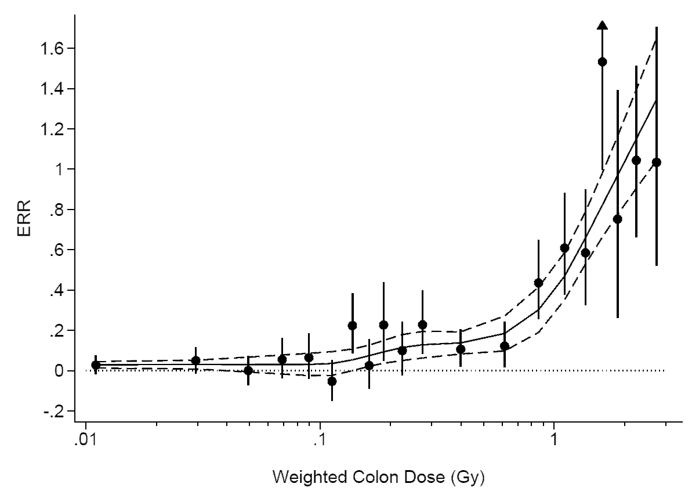
An Alternative View of the Japanese A-Bomb Survivor Data (through 2003) (Ozasa et al. 2013; Doss et al. 2012)
Notes:
Slide 20 - McClellan

Slide 21
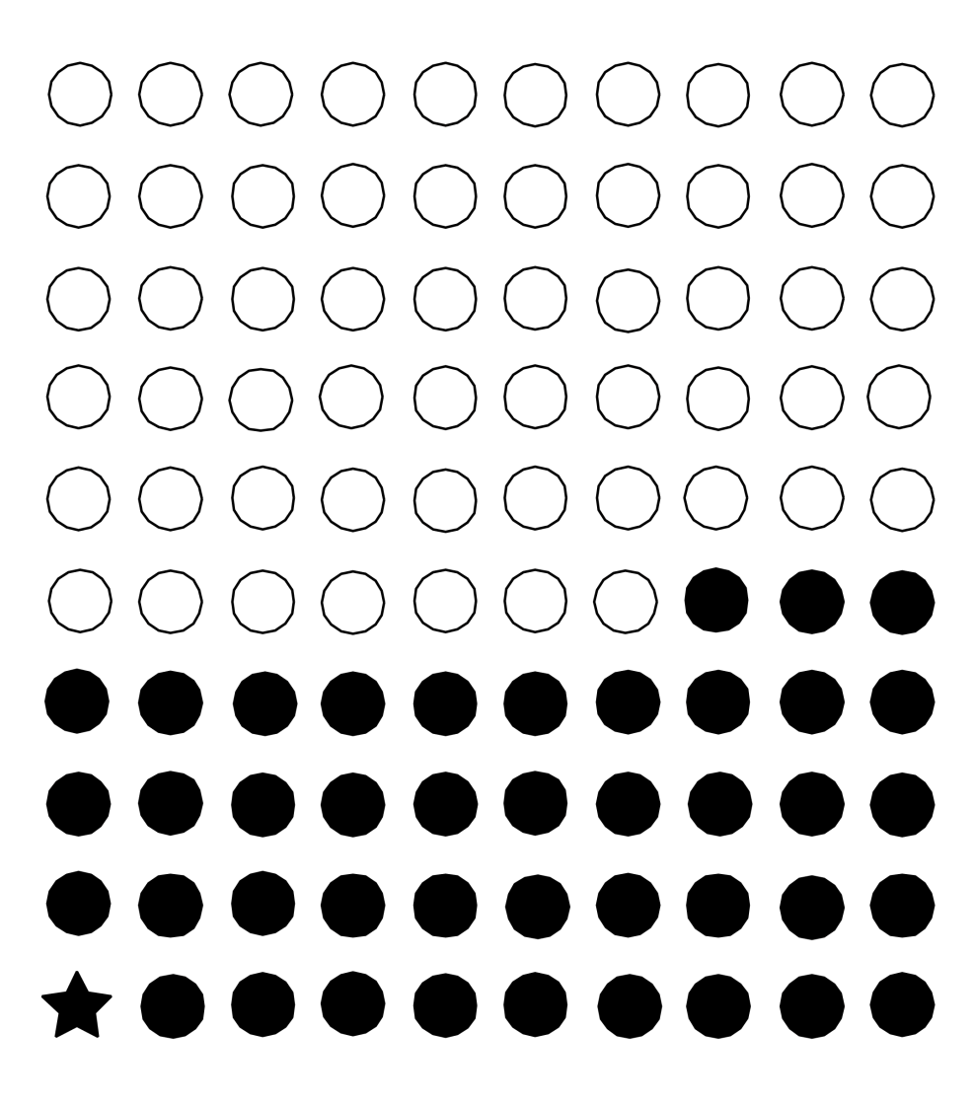
Linear no-threshold exposure – response model: Science or Policy? NAS/NRC Biological Effects of Ionizing Radiation VII (2006)
Lifetime cancer risk estimated for single exposure to 100 mSv of low-LET radiation
- Cancer cases
- Cancer case
from radiation
Excess cases are “identified” statistically
Notes:
Slide 50 - McClellan

Slide 22
National Institute for Occupational Safety and Health Chemical Carcinogen Policy, Current Intelligence Bulletin 68, December 2016
Builds on cancer hazard classifications conducted by:
- HHS National Toxicology Program
- EPA Integrated Risk Information System
- WHO International Agency for Research on Cancer
Based on premise – “that there is no known safe level of exposure to a carcinogen” and therefore that reduction of worker exposure to chemical carcinogens as much as possible “---” is the primary way to prevent occupational cancer.”
Shift from use of “Recommended Exposure Limit (REL)” to an initial starting point for control called the “Risk Management Limit for Carcinogens (RML-CA)”
For each chemical identified as a carcinogen, this level corresponds to the 95% lower confidence limit of the risk estimate of one excess case in 10,000 workers in a 45 year working lifetime
Striving for lower levels of exposure is recommended (sounds a lot like As Low As Reasonably Achievable)

Slide 23
Current Understanding of Radiation-Induced Disease
Late-occurring radiation-induced diseases occur in a “stochastic” (random) manner as very small increases in “spontaneous” diseases and have no unique radiation-related markers.
Epidemiological evidence is the cornerstone of our knowledge of radiation-induced disease and has come from studies of “human misfortune.”
Statistical limitations are critical barrier to understanding dose-response relationships for doses below 0.1 Gy or 0.1 Sv
Lifespan studies of radiation and radioactivity in long-lived laboratory animals has aided in extending the utility of the epidemiological findings.
Experimental studies of short duration in cells, tissues and laboratory animals focusing on “deterministic” endpoints from high dose rates and high doses have provided many interesting insights into the mechanisms of action of radiation, but have been of limited value in setting radiation protection standards. Contrast with relative risk approach of epidemiology.
Major breakthroughs in understanding diseases that occur late in life in a “stochastic” manner, such as those attributable to radiation as excess risk over background occurrence, will likely require use of research strategies that increasingly focus on “stochastic” steps and outcomes.

Slide 24
Conceptual *Framework Linking Events from Exposure to External Sources or Internally-Deposited Radioactivity to Dose to Biological Responses
*Grossly over-simplified in view of current state of knowledge. Critical need to link occurrence of multiple precursor events to ultimate occurrence of disease
Notes:
Slide 51 - McClellan

Slide 25
McClellan’s View of Current Radiation Protection Standards
Consistent with extraordinary body of scientific knowledge of radiation-induced disease in humans and other species
Numerical levels and over-arching use of “As Low As Reasonably Achievable” are prudent policy choices
Major conservative choices relate to dose dose rate effectiveness factor
Standards for radiation are informed by more extensive science base than exists for any other hazardous agent/factor
Major uncertainties in estimates of exposure and potency for other hazardous agents limits comparative risk analysis
Substantial opportunity for improved communication with other scientists and public at large

Slide 26
BACKUP SLIDES

Slide 27
Relative Contribution of Different Radiation Sources to the Average Radiation Dose Received by the U.S. Public for 2006 (NCRP Report 150, 2009)
Background Millisieverts (mSv ) Percent
Space radiation 0.31 5
Internal radionuclides 0.31 5
Terrestrial dose 0.19 3
Radon and thoron 2.29 37
Background 3.10 50
Anthropogenic
Computer tomography (CT) 1.49 24
Nuclear Medicine 0.74 12
Interventional fluoroscopy 0.43 7
Conventional radiography/fluoroscopy 0.31 5
Consumer products 0.12 2
Occupational <0.1 <0.1
Industrial <0.1 <0.1
Anthropogenic 3.10 50
TOTAL 6.20 100
Notes:
Slide 10 - McClellan

Slide 28
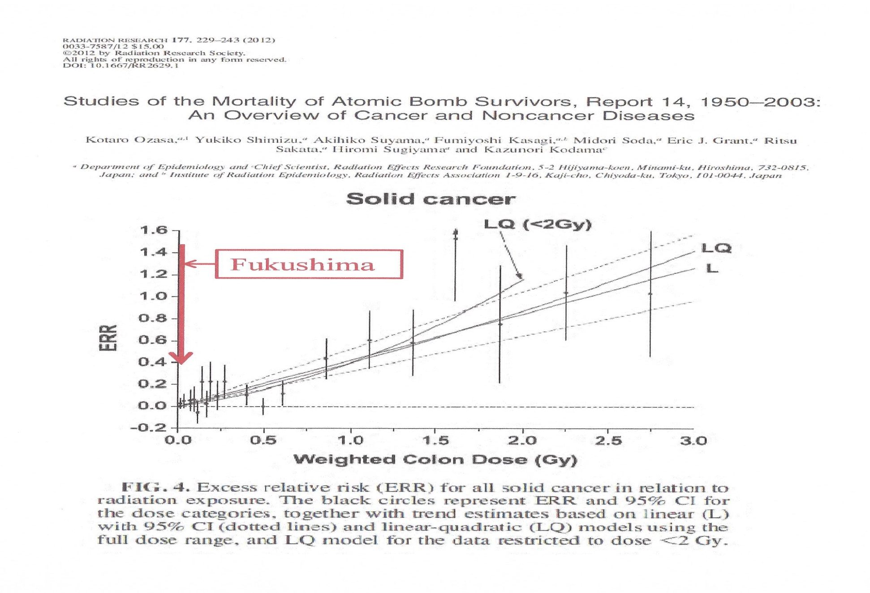
(Slide courtesy of Professor Shunichi Yamashita)
Notes:
Slide 21 - McClellan

Slide 29
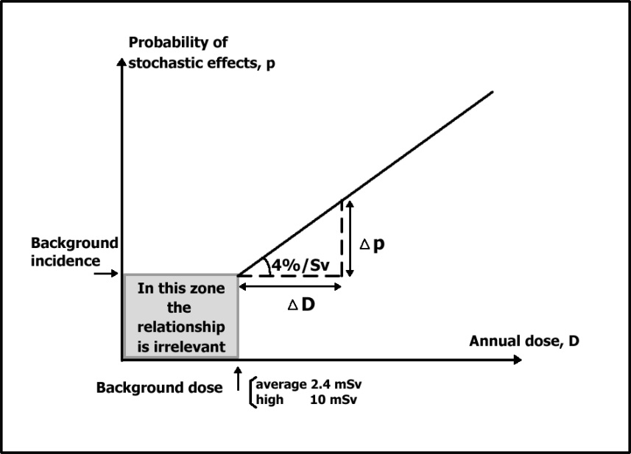
Region of the Dose-Response Curve when Risk Factors Apply
(Clarke 2008)

