Slide 1
NCRP Commentary 27: Implications of Recent Epidemiologic Studies for the LNT Model of Radiation Protection and for DREF
Conference on Radiation-Response Models and Low Dose Protection Standards
Pasco, WA October 2018
Roy Shore
NYU School of Medicine (Retired)
hrshore@gmail.com

Slide 2
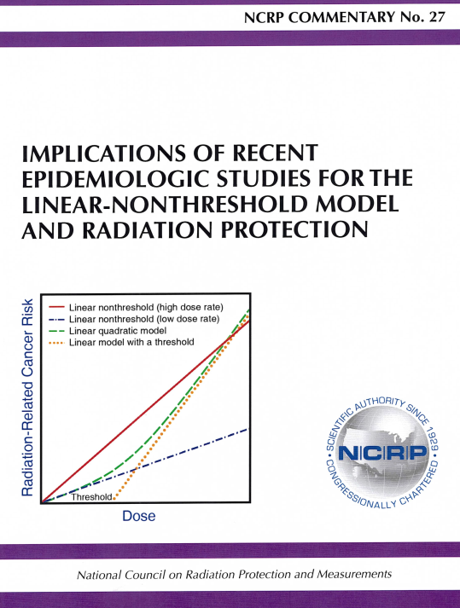

Slide 3
NCRP Conducted Reviews of Epidemiologic Studies regarding LNT, Primarily those with “Low Cumulative Doses or Low Dose Rates” (LDR) and Dose-Response Analyses

Slide 4
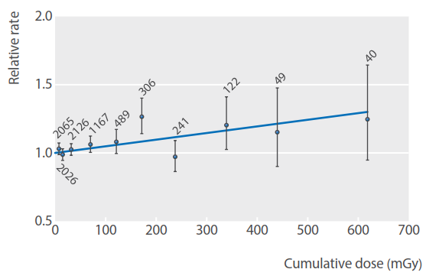
INWORKS: ‘All Cancer except Leukemia’ Mortality by Cumulative Doses in the Combined Nuclear Worker Cohorts from US, UK and Franceª
ERR Gy⁻¹ = 0.48 (90% CI 0.20, 0.79)
ª 308,000 workers (19,064 cancer deaths)
(Richardson et al, Br Med J 2015, 351: h5359)

Slide 5
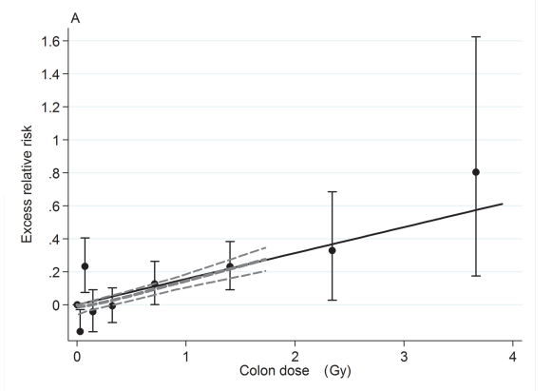
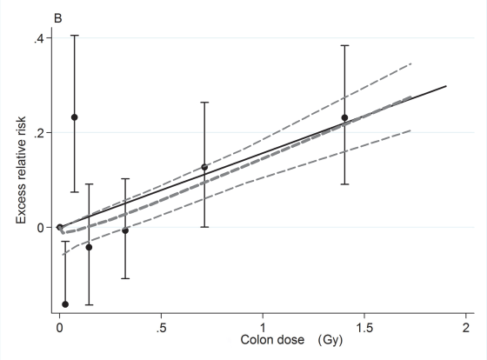
Mayak Workers – Cumulative External Radiation and Mortality from Solid Cancer (Excluding Lung, Liver and Bone – the main Plutonium deposition sites)
ERR Gy⁻¹ = 0.12 (95% CI 0.03, 0.21)*
Full Dose Range
Dose Range 0 – 1.5 Gy
* Risk estimate adjusted for estimated plutonium deposition; (1,825 cancer deaths)
(Sokolnikov, PLoS One, 2015;e0117784)
Notes:
9. Mayak D-R - No sig evidence for upward curvature – reasonably linear

Slide 6
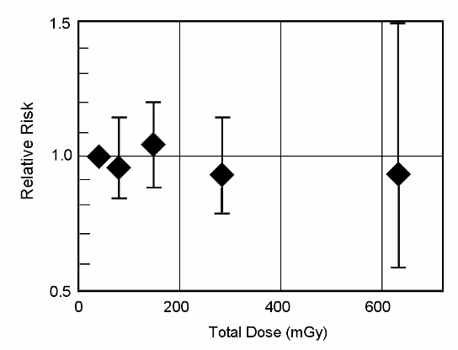
Relative Risk for Incidence of All Cancer except Leukemia by Cumulative Dose – High Natural Background Radiation Area in Kerala, India
(ERR at 1Gy: -0.13 (95% CI -0.58, 0.46)
Nair et al. Health Phys, 96:55-66, 2009; (1,349 cancer cases) Boice et al. Radiat Res, 173: 849-54, 2010
(Slide courtesy of John Boice, Jr.)
Notes:
12. Kerala D-R – No indicatn of rad risk.

Slide 7
NCRP Commentary No. 27: Review of LSS and Low-Dose or Low Dose-Rate (LDR) Epidemiologic Studies
Life Span Study (LSS) of Japanese Atomic Bomb Survivors
INWORKS (International Nuclear Workers Study)
Mayak workers
Million Person Study – U.S. nuclear power plant workers, industrial radiographers, Rocketdyne, Mound, U.S. atomic veterans, etc.
Japanese nuclear workers
Canadian nuclear workers
Chernobyl clean-up workers
Other Worker Studies – Chinese x-ray workers, U.S. radiologic technologists, French uranium processing workers
Techa River cohort
High Natural Background Areas – Kerala, India; Yangjiang, China
Taiwan residents of radiocontaminated buildings
Chernobyl and other radiation fallout studies
Pooled studies of low-dose external irradiation and thyroid cancer
Medical studies: Pediatric CT scans, TB multiple fluoroscopic exams
Notes:
15. Listing of studies or groups of studies considered – 29 studies or groups of studies
Nearly all the studies had low doses or low dose-rates.
Some of more important studies shown in colors

Slide 8
Critical Review of Individual Epidemiologic Studies in NCRP Commentary No. 27
Epidemiologic data & methodology – size of study; soundness of methods; potential for bias; epidemiologic uncertainties considered?
Dosimetry – data quality; methods; dose uncertainties examined?
Statistical methods & results – appropriate; statistical precision; evaluation of shape of dose-response?
Study strengths and limitations?
Implications for LNT and radiation protection?

Slide 9
Commentary No. 27: Evaluations of Epidemiologic Studies for Consistency with the LNT Model
Strong support – 5 studies (17%)
E.g., INWORKS (US, UK, Fr.) (Richardson 2015)
Moderate support – 6 studies (21%)
E.g., Mayak nuclear workers (Sokolnikov 2015, 2017)
Limited-to-Moderate support – 9 studies (31%)
E.g., Chernobyl clean-up workers, Russia (Kashcheev 2015)
No support – 5 studies (17%)
E.g., Kerala, India – high natural background radiation area (Nair 2009)
Inconclusive – 4 studies (14%)
E.g., CT examinations of young people, Australia (Mathews 2013), Nuclear weapons test fallout studies (Marshall Islands etc.)
Notes:
18. Ratings of Degree of support for LNT model
Nearly 70% provided some support for LNT, ranging from fairly-weak to strong.
Only 17% judged as providing no support.

Slide 10
All Solid Cancer, Mortality or Incidence: Excess Relative Risk (ERR) Gy⁻¹ in the Largest LDR Studies (>250 cancer cases)
-1
Mean Dose
(mSv)
A
[I]
[I] ^{B}
^{A} Nuc = nuclear workers ^{B} HBRA = high background radiation area
[I] = incidence data
-2 0 2
(Shore et al, Int J Radiat Biol, 93:1064-78, 2017)
Notes:
19. Found 23 LD/LDR studies with individual dose estimates and D-R analy of ERR.
ERRs for 12 largest studies. Mostly occup & 9/12 pos risk coeff.
Meta-analy heavily influenced by studies with narrow CI. – Mayak & INWORKS
Mostly occup studies, & 9/12 w positive coeff.
Fair amount of evidence of some risk at LD/LDR.

Slide 11
Analyses of Risk at Low Doses
(≤ 100 mGy)
Notes:
23. Mean doses in most LD/LDR studies are low (<50 mGy), but doses skewed & results tend to be influenced substantially by higher doses.
Analyses of data in restricted, low dose ranges. Only a few studies have published such analyses.

Slide 12
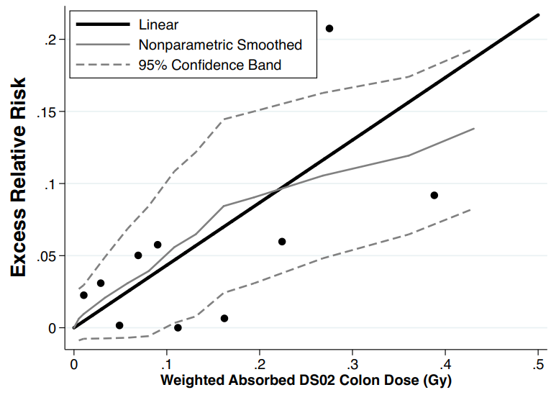
LSS Dose-Response at 0-100 mGy for Solid Cancer Incidence and Mortality, Sexes Combined
Solid Cancer Incidence
Dose Range | ERR Gy⁻¹ (95% CI)
Full dose range | 0.50 (0.42, 0.59)
0-100 mGy | 0.49 (0.026, 1.01)
Solid Cancer Mortality
(Numeric risk estimates from: Grant et al, Radiat Res, 187:513-37, 2017
Graph based on mortality data available online at http://www.rerf.jp, from LSS Report 14 (Ozasa, Radiat Res, 177:229-, 2012)
Notes:
25. LSS. Solid Ca mort. Can see no evidence of sub-linearity at doses <100 mGy.
Solid Ca incid. For sexes combined find stat sig positive risk over range 0-100 mGy.

Slide 13
Dose Response for Mortality from All Cancer except Leukemia, at Low Doses and Low Dose Rates
Range of Doses Included | Excess Relative Risk Gy⁻¹ (90% CI)
INWORKS Studyª
Full dose range | 0.48 (0.20, 0.79)
0–100 mGy only | 0.81 (0.01, 1.64)
Updated UK NRRW Study^{b}
Full dose range | 0.28 (0.06, 0.53)
0–100 mGy only | 1.42 (0.51, 2.38)
(ª Richardson et al, BMJ 2015, 351: h5359; ^{b} Haylock et al, Br J Cancer 2018, Online)
Notes:
NRRW = National Radiation Registry of Workers

Slide 14
Risk of Leukemia in LDR Studies
Notes:
27. Leuk. Have talked mainly about LD/LDR studies & solid cancer. What about leukemia?

Slide 15
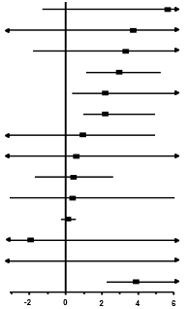
Non-CLL Leukemia^{A} Risks in Studies with LDR (Low-Dose/Low Dose-Rate) Exposures and ≥20 Leukemia Cases
Study | ERR/Gy (90% CI) | ERR/Gy (90% CI) | Mean Dose (mGy) | No. Leukemias
US NPPs nuc (Howe'04) ^{B} |  | 5.7 (-1.2, 26) | 26 | 26
Kerala, high background radiat (Akiba'13)[I] ^{C} |  | 3.7 (-276, 283) | 161 | 20
US Fernald U-processing nuc (Silver'13) |  | 3.3 (-1.7, 24) | 24 | 28
INWORKS (UK,US,Fr) nuc (Leuraud'15) |  | 3.0 (1.2, 5.2) | 16 | 531
Chernobyl clean-up, Ukr. (Zablotska'13) [I] |  | 2.2 (0.4, 6.7) | 82 | 52
Techa River, residents (Krestinina'13) [I] |  | 2.2 (1.0, 4.9) | 420 | 72
German U miners (Kreuzer'17) |  | 0.9 (-3.1, 4.9) | 48 | 120
US Rocketdyne nuc (Boice'11) |  | 0.6 (-4.1, 10) | 14 | 25
Chernobyl clean-up, Russ. (Ivanov'12) [I] |  | 0.4 (-1.7, 2.6) | 108 | 111
US Mound nuc (Boice'14) |  | 0.4 (-3.0, 6.0) | 26 | 26
Mayak nuc (Preston'17) |  | 0.1 (-0.2, 0.5) | 120 | 90
Japan nuc (Akiba'12) |  | -1.9 (-5.5, 6.9) | 12 | 80
US atomic veterans (Caldwell'16) |  | -50 (-125, 26) | 3.2 | 27
A-bomb LSS (exposed ages 20-39) (Hsu'13)[I] |  | 3.9 (2.3, 6.1) | 230 | 122
^{A} Leukemias, excluding chronic lymphocytic leukemia; ^{B} “nuc” = nuclear workers; ^{C} [I] = incidence; otherwise mortality. (ICRP TG-91, Shore et al, unpublished)
Notes:
Leuk. Looked for LD/LDR studies with D-R analyses of non-CLL leuk.
Found 13 LD/LDR studies with ≥ 20 cases of non-CLL leuk (+ US NPP & indust radiog).
11 of 13 reported positive risk coeff.
Can see LSS risk estimate for adult exposures, for comparison.

Slide 16
Final Considerations and Conclusions

Slide 17
Is the LNT Model Appropriate for Assessing Cancer Risk for Purposes of Radiation Protection?
LDR study-size constraints, dose uncertainties and epidemiological weaknesses limit the statistical power and precision of risk estimates, especially for data below 100 mGy.
Preponderance of LDR studies showed reasonable consistency with LNT for total solid cancer and evidence of risk for leukemia, but the data are not precise enough to fully exclude models with a dose-response threshold or strong upward curvature.
Only a few studies with evidence of no risk after low dose-rate exposures.
Thus much of the quantitative LDR epidemiological data broadly supports a LNT model, perhaps with a DDREF >1, for total solid cancer and leukemia.
NCRP committee concluded that the LNT model is prudent and practical for radiation protection purposes.
(Adapted from NCRP Commentary No. 27)
Notes:
29. Is LNT model appropriate for rad protectn?
Risk at low doses, little evidence of dose-response threshold or pure quadratic, or hormesis.
Need to qualify conclusions, because of uncertainties & weaknesses of data.
No sharply different alternative appears prudent for rad protectn.
We have tried to develop a knowledge-base to inform the choice of a dose-response model that is prudent to use.

Slide 18
Gratitude for Outstanding Group Efforts and Expertise to Address LDR Questions
NCRP SC 1-25 - LNT
L Dauer, co-chair
H Beck
J Boice
E Caffrey
S Davis
H Grogan
F Mettler
J Preston
J Till
R Wakeford
L Walsh
ICRP Task Group 91 - DREF
W Rühm, Chair
T Azizova
L Walsh
Notes:
Thanks to the colleagues with whom I’ve had the pleasure to work.

