Slide 1

Status of ICRP Committee 1 on Low Dose and Low Dose Rates for Ionizing Radiation
Applicability of Radiation-Response Models to Low Dose Protection Standards
American Nuclear Society &
Health Physics Society Joint Topical
Tri-Cities, Washington, US
October 1, 2018
Werner Rühm, Helmholtz Center Munich, Germany

Slide 2
ICRP Mission
To protect people and the environment from harmful effects of ionising radiation, without unduly limiting its beneficial use
Based on most recent scientific evidence
ICRP Committee 1 on „Radiation Effects“
Members with expertise in biology, genetics, human and veterinary medicine, mathematics and statistics, physics and dosimetry, epidemiology, and radioecology
Werner Rühm (Chair), Germany
Adrzej Wojcik (Vice-Chair), Sweden
Jacqueline Garnier-Laplace (Secretary), France
Tamara Azizova, Russia Ranajit Chakraborty, USA (deceased)
Wolfgang Dörr, Austria Michael Hauptmann, Netherlands
Kotaro Ozasa, Japan Preetha Rajaraman, India
Kazuo Sakai, Japan Sisko Salomaa, Finland
Mikhail Sokolnikov, Russia Dan Stram, USA
Quanfu Sun, China Richard Wakeford, UK
Gayle Woloschak, USA
*)
*)
*)
*)
2
*)
*) new since 07/2017
2

Slide 3
ICRP Committee 1, Task Group TG91
“Radiation Risk Inference at Low-dose and Low-dose Rate Exposure for Radiological Protection Purposes: Use of Dose and Dose Rate Effectiveness Factors”
Full Members
W Rühm (Chair) (Germany),
T Azizova (Russia),
S Bouffler (UK), M Little (USA)
R Shore (USA), L Walsh (Switzerland)
G Woloschak (USA)
Corresponding Members
B Grosche (Germany), M Kai (Japan),
K Ozasa (Japan), K Sakai (Japan),
Q Sun (China), A Gonzales (Argentina, consultant)
Workshop in Kyoto, Japan, in 2015: Brainstorming open questions and TG91 work
Transparency: To publish results first in the open literature and to give presentations on current status of work, followed by detailed ICRP report on the topic
Low Dose Effectiveness Factor (LDEF): Measure of deviation from linear dose response
Dose Rate Effectiveness Factor (DREF): Comparison of effects at low vs. high dose rates
Reminder (UNSCEAR definition): low dose rate: < 6,000 μGy/h
low dose: < 100 mGy
3

Slide 4
History – Governed by Advances in Science
UNSCEAR 1958
Mentions the distribution of ionizing radiation in time as important physical factor
“Opinions as to the possible effects of low radiation levels must be based only on extrapolations from experience with high doses and dose rates.”
UNSCEAR 1962
Information from the atomic bomb survivors was still limited
Animal experiments were considered important. However, their usefulness was judged limited “by the difficulty of making valid extrapolations … to man from animals …”.
UNSCEAR 1969
“Incidence of chromosome aberrations and that of tumours both increase with increasing dose, but the relationship between the two effects is complex.”
UNSCEAR 1977
From animal data, reduction factors between 2 and 20 were reported
Estimates of harmful effects in man should use data from human populations

Slide 5
.
.
.
Long story
e.g., NCRP (US), UNSCEAR, BEIR VII (US), ICRP, WHO, SSK (Germany), …
SENES Report 2017 (to be used in the US for compensation claims)
Suggested DDREF of 1.3 (50%) and a range of values of 0.47 – 3.46 (5% –95%)
Rühm, W., Woloschak, G. E., Shore, et al. (2015) Dose and dose-rate effects of ionizing radiation: a discussion in the light of radiological protection. Radiat Environ Biophys 54: 379-401
Review done ✓
(see also A. Gonzalez, Medical Radiology and Radiation Safety, 2017)

Slide 6
Review of typical dose rates and doses in radiobiological and epidemiological studies - Examples
Human cohorts – examples
General Population: 0.3 (0.1 – 1) μSv/h
Air crew: 2 (< 6) μSv/h
Astronauts: ∼18 μGy/h
Mayak workers: <150 μGy/h
Chernobyl clean-up: 320 μGy/h (first year)
Cellular studies
1,000 – 60,000 μGy/h
Animal studies
780 μGy/h – 22.6 Gy/h (US database)
1,350 μGy/h – 240 Gy/h (EC database)
2, 42, 830 μGy/h (IES, Japan)
For comparison – LSS Hiroshima
Kerma rates and kerma fia, various
sources, at 1,000 m distance
prompt sec. γ: 6.9 Gy/s (in 0.2 s), 1.38 Gy
delayed γ: 0.3 Gy/s (in 10 s), 2.77 Gy
Review done ✓
Rühm., W., Azizova, T., Bouffler, S., Cullings, H., Grosche, B., Little, M.P., Shore, R., Walsh, L., Woloschak, G. (2018) Typical Doses and Dose Rates in Studies Pertinent to Radiation Risk Inference at Low Doses and Low Dose Rates. J. Radiat Res 59 (S2): ii1-ii10

Slide 7
Review of Molecular and Cellular Studies (S. Bouffler)
Endpoints chosen that are considered relevant for carcinogenesis (preliminary)
DNA double strand break induction and repair
Gene mutation studies
Chromosomal aberration studies
Thresholds for cell cycle checkpoint activation & apoptosis
Provisional conclusions (still to be discussed…)
Chromosomal studies indicate DDREF values around 4
but …
Much time between induction of those changes and clinical presentation of cancer
Many processes could have a significant influence on the magnitude of DDREF.
S. Bouffler in Rühm, W., Woloschak, G. E., Shore, et al. (2015) Dose and dose-rate effects of ionizing radiation: a discussion in the light of radiological protection. Radiat Environ Biophys 54: 379-401
Paper published ✓

Slide 8
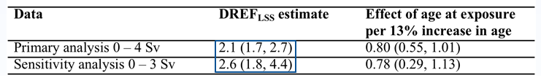
Evidence from animal studies
BEIR VII report based much on the Oak Ridge animal data set
Now: Use of large animal data sets for the first time ever possible including US
JANUS and EU ERA databases
Haley, B., Paunesku, T., Grdina, D.J., Woloschak, G.E. (2015) Animal Mortality Risk Increase Following Low-LET Radiation Exposure is not Linear-Quadratic with Dose. PLOS One, 10(12): e0140989
Paper published ✓
Pooled analysis, linear model, life-shortening (Woloschak et al., prelim.)
Paper submitted

Slide 9
TG91: Animal LDEF, DREF (Tran & Little, 2017)
Study based on animal mortality, among Janus mice
Gamma-Radiation, all tumors combined
LDEF: 0.86 (0.65; 1.24) – 1.06 (0.99 – 1.14) depending on dose rate
DREF: 1.19 (0.86 – 1.72)
Paper published ✓
Tran., V., Little, M.P. (2017) Dose and dose rate extrapolation factors for malignant and non-malignant health endpoints after exposure to gamma and neutron radiation. Radiat Environ Biophys 56, 299-328

Slide 10
Biologically-Based Mechanistic Models to Describe
Epidemiological Data
Example: The Two-Stage Clonal Expansion Model
Review initiated by TG91
14 low-LET studies, 14 high-LET studies
5 low-LET cohorts, 12 high-LET cohorts
Mainly TSCE, but recently also more sophisticated models

Slide 11
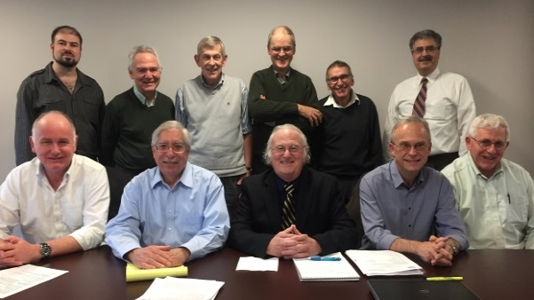
Conclusions - On the Use of Mechanistic Models
.
.
.
Long story
Uncertainties involved are still considerable
Current assumptions in radiation protection (including the LNT model) are not in contradiction to what is presently known on the process of cancer development.
Rühm, W., Eidemüller, M., Kaiser, J.C. (2017) Application of Biologically-Based Models of Radiation-Induced Carcinogenesis to Epidemiological Data. Int J Radiat Biol 93, 1093-1117
Paper published ✓
Nov 2017: NCRP Committee SC1-26
“Approaches for Integrating Biology and Epidemiology for Enhancing Low Dose Risk Assessment”
Chair: J Preston; Co-chair: W. Rühm
TG91 members

Slide 12
Update of Meta-Analysis of Low-Dose-Rate
Epidemiological Studies on Solid Cancer
22 low-dose-rate studies that can be compared to the LSS
Compute “matching” cancer risks in atomic bomb survivors according to sex, age at
exposure, grouping of cancer types and follow-up time
All cohorts together (mort + incidence): DREF consistent with 2 to 3
If Mayak is left out: DREF ~ 0.9 for mortality; ~ 1.3 for mortality + incidence
Shore, R., Walsh, L., Azizova, T., Rühm, W. (2017) Risk of Solid Cancer in Low-dose and Low Dose-Rate Radiation Epidemiological Studies and the Dose Rate Effectiveness Factor. Int J Radiat Biol 93, 1064-1078
Paper published ✓
(Results confirmed recently by D. Hoel, IJRB, 2018)

Slide 13
Analysis of dose response curvature in LSS mortality data (M. Little) Ozasa et al 2012
Solid cancer endpoint | Linear model | Linear-quadratic model
 | ERR/Sv (α) (+95% CI) | Linear ERR/Sv (α) (+95% CI) | Quadratic/linear term (β/α) ERR/Sv (+95% CI) | Ratio linear / linear from linear-quadratic | p-valueª
All solid | 0.277 (0.183, 0.385) | 0.233 (0.121, 0.380) | 0.105 (-0.087, 0.544) | 1.190 | 0.362
Female breast | 0.897 (0.294, 1.778) | 1.155 (0.355, 2.425) | -0.102 (-0.256, 0.200) | 0.777 | 0.330
Colon | 0.337 (0.068, 0.741) | 0.055 (-0.254, 0.364) | 1.787 (-10.536, 14.107) | 6.130 | 0.024
Liver | 0.304 (0.044, 0.593) | 0.380 (-0.066, 0.987) | -0.093 (-0.462, 0.275) | 0.801 | 0.721
Lung | 0.379 (0.148, 0.651) | 0.474 (0.155, 0.941) | -0.099 (-0.312, 0.376) | 0.800 | 0.480
Stomach | 0.140 (-0.024, 0.324) | 0.121 (-0.064, 0.374) | 0.081 (-0.223, 3.957) | 1.153 | 0.749
All solid except breast, colon, liver, lung, stomach | 0.257 (0.093, 0.480) | 0.194 (0.026, 0.508) | 0.163 (-0.173, 3.673) | 1.320 | 0.501
LDEF ~1.2 overall, depending on cancer sites
Indications of larger curvature over lower dose range (0-2 Gy)
In Rühm, W., Azizova, T. V., Bouffler, S. D., Little, M. P., Shore, R. E., Walsh, L., & Woloschak, G. E. (2016). Dose-rate effects in radiation biology and radiation protection. Ann ICRP 45(1S), 262-279
Paper published ✓

Slide 14
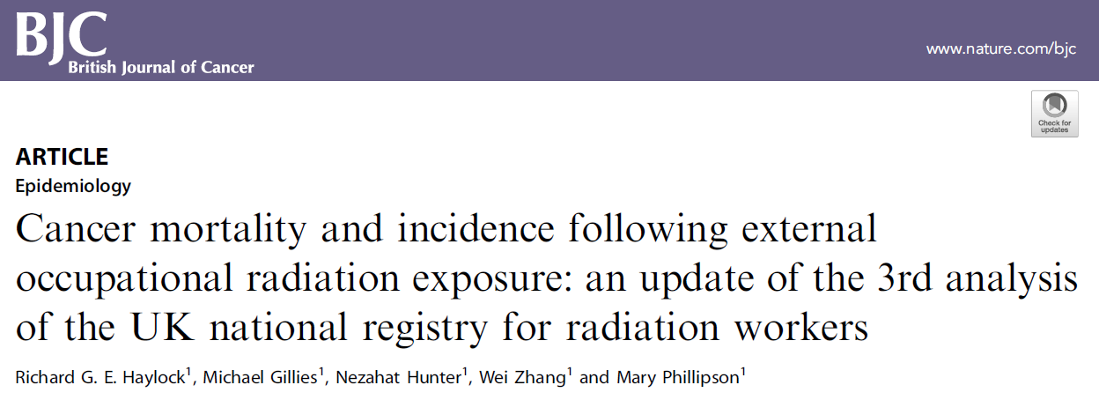
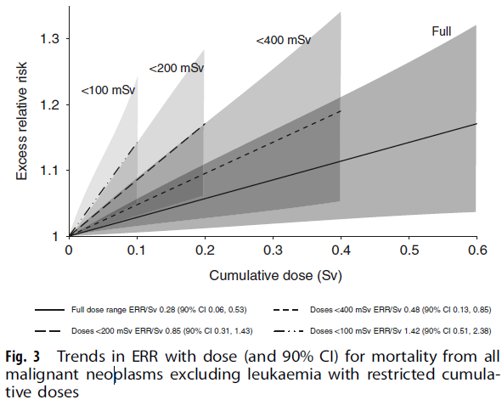
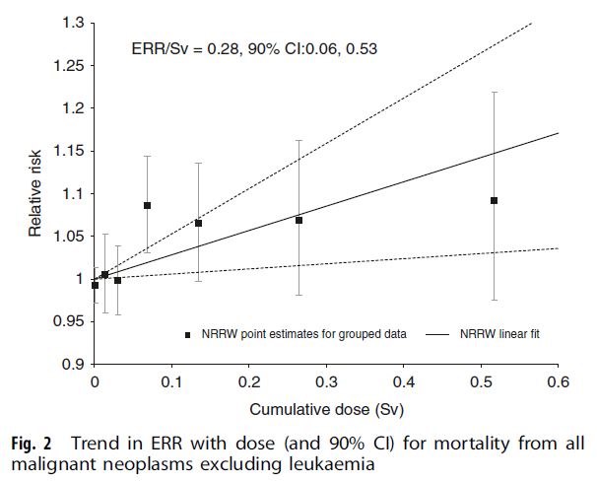
And the story continues!
Most Recent Epidemiological Data – E-pub Ahead of Print Aug 18, 2018

Slide 15
Summary and Conclusions
Required reviews done
History
Dose and dose rates
Biological models
TG91 work includes
Reviews
Own scientific analyses
Transparency
Publications in open literature
Presentations at various occasions
Preparation of TG report
Molecular and Cellular data
DREF ~ 4
Animal data, Janus, cancer mortality
LDEF ~ 0.9 – 1.1
DREF ~ 1.2
Animal data, Janus + ERA, life short.
DREF ~ 2.1 – 2.6
But …
Considerable uncertainties involved in any single estimate
Much remains to be done
Meta analysis epidemiological cohorts
DREF ~ 2-3 (all cohorts together)
DREF ~ 0.9 – 1.3 (Mayak left out)
Curvature LSS Mortality data
LDEF ~ 1.2
And … the story continues!

Slide 16
Acknowledgement
Full Members
W Rühm (Chair) (Germany),
T Azizova (Russia),
S Bouffler (UK), M Little (USA)
R Shore (USA), L Walsh (Switzerland)
G Woloschak (USA)
Corresponding Members
B Grosche (Germany), M Kai (Japan),
K Ozasa (Japan), K Sakai (Japan),
Q Sun (China), A Gonzales (Argentina, consultant)

Slide 17

THANK YOU!

Slide 18


