Slide 1

EPA Perspectives on Risk Projections for Low Dose and Dose Rate Exposures
David Pawel, Ph.D.
Office of Radiation and Indoor Air (EPA)
American Nuclear and Health Physics Society Topical
October 1, 2018

Slide 2
Outline
Some regulatory basics
What is LNT?
How is it used?
Why LNT?
What can go wrong?
Low dose and dose rate epidemiological studies: viable alternatives? What about bias?

Slide 3
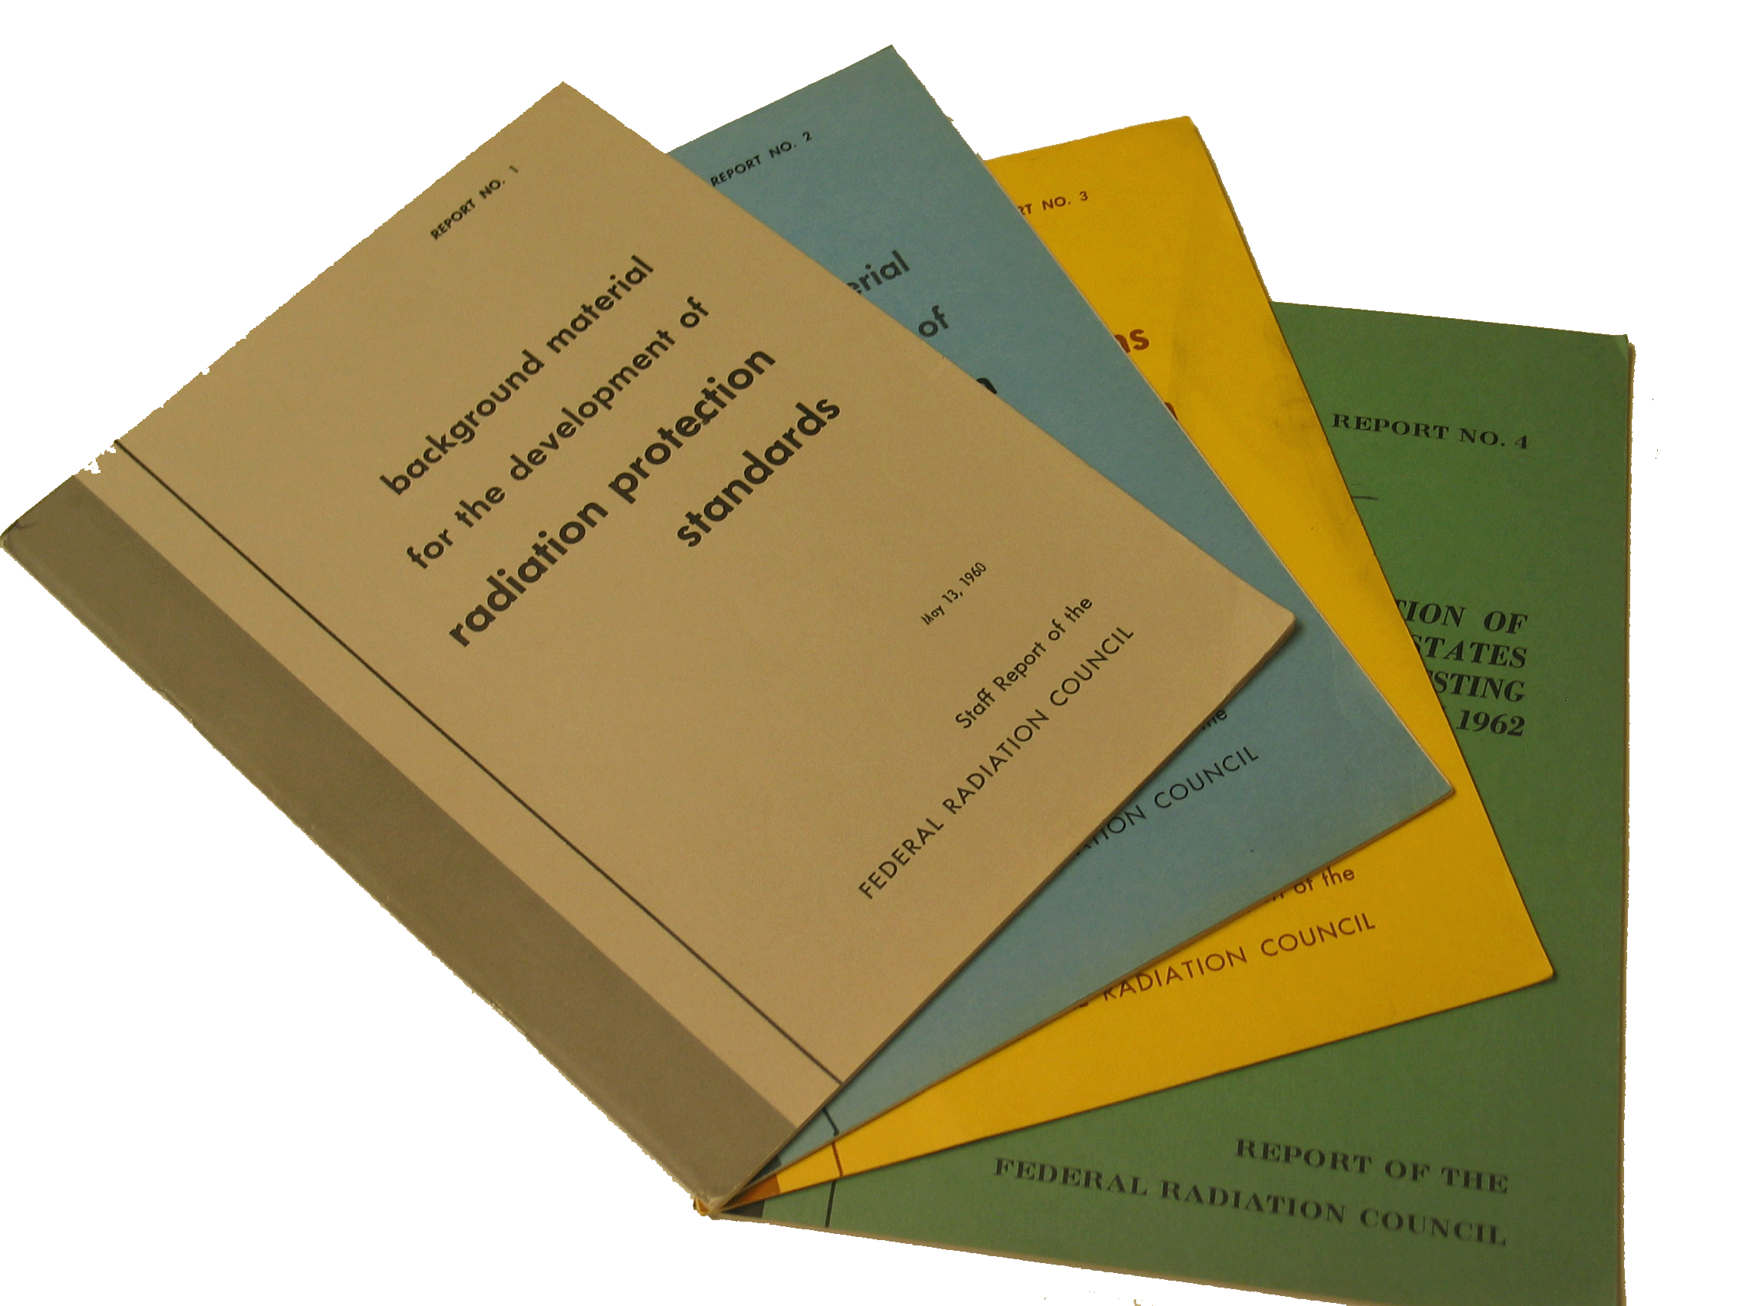
EPA’s Federal Guidance Authority
In 1970, federal guidance authority was transferred from the Federal Radiation Council to EPA. EPA provides advice to federal agencies in the formulation of radiation protection standards.

Slide 4
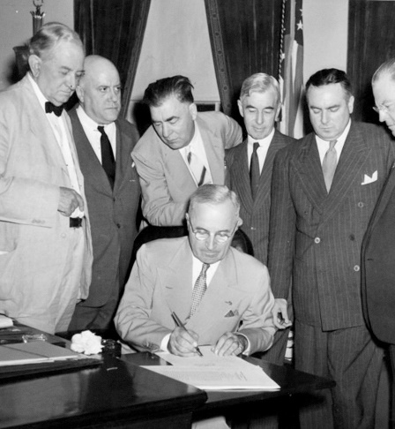
Statutory Drivers
Atomic Energy Act instructs EPA to consult:
National Academy of Sciences, National Council on Radiation Protection and Measurements
Qualified experts in biology medicine, and health physics.

Slide 5
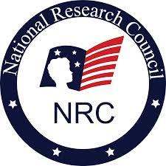

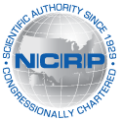
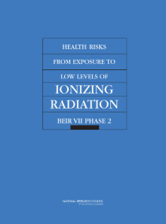

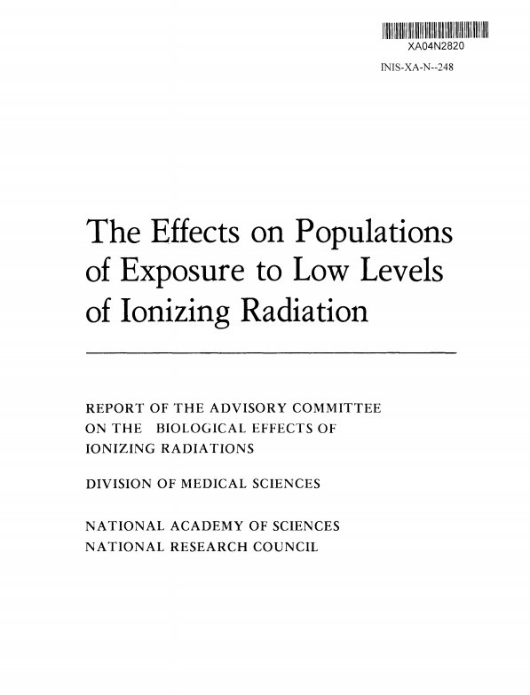
Support from Scientific Bodies
National Academy of Sciences
National Research Council (NRC)
International Commission on Radiological Protection (ICRP)
National Research Council (NRC)
Publication
BEIR VII Phase 2
National Council on Radiation Protection and Measurements (NCRP)
National Research Council (NRC)
The Effects on Populations of Exposure to Low Levels of Ionizing Radiation
United Nations Scientific Committee on the Effects of Atomic Radiation (UNSCEAR)

Slide 6



Limiting Radiation Risk to the Public
EPA’s mission is to protect human health.
To protect human health, EPA must estimate risk at low doses to limit risk of radiogenic cancers to a defined range.

Slide 7
Linear No Threshold (LNT) Model in Regulatory Radiation Protection
Despite uncertainties at low doses, the LNT model remains the most practical and implementable model for radiation protection.
EPA applies the LNT model to predict average cancer risks to representative populations, allowing risks to be summed across various exposure situations.
Cancer Risk
Radiation Dose
Low Doses

Slide 8
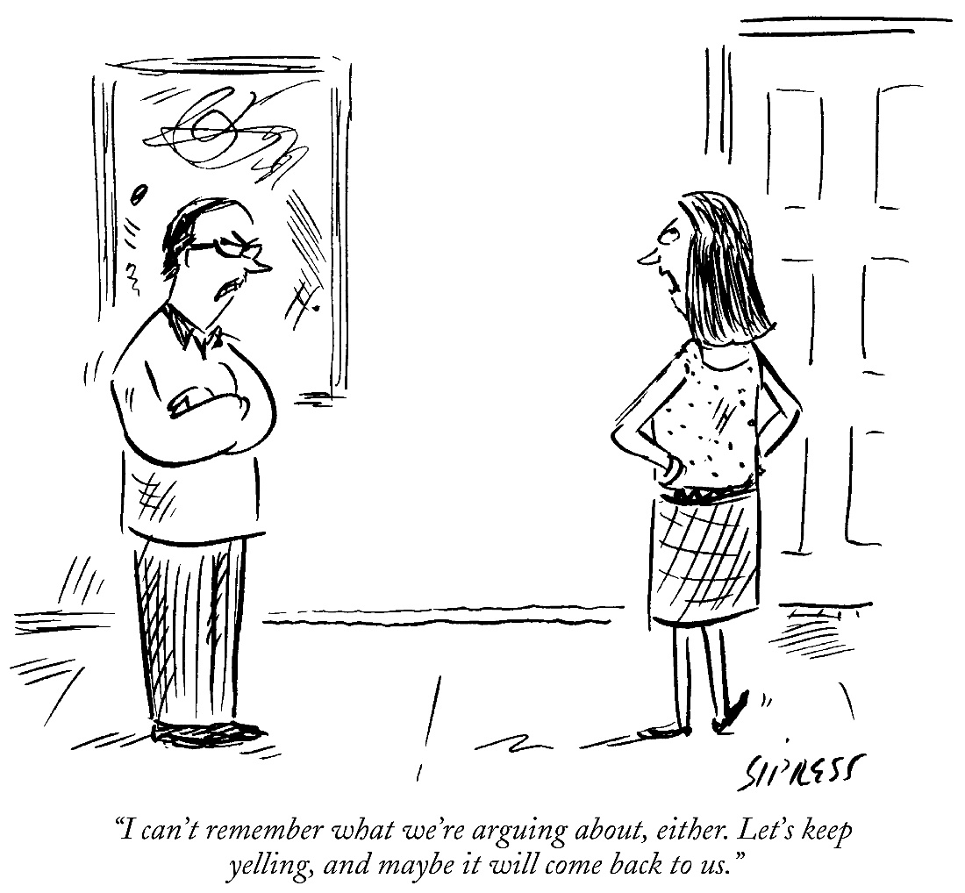
What is the LNT Model?
I can’t remember what we’re arguing about, either. Let’s keep yelling, and maybe it will come back to us.
David Sipress, New Yorker Magazine (from Condé Nast collection)

Slide 9
Linear No Threshold (LNT) Model
Excess risk of cancer at low doses is (approximately) proportional to dose
There is no threshold
Dose response models which satisfy the LNT hypothesis include
Models that are linear over a range of doses and with no threshold !!!!
Linear-quadratic (LQ) models

Slide 10
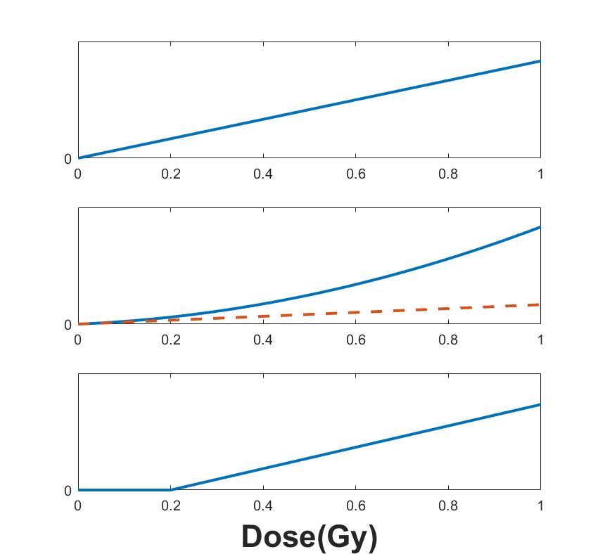
Which Satisfy the LNT Model?

Slide 11
How is LNT Used to Estimate Risks for LD/LDR Exposures?
Current LD low-LET risk projections (UNSCEAR, BEIR VII, EPA) are based on interpolations/extrapolations.
Risk models fit to Atomic Bomb Survivor data
Assume LQ dose response (sometimes with additional term(s), e.g., for cell killing
In theory can use other type of parametric models
Most models considered satisfy LNT

Slide 12
WHY Do We USE this approach?

Slide 13
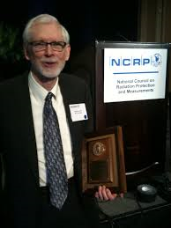
Sample Size (and other!) Requirements
Estimating Cancer Risks from Low Doses of Ionizing Radiation: “Precise direct estimation of small risks requires impracticably large samples.”
Land (1980)

Slide 14
Some “Impracticably Large” Sample Requirements
Does the radiation from mammography (about 10 mGy) cause breast cancer?
Cohort study: about 100 million (20 y follow-up)!
Case-control: about 1 million cases (4:1 ratio)
at 100 mGy, 1 million (cohort); 10K (case-control)
Does radiation cause leukemia?
Much smaller baseline rate
About 1300 cases (assume 1 rad to bone-marrow)

Slide 15
Is Sample Size the Whole Story?
NO!*
“Subtle sources of bias … may be comparable in effect to exposure. Increasing sample size cannot compensate for such bias, and may in fact add to difficulties … On the other hand, when the excess risk due to radiation is high, such biases often can be ignored.” (Land 1980)
*Marcel Marceau, “Silent Movie”

Slide 16
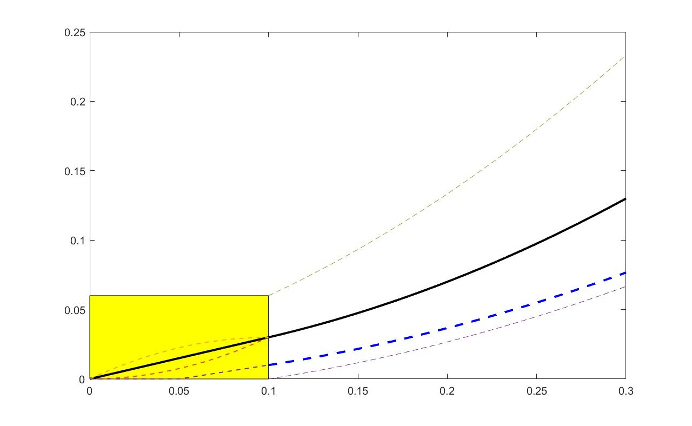

What Could Possibly Go Wrong? (Model Misspecification)

Slide 17
No Better Alternative?
Dr. Land (1980): “There seems to be no way to evade the problem of curve fitting and extrapolation from high-dose estimates of excess risk.”
“We do not have the resources for adequate epidemiologic studies of populations exposed to low doses of radiation …”
But NOW with technological advances such as computerized medical record keeping …

Slide 18
Recent Studies with Sufficient Power
Higher doses, lower dose rates
Techa River, Mayak, Chernobyl, …
Large low dose studies
CT studies (Great Britain, Australia …)
Childhood leukemia natural background studies
Pooled analyses
Nuclear workers (INWORKS)
Radon residential case/control
“Stay Tuned”: Million Person Studies

Slide 19
For Future (UNSCEAR, BEIR) Reports on Radiation Risk
What epidemiologic data should new risk projections be based on?
LSS, Subset of low dose rate studies, or Both
What type of approach might be used for deriving the projections?
Pooled, Meta, or …
But what about that problem of bias?

Slide 20
Low Dose vs. Low Dose Rate Studies
Assertion: Low dose studies have the potential for large bias in radiation cancer risk estimates
Exception: Radiosensitive cancers/subpopulations
Pooling/meta analyses increase precision but, in general, do not necessarily reduce bias
Prefer low dose rate studies that include subjects with moderate to large doses
Risks at low doses vs. risks at low dose rates?

Slide 21
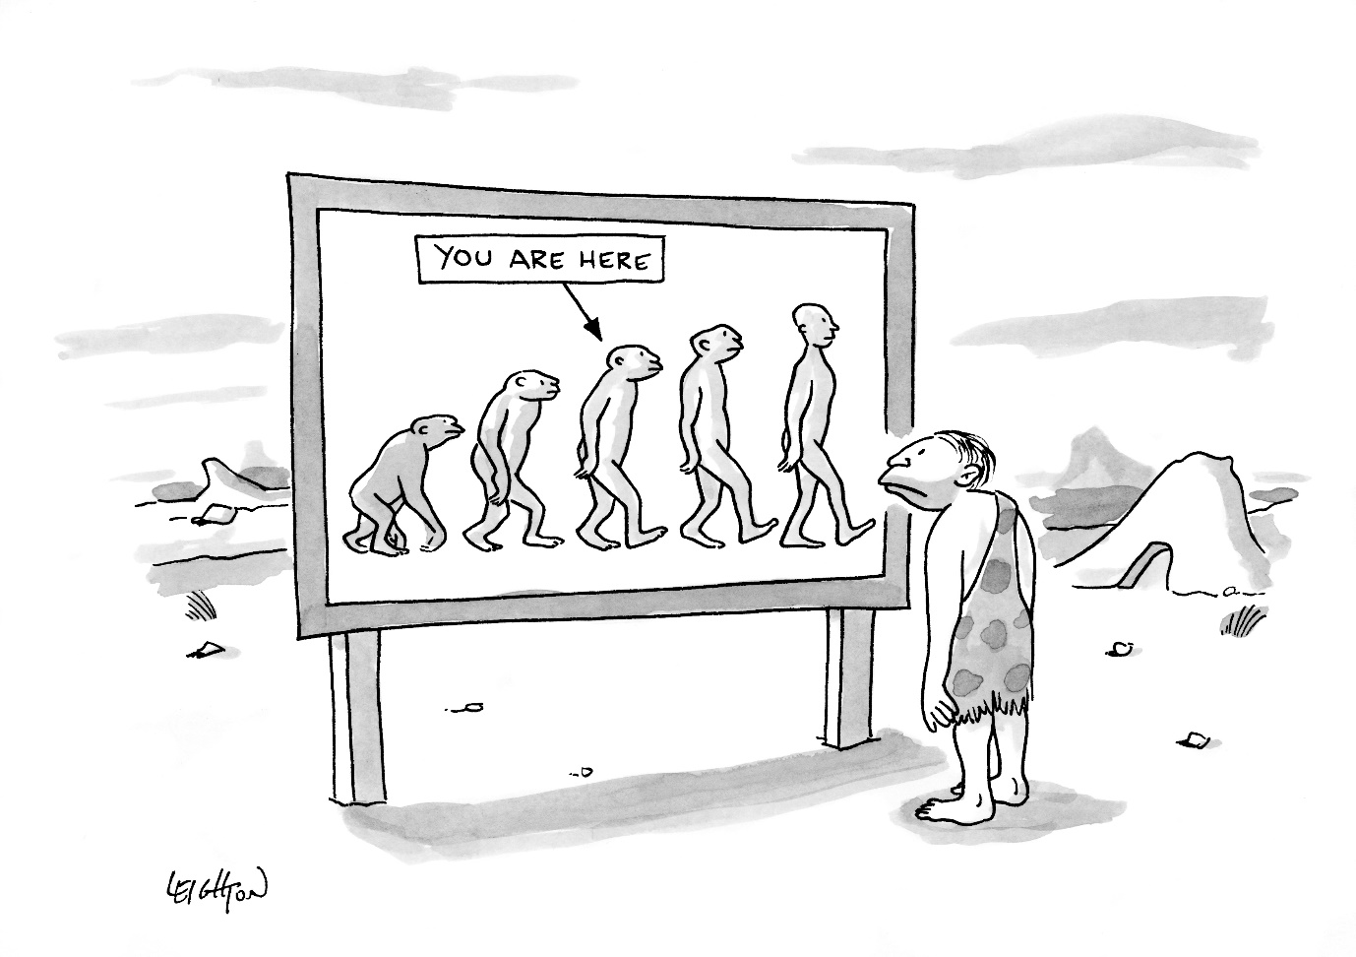
Interpreting Results from Epidemiological Studies is Difficult
Robert Leighton, New Yorker magazine (from Condé Nast collection)

Slide 22
NCRP (2018): Implications of Recent Epidemiological Studies for the LNT Model
“The most recent epidemiologic studies show that the assumption of a dose-threshold model is not a prudent pragmatic choice for radiation protection purposes. The consistency of the better-designed and larger studies with dose-response functions that are essentially linear or LQ, argues for some risk at low doses.”

Slide 23
Conclusions and Additional Remarks
Use LNT to project risks at low doses: Excess risk of cancer at low doses is proportional to dose.
Land: “Precise direct estimation of small risks requires impracticably large samples.”
Also warned about bias in low dose studies
Still? Prefer “low dose rate” studies to low dose” studies
Study of radiation effects involves many disciplines
Most of us strive to be competent in one
What about Adverse Outcome Pathways?
No chain is stronger than its weakest link …

Slide 24
What is the Lowest Dose at Which Cancer Risk is Shown in the LSS?
LSS (Grant et al 2017): “The lowest dose range that showed a statistically significant dose response … was 0-100 mGy (p=0.038).”
Estimated ERR at 0.1 Gy is about 0.05.
Are these slightly elevated cancer rates evidence of radiation risk or something else?

Slide 25
Survivors within 3 km
Courtesy of Dale Preston

Slide 26
What if Baseline Cancer Rates are Correlated with Dose?
Suppose survivors with doses ≤ 0.1 Gy were exposed (at 0.1 Gy) or not exposed (0 Gy).
Suppose the ERR at 0.1 Gy is about 0.05.
In Hiroshima, the “non-exposed” live closer to the edge of the city. If the baseline cancer risk is just 2% higher at these locations, the “corrected” P-value would be about 0.2.

