Slide 1
The IAEA Safety Standards
presented at
Applicability of Radiation-Response Models to Low
Dose Protection Standards
Pasco, 1-3 October 2018
Tony Colgan
Head, Radiation Protection Unit

Slide 2
Mandate of IAEA
IAEA Statute (Article III.A.6)
6. To establish or adopt, in consultation and, where appropriate, in collaboration with the competent organs of the United Nations and with the specialized agencies concerned, standards of safety for protection of health and minimization of danger to life and property (including such standards for labour conditions), and to provide for the application of these standards to its own operation as well as to the operations making use of materials, services, equipment, facilities, and information made available by the Agency or at its request or under its control or supervision; and to provide for the application of these standards, at the request of the parties, to operations under any bilateral or multilateral arrangements, or, at the request of a State, to any of that State's activities in the field of atomic energy

Slide 3
Mandate of IAEA
IAEA Statute (Article III.A.6)
6. To establish or adopt, in consultation and, where appropriate, in collaboration with the competent organs of the United Nations and with the specialized agencies concerned, standards of safety for protection of health and minimization of danger to life and property (including such standards for labour conditions), and to provide for the application of these standards to its own operation as well as to the operations making use of materials, services, equipment, facilities, and information made available by the Agency or at its request or under its control or supervision; and to provide for the application of these standards, at the request of the parties, to operations under any bilateral or multilateral arrangements, or, at the request of a State, to any of that State's activities in the field of atomic energy

Slide 4
Mandate of IAEA
IAEA Statute (Article III.A.6)
6. To establish or adopt, in consultation and, where appropriate, in collaboration with the competent organs of the United Nations and with the specialized agencies concerned, standards of safety for protection of health and minimization of danger to life and property (including such standards for labour conditions), and to provide for the application of these standards to its own operation as well as to the operations making use of materials, services, equipment, facilities, and information made available by the Agency or at its request or under its control or supervision; and to provide for the application of these standards, at the request of the parties, to operations under any bilateral or multilateral arrangements, or, at the request of a State, to any of that State's activities in the field of atomic energy

Slide 5
IAEA Safety Standards
Not binding on Member States but may be adopted by them
Binding for IAEA’s own activities
Binding on Member States in relation to operations assisted by the IAEA
Binding on Member States entering into project agreements with the IAEA
The IAEA SAFETY STANDARDS: THE GLOBAL REFERENCE
FOR PROTECTING PEOPLE AND THE ENVIRONMENT

Slide 6
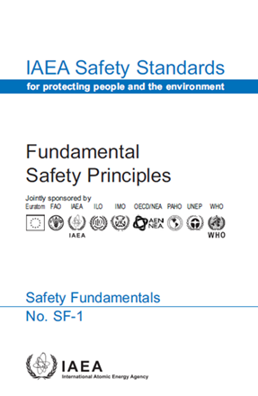
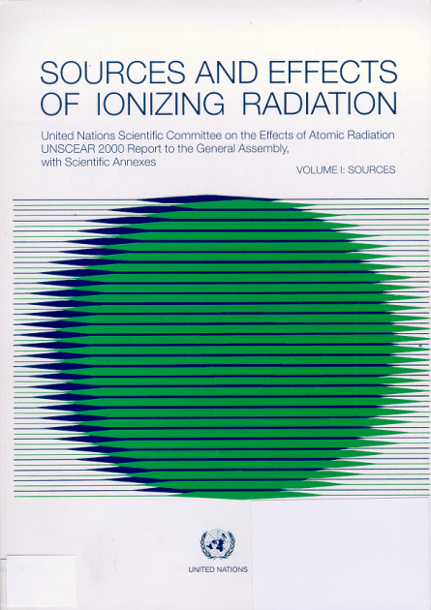
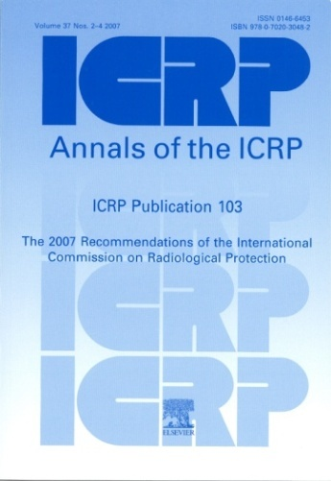
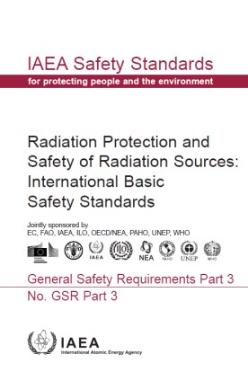
International Basic Safety Standards
Notes:
6
The revised BSS will be based on:
the scientific evidence analysed by UNSCEAR,
the recommendations of ICRP, and
the Fundamental Safety Principles.
The new Safety Requirements will include all the essential prescriptive criteria for radiation safety that underpin publications in the Safety Standards Series, such as: requirements defining responsibilities for safety; measures for protection of workers, patients and the public; numerical values of dose limits, action levels, exemption levels, etc. These basic requirements apply across the spectrum of circumstances of exposure to radiation, including nuclear power generation, industrial applications of radiation technology, radioactive waste disposal, and transport of radioactive material.

Slide 7
Basis for the IAEA Basic Safety Standards
“The Agency's basic safety standards will be drawn up in accordance with the provisions of Article III. A. 6 of
the Statute and will be based, to the extent possible,
on the recommendations of the International Commission
on Radiological Protection (ICRP).”
Source: IAEA Board of Governors, INFCIRC/18 (31 May 1960)

Slide 8
IAEA Safety Standards
Safety Fundamentals
high level underlying principles
Safety Requirements
specify obligations and responsibilities
(“shall” statements)
recommendations to support requirements (“should” statements) based on international best practices
Safety Guides

Slide 9
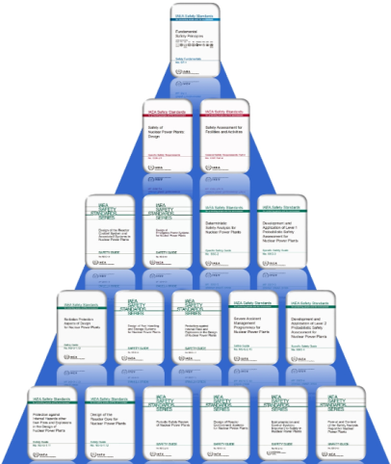
Co-sponsorship of the Safety Standards
Enhances the quality and consistency of advice given to national authorities
Enhanced exchange of information on the work activities of the cosponsoring organizations in relation to the need for the development, or review and revision of safety standards, and on their experience in the application of the safety standards
Facilitates applicability outside IAEA Member States

Slide 10
International Basic Safety Standards
Radiation Protection and Safety of Radiation Sources: International Basic Safety Standards published as GSR Part 3 in 2014
Key safety requirements for radiation safety
Applies to all facilities and all activities
Covers all three exposure situations – planned, emergency and existing
Covers all categories of exposure – workers,
patients, public and environment
Addresses both natural and man-made radioactivity

Slide 11
Role of the IAEA in Radiation Safety
While safety is a national responsibility, the IAEA safety standards
serve as a global reference for Member States
deliver a harmonized high level of safety for protecting people and the environment from the harmful effects of ionizing radiation
ensure sustainable continuous improvement through effective feedback on experience in application

Slide 12
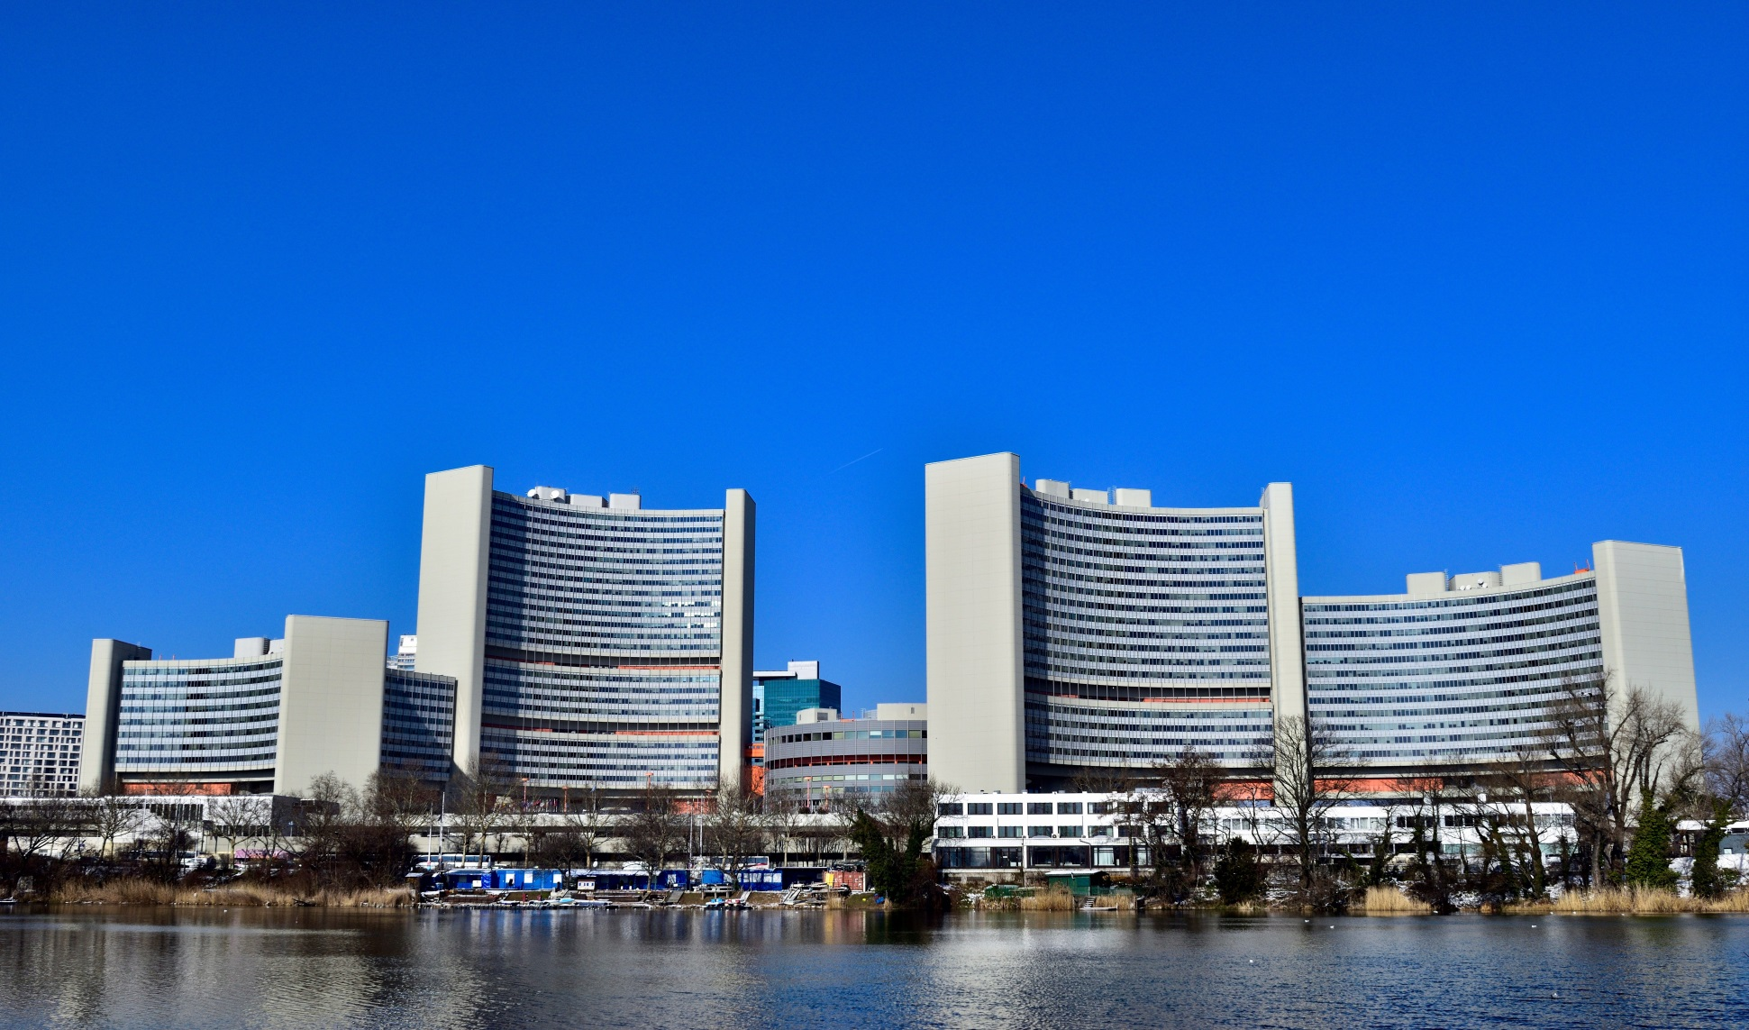
Thank You!

