Slide 1
Disclaimer
Some of the views and observations expressed in this session are my own and may not represent those of my employer, the South Australian govt.

Slide 2
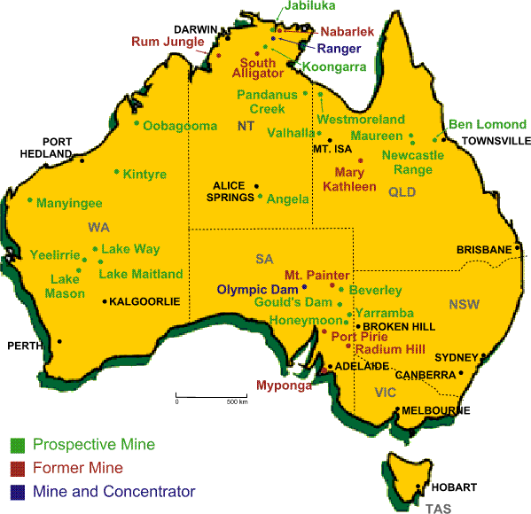
South Australia's involvement with radiation
Radium/uranium first mined in SA in 1906 at Radium Hill and Mt Painter
Olympic Dam
largest uranium deposit in world
4th largest copper
also mines gold/silver
Maralinga British atomic test site
1956 – 1963
7 nuclear tests
Approx 700 sub-critical tests
Intensive clean-up undertaken
Proton therapy
Will be first in southern hemisphere

Slide 3
Short answer = YES…..but
Can Regulators Accommodate an Alternative Dose-Response Paradigm? An Australian perspective.
We already decide what we want to regulate and how, primarily based on resource issues (and to a small extent radiation risk), however it is not uniformly implemented across jurisdictions and often modality specific.
Leads to non-uniformity and confusion on actual risks of radiation
eg IAEA GSR Part 7 Preparedness and Response for a Nuclear or Radiological Emergency
  Communication disaster waiting to happen??

Slide 4
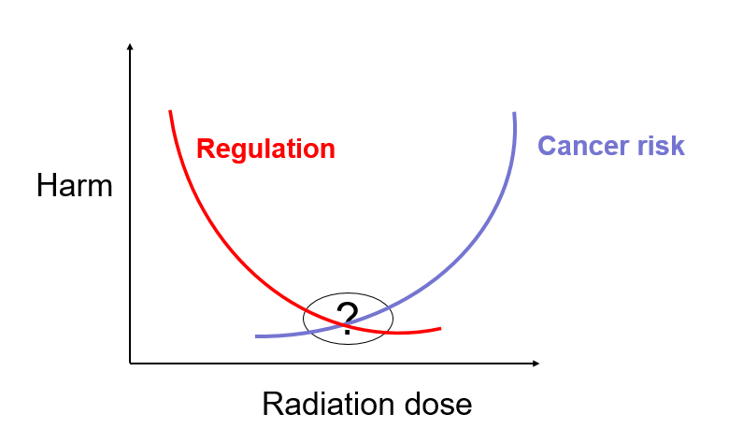
Risk based regulation
“The aim of risk-based approaches for regulators is to reduce the cost, to the regulator and the businesses they regulate, of ensuring compliance.”
  Regulator Audit Framework, Productivity Commission, March 2014
“Adopting an appropriate risk-based approach can assist a regulator in minimising compliance costs for regulated entities, streamlining interactions between them and regulated entities, and enhancing the benefits derived for the community.”
  Regulator Performance Framework, 29th October 2014
We talk about radiation regulation based on ALARA, but in most instances we do not take social and economic factors into consideration when making regulations

Slide 5
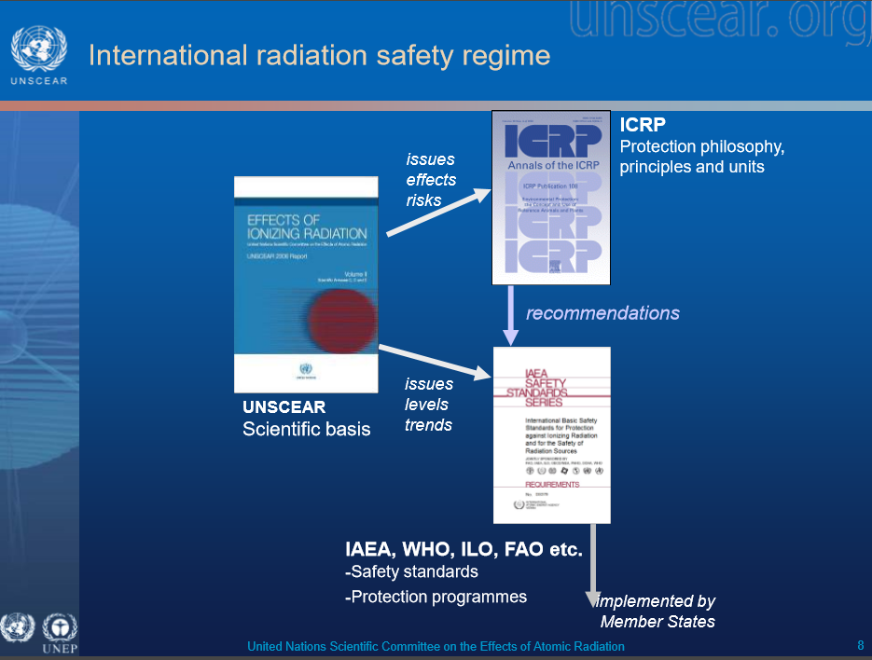
Govt owns the legislation and they decide on the legislative reform program – not the regulator
Would take a brave politician to move away from “international best practice”
  No votes here if it goes wrong!
Any change would need to be driven by ICRP, NCRP, IAEA, UNSCEAR
  Or by the public?? Votes here!!
Needs to be publically acceptable!!
  This requires a lot of communication

Slide 6
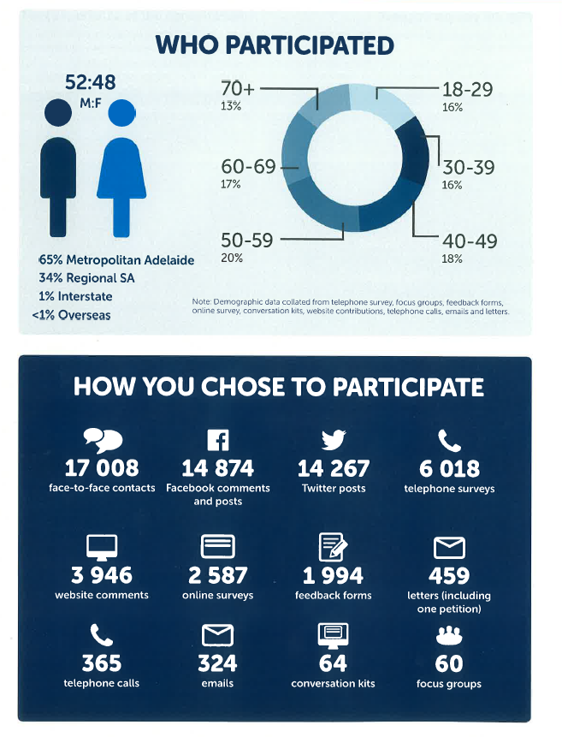
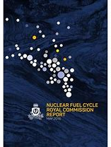
March 2015 – May 2016
http://nuclearrc.sa.gov.au/
May 2016 – November 2016
http://nuclear.yoursay.sa.gov.au/

Slide 7
