Slide 1
Overview of the
Russian Health Studies Program and
Summary of Key Research Findings
Barrett N. Fountos, M.S.
Program Manager
U.S. Department of Energy
Office of Environment, Health, Safety and Security (AU-1)
Office of Health and Safety (AU-10)
Office of Domestic and International Health Studies (AU-13)
October 1, 2018

Slide 2
Outline
Purpose and Objectives
Background
History of the Program
Scientific Oversight
Ongoing Research
Status and Current Results
Key Observations
Path Forward
Further Information

Slide 3
Background
The Office of Health and Safety (AU-10) of the U.S. Department of Energy (DOE) is responsible for protecting DOE nuclear workers and residents in communities surrounding DOE sites across the USA
As part of this broad mandate, AU-10 sponsors and manages extramural research programs to provide data on the health effects of ionizing radiation:
Japan Program/Radiation Effects Research Foundation (RERF) Study of the Japanese Atomic Bomb Survivors in Hiroshima and Nagasaki, Japan
Marshall Islands Medical Surveillance and Environmental Monitoring Program
Russian Health Studies Program
Palomares, Spain Medical Surveillance and Environmental Monitoring Program
Chernobyl Radiation Health Effects Research Program

Slide 4
Background Current Radiation Protection Standards
The NRC Annual Whole Body Dose Limit for:
Workers is 5 rem (50 mSv)
Public is 0.1 rem (1 mSv)
Radiation health effects researchers consider cumulative exposures of 0 to 10 rem (100 mSv) to be low doses
Most crucial issue in radiation research:
Determination of the effects on human health of exposures of less than 5 rem (50 mSv) per year
Such exposures are more likely to have been received by DOE workers and surrounding populations
Other key issues: Dose rate (low versus high); Time period (acute versus chronic exposures); Degree of protection: sufficient, over, or insufficient

Slide 5
Background Basis for Current Radiation Protection Standards
Current radiation protection standards are mainly based on high-quality data from studies of the Japanese Atomic Bomb Survivors and on patients who received medical radiotherapy treatments
For many years, DOE funded research across DOE former weapons production sites across the USA:
No consistent pattern of cancer emerged across the sites either in workers or in residents in communities surrounding these sites.
Primarily due to lower exposure levels and therefore lower observed cancer risks.
The magnitude of the radionuclide releases and exposures from the Chernobyl Nuclear Power Plant accident of April 26, 1986, led to increased interest in the adverse effects of ionizing radiation on human health and the environment, not just around nuclear power plants, but also around nuclear weapons production plants

Slide 6
Background The Role of Epidemiology and Dosimetry in Assessing Radiation Risks
Epidemiology and dosimetry are the key components of radiation health effects research in humans
Epidemiology is the study of the distribution and causes of diseases in groups of people with the goal of determining whether causal relationships exist between an exposure to an agent and the subsequent development of illness or disease in a host
Epidemiologists employ a variety of tools to assess the statistical likelihood of relationships between exposures and diseases
An epidemiological study is a screening tool with a certain sensitivity and specificity
The higher the radiation dose, the greater the likelihood of detecting adverse effects

Slide 7
Background The Role of Epidemiology and Dosimetry in Assessing Radiation Risks, Cont’d.
In radiation protection, dosimetry is the measurement, calculation, and assessment of the ionizing radiation dose absorbed by the human body, whether from internal exposures due to ingested or inhaled radioactive substances or from external exposures due to irradiation by sources of radiation, or a combination of both
Assessment of internal exposures relies on a variety of monitoring, bioassay, or biokinetic modeling techniques
Assessment of external exposures is based on measurements with a dosimeter or inferred from measurements made by other radiological protection instruments
Dosimetry involves reconstructing individual doses and uncertainties about the doses from exposure to external and internal ionizing radiation
To generate accurate cancer risk estimates, it is imperative to reconstruct as accurately as possible individual worker or environmental doses and to determine the uncertainty about those individual dose estimates

Slide 8
Background Rationale for Studying Mayak Workers and Residents in Surrounding Communities
DOE decided to study the risks of ionizing radiation which occurred from occupational and environmental exposures from the Mayak Production Association (Mayak), the first Soviet nuclear weapons production facility located in the formerly secret and still closed city of Ozersk in the Southern Urals region of Russia
Mayak workers had occupational exposures 100 to 1,000 times higher than U.S. weapons production and commercial nuclear power plant workers
Residents in communities along the Techa River had chronic exposures to low doses from releases of liquid radioactive wastes into the river and airborne releases from:
Mayak stacks from 1948 to 1982;
An explosion of a liquid radioactive waste cooling tank in 1957; and
Resuspension of radionuclides from a dry lakebed during a tornado in 1967

Slide 9

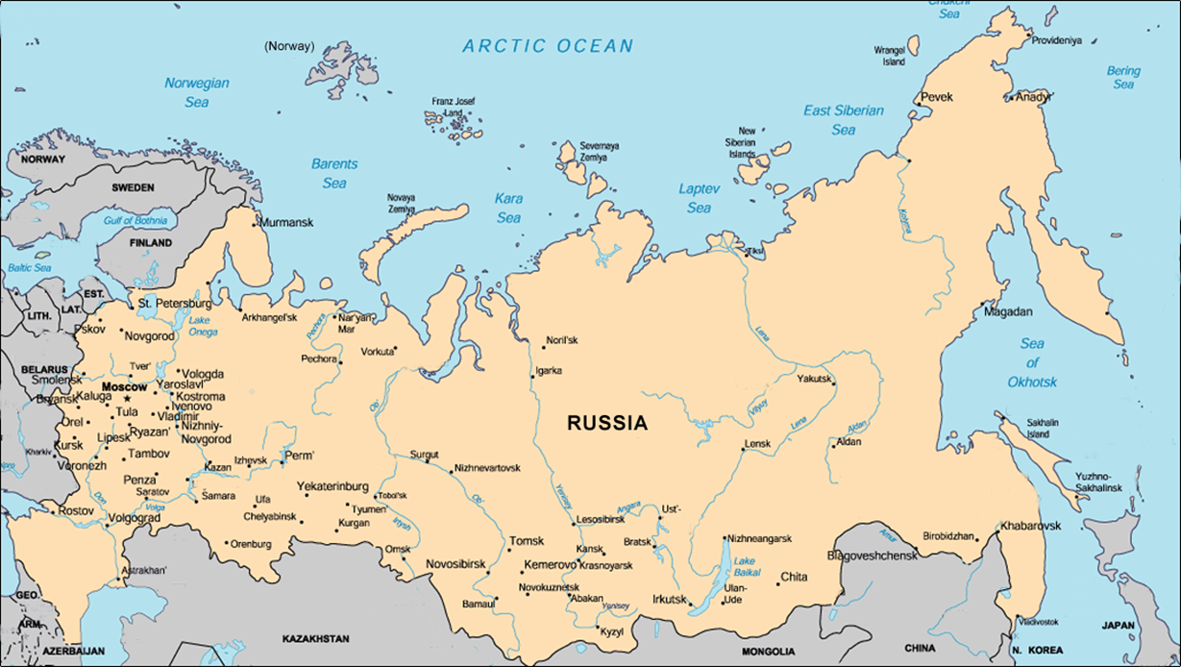
Background Location of Mayak
Mayak
Adapted from Bradley, Donald J. Behind the Nuclear Curtain: Radioactive Waste Management in the Former Soviet Union. Battelle Press, Columbus, OH (1997)

Slide 10
Russian Health Studies Program
The Joint Coordinating Committee for Radiation Effects Research (JCCRER) is a bilateral Government committee representing agencies from the United States and the Russian Federation
The JCCRER’s major role is to coordinate scientific research on the health effects of exposure to ionizing radiation in the Russian Federation from the production of nuclear weapons
The subset of JCCRER projects funded by DOE comprise the Russian Health Studies Program
The Program’s name helped avoid confusion with the Joint Coordinating Committee for Civilian Nuclear Reactor Safety (JCCCNRS) Program, which focused on assessing the effects of radiation from the Chernobyl nuclear power plant accident of 1986

Slide 11
Program’s Purpose and Goals
Purpose
To assess worker and public health risks from radiation exposure resulting from nuclear weapons production activities in the former Soviet Union
Goals
To better understand the relationship between health effects and chronic, low-to-moderate dose rate radiation exposures
To provide information to the national and international organizations that determine radiation protection standards and practices
To estimate cancer risks from exposure to gamma, neutron, and alpha radiation

Slide 12


JCCRER Member Organizations
U.S. Members:
Russian Members:
Department of Energy (DOE), U.S. Executive Agent
Department of Defense (DoD), including the Armed Forces Radiobiology Research Institute (AFRRI)
Department of Health and Human Services (DHHS), including the Centers for Disease Control and Prevention (CDC)
Environmental Protection Agency (EPA)
National Aeronautics and Space Administration (NASA)
Nuclear Regulatory Commission (NRC)
Federal Medical-Biological Agency (FMBA), Russian Executive Agent
State Research Center-Burnasyan Federal Medical Biophysical Center (BFMBC)
State Atomic Energy Corporation (Rosatom)
State Scientific Center – Institute of Medical and Biological Problems of the Russian Academy of Sciences (IBRAE)
Mayak Production Association (Mayak)

Slide 13
Suitability of Russian Studies for Radiation Health Effects Research
Data Characteristics
Research Focus
Application/
Relevance
Detailed Health and Exposure Records
Close examination of health and doses of Mayak worker and Techa River residents for over 50 years
Research results relevant to understanding radiation risks experienced by nuclear weapons production workers, commercial nuclear workers, and residents of surrounding communities
Stationary Worker and Exposed Populations
External and
Internal Exposures
Chronic duration of exposures over a wide range of doses
Subjects of
both Sexes

Slide 14
History Phased Implementation
Completed Phases
Phase I
Phase II
Phase III
Coordinating, planning, building infrastructure, providing equipment and supplies, and linking U.S. and Russian researchers
Feasibility studies and
data preservation of
paper records
Successful feasibility studies resulted in multi-year projects
Current Phases
Phase IV
Refining dosimetry, uncertainty, and cancer risk estimates
Results Published
342 peer-reviewed publications (as of 12/31/2017)

Slide 15
Scientific and Programmatic Oversight
Critical and vital element of the program
External Scientific Review Group (SRG) – U.S. and Russian SRGs
Eminent U.S. and Russian radiation effects research scientists with expertise in:
Radiation epidemiology and dosimetry
Historical occupational and environmental dose reconstruction
Radiation measurements and shielding
Health physics
Medicine, public health, and biostatistics
Meet every 6 months to review semi-annual technical progress reports and proposals
Developed three 5-year plans containing a detailed research agenda

Slide 16
Ongoing Research and Scientific Outreach
5 Current Projects
Community Studies
Worker Studies
1.1, Techa River Population Dosimetry
1.2b, Techa River Population Cancer Morbidity and Mortality
2.2, Mayak Worker Cancer Mortality
2.4, Mayak Worker Dosimetry
2.8, Human Radiobiology Tissue Repository

Slide 17
Ongoing Research and Scientific Outreach Principal Investigators (PIs) and Supporting Organizations
Project Number | Title | Russian PI | Organization | U.S. PI | Organization
1.1 | Techa River Population Dosimetry | Marina Degteva | Urals Research Center for Radiation Medicine (URCRM) | Bruce Napier | Pacific Northwest National Laboratory (PNNL-Battelle)
1.2b | Techa River Population Cancer Morbidity and Mortality | Alexander Akleyev Ludmila Krestinina | URCRM | Daniel Stram | University of Southern California
2.2 | Mayak Worker Cancer Mortality | Mikhail Sokolnikov | Southern Urals Biophysics Institute (SUBI) | Daniel Stram | University of Southern California
2.4 | Mayak Worker Dosimetry | Alexander Efimov | SUBI | Bruce Napier | PNNL-Battelle
2.8 | Human Radiobiology Tissue Repository | Evgeniya Kirillova | SUBI | Christopher Loffredo | Georgetown University

Slide 18
Project 1.1 Scope of Research
The Techa River Dosimetry System (TRDS) developed in Project 1.1, Techa River Population Dosimetry, provides point estimates (TRDS-D) and Monte Carlo distributions (TRDS-MC) of organ doses for:
Project 1.2b, Techa River Population Cancer Morbidity and Mortality
NCI and EC-funded studies (SOUL and SOLO Programs)
The TRDS provides individual dose estimates for internal, external, and medical exposures for:
Techa River Cohort (TRC), which consists of 29,710 persons born before the start of contamination
Techa River Incidence Cohort (TRIC), which consists of 17,432 persons born before the start of contamination
East Urals Radioactive Trace Cohort (EURTC), which consists of 19,839 persons born before the “Kyshtym explosion” in 1957 and who lived in contaminated villages from the date of the accident through December 31, 1960
Post-natal doses to the Techa River Offspring Cohort (TROC), which consists of 24,243 persons born after the start of contamination (conducted under SOLO Program)
The TRDS-2017MC TRC doses were provided in October 2017 and the EURTC doses were provided in January 2018

Slide 19
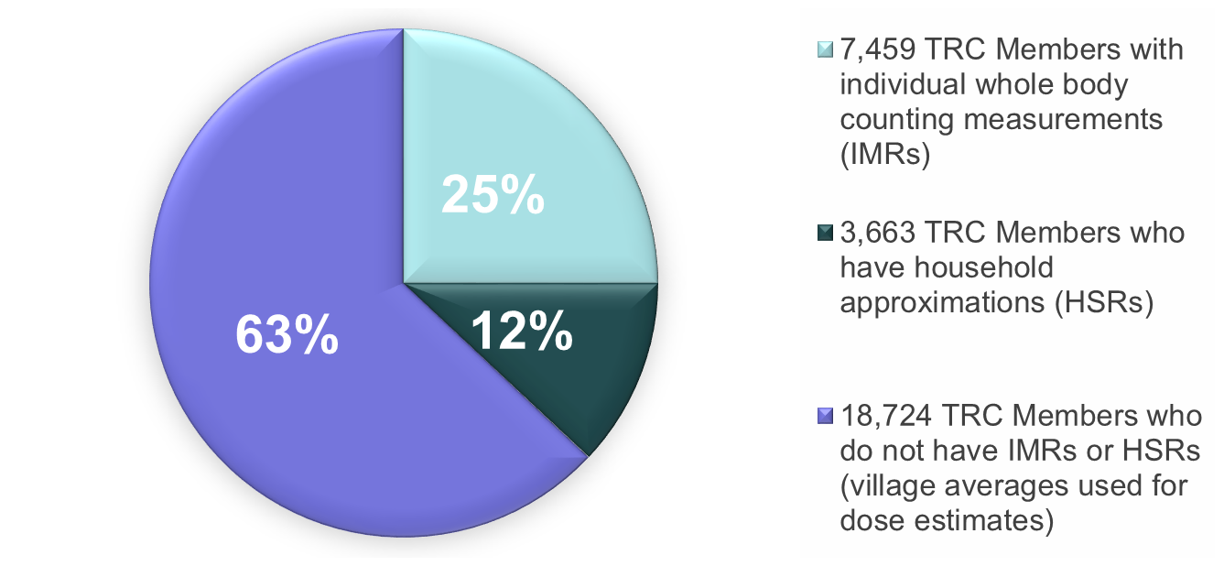
Project 1.1 Scope of Research, Cont’d
30,000 TRC Members

Slide 20
Project 1.2b Scope of Research
Project 1.2b, Techa River Population Cancer Morbidity and Mortality, and companion Project 1.1, Techa River Population Dosimetry, address cancer incidence and mortality in residents downstream from Mayak
Residents were exposed to both internal and external radiation (less than 1 rem or 10 mSv per year) over a long period (20 to 30 years)
Published results use these follow-up periods:
1956-2007 (52 years) with TRDS-2009 for solid cancer incidence
1953-2007 (55 years) with TRDS-2009 for leukemia incidence
1950-2007 (58 years) with TRDS-2009 for solid cancer mortality

Slide 21
Project 1.2b Description of Cohorts
Techa River Cohort (TRC)
Techa River Incidence Cohort (TRIC)
29,710 exposed permanent residents of villages on the Techa River born before the start of contamination in 1950 (1-1-1950)
Lived in riverside villages up to 120 miles downstream at any time between 1-1-1950 and 12-31-1960
17,432 exposed permanent residents of villages on the Techa River born before the start of contamination in 1950 (1-1-1950)
Lived in the riverside villages at any time between 1-1-1956 and 12-31-1960
The East Urals Radioactive Trace Cohort
(EURTC)
Techa River Offspring Cohort (TROC)
19,839 persons born before 9-28-1957, the day before the Kyshtym explosion, including 9,500 evacuees resettled due to the accident
Lived in contaminated villages between 9-29-1957, the date of the Kyshtym explosion, and 12-31-1960
24,243 persons born to parents in the contaminated villages along the Techa River after the start of contamination in 1950
Conducted under the SOLO Program, not under JCCRER Project 1.2b

Slide 22
Project 1.2b Follow-up
TRC follow-up through 12-31-2014:
9% lost to follow-up (due to migration from the catchment area)
Vital status is known for 93% of the cohort:
16% were alive
84% were known to have died
Cause of death is known for 91% of the decedents

Slide 23
Project 1.2b Current Risk Estimates
Statistically significant dose-responses for:
Solid cancer mortality (Schonfeld et al., 2013):
ERR solid cancer mortality = 0.061 per 100 mGy 95% CI (0.004-0.13)
Solid cancer incidence adjusted for smoking (Davis et al., 2015):
ERR solid cancer incidence = 0.10 per 100 mGy 95%CI (0.0013-0.15)
Non-chronic lymphocytic leukemia (non-CLL) incidence (Krestinina et al., 2013):
ERR non-CLL incidence = 0.22 per 100 mGy 95%CI (0.08-0.54)
No evidence of radiation effect for CLL
No statistically significant differences between solid cancer and leukemia ERR estimates in the Techa River cohort (chronic low dose rate exposures) and those for the A-bomb survivors (acute high dose rate exposures)

Slide 24
Project 2.2 Scope of Research
Project 2.2, Mayak Worker Cancer Mortality, and companion Project 2.4, Mayak Worker Dosimetry, address cancer mortality in Mayak workers
25,757 workers hired from 1948-1982, 25% female
Workers exposed to both internal and external radiation in reactor complex, radiochemical plant, plutonium production plant, or auxiliary departments
Protracted low dose-rate exposure similar to that of interest for radiation protection
Extensive Pu exposure (many Sv per year) for many radiochemical and plutonium plant workers
Project 2.2 was the first study to demonstrate in humans significantly increased incidence of lung, liver, and bone cancer related to internal deposition of plutonium
Additional follow-up and new dosimetry system MWDS-2016 (Project 2.4) will improve risk estimation

Slide 25
Project 2.2 Follow-up
Follow-up through 12-31-2014 (up to 67 years):
22% lost to follow-up
Vital status is known for all Ozersk residents and most pre-2004 migrants
Among the residents with known vital status:
18% were alive
72% were known to have died
Cause of death is known for 96% of the decedents

Slide 26
Project 2.2 Current Risk Estimates (ERR per 100 mGy)
Site | Years Since Exposure | Plutonium |  | Gamma Both Sexes
 |  | Men | Women
Lung (Gilbert et al., 2013) | 5+ | 0.74* (0.5 – 1.1) | 2.4* (1.1 – 5.6) | 0.024* (0.008 – 0.044)
Liver (Sokolnikov et al., 2008) | 5+ | 0.26* (0.07 – 0.60) | 2.9* (1.0 – 9.5) | 0.021 (<0 – 0.10)
Bone (Sokolnikov et al., 2008) | 5+ | 0.079 (<0 – 0.52) | 0.34* (0.04 – 2.0) | 0.035 (<0 – 0.44)
Other Solid Cancers (Sokolnikov et al., 2015) | 5+ | -- | -- | 0.016* (0.007 – 0.026)
Non-CLL Leukemia (Sokolnikov et al, in progress) | 2 - 4 | -- | -- | 0.69* (0.29 – 1.5)
Non-CLL Leukemia (Sokolnikov et al, in progress) *p<0.05 | 5+ | -- | -- | 0.045* (0.01 – 0.11)

Slide 27
Project 2.2 Key Findings
Following protracted exposure to plutonium, researchers observed:
Very large excess risks from cancers of the lung, liver, and bone, confirming results from previous research in Beagle dogs
Larger excess risks from cancers of the lung, liver, and bone in women than men exposed to same dose
Following protracted exposure to gamma rays, researchers observed:
Excess risks from other solid tumors
Very significant excess risks from leukemia

Slide 28
Project 2.4 Scope of Research
The Mayak Worker Dosimetry System (MWDS) developed in Project 2.4, Mayak Worker Dosimetry, provides the dosimetric data for companion Project 2.2, Mayak Worker Cancer Mortality
MWDS deals explicitly with shared and unshared uncertainties in the models used to calculate doses from both external and internal sources:
A novel Bayesian approach has been developed to interpret the bioassay measurement data
MWDS-2013 external doses (probability distributions for external gamma, external high energy neutron, external low-energy neutron, and medical exposures for the period 1948 through 2008) were provided to epidemiologists in February 2014
MWDS-2013 internal doses (probability distributions of organ doses following inhalation of plutonium) were provided to epidemiologists in September 2014
MWDS-2016 internal doses (probability distributions of organ doses following inhalation of plutonium) were provided to epidemiologists in September 2016 (external doses remained the same
22 articles describing the MWDS-2013 approaches and results were published as a single topical issue of Radiation Protection Dosimetry (Volume 176, Issue 1-2, October 1, 2017); an article comparing MWDS-2013 with MWDS-2016 submitted.

Slide 29
Project 2.8 One-of-a-kind Resource to the
Scientific Community
Project 2.8, Russian Human Radiobiological Tissue Repository:
The first and only facility in Russia to preserve and make available to the scientific community unique biospecimens of Russian nuclear facility workers
The repository preserves samples of biological tissues of employees from the first Russian domestic nuclear enterprise, Mayak, which was created at a time when its workers had no experience in operating such facilities
Mayak employees were exposed to prolonged external gamma radiation and/or internal alpha radiation due to Pu-239 in a wide range of doses
For each donor, there is information on occupational exposure history, as well as detailed medical and biological information
Real-time information about the contents is searchable online
The contents facilitate molecular epidemiology studies designed to assess the relationship between disease and radiation exposure
Inventory
About 315,839 biological specimens from 9,655 registrants in storage
Includes samples from 8,515 Mayak workers and 1,140 Ozersk residents without occupational exposure to ionizing radiation

Slide 30
Project 2.8 Repository Structure and
Contents
Tissue Repository and Contents
.
Autopsy Tissue Bank
Surgical/Biopsy Tissue Bank
Repository of Blood and Its Components
Bank of Other Tissues
Archival autopsy tissues from 1,058 individuals who died from 1951 through 2018
Surgery/biopsy tissue samples from malignant and benign tumors of different sites from 974 individuals
Suspensions of leukocytes, lymphocytes, immortalized B-lymphocytes, erythrocytes, plasma, serum, and extracted DNA from 8,067 individuals
Buccal epithelial cells, bone marrow, lymphoid tissue, cells from sputum from 1,718 individuals

Slide 31
Key Observations
DOE is the leading sponsor of radiation health effects research in Russia
JCCRER studies of Mayak workers and Techa River populations are valuable because both cancer and non-cancer effects have been observed
The Mayak Worker Cohort provides confirmatory evidence of bone, lung, and liver cancer in humans
Radiation effects following exposure to plutonium appear to be linear
Radiation effects are commensurate with those from the Japanese LSS
Contrary to expectations, doses delivered at low dose rates appear to be as effective in producing cancer as doses delivered at high dose rates, i.e., the dose and dose-rate effectiveness factor is about 1

Slide 32
Key Observations, Cont’d.
Program fills data gaps in radiation research
Mayak worker cohort is a unique resource for evaluating:
Risk of cancer from long-term internal exposure to plutonium
Risk of cancer from long-term external gamma exposure
Techa River cohort is a unique resource for evaluating long-term environmental exposures, such as those in communities surrounding DOE nuclear facilities
Data from both cohorts are useful for evaluating whether doses delivered at low dose rates appear to be as effective in producing cancer as doses delivered at high dose rates

Slide 33
Path Forward
Complete current research priorities and commitments made to the JCCRER according to the 5-year plan
Focus on completing 4 core epidemiology and dosimetry studies of Techa River and Mayak worker cohorts
Focus on maintaining and improving the radiobiology tissue repository

Slide 34
Further
Information
Russian Health Studies Program Website:
http://www.energy.gov/ehss/russian-health-studies-program
JCCRER Website:
http://www.energy.gov/ehss/russian-health-studies-program-joint-coordinating-committee-radiation-effects-research-jccrer
List of Peer-Reviewed Publications and Outcomes
http://www.energy.gov/ehss/downloads/russian-health-studies-program-peer-reviewed-publications-and-outcomes
Russian Human Radiobiology Tissue Repository:
http://rhtr.subi.su/lang.php

