Slide 1

Cancer Risk Due to Radiation Exposure in the Southern Urals Mayak Workers and Techa River Cohort Studies
Daniel Stram;
University of Southern California

Slide 2
Outline
Epidemiologic Studies
Mayak Workers Cohort (MWC)
Techa River Cohort (TRC)
Eastern European Radioactive Trace Cohort (EURTC)
A little statistics
Risk results from these cohorts

Slide 3
Mayak Production Association
Nuclear facilities located in the southern Urals where the plutonium for the first Soviet nuclear weapons were produced
Construction began in November 1945
First bomb test August 1949
Notes:
Mention mean and maximum dose for Pu and external doses

Slide 4
Occupational exposures:
Included internal (Pu) and external (gamma) radiation
Mean cumulative occupational exposures were high
Exposures were protracted over (often many) years
Notes:
Especially for internal exposures

Slide 5
Environmental Exposures
Source:
Releases from Mayak PA into Techa River in 1949-1956. About 10¹⁷ Bq radiation
East Urals Radioactive Trace (EURT, 29 Sept 1957)
Thermal explosion of storage tank
7x10¹⁶ Bq radioactivity released
Notes:
Check release sizes with Bruce give Bq (becquerels) or Ci (curies) for both

Slide 6
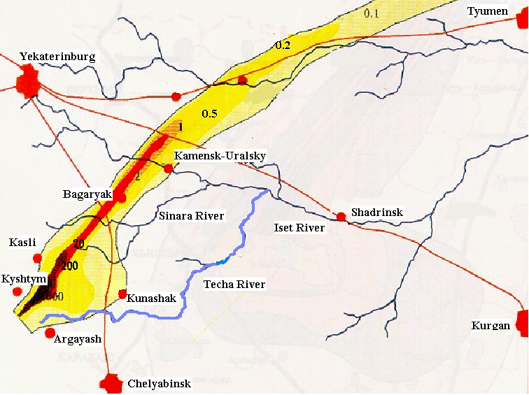
Map of regions of contamination
v\

Slide 7
The three studies of interest here
Mayak Workers Cohort (MWC) study
Mayak workers hired from 1948-1982 (n=26,000)
MWDS dosimetry based on film badges from early on. Plutonium monitoring began in 1970’s.
Follow-up from 1948 – current
Techa River Cohort (TRC) study
Persons (n=30,000) born before 1 Jan 1950 who resided in one or more of the 41 Techa riverside villages between 1950 and 1960
TRDS dosimetry
Internal dose estimates based on many individual measurements.
External dose estimates from measured and calculated dose rate in air.
Follow-up from 1950-current
East European Radioactive Trace (EURTC) cohort study
Cohort definition: Persons (n=22,000) residing in one or more of 33 EURT villages in Chelyabinsk oblast between 29 Sept 1957 and 1960
Dosimetry same as TRDS
Follow-up from 29 Sept 1957 - current
Notes:
Mention that there is some overlap in TRC and EURT. Also that about 25,000 were initially exposed between 1950 and 1952 the remainder moved into exposed villages between 1953-1960. About 5,400 TRC members have some exposure as a result of the 1957 accident, and 1,600 are members of both cohorts

Slide 8
Selected Publications
MWC
Mortality from lung, liver, bone 1948-2003
Mortality from lung cancer, with follow-up through 2008
Mortality from solid cancers other than lung, liver, and bone 1948-2008
Leukemia in the MWC 1948-2008*(in review)
Most used MWDS2008
TRC
Solid cancer mortality, 1950-2007
Solid cancer incidence, 1956-2007
Leukemia incidence, 1953-2007
All studies used TRDS 2009

Slide 9
Recent progress: Techa River Cohort
Extension to include EURTC in risk analyses
Follow-up through 2016.
Dosimetry updates (TRDS2016)
Includes estimation of doses from EURT exposures
Utilizes updated source term, river transport models, increased individualization of doses.
Represents dosimetric uncertainty using Monte-Carlo realizations of possible annual dose

Slide 10
Recent progress in MWC
Update of follow-up through 2015
Improved dose estimates in MWDS2016
Changes in biological/chemical parameters lead to generally higher Pu dose
Provides MC realizations representing uncertainty for both plutonium doses and occupational gamma exposures

Slide 11
Mean MWDS 2016 vs 2008 Pu dose
Notes:
Taken from progress report for 10-15-2014 – this is DS2013. Most MWDS lung doses are higher than in 2008

Slide 12
Progress in statistical modeling
Incorporation of dosimetric uncertainty into epidemiologic calculations
IE what do we do with the multiple realizations??

Slide 13
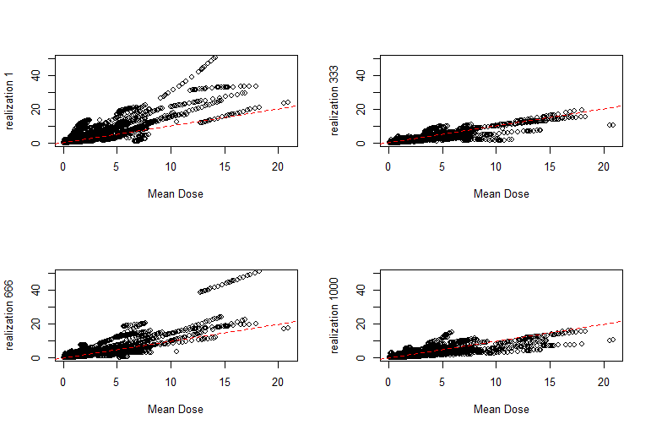
Dose uncertainty as represented by MC realizations of internal dose (cumulative Mayak Lung Dose) Units are Gy
Notes:
Add units to x and y axes (Gy)

Slide 14
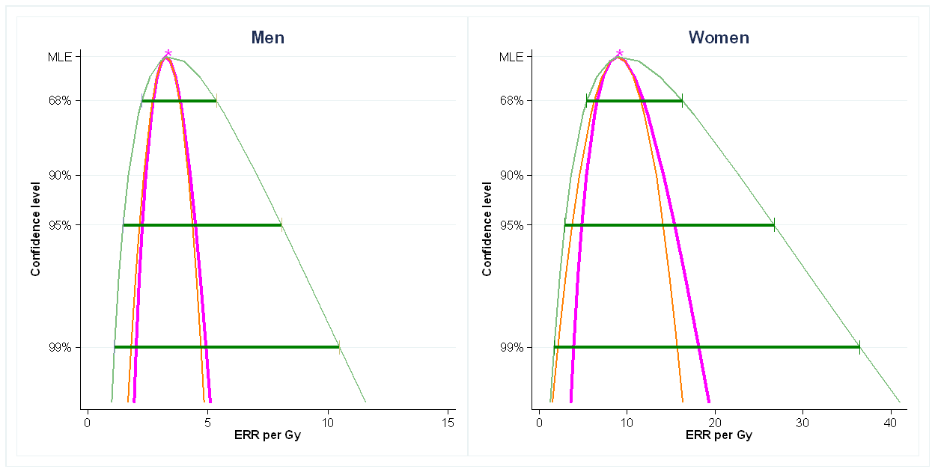
Dose uncertainty as incorporated into the epidemiologic analysis: adjusted and unadjusted confidence bounds
Uses corrected information (CIM) approach of Stram et al 2015 and Zhang et al 2017
Notes:
Maybe just show Women and stress larger impact on upper bound

Slide 15
Lung cancer in MWC associated with Pu
Gilbert 2013: MWDS 2008 follow-up through 2008, no dose uncertainty
Males Females
ERR / Gy at age 60 7.4 24
(Wald Confidence Interval) (5.0 – 11) (11– 56)
Stram et al, (in progress) MWDS 2016, follow-up through 2014, including adjustment for uncertainty Males Females
ERR / Gy at age 60 3.6 9.9
(Wald CI) (2.4 – 4.8) (4.2 – 15.7)
(Adjusted CI) (1.6 – 8.8) (3.3 – 29)

Slide 16
Dose response over 0-4 Gy Pu exposure

Slide 17
Dose response over 0-0.5 Gy Pu exposure

Slide 18
Lung cancer associated with MWC external dose
Sokolnikov 2008: MWDS 2008 follow-up through 2003, no dose uncertainty
Males+Females
ERR / Gy at age 60 0.19
(Confidence Interval) (0.05—0.39)
Stram et al, (in progress) follow-up through 2014
Males+ Females
ERR / Gy at age 60 0.20
(Unadjusted Wald CI) (0.07 – 0.32)
(Adjusted Wald CI) (0.07 – 0.34)
Notes:
Make the comment that it doesn’t matter

Slide 19
External lung dose response 0-2.5 Gy

Slide 20
Lung external dose response 0-1 Gy

Slide 21
All Solid Tumors in the TRC
Schonfeld 2013: Mortality TRDS 2009 follow-up through 2007, no dose uncertainty
TRC only
ERR / Gy 0.61
(Wald Confidence Interval) (0.04—1.27)
Davis 2013: Incidence TRDS 2009 follow-up through 2007, no dose uncertainty
TRIC Cohort only
ERR / Gy 0.77
(Wald CI) (0.13 – 1.5)
Notes:
Maybe drop this slide since it is partly redundant with next slide

Slide 22
Updated analysis TRC EURTC separately and combined
All solid tumor mortality: TRDS2016 follow-up through 2016
TRC Cohort Comment
ERR / Gy 0.55 Assumes no
(Wald Confidence Interval) (0.06—1.05) dose uncertainty
EURT Cohort
ERR / Gy 0.46 Assumes no
(Wald CI) (-0.11 —1.03) dose uncertainty
Combined Cohort
ERR / Gy 0.60 Assumes no
(Wald Confidence Interval) (0.15—1.04) dose uncertainty
ERR / Gy 0.60 Adjusted for
(Adjusted Wald CI) (0.15 – 1.28) dose uncertainty

Slide 23
Non-CLL leukemia in the TRC
Krestinina 2013: Mortality TRDS 2009 follow-up through 2007, no dose uncertainty
TRC only
ERR / Gy 2.2
(Likelihood-based Confidence Interval) (0.8—5.4)
Current analyses: Mortality follow-up through 2016, includes adjustment for uncertainty, TRDS16
TRC+EURT
ERR / Gy 2.04
(Likelihood-based CI) (0.75 – 4.4)
(Wald based CI) (0.33 – 3.5)
Adjusted Wald-based CI (0.20 -- 45.0)

Slide 24
Non-CLL leukemia mortality in the MWC (Sokolnikov 2018 in review)
gamma dose-response appears to be quadratic in RBM exposure
Attained age rapidly reduces excess relative risk of exposure – proportional to 1/age^{2.5}
The ERR for doses received 2-4 years in the past is roughly 3 times that for doses received 5+ years prior
No evidence of effect of Pu on leukemia risk

Slide 25
For example
60 year old last exposed before age 55 the ERR for a 1 Gy total dose is 0.25.
For 100 mGy exposure this becomes 0.0025
At age 70 these ERRs are reduced by approximately 1/3.
The significance of this description is driven by the higher exposures
Uncertainty calculations in progress

Slide 26
Conclusions
These studies provide compelling evidence for radiation effects (Lung, Solid Cancers, Leukemia) due to protracted exposures to both internal and external radiation
The information for more detailed site-specific analyses is limited.
Most site-specific risk estimates tend to be positive, but with limited power
Both studies are providing information but about different ranges of dose.
Techa doses are lower but risk estimates / Gy are higher
Techa doses are providing information about low doses delivered at very low rates. Techa is relevant to accident, terrorist scenarios
Uncertainty results reflect that internal exposures (to alpha from Pu, beta from Sr), are inherently harder to estimate than external dose.
Notes:
In site-specific analyses of 15 sites 10 are positive in Mayak and Techa 10 out of 15

Slide 27
Acknowledgments
Funding by the US Department of Energy, Russian Health Studies Program, and by the Russian Federal Medical and Biological Agency
DOE Program Officer Barrett Fountos
Key co-investigators
SUBI: Mikhail Sokolnikov
URCRM: Ludmilla Krestinina
PNNL: Bruce Napier
Hirosoft: Dale Preston

