Slide 1
Radiation Effects on Cancer Risks in the Techa River, Mayak Worker, Atomic Bomb Survivor Studies
Applicability of Radiation-Response Models to Low Dose Protection Standards
October 1, 2018
Dale L. Preston Hirosoft International

Slide 2
Outline
Topics
Background
Cohort comparisons
Risk estimate comparisons
Conclusions

Slide 3
Mayak Production Association
Mayak Production Association
Operations began in 1948
Reactor complex (Re)
Radiochemical plant (RC)
Plutonium production (Pu)
Auxiliary facilities (Aux)
Occupational exposures
External gamma exposures
Film-badge measurements for workers in most years
Annual doses very high in first decade, declined over time
Internal exposure to Pu aerosols (RC & Pu)
Highest exposures in first decade
Urinalysis and autopsy measurements for ~40% of RC/Pu workers from 1970’s

Slide 4
Mayak Production Association Environmental Releases – Techa River
115 PBq, between 1950 and 1956
95% 1949-51
137Cs, 89Sr, 90Sr most important isotopes
41 affected villages along 240 km river
21 of 24 villages within 140km of source evacuated by late 1950’s

Slide 5
Mayak Production Association Environmental Releases – 1957 Accident
Storage tank explosion on September 29, 1957
80 PBq released
~90% contaminated area near release
8 PBq contaminated ~400 km² northeast of Mayak (East Urals Radioactive Trace - EURT)
22 of 82 EURT villages were evacuated

Slide 6
Mayak Worker Cohort
25,757 workers initially employed between 1948 and 1982

Slide 7
Mayak Worker Cohort
25,757 workers initially employed between 1948 and 1982
Highest annual doses in the first decade with rapid decline over time

Slide 8
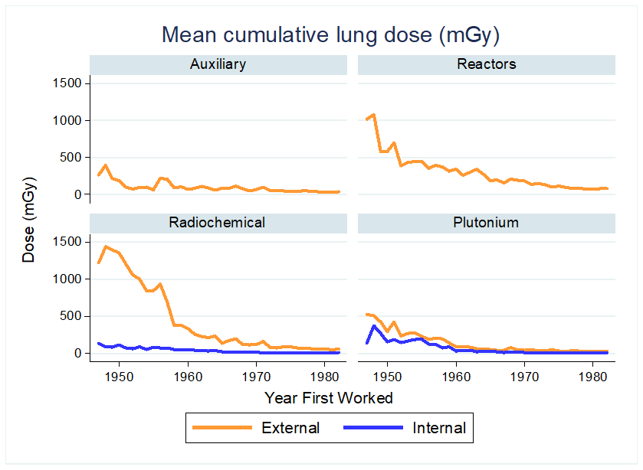
Mayak Worker Cohort
25,757 workers initially employed between 1948 and 1982
Highest annual doses in the first decade with rapid decline over time
Lifetime cumulative doses were quite high for early workers with much variability between plants

Slide 9
Mayak Worker Cohort Current Vital Status (through 2015)
25% of workers are women
Mean age at initial exposure about 25
20% of cohort members lost due to migration
73% of men and 70% of women have died

Slide 10
Mayak Worker Cohort Doses
Median doses and dose rates are much lower

Slide 11
Techa River Cohort
29,710 riverside village residents
Born before 1950
Resident at some time between 1.1.1950 and 12.31.1960
24,710 original cohort members lived on Techa between 1950 and 1952
5,004 late entrants first lived on Techa between 1953 and 1960
58% women
Women older than men due to impact of war and greater male mortality
Mean age at initial exposure: Men 25; Women 31
40% initially exposed as children

Slide 12
EURT Cohort
19,839 people
Born before accident
No Techa in-utero exposures
Resident in one of 33 EURT villages in Chelyabinsk Oblast between 28.9.1957 and 31.12.1959
Includes 1,598 people who are members of the TRC
56% Women
Age at time of accident:
Men 24 (40% < 20)
Women 30 (30% < 20)

Slide 13
Techa / EURT cohorts Current Vital Status (2015)
Notes:
Dead: 86% TRC 75% EURT Lost: 7% TRC 19% EURT
Migrant: 16% TRC 20% EURT

Slide 14
Techa River / EURT Cohort Doses and Dose Rates
Median doses and dose rates are much lower

Slide 15
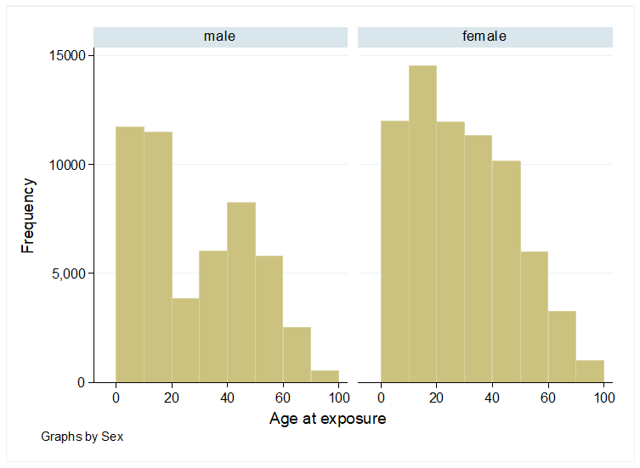
Atomic Bomb Survivor Life Span Study
120,321 residents of Hiroshima and Nagasaki
93,741 in the cities
86,720 with known dose
26,580 not in the cities
58% women
Marked deficit of men between 18 and 40
Mean age at exposure:
Men 24
Women 27

Slide 16
Atomic Bomb Survivors Vital Status
63% of men and 56% of women have died
Ages at death and cancer greater than in Mayak or Techa

Slide 17
Atomic Bomb Survivors Doses
Little difference between survivor colon and marrow doses
Survivor doses markedly lower than Mayak gamma doses
Survivor soft tissue doses higher than Techa doses, marrow doses roughly similar

Slide 18
Comparing LSS, Mayak, and Techa Risk Estimates
LSS risk models parameterized to reflect sex-ratios in Techa and Mayak cohorts and adjusted to reflect typical ages at exposure and ages at cancer death in Techa and Mayak cohorts
Techa: age at exposure 25 solid cancer death at age 65, leukemia death at age 50
Mayak: age at exposure 25 solid cancer death at age 65 leukemia death at age 55
Report risks as percentage increase in death rate at 100 mGy
Dose of interest for radiation protection
Avoids misleading comparisons for non-linear models

Slide 19
Comparing LSS and Mayak Cancer Risk Estimates
* Mayak alpha-dose-associated lung cancer dose effect (% increase at 100 mGy): Men 28%
Women 72% Plutonium exposure related deaths: 190

Slide 20
Comparing LSS and Techa + EURT Cancer Risk Estimates

Slide 21
Conclusions (1)
Mayak leukemia risks and external dose cancer risks appear to be somewhat lower than corresponding LSS-based estimates
Techa leukemia and solid cancer risk estimates appear to be similar to LSS risk estimates

Slide 22
Conclusions (2)
Cohorts differ with respect to nature of exposures and demographics so care must be taken to make appropriate comparisons
These comparisons do not address effect modification
Some suggestions of different attained age patterns in Techa than in the LSS
Power to detect external dose effect modification is low in Russian studies
Power to investigate site-specific risks is generally limited in the Russian studies.

Slide 23
Acknowledgments
Mikhail Sokolnikov, Nina Koshurnikova (SUBI)
Lyudmila Krestinina, Marina Degteva (URCRM)
Dan Stram (USC)
Bruce Napier (PNNL)
Barry Fountos (DOE-JCCRER)
Funding from US Department of Energy (JCCRER) and Federal Medical Biological Agency of the Russian Federation

Slide 26
Mayak Production Association Other Environmental Releases
Gaseous aerosols (131-I)
38PBq from Mayak in the 1950s
Affected Ozyorsk, Khysthm, Kasli and nearby villages
Karachai Pond 1967
20 PBq from resuspension of contaminated soil from Mayak waste storage pond

Slide 27
Techa and EURT cohorts Current Vital Status (2015)
Notes:
Dead: 86% TRC 75% EURT Lost: 7% TRC 19% EURT
Migrant: 16% TRC 20% EURT

Slide 28
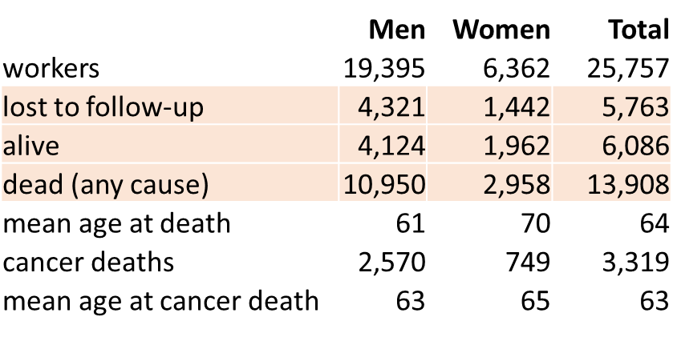
Mayak Worker Cohort Current Vital Status (through 2015)
25% of workers are women
Mean age at initial exposure about 25
20% of cohort members lost due to migration
73% of men and 70% of women have died

Slide 29
Comparing LSS and Mayak Cancer Risk Estimates
* Mayak internal (plutonium) dose effect (% increase at 100 mGy): Men 28%
Women 72% Plutonium exposure related deaths: 190

