Slide 1
Introduction to Internal Dosimetry
Richard Bull

Slide 2
Internal dosimetry
Source is internal within body, due to
Ingestion
Injection (wound)
Absorption
Inhalation
Person is committed to receive a dose for as long as material is within body
Cannot be measured directly

Slide 3
Internal Dosimetry
Need to calculate the dose from internally-deposited radionuclides
Direct methods are impossible, so we must use indirect methods
External dose rate ends when the worker is removed from the radiation
field
Internal dose rate continues when the worker is removed from the source of contamination
External dose is dominated by low LET radiation, internal dose usually high LET

Slide 4
Methods of Internal Dosimetry
Three detection strategies:
Measure activity before it enters the body—air sampling
Measure activity when it is in the body---in-vivo monitoring, autopsy
Measure activity as it leaves the body---excretion sampling

Slide 5
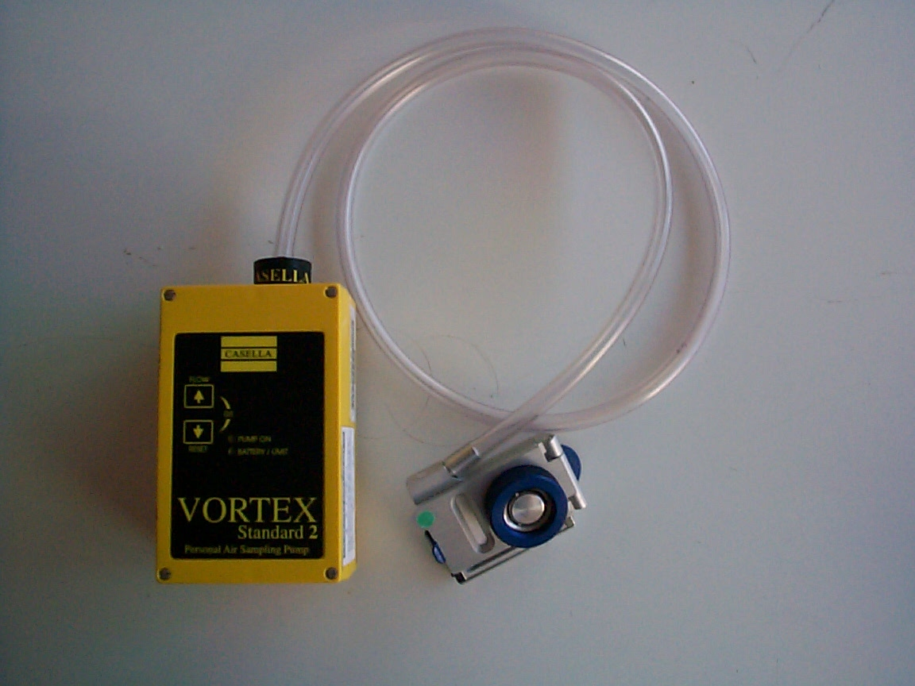
Air monitoring

Slide 6
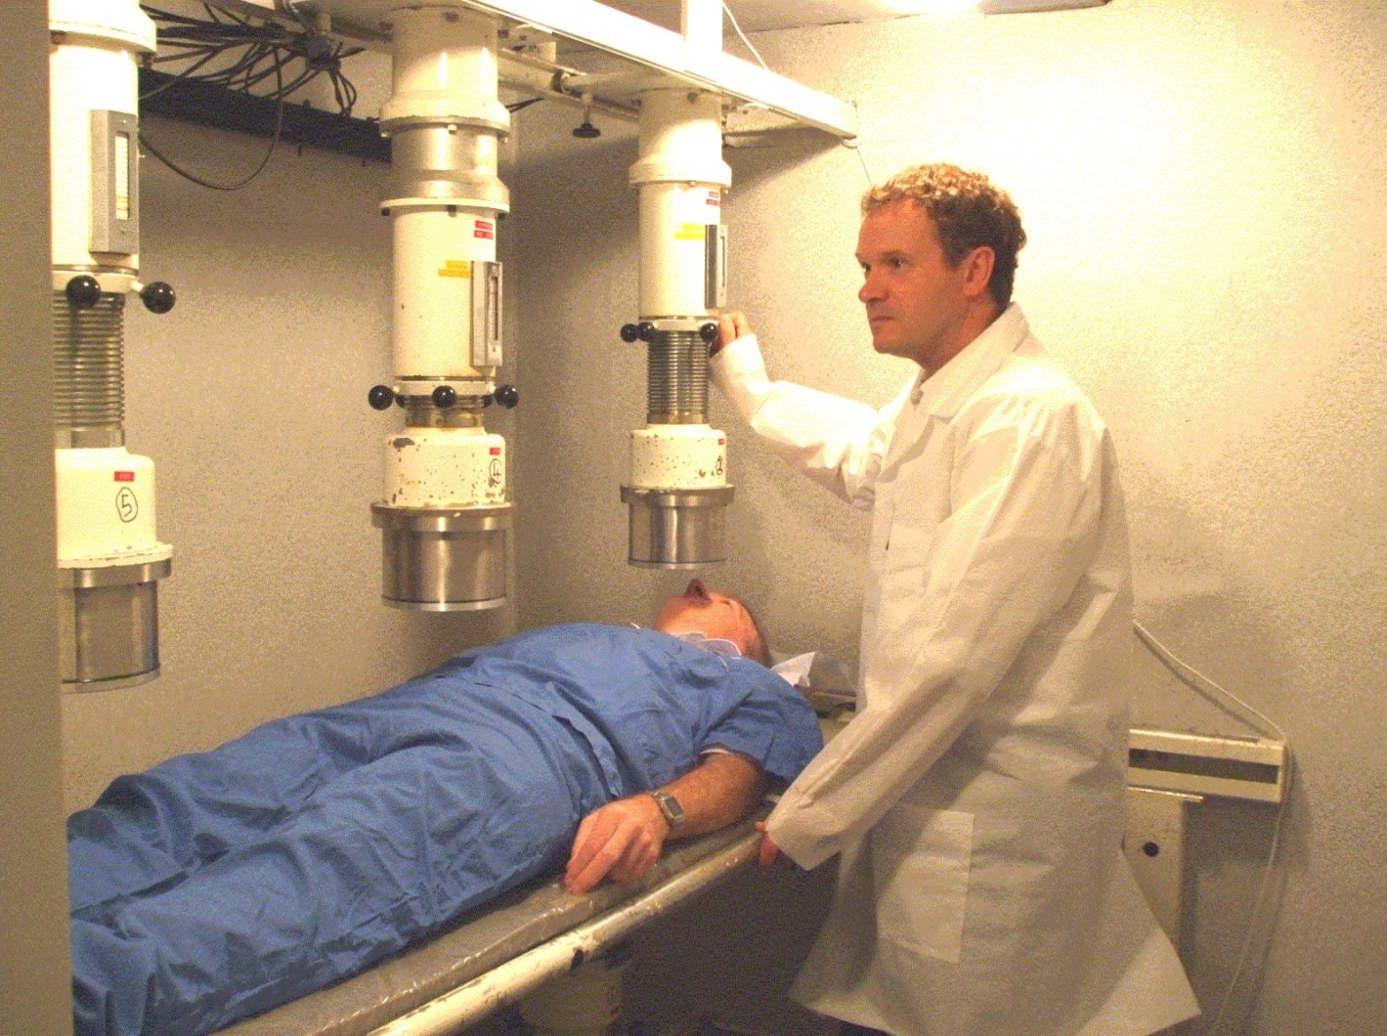
In-vivo monitoring

Slide 7

In-vitro monitoring (bioassay)
Urine sampling
Indicates activity in circulation within body
Faecal sampling
Indicates activity within the gut and lung
Dependent on solubility of inhaled material
Sensitivity | Soluble ²⁴¹ Am | Insoluble ²⁴¹ Am
Annual urine | 0.5 mSv | 4 mSv
Annual faecal | 3 mSv | 0.5 mSv

Slide 8
Interpretation
We need to relate excretion/retention to intake
Need to relate intake to dose
Require biokinetic models (lung, systemic organs etc)
Require dosimetric models (radiation transport between source organs and target organs)

Slide 9
Internal dosimetry modelling & assessment
Overview of biokinetic processes

Slide 10
Uncertainties
Point estimates of intake and organ dose are relatively straightforward
However there are large uncertainties in measured quantities and model parameter values
Assign prior probability distributions to these quantities
Use a Bayesian method (WELMOS, Markov Chain MC) to produce posterior distributions of intake and dose
Provide the epidemiologists with calendar year organ doses and uncertainties.
!

