Slide 1

Biological Effects of Low Dose Radiation Dr. Antone L. Brooks (Tony)
Applicability of Radiation-Response Models
to Low Dose Protection Standards
American Nuclear Society and Health Physics Society Pasco Washington Sept 30-Oct 3, 2018

Slide 2
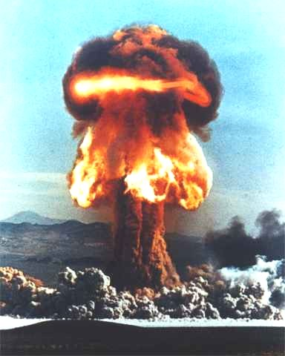
Nuclear weapons were part of my early life

Slide 3
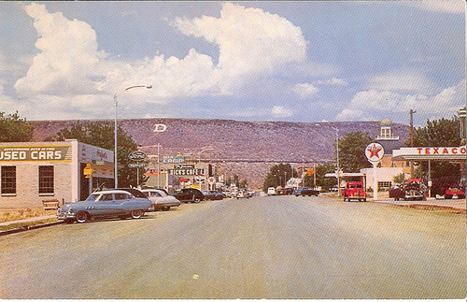
ST. George, Utah
1955
ST. George Utah, 1945

Slide 4

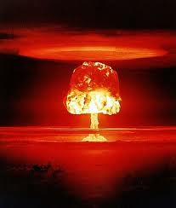
Fallout from 103 A-bombs tested above ground.
Utah
Fallout Patterns
103 A-Bombs
St. George
Nevada Test Site

Slide 6
Radiation Weighting Factors Radiation-Induced Chromosome Aberrations
241-Am (alpha)
3
2
239-Pu (alpha)
Aberrations/Cell
252-Cf (alpha + fission fragments)
Acute
Chronic 60-Co (gamma)
1
144-Ce (beta-gamma)
0
0
10
20
30
Dose (Gy)

Slide 8
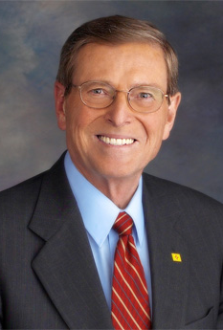
Goals and Expectations: Low dose Program
“In this year’s Energy and Water Appropriation Act (1998), we initiated a ten year program (13 million/year) to understand how radiation affects genomes and cells so that we can really understand how radiation affects living organisms. For the first time, we will develop radiation protection standards that are based on actual risk.”

Slide 9
Biological Responses Induced by Low Doses of Radiation: Need for Paradigm Shifts in Radiation Biology
Adaptive Response
Genomic Instability
Bystander Effects
Genetic Sensitivity

Slide 10
Adaptive Response Sub-linear dose response
Intervention
Transformation Frequency
0
10
20
30
40
50
60
70
80
90
100
Dose (cGy)
Redpath et al. 2001

Slide 11
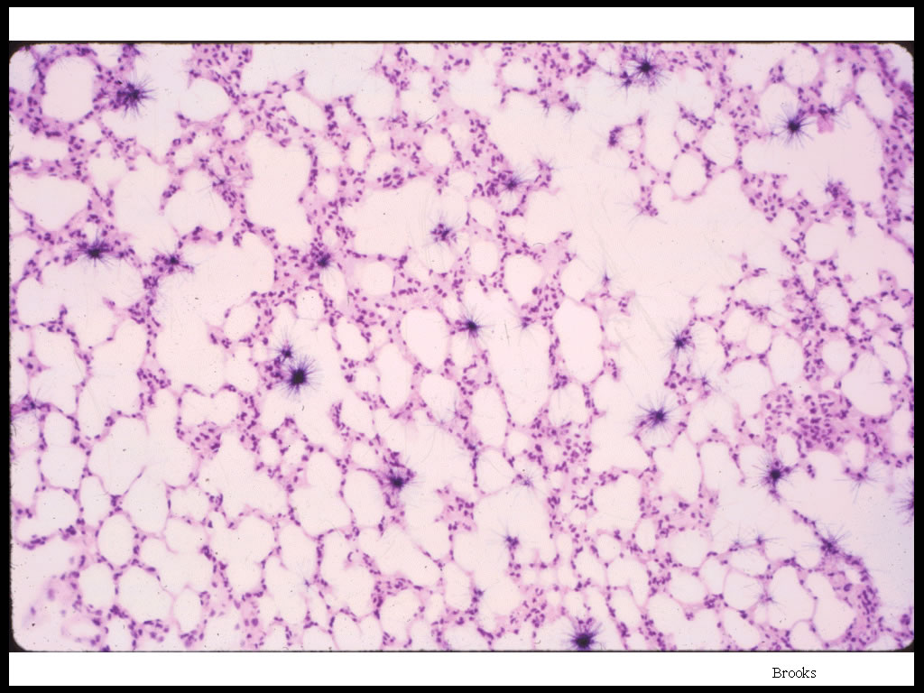
Non-Uniform Dose Distribution from Plutonium Inhalation

Slide 12

The Influence of ²³⁹PuO₂ Particle Size on the Dose-Distribution in the Liver of Chinese Hamsters
Citrate
0.44µm
0.17µm
0.84µm
Notes:
Studies using injected ²³⁹Pu oxide particles illustrate that bystander effects are present in the liver of experimental animals. The figure shows a schematic view of what liver tissue following the deposition different sizes of radioactive ²³⁹Pu oxide particles. For small particles most every cell is traversed by an alpha particle. Injecting the same amount or activity into the liver using large ²³⁹Pu oxide particles results in only a small fraction of the total cells being hit. However, those cells that are hit receive multiple alpha traversals and large amounts of energy. Using the "hit theory" the cells with multiple traversals should be killed and produce no adverse health effect and those cells that were not hit would not be damaged. The hit theory predicts a small response to the large plutonium particles.
The Influence of
239
PuO
2
Particle Size
on the Dose-Distribution in the Liver
of Chinese Hamsters
Citrate
0.84µm
0.17µm
0.44µm

Slide 13
The Influence of ²³⁹Pu Dose-Distribution on Chromosome Aberration Frequency
Aberrations/Cell
Brooks et al
Notes:
To test this theory, the frequency of chromosome aberrations in the liver cells is plotted against the radiation dose. This figure shows that the number of chromosome aberrations increases as a function of total dose and not as a function of the number of cells that were traversed. This suggests that a bystander effect is present in whole organs and tissues and that the cells hit with large amounts of energy are capable of signaling the non-hit cells to result in the same amount of damage per unit of dose to the whole organ. Bystander effects thus are demonstrated for alpha particle exposure both in tissue culture and in experimental animals. Such experiments question the “hit theory”. A major research question that is currently being addressed in this program is to determine if bystander effects are produced by low doses of low-LET radiation.
.

Slide 14
Genomic Instability can be demonstrated in some strains of mice
0.35
0.3
Sensitive BALB/c mice
Resistant C57BL/6 mice
0.25
0.2
Aberrations/Cell
0.15
0.1
0.05
0
4
8
12
16
20
24
28
Population Doublings
B. Ponnaiya & R.L. Ullrich, 1998

Slide 15
BEIR VII and Low Dose Research
Genomic Instability
“Until molecular mechanisms responsible for genomic instability and its relationship to carcinogenesis are understood, extrapolation of dose-response data for genomic instability to radiation-induced cancers in the low dose range <100 mGy is not warranted.”
Bystander Effects
“...both beneficial and detrimental effects may result from bystander effects.”
Adaptive Response
“ Relevant endpoints should include not only chromosome aberrations and mutations but also genomic instability and if possible tumor induction.”

Slide 16
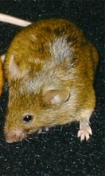

Bernell and Jirtle 2011

Slide 17
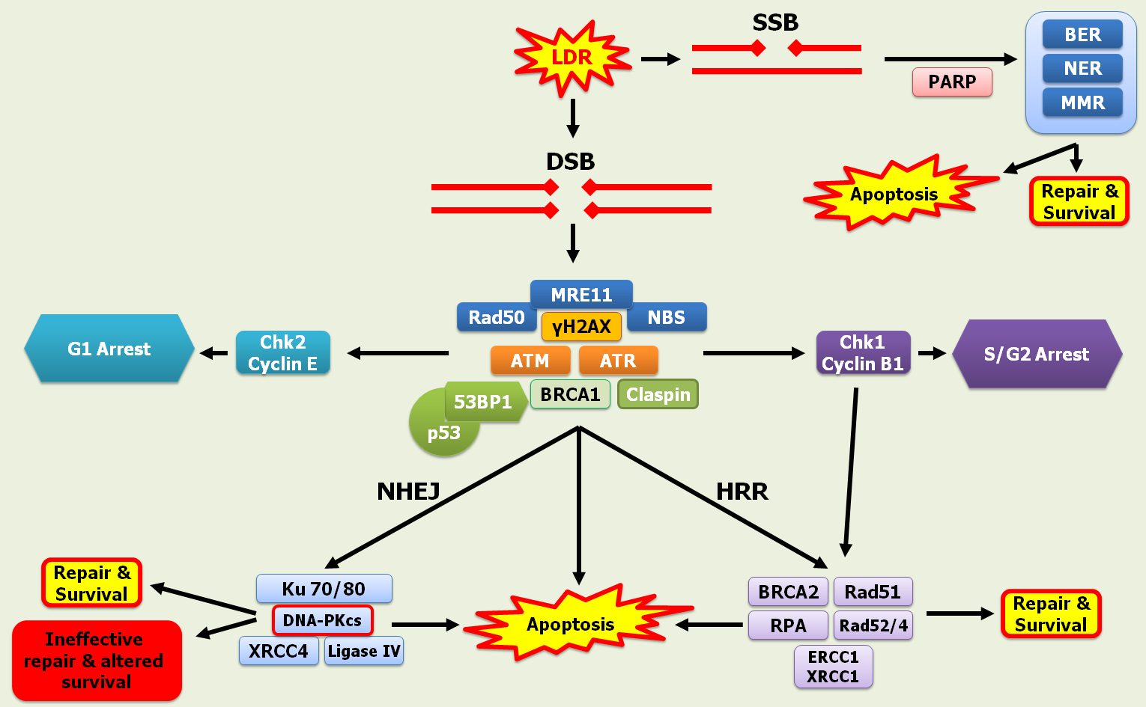
LDR & DNA Damage

Slide 18
Key Biological Molecules 2016
* DNA
* DNA modifications:
histones (acetlylation etc.), methylation...
* tRNA
* rRNA
* mRNA
* micro RNA
* long noncoding RNA
* circular RNA
* RNA modulation by degradation... in dozens of ways
* proteins
* protein modifications:
ubiquitination, phosphorylation,
SUMOylation, NEDylation, acetylation,...
Full information accessible and often from individual cells
Gayle Woloschak

Slide 19
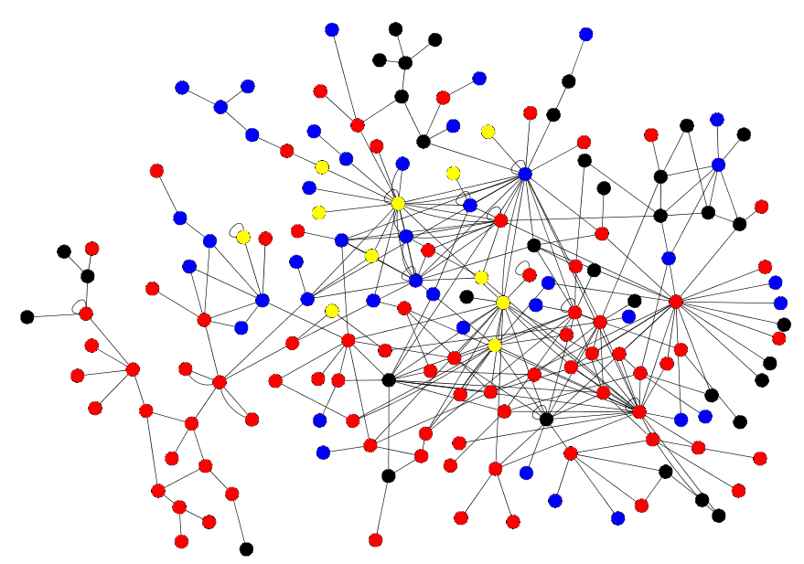
Network Reconstruction Using Integrated Data Are More Comprehensive And Accurate
Microarray
Proteomics
Powerblot
Multiple
SRC
▬EGFR
STAT3
AP-1
▬ERK2
FOS

Slide 20
What Causes Cancer?
WHO: Cancer is a poor Carcinogen

Slide 21
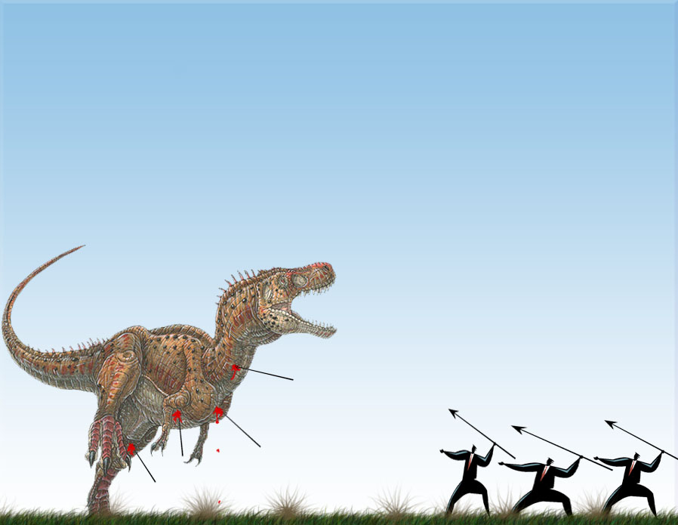
Negative Rebuttal: The Dinosaur of LNTH is scientifically dead for low-dose risk assessment.
Radiation is a poor mutagen and Carcinogen
Radiation cancer risk is very small and not detectable after low doses. Fear and radiation protection kills people and
Is very expensive.
All these cell and molecular responses are radio-protective !!!
Systems Biology
Genomics
Epigenomics
LNTH
Adaptive
Protection
Proteomics
Metabolomics
ROS
Modification
Bystander
Selective Apoptosis

Slide 22
Summary
With modern biology and bystander effects the “hit theory” and the physics of radiation do not describe how biological systems respond to low doses of radiation.
There are many changes required for a cancer to express and develop. DNA damage and mutations increase as a linear function of dose but many molecular processes including DNA repair show non-linear kinetics.
There is no question that high doses of radiation can cause cancer and interact with other environmental factors to cause cancer.
The LNTH continues to be used to control human exposure and protect the public, however, when it is combined with collective dose and ALARA the cost, fear and damage done far outweigh the protective gain.
Research has shown that the LNTH is not supported by science and most scientists agree that is overestimates radiation hazards in the low dose region.

Slide 23
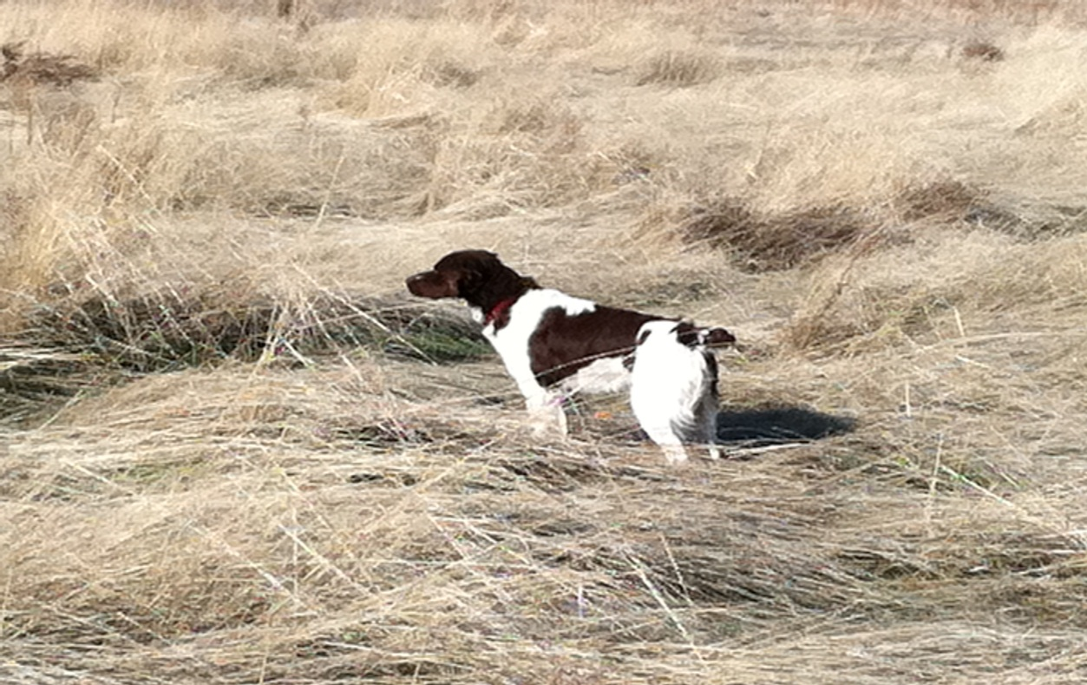
I have enjoyed my career as a radiation biologist. Radiation science has been such a wonderful experience for me. I even named my dog “Sievert” we may not know what a Sievert is but we do know it is worth 100 of those rems.
Sievert

