Slide 1
Using Mode of Action to Reduce Uncertainty in Risk Estimates
R. Julian Preston
Special Government Employee (Expert)
US Environmental Protection Agency
Low Dose Conference, October 2018

Slide 2
Risk Assessment
The general approach for calculating risk estimates at low doses (<100mGy) and low dose rates (<5mGy per hour) for radiation-induced diseases is to extrapolate from epidemiological data obtained over a range of acute doses (medium to high) to predict levels at these low dose levels. A dose and dose-rate effectiveness factor (DDREF) is then applied to account for observed or proposed reductions in effect of low compared to high dose and low compared to high dose rates. Some low dose rate data have been used in support of these higher dose acute estimates

Slide 3
The Present Situation
The calculation of radiation risk estimates for cancer and noncancer
diseases relies almost exclusively on epidemiological data from
radiation exposed populations, especially for cancer from the Japan
atomic bomb survivors. A number of these epidemiological data sets
are very comprehensive but despite this there are quite large
uncertainties associated with the calculated risk estimates.
Biological data are used most extensively in the calculation of
DDREF.

Slide 4
Extrapolation Models
For cancer, extrapolation from effects at high/medium doses to predict effects at low doses is currently accomplished using the liner-no threshold (LNT) model.
For noncancer effects extrapolation from effects at high/medium doses is used to calculate estimates of ‘practical’ threshold doses defined at the level of 1% incidence.
(See ICRP Report No. 118 for details)

Slide 5
Enhancing Risk Assessment by Integrating Epidemiology and Radiation Biology
To reduce uncertainty in the estimation of risk at low doses and low dose rates, it will be necessary to develop approaches for integrating the large scale epidemiology studies for exposed persons with the large data base already available and to be developed for radiation effects on human biosamples, laboratory animals, and at the cellular and the molecular levels (NCRP Commentary N0. 24: NCRP SC1-26 in progress). One such approach can build on that being utilized for environmental chemicals using Adverse Outcome Pathways (AOPs) and the associated Key Events (KEs).

Slide 6
What Are AOP’s and Key Events?
An adverse outcome pathway is “an analytical construct that describes a sequential chain of causally linked (key) events at different levels of biological organization that lead to an adverse health effect”.
A key event is defined as “an empirically observable precursor step that is itself a necessary element of the mode of action (adverse outcome pathway) or is a biologically-based marker for such an element”.

Slide 7
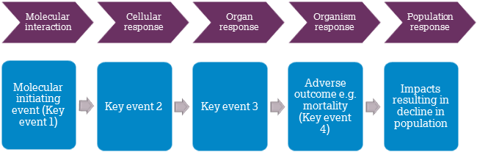
Generalized Adverse Outcome Pathway

Slide 8
AOP Steps
Key Events
Interaction with Radiation
Energy Deposition
Exposure of Target Tissue
Single, double and multiple DNA breaks
Base modification
Protein Oxidation
Free Radical Formation
Chromosome Alterations
Macro-Molecular Alterations
Cellular Responses
Gene Activation
Protein Production
Altered Signaling
Cell killing and Tissue Disruption
Organ Responses
Altered Physiology
Disrupted Homeostasis
Altered Tissue Development/Function
Impaired Development
Impaired Reproduction
Cancer and Non-cancer Effects
Adverse Outcome

Slide 9
AOPs and Chemical Exposures
For radiation exposures only a small amount of data exists currently for identifying AOPs and Key Events. On the other hand there is a fairly extensive data base for AOPs and Key Events for chemical exposures. A list of projects under review or underway through the OECD can be found at https://aopwiki.org/aops . Examples of research proposals that are under review currently through OECD is available.

Slide 10
Use of AOP/KE Data in Dose Response Development
The generalized approach is to develop AOPs and their associated KEs for specific radiation-induced adverse outcomes (cancer or non-cancer) and use these KEs as parameters in a Biologically-Based Dose-Response (BBDR) model [for example, a multi-stage clonal expansion (MSCE) model].

Slide 11
The Way Forward
Clearly this is a significant undertaking but the rapid ever-increasing knowledge of the mechanisms of disease formation, including radiation-induced diseases, coupled with the highly significant technical advances for molecular characterization of cellular changes and the computational assessment of very large data bases, for example, provide great optimism.
To advance the proposed approach, research programs need to be based on the AOP/key event approach – targeted research.
BBDR models need to be developed or current ones enhanced to be able to fully utilize an integrated epidemiology/biology apporach

Slide 12
Additional Information
Recent Review:
Can radiation research impact the estimation of risk?
R. Julian Preston
International Journal of Radiation Biology 93: 1009-1014, 2017.

Slide 14
Uncertainties
A range of uncertainties are associated with these cancer risk estimates and include:
Dosimetric uncertainties;
Epidemiological and methodological uncertainties;
Uncertainties from low statistical power and precision;
Uncertainties from inadequate modeling of radiation risk data;
Transport of (or generalizing) risk estimates to different populations;
Model used for extrapolation;
DDREF value used for risk reduction at low doses and dose rates; and
Quality factor used for high LET effects.

Slide 15
CLIP2 Overexpression and Papillary Thyroid Cancers
The study described by Kaiser et al. (2016) is informative to the key event approach for risk estimation because it utilizes a specific bioindicator of thyroid carcinogenesis to estimate radiation cancer risk. CLIP2 overexpression was found in the majority of the papillary thyroid cancers (PTC) from young patients in the Chernobyl tissue bank.
Based on this observation Kaiser et al developed a mechanistic model for PTC development “that involves a sequence of rate-limiting events in two distinct paths of CLIP-associated and multistage carcinogenesis”. This model provides an integration of a key event into the risk assessment process. It also highlights the use of key events as parameters in Biologically-Based Dose-Response (BBDR) Models.

Slide 16
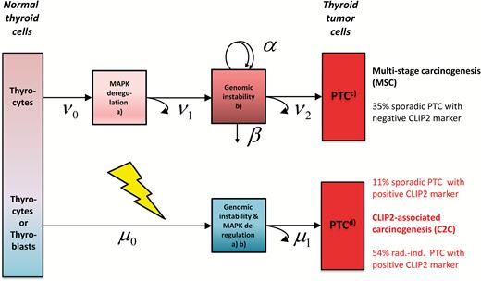
Kaiser JC et al. Carcinogenesis, 37: 1152- 1160, 2016

