Slide 1
How Fractionation Affects Ionizing Radiation Risks
Applicability of Radiation-Response Models to Low Dose Protection Standards
October 2, 2018
Alia Zander
Notes:
Thank you for inviting me to speak today. I’m going to talk to you about how fractionation affects ionizing radiation risks

Slide 2
Dose and Dose Rate Effectiveness (DDREF) estimates
Research Institution | DDREF Value
United Nations Scientific Committee on the Effects of Atomic Radiation (UNSCEAR) | 1.2-2.85 (2006) NA (2012)
SSK German Commission on Radiological Protection | 1
International Commission on Radiological Protection (ICRP) | 2.0
National Council on Radiation Protection (NCRP) | 2.0-10.0
National Academy of Sciences (NAS) - Biological Effects of Ionizing Radiation (BEIR VII) | 1.5
Notes:
One of the major questions in our field is – how does receiving the same dose of radiation over a longer period of time, compared to an acute exposure, impact human health?
A popular method for answering that question is through DDREF – dose and dose rate effectiveness factor. It has been estimated around the world with varying conclusions. Theoretically, it represents the factor difference for risk in acute vs. protracted exposures.
The United Nations Scientific Committee on the Effects of Atomic Radiation estimated a large range of 1.2-2.85 in 2006 and their most recent report concluded that they could not properly estimate. NCRP gives a range of estimates from 2-10. SSK German commision on Radiological Protection wants to abolish DDREF claiming it’s unneccessary, the value is one, there is no difference between risk in acute and protracted exposure. Biological Effects of Ionizing Radiation – BEIR VII was the 7th report in a seris from the National Research Council and our goal standard.

Slide 3
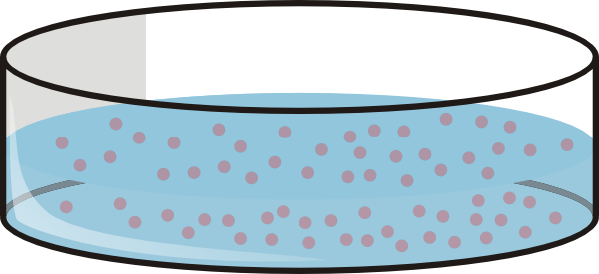


Types of radiation studies
Types of studies | Pros | Cons
 | Controlled experiment Economically advantageous Ease of genetic manipulation | Not as physiologically accurate
 | Controlled experiment Varying doses Varying dose rates Can test multiple species Ease of genetic manipulation | Not species of interest
 | Species of interest | Confounding factors Lack of ethnic diversity Small sample size Mostly acute exposures
Notes:
These estimates combined several data sets to obtain their final result.
There are several methods for determining how ionizing radiation effects human health, and this outlines a few of the pros and cons from each option. In vitro studies are useful because they’re very well controlled, economically advantageious, and easy to genetically manipulate. However, these experiments are less useful for big picture questions because of their simplicity.
Animal experiments are also well controlled and easy to genetically manipulate. You can control the exact doses and dose rates that animals are exposed to and test multiple species. The issue here is that humans are our species of interest.
That leaves epidemiological studies – they’re very useful because we see exactly how the human body responds to ionizing radiation. Issues occur though with confounding factors (was this person a smoker? Did he or she stick to a healthy diet and exercise?), lack of ethnic diversity (nuclear disaster data comes from a specific group of people in a small area), small samples sizes, and mostly acute exposures like the atomic bomb survivors. We believe that combining data from all resources is the best way to determine the risks that humans face. Our lab focuses on animal studies, and today I’m going to talk to you specifically about the Janus data set.

Slide 4
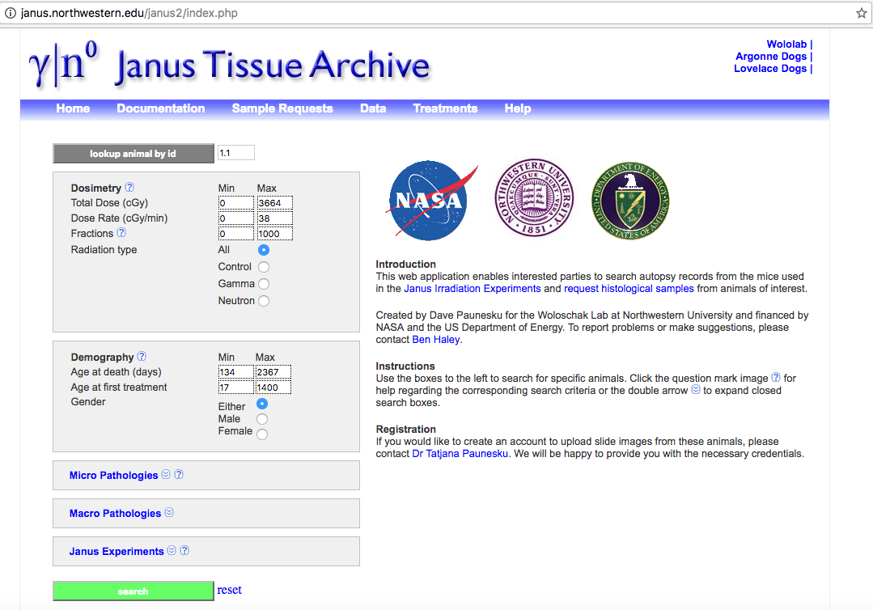
Janus Tissue Archive
Notes:
The Janus Tissue Archive housed in the Woloschak Lab at Northwestern University includes 10 individual studies exploring the effects of neutron and gamma irradiation on over 50,000 mice. This data was only recently publicly digitized and therefore had not been included in any of the previous DDREF estimates. Exposures in mice were acute and fractionated, doses varied from low to high, and age first irradiated was delayed in a small group of animals. I will also point out that tissue samples are available and you can request them through our website here if you’re intertested.
Gamma ray doses 90-5,111cGy Cobalt 60 multiscource irradiator
Neutrons 1-470 cGy .85 MeV Janus reactor

Slide 5
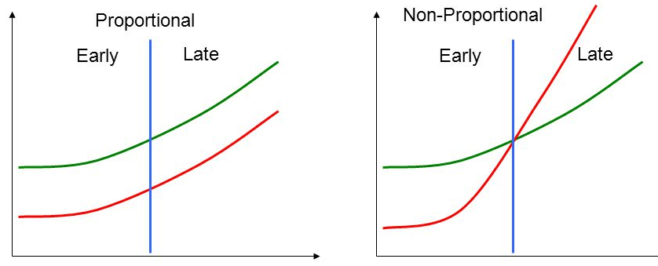
Cox Proportional Hazard Models - Benefits
Most popular model for survival analysis
Allow multivariate survival analysis
Continuous and categorical covariates
Includes interactions between covariates
Stratification to control for nuance variables
Notes:
To determine how these factors impact survival, we used cox proportional hazards models. This is the most common model used for survival analysis and last I checked, it had been cited over 48,000 times. Cox ph is similar to a Kaplan meier, but more powerful.
It allows you to use multiple independent variables that can be categorical OR quantitative, you can include interactions between independent variables, and you can stratify your model.
The hazard ratio is the ratio between the hazard of the event in one group compared to the hazard of the event in another group. In our case today, we are looking at the hazard of death, so our hazards are the instantaneous risk of dying at a given time, given that a subject is still at risk of the event.

Slide 6
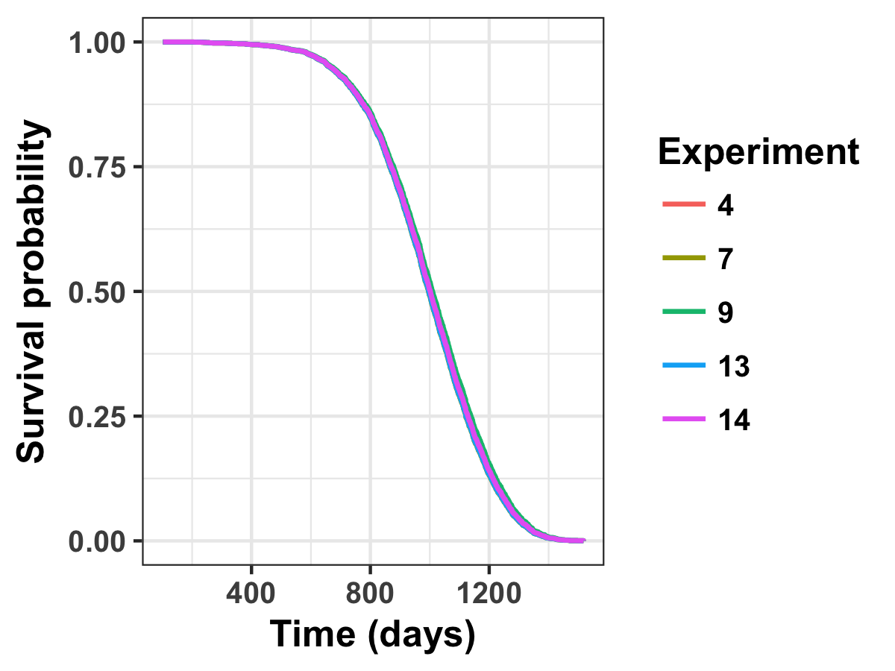
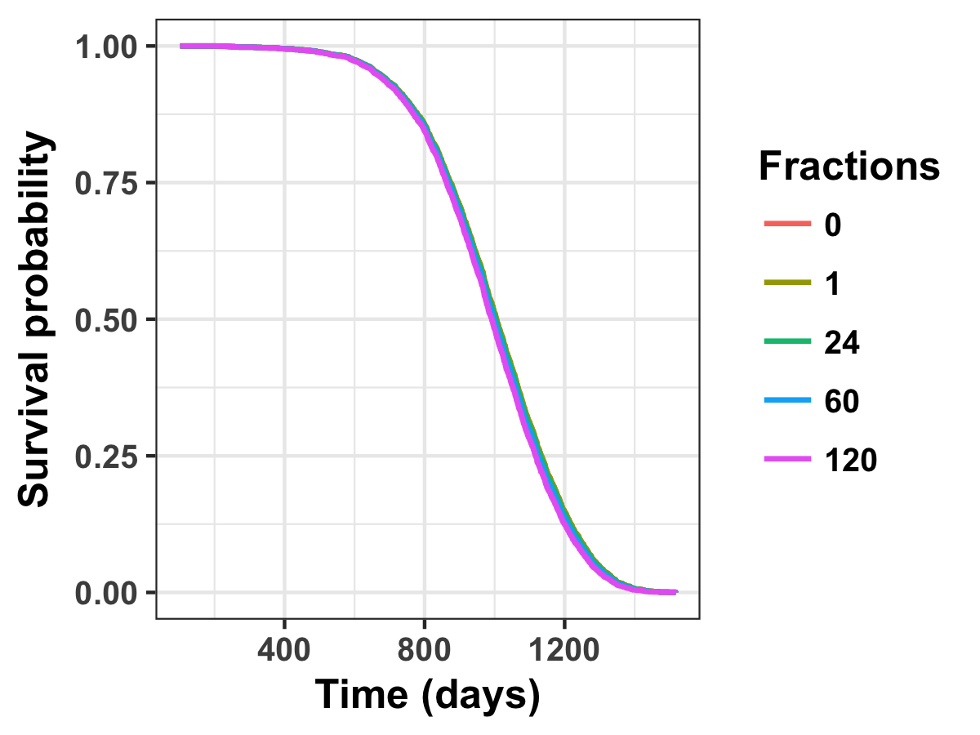
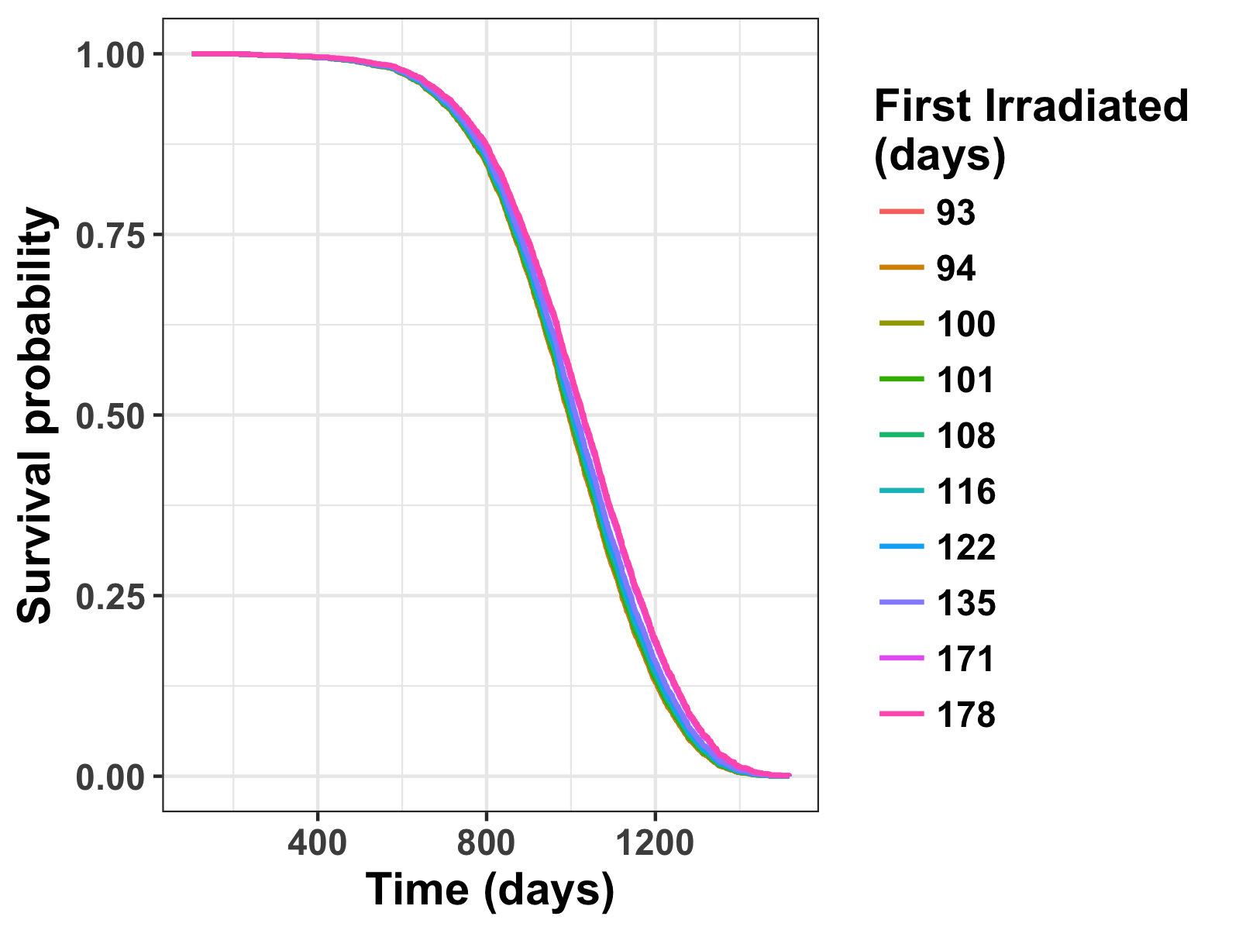
Controls Analysis
Notes:
To begin our analysis, we wanted to be able to safely compare all mice from across experiments. Each experiment was individually planned with a specific question in mind, but also designed to allow for cross-experiment anlaysis. We realize that while this was a great strategy in theory, in practice conditions changed over time. To make sure any significant changes we see between groups of animals is due to our specific questions and not due to differences in baseline models, we filtered mice so that there is no statistically significant differences in control mice based on experiment group, total number of ractions, and age first irradiated. This is the finished produce with a Cox PH estimation of survival

Slide 7
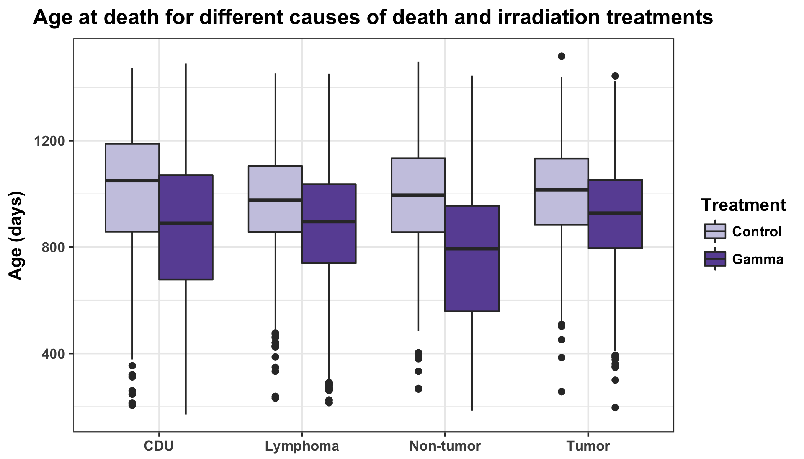
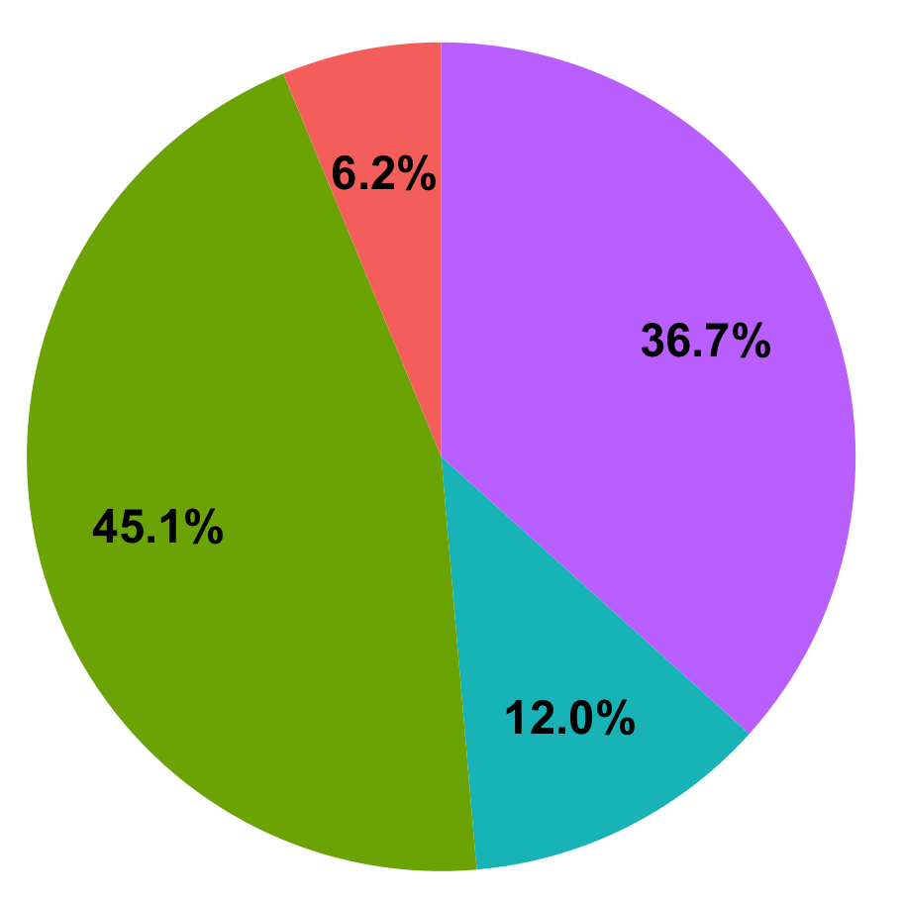
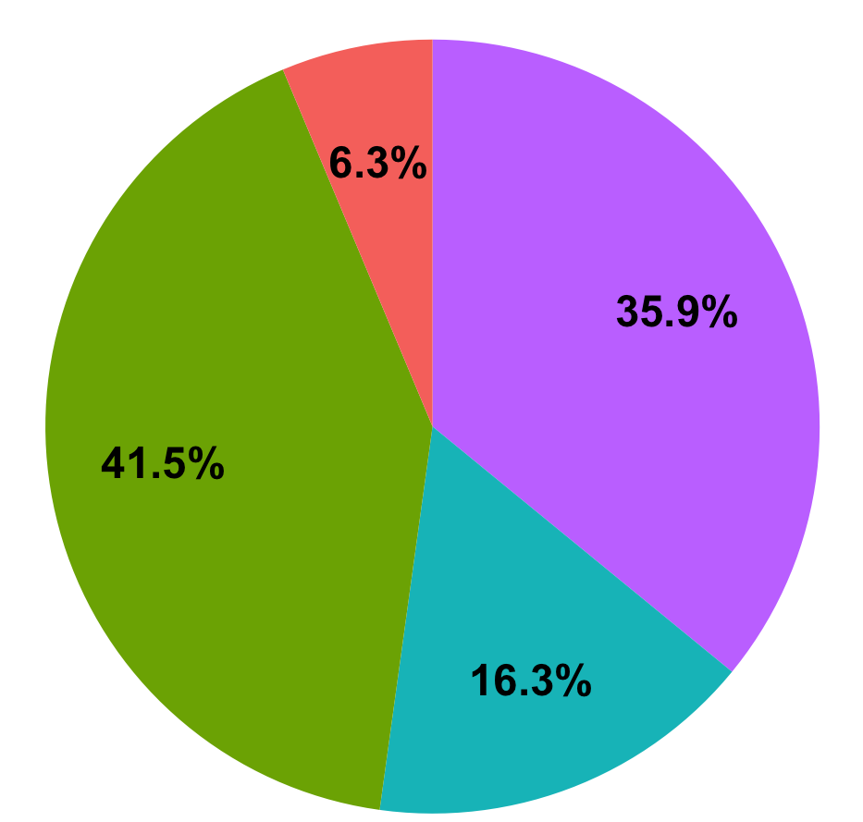
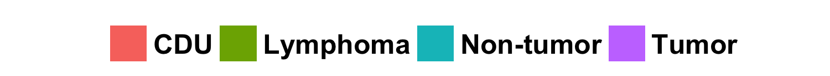
Descriptive Analysis
Control
Gamma

Slide 8
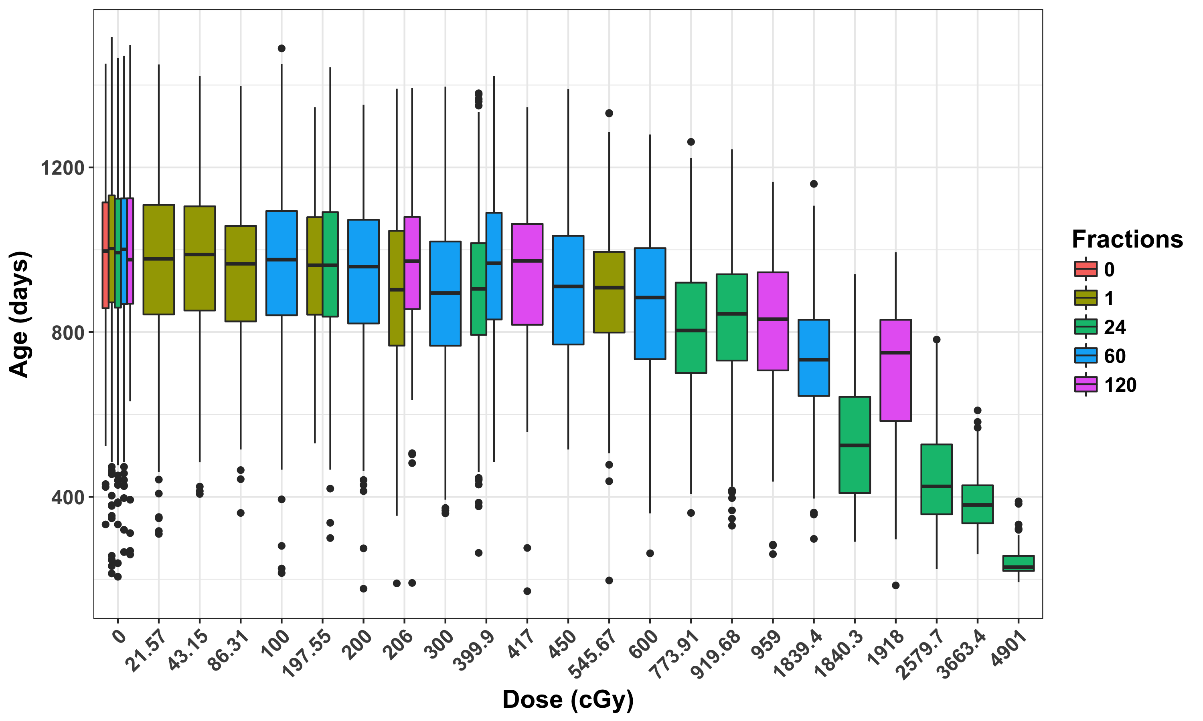
Descriptive Analysis

Slide 9
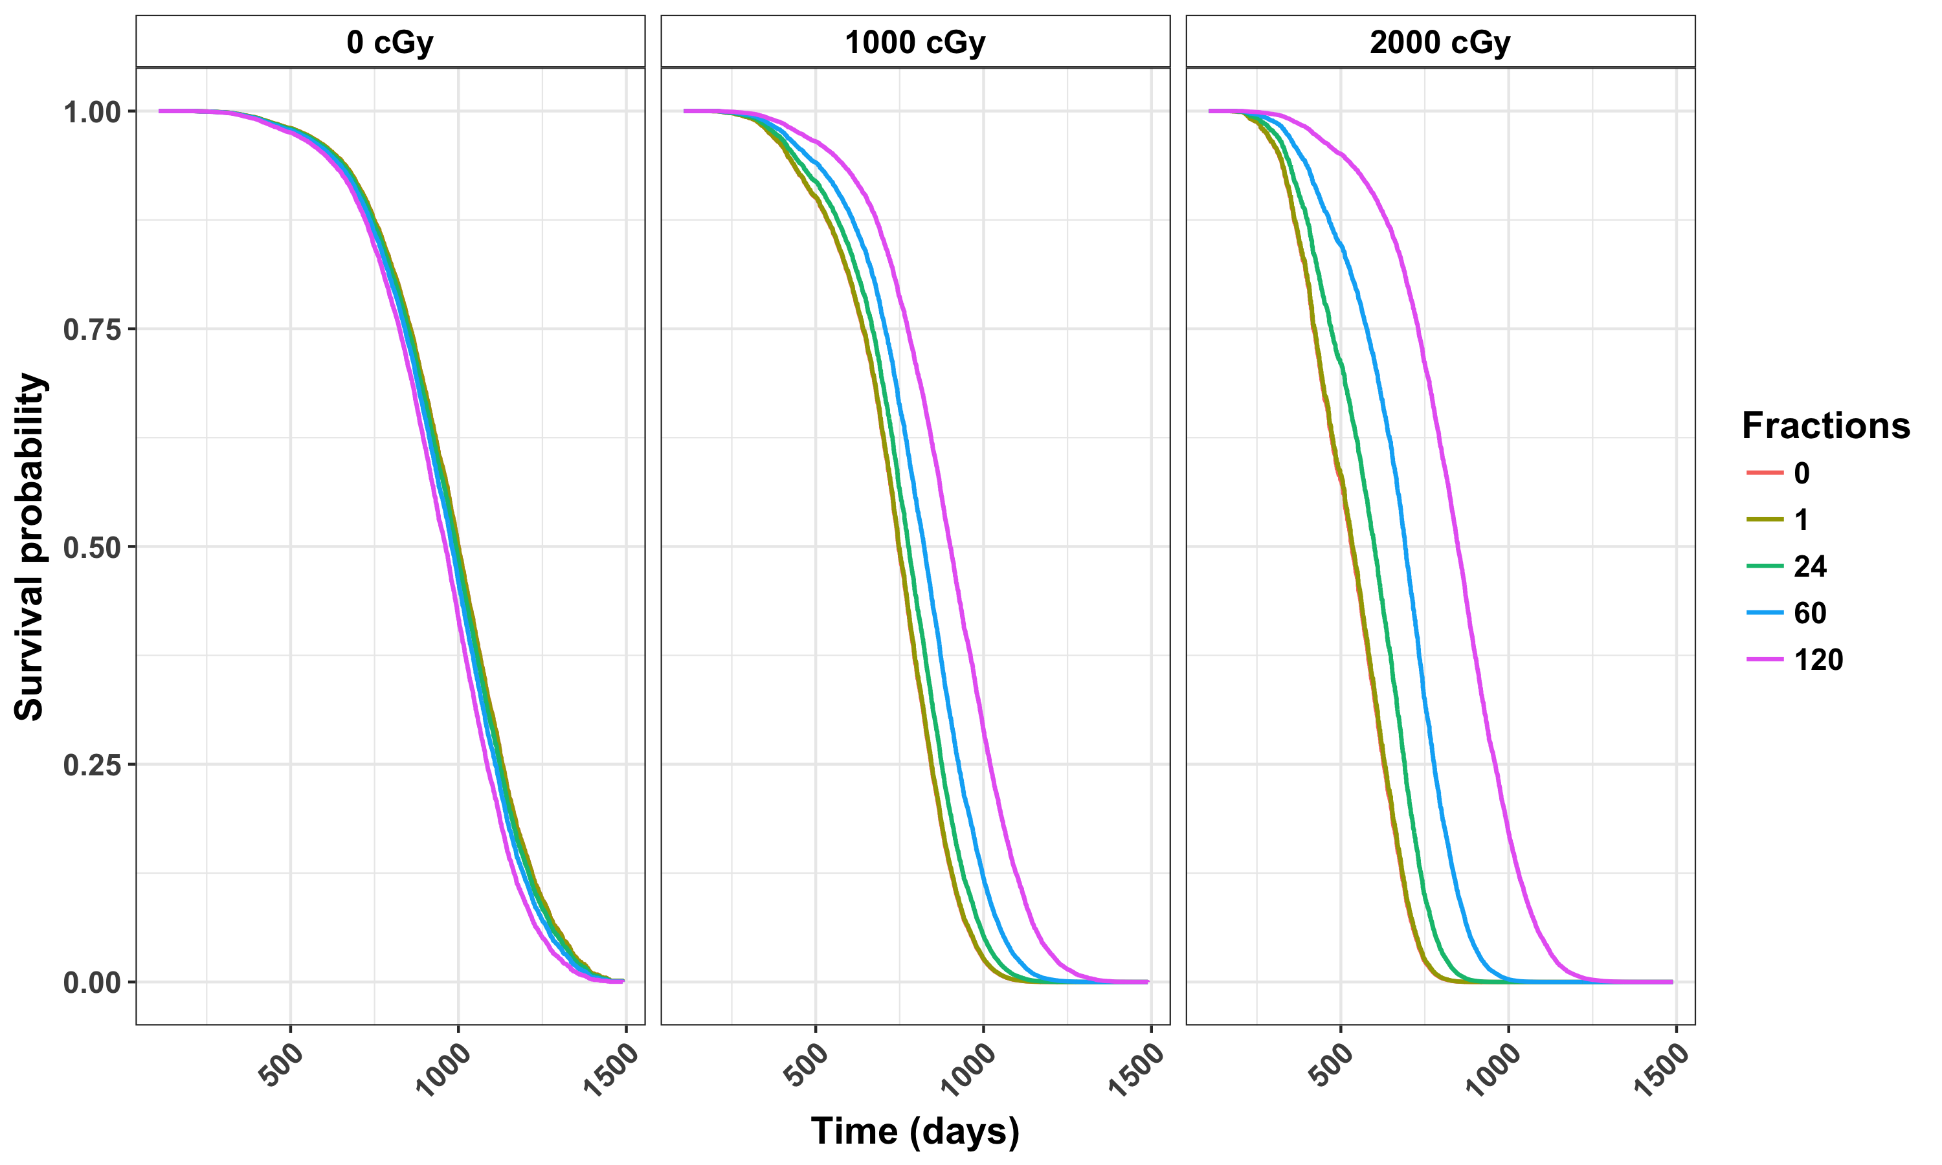
Cox Proportional Hazards Base Model
Notes:
First irrad = 115

Slide 10
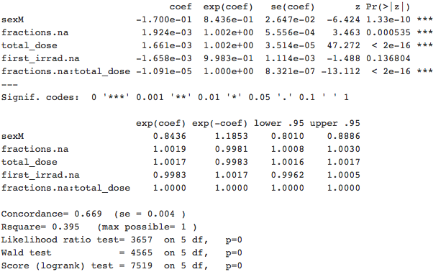
Cox Proportional Hazards Base Model
Notes:
First irrad = 115

Slide 11
Base Model: Robustness checks
Base model:
Sex (categorical covariate) → Stratify ✓
Fractions (continuous covariate) → categorical ✓
24 fractions shows opposite effect, look into this
Dose (continuous covariate) → categorical
Too many degrees of freedom
First Irradiated (continuous covariate) → categorical
Too many degrees of freedom
Notes:
Should I instead add a variable that says control or not? That would only work to give separate values for control or treated. Already did the control analysis, don’t need to do more with that.
For >500 days, mention leverage? Should I show data or can I just explain in words?

Slide 12
Conclusions and Future Directions
Janus data from separate experiments can be combined for one large analysis
Fractionation of gamma irradiation significantly decreases the death hazard in mice
Competing risks analysis can be performed to determine risk for specific causes of death
Neutron irradiated mice will be analyzed

Slide 13
Thank you!
Dr. Gayle Woloschak
Dr. Tatjana Paunesku
Dr. Edward Malthouse
Dr. Alfred Redamaker
Dr. Adin-Christian Andrei
Dr. Ben Haley
Carissa Ritner

