Slide 1
Low-Dose Radiobiology Program at Canadian Nuclear Laboratories:
Past, Present and Future
Dmitry Klokov
Canadian Nuclear Laboratories
Joint Topical ANS & HPS
Tri-Cities, WA
Sept 30 – Oct 3, 2018

Slide 2
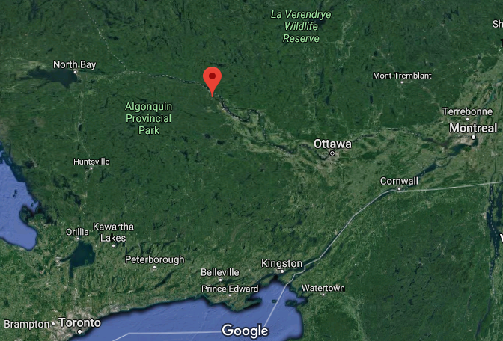
Canadian Nuclear Laboratories
Atomic Energy of Canada Limited
Tri-Cities, Oct 2, 2018
By Dmitry Klokov

Slide 3
Chalk River: birth place of international RP
WWII:
UK nuclear lab moved to Canada in 1942 (Montreal lab)
Joins the Manhattan project and moves to Chalk River
needs for agreed RP norms
1949: Permissible Doses Conference in Chalk River, ON
1st of the Tripartite Conferences on RP Standards
UK, USA and Canadian geneticists/health physicists
First set of internationally agreed RP standards
…based on threshold (permissible) doses
Tri-Cities, Oct 2, 2018
by Dmitry Klokov
Taylor (1980, 1983)

Slide 4
Early studies (1945-1970s): pioneering LDR studies
Mutagenic effects of radiation in:
bacteria (Newcombe 1948, 1949, 1953, 1959)
mammalian cells (Rhynas 1960; McGreggor,1961)
fish (McGreggor 1968)
Epidemiological studies/new quantitation approaches (Newcombe 1959, 1967)
Low dose studies:
Stimulation of production of trout embryos (Newcombe 197a)
Beneficial effects in the offspring (Newcombe 1972b)
“Harm” vs. “benefit” argument (Newcombe 1973)
long before the radioadaptive response Olivieri 1984
Tri-Cities, Oct 2, 2018
By Dmitry Klokov

Slide 5
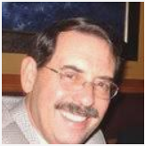
Early studies (1970s-2000s): LDR protects from neoplastic transformation in vitro
Ron Mitchel
Radiation-induced heat-shock proteins (Mitchel 1982)
Inducible DNA repair mechanism (Mitchel 1987)
Mammalian cells exposed to LDR showed neoplastic transformation rates below spontaneous rates (Azzam 1996)
Tri-Cities, Oct 2, 2018
By Dmitry Klokov

Slide 6
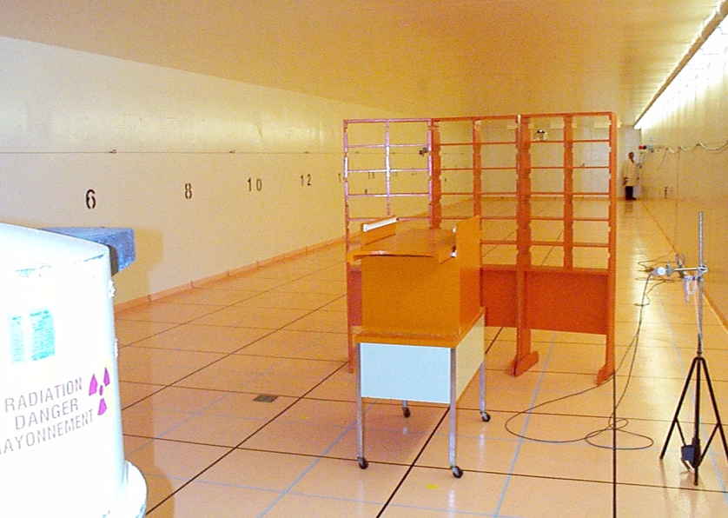
Early studies (1970s-2000s): globally unique low-dose animal irradiation facility
30 m long
SPF
Cs-137: 605 μGy/h to 5.4 Gy/h
Co-60: 76.4 μGy/h to 65,7 mGy/h
One in Norway
One in Japan
Tri-Cities, Oct 2, 2018
By Dmitry Klokov

Slide 7
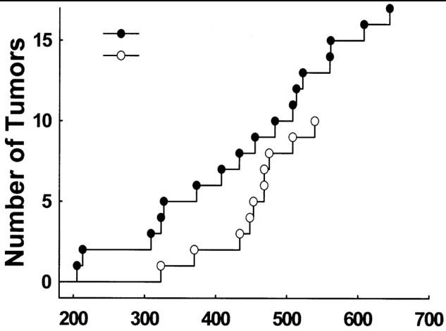
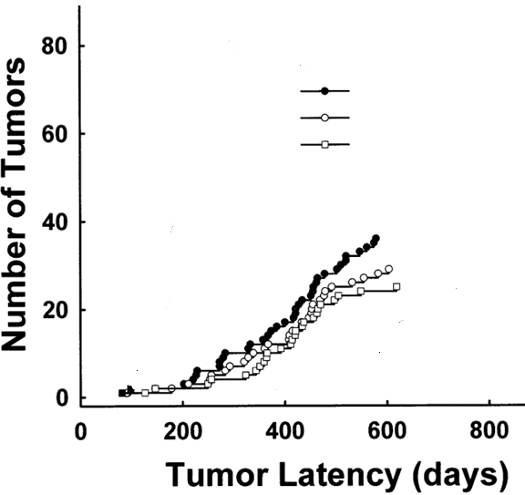
Early studies (1970s-2000s): LDR delays the onset of tumorigenesis in mice in vivo
(Mitchel 1999, 2003)
>100 citations each
osteosarcoma
lymphoma
no dose
low dose
no dose
low dose 1
low dose 2
mechanisms unknown
tumor-free time
tumor-free time
Tri-Cities, Oct 2, 2018
By Dmitry Klokov
Time to Tumors (days)
Time to Tumors (days)

Slide 8
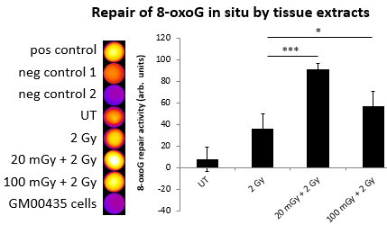
Mechanisms (2007-…): is DNA repair involved?
DNA double-strand break repair is not activated (Blimkie 2014; Bannister 2016)
Other types of DNA repair pathways are activated in mice after 10 and 100 mGy
Tri-Cities, Oct 2, 2018
By Dmitry Klokov

Slide 9
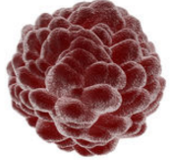
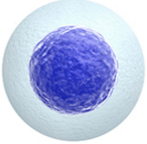
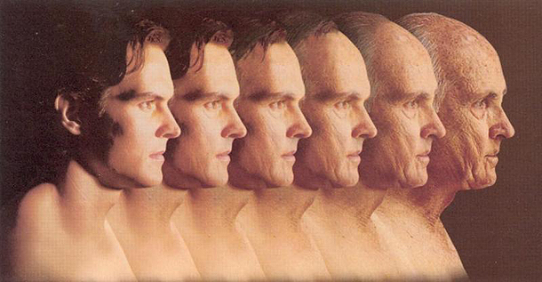
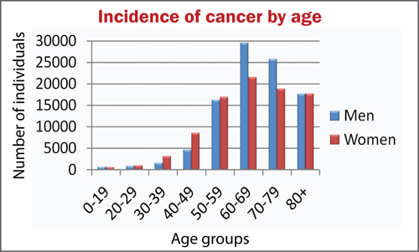
Systemic approach (2014-…):
Cancer
and Aging
DNA damage
Inflammation/Immune system
Genes
Epigenome
Angiogenesis
Genome
EMT
Tri-Cities, Oct 2, 2018
By Dmitry Klokov

Slide 10
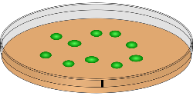
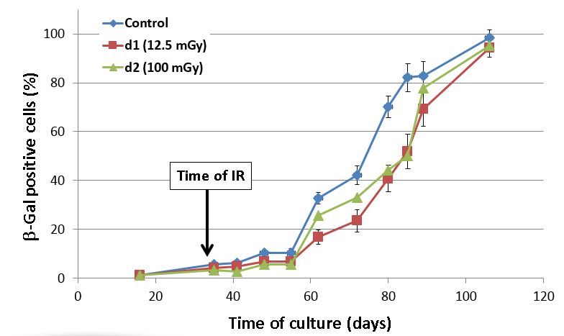
Mechanisms (2014-…): LDR suppresses cellular aging in vitro
Normal human fibroblasts
10 or 100 mGy
cells aged
aged cells quantified
delay in aging
onset
gene expression
protein levels
Tri-Cities, Oct 2, 2018
By Dmitry Klokov
Velegzhaninov et al (2018)

Slide 11
Mechanisms (2014-…): other acute gamma LDR effects
LDR in vivo:
does not enhance aging markers in mice in vivo
potentiates the immune system of old, but not young mice
enhances the Immune Checkpoint Therapy efficacy in mice
LDR in vitro:
partially reverses aging-related loss of stem cells:
muscle SC
mesenchymal SC
endothelial SC
Cancer therapy
Regenerative medicine
Tri-Cities, Oct 2, 2018
By Dmitry Klokov

Slide 12
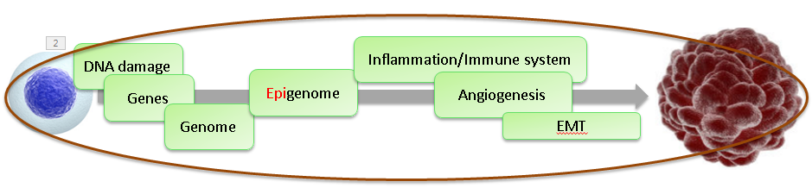


Systemic approach (2016-…): whole picture
Colon Breast Lung
2 months
Apc^{min/+}
MMTV-Neu
A/J
End-points:
DNA damage/repair
DNA methylation
inflammation
immune function
tumor rates/size
stem cell function
…
HTO Gamma Control
Tri-Cities, Oct 2, 2018
By Dmitry Klokov

Slide 13
Systemic approach (2012-…): LDR tritium in vivo
1 or 8 months
Dose-rates:
10 KBq/L == n/a
1 MBq/L == 1.4 μGy/h
20 MBq/L == 31 μGy/h
HTO Gamma Control
HTO or OBT
End-points:
DNA damage/repair
Chromosome aberrations
mRNA, miRNA
Inflammation
Physiological toxicity
Tumorigenesis and life span (CBA, 2-week exposure)
Surette et al (In Prep)
Tri-Cities, Oct 2, 2018
By Dmitry Klokov
(Roch-Lefevre 2018; Gueguen et al 2018)

Slide 14
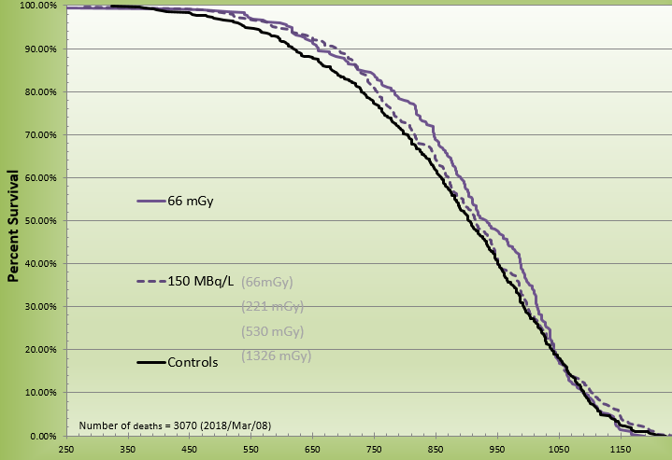
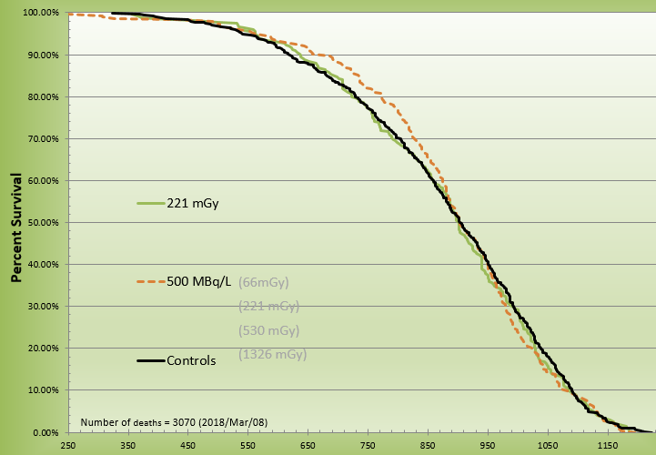
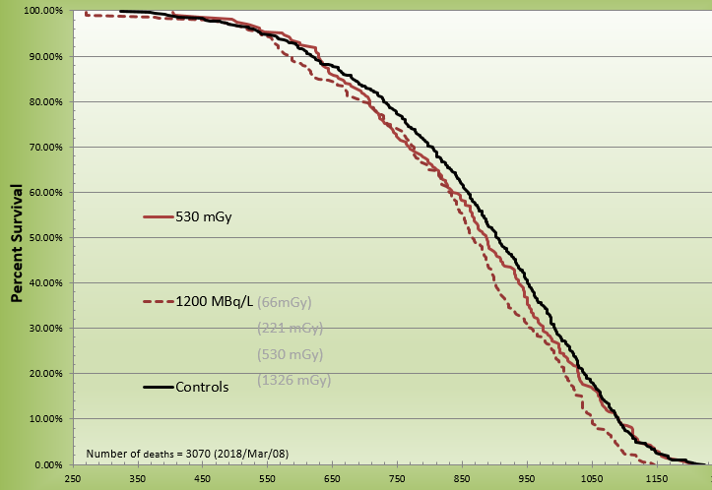
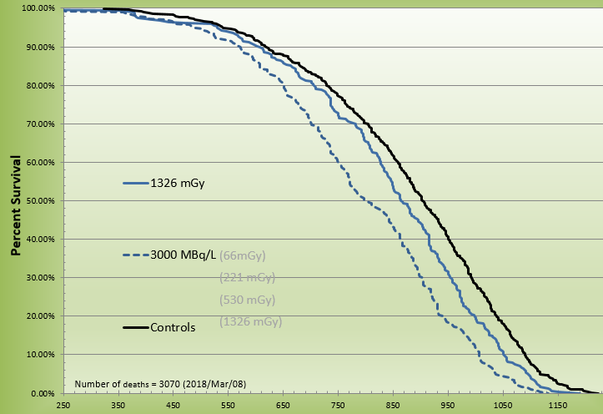
In Vivo Study: CBA/J Life Span
66 mGy
221 mGy
66 mGy
150 MBq/L
Control
221 mGy
500 MBq/L
Control
530 mGy
1326 mGy
*
*
530 mGy
1200 MBq/L
Control
1326 mGy
3000 MBq/L
Control

Slide 15
CONCLUSIONS
CNL maintains the world’s longest low-dose research program
CNL maintains one of the world’s unique low dose / low dose rate animal irradiation facilities (external + internal)
Results collectively support the lack of detrimental biological and health effects at low doses
Lack of effects (DNA DSB repair, CBA mice life span, aging markers)
Stimulatory effects (DNA repair, stem cells)
Beneficial effects (delay of tumorigenesis in mice)
Holistic (molecules->cells->tissues->organism) understanding of health outcomes is needed: studies ongoing, but more collaboration needed
Future: therapy applications, individual radiosensitivity…
Tri-Cities, Oct 2, 2018
By Dmitry Klokov

Slide 16
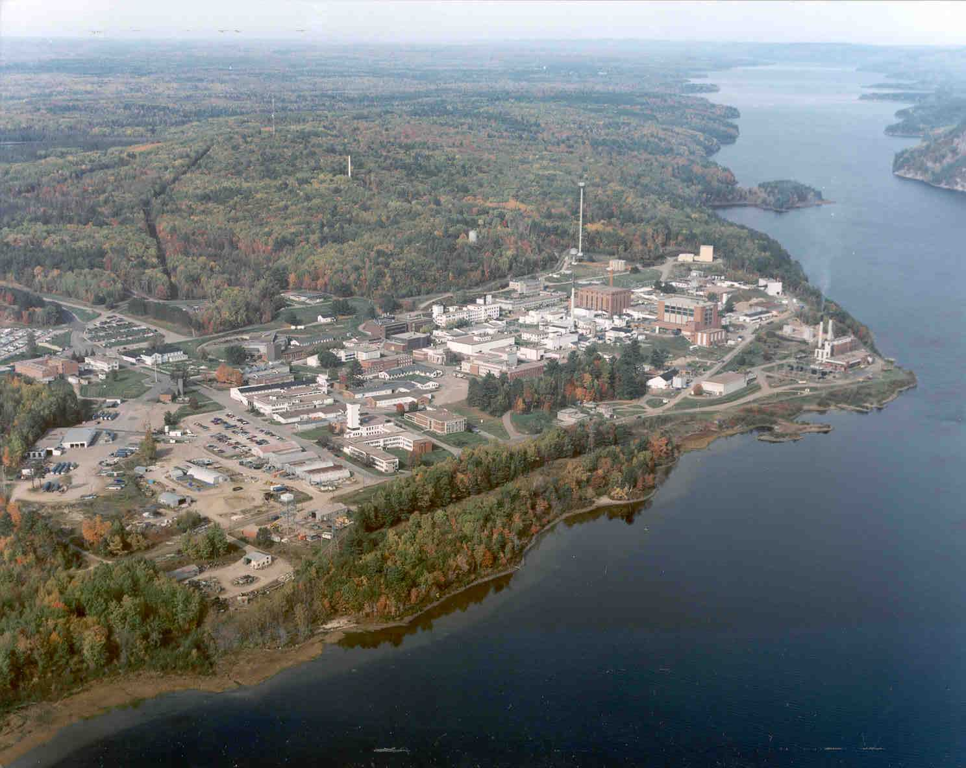

Acknowledgements
CNL
Mathew Flegal
Lindsey Bertrand
Yi Wang
Soji Sebastian
Yevgeniya Le
Animal Facility team
Russian Academy of Sciences
Ilya Velegzhaninov
Katya Plyusnina
Alexey Moskalev
Canadian Nuclear Laboratories
IRSN
Sandrine Roch-Lefevre
Eric Gregoire
Yann Gueguen
…
Funding
Canada
COG
Notes:
Please note: Limited to 1 slide max
Project status must include:
Tasks Performed in the first six months
Milestone and budget

