Slide 1



Delayed Effects of a Whole-body Exposure to
Low-dose Radiation on
Somatic and Germinal Cells of Mice
Kanokporn Noy Rithidech
Witawat Jangiam
Montree Tungjai
Louise Honikel
Chris Gordon

Slide 2
Why is it important to conduct this study?
There is insufficient information on late (or delayed) effects of low-dose radiation (LDR) that are highly relevant to risk assessment.
2. There is scant information on late effects of LDR on germinal cells (testis). It is known that any damage in these cells is likely to be transmitted to the offspring and, hence, such damage is highly relevant to genetic risks.
3. There is no information on the late effects of LDR across tissues of the same exposed individual using various biological metrics highly relevant to health risks.
ANS/HPS, 2018

Slide 3
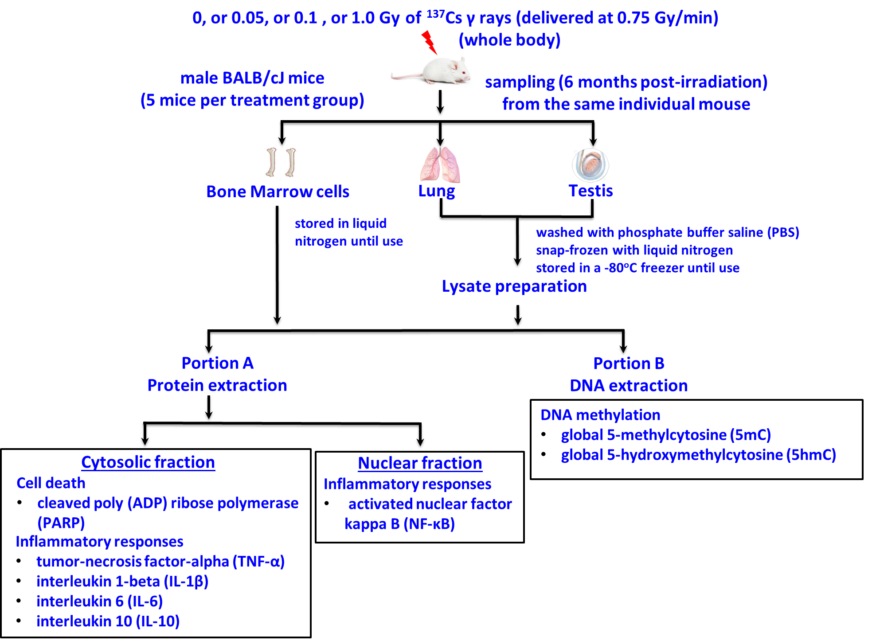
METHODS

Slide 4
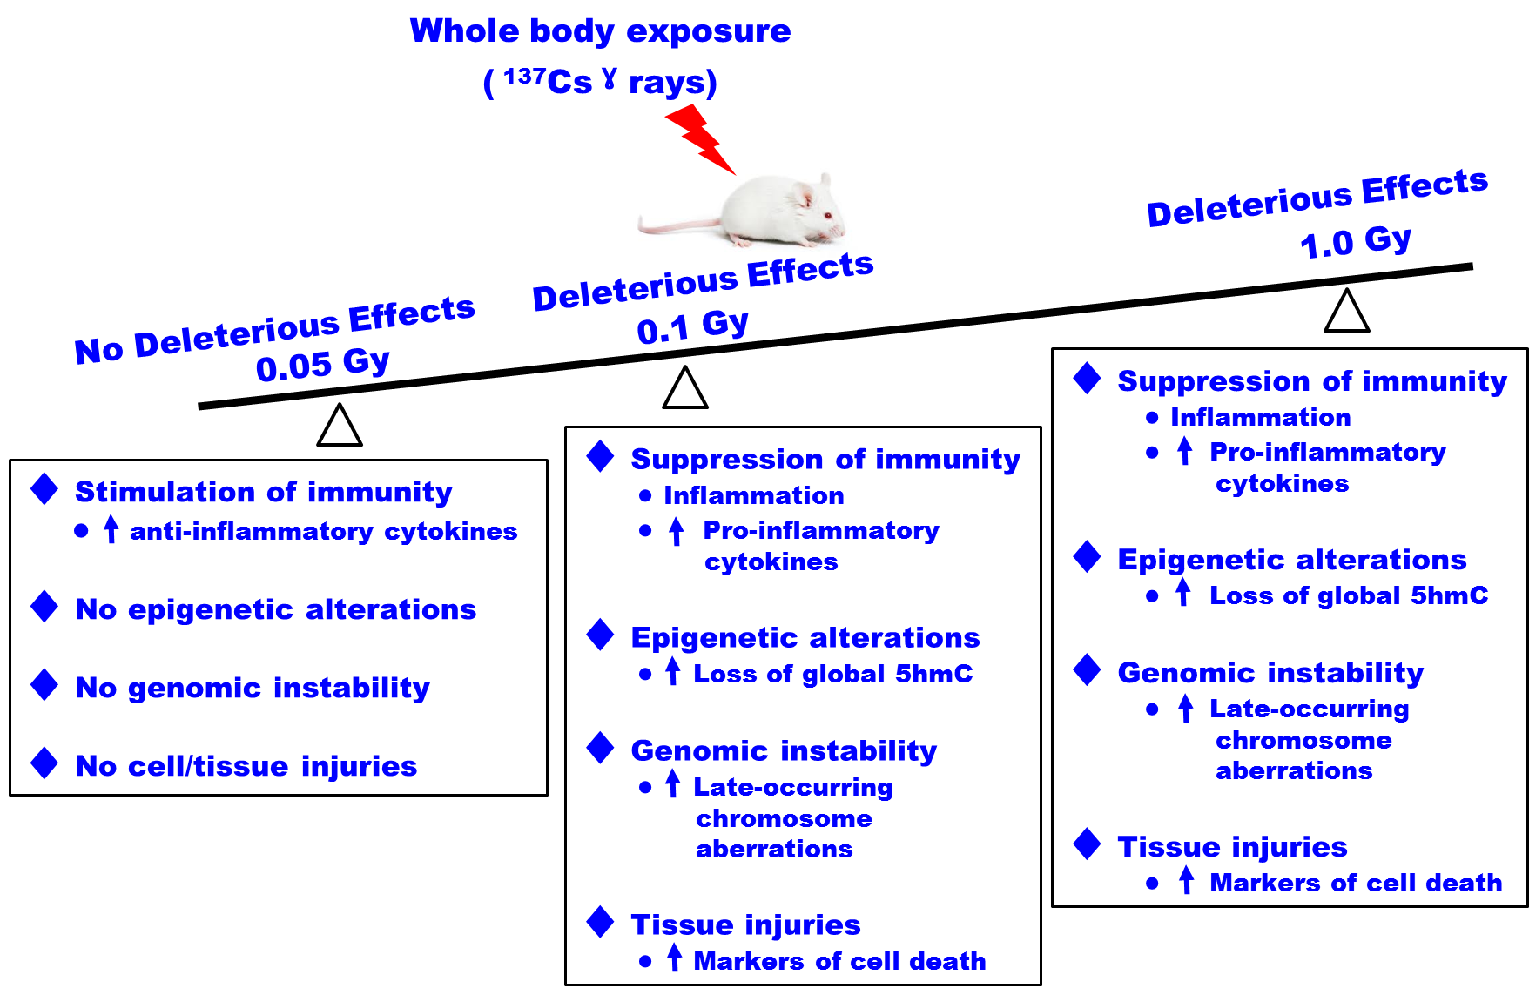
RESULTS and CONCLUSIONS
Our data demonstrated not only no harm but also hormesis in the 0.05-Gy exposed mice. Yet, such hormetic effects appear to be dependent on the tissue and biological metric used for the analyses.

