Slide 1
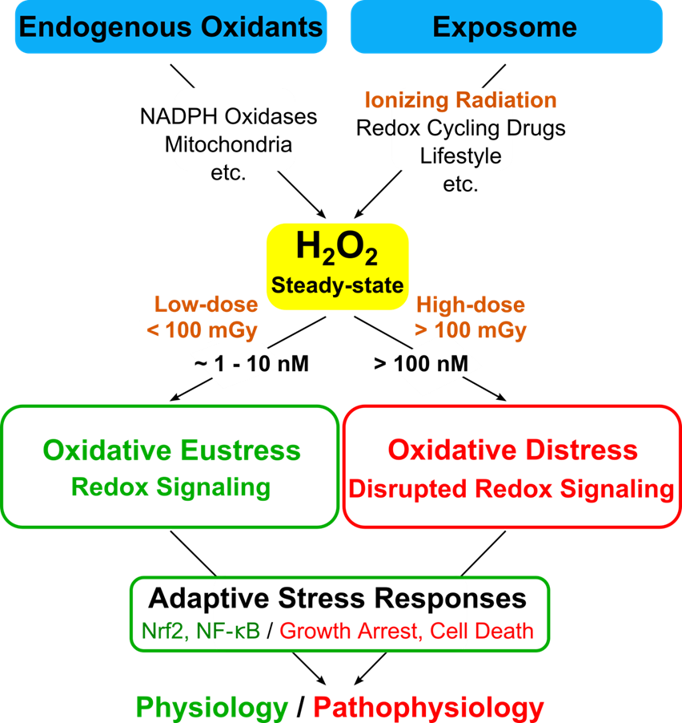

Slide 2
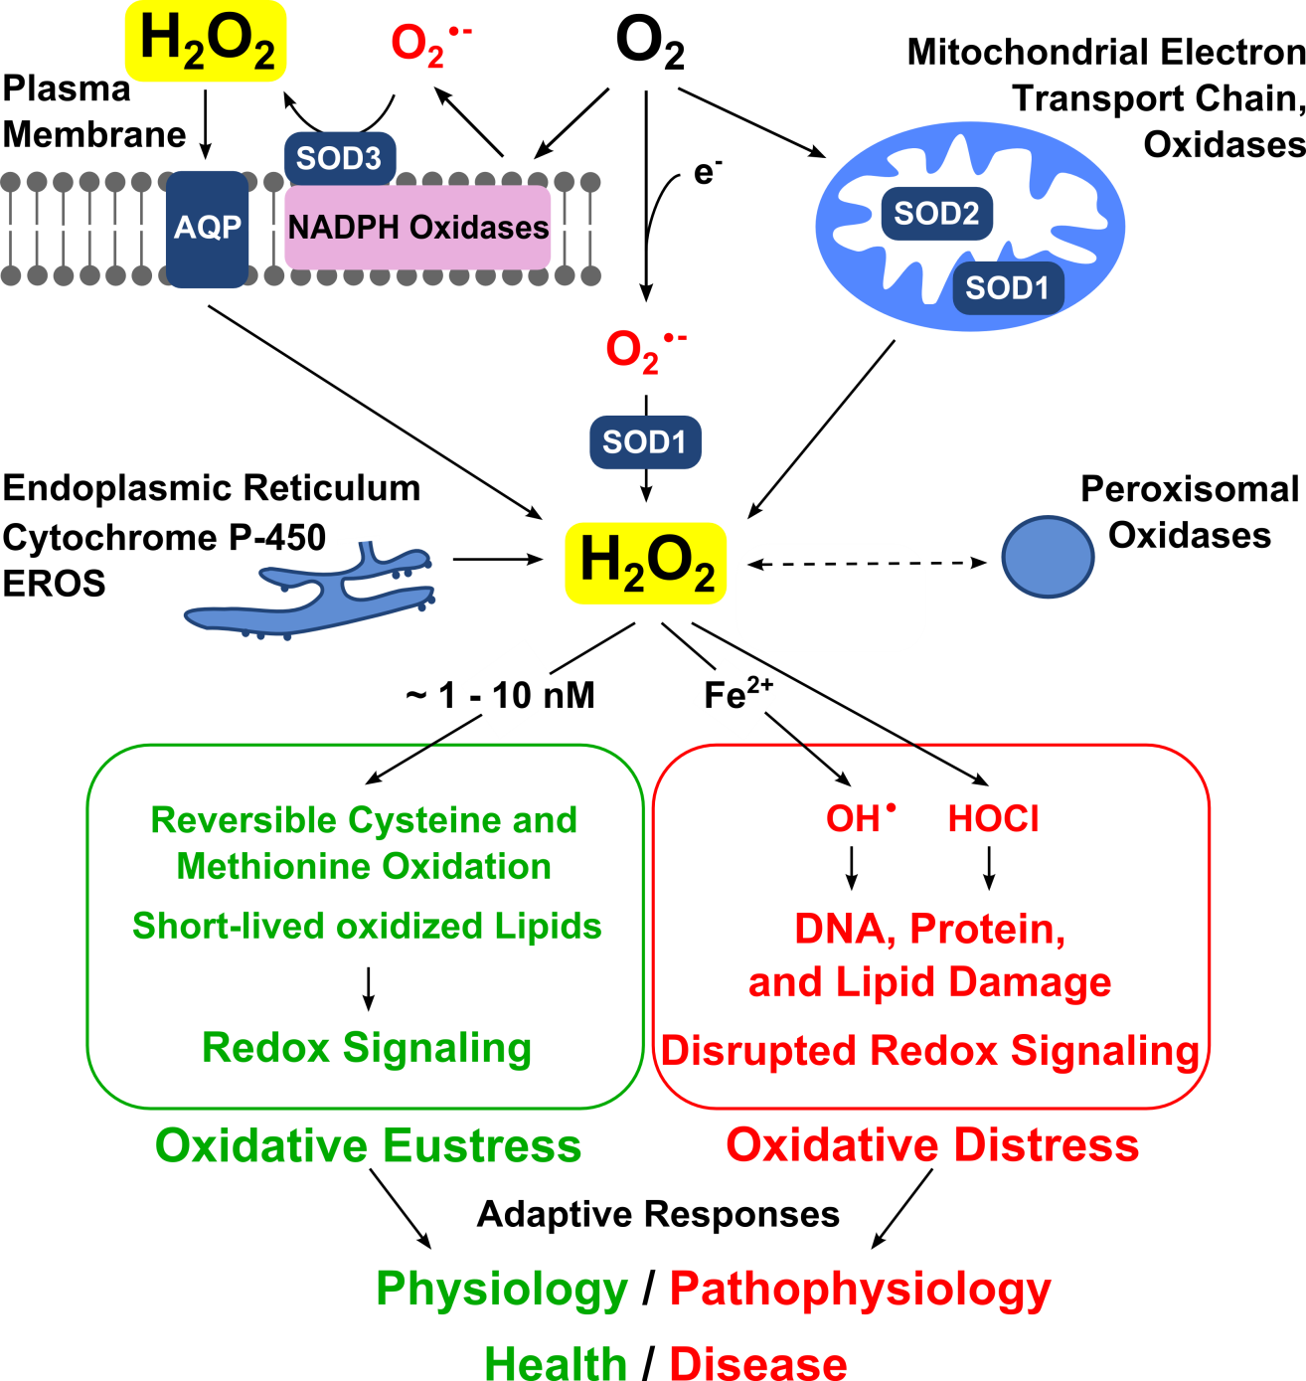
Redox Biol. 11, 613-619, 2017

Slide 3
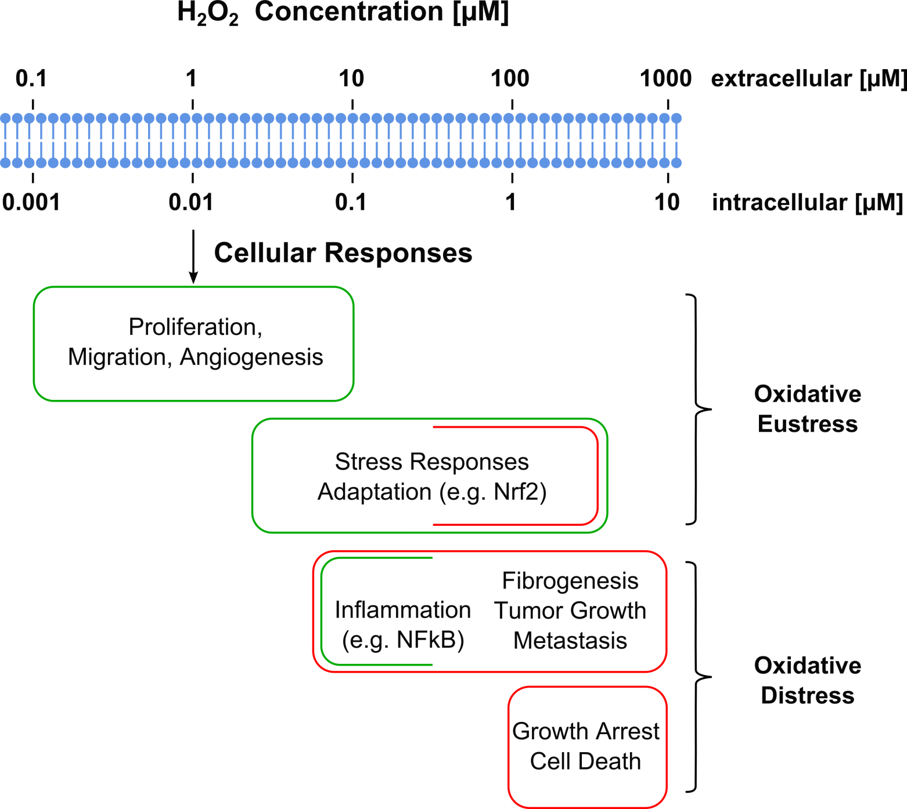
Redox Biol. 11, 613-619, 2017

