Slide 1
Low-Dose Radiation: Interagency Collaboration on Planning Research Could Improve Information on Health Effects
Allen Chan
U.S. Government Accountability Office
October 2, 2018

Slide 2
Who Are We?
GAO is an independent, nonpartisan agency serving the Congress to help improve the performance and ensure the accountability of the federal government.
Our work is done at the request of congressional committees or subcommittees or is mandated by public laws or committee reports.
To ensure independence, the Comptroller General is appointed to a 15-year term by the President. Other than the CG, there are no political appointees at GAO.

Slide 3
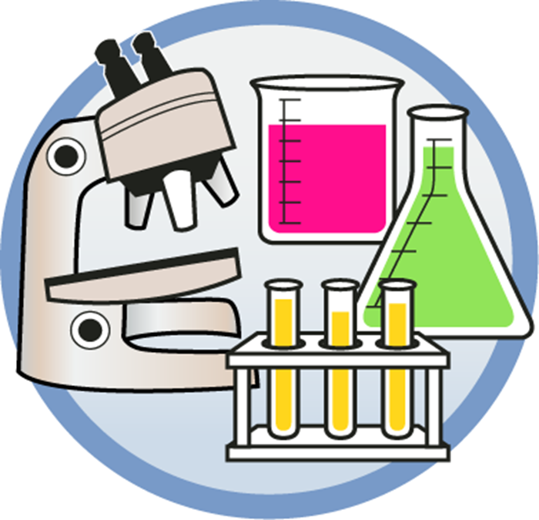
How Are We Organized?
GAO is organized into 14 mission teams by subject area
GAO’s Science and Technology Issue Area conducts audits of federally funded R&D, IP protection & innovation programs
GAO's Center for Science, Technology, and Engineering conducts technology assessment and provides expertise to audit teams

Slide 4
Background and Reporting Objectives
Request from House Committee on Science, Space, and Technology
Interest in understanding federal agencies’ radiation protection requirements and guidance, and related federal research
GAO issued report in September 2017 (GAO-17-546) and subsequently testified to Congress on report in November 2017 (GAO-18-184T)
Reporting Objectives
How have selected federal agencies developed and applied radiation protection requirements and guidance for workers and the public?
To what extent have federal agencies funded and collaborated on research on the health effects of low-dose radiation?

Slide 5
Scope and methodology
Definition of “low-dose” radiation
Below 100 millisieverts (10 rem) according to National Academies 2006 report
Focus on ionizing radiation
Research Inclusions/Exclusions
Also Included research on high-dose radiation if agency officials indicated potential implications for low-dose research
Excluded research on radiation countermeasures for emergency response and medicines for treating cancer
Excluded research on health effects of radiation in space

Slide 6
Scope and methodology
Four settings in which radiation exposure can occur:
Operation and decommissioning of nuclear power plants
Cleanup of sites with radiological contamination
Use of medical equipment that produces radiation, and
Accidental or terrorism-related exposure to radiation
Four federal agencies involved in setting requirements:
Environmental Protection Agency (EPA)
Nuclear Regulatory Commission (NRC)
Department of Energy (DOE), and
Food and Drug Administration (FDA)
Three advisory bodies
International Commission on Radiological Protection (ICRP)
National Council on Radiation Protection and Measurements
National Academies of Sciences, Engineering, and Medicine

Slide 7
Scope and methodology
Requested information from federal agencies on their funding of research on low-dose radiation in fiscal years 2012-2016:
Environmental Protection Agency (EPA)
Nuclear Regulatory Commission (NRC)
Department of Energy (DOE)
Food and Drug Administration (FDA)
Centers for Disease Control and Prevention (CDC)
National Institutes of Health (NIH)
Occupational Safety and Health Administration (OSHA)
National Aeronautics and Space Administration (NASA)
National Institute of Standards and Technology (NIST)
Department of Defense
Department of Homeland Security (DHS)

Slide 8
Objective 1: Agencies Relied on Advisory Bodies to Develop Radiation Protection Requirements
Scientific Advisory Bodies: ICRP, NCRP and National Academies
Support linear no-threshold model – assumes risk of cancer increases with every incremental increase in radiation exposure
Recognize challenge in accurately estimating cancer risks from very low doses of radiation exposure (below 100 millisieverts (10 rem) according to National Academies 2006 report)
National Academies report identified research needs in several areas
Agency regulations
Under linear no-threshold model, federal agencies set dose limits for radiation exposure well below National Academies low-dose level
Agency radiation protection requirements vary depending on setting

Slide 9
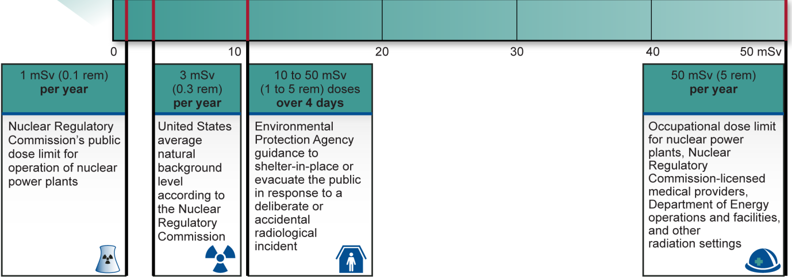
Objective 1: Federal Agency Radiation Protection Requirements

Slide 10
Objective 2: Federally Funded Research on Low-Dose Radiation Health Effects
Seven agencies funded research FY2012-2016
DOE, CDC, DOD, EPA, NASA, NIH and NRC obligated about $210 million for research on the health effects of low-dose radiation
DOE and NIH accounted for most of this funding
DOE’s Office of Science funded Low Dose Radiation Research Program for radiobiological research
DOE’s Office of Environment, Health, Safety, and Security funded several epidemiological studies, including those involving Japanese atomic bomb survivors and assessments of Russian worker and public health risks from radiation exposure in nuclear weapons production in the former Soviet Union
NIH has funded both epidemiological and radiobiological studies on low-dose radiation to quantify and understand cancer risks

Slide 11
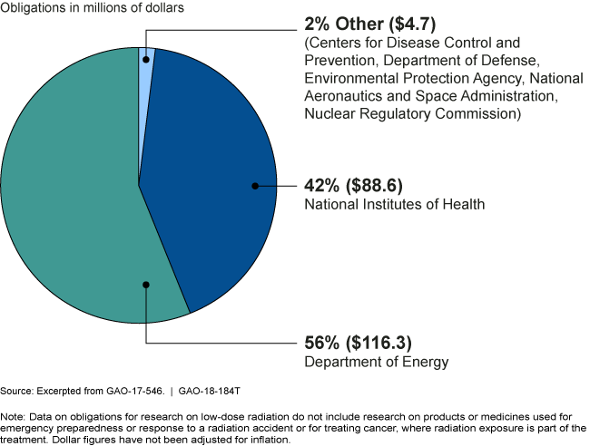
Objective 2: Obligations for Research on Health Effects of Low-Dose Radiation, by Federal Agency, for Fiscal Years 2012-2016

Slide 12
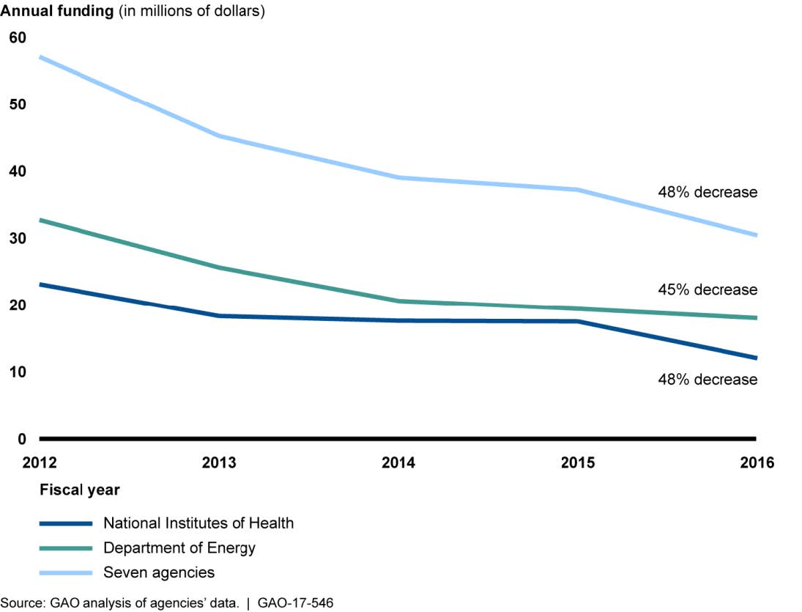
Objective 2: Federally Funded Research on Low-Dose Radiation Health Effects
Federal funding for low-dose radiation research decreased by 48% from FY2012-2016

Slide 13
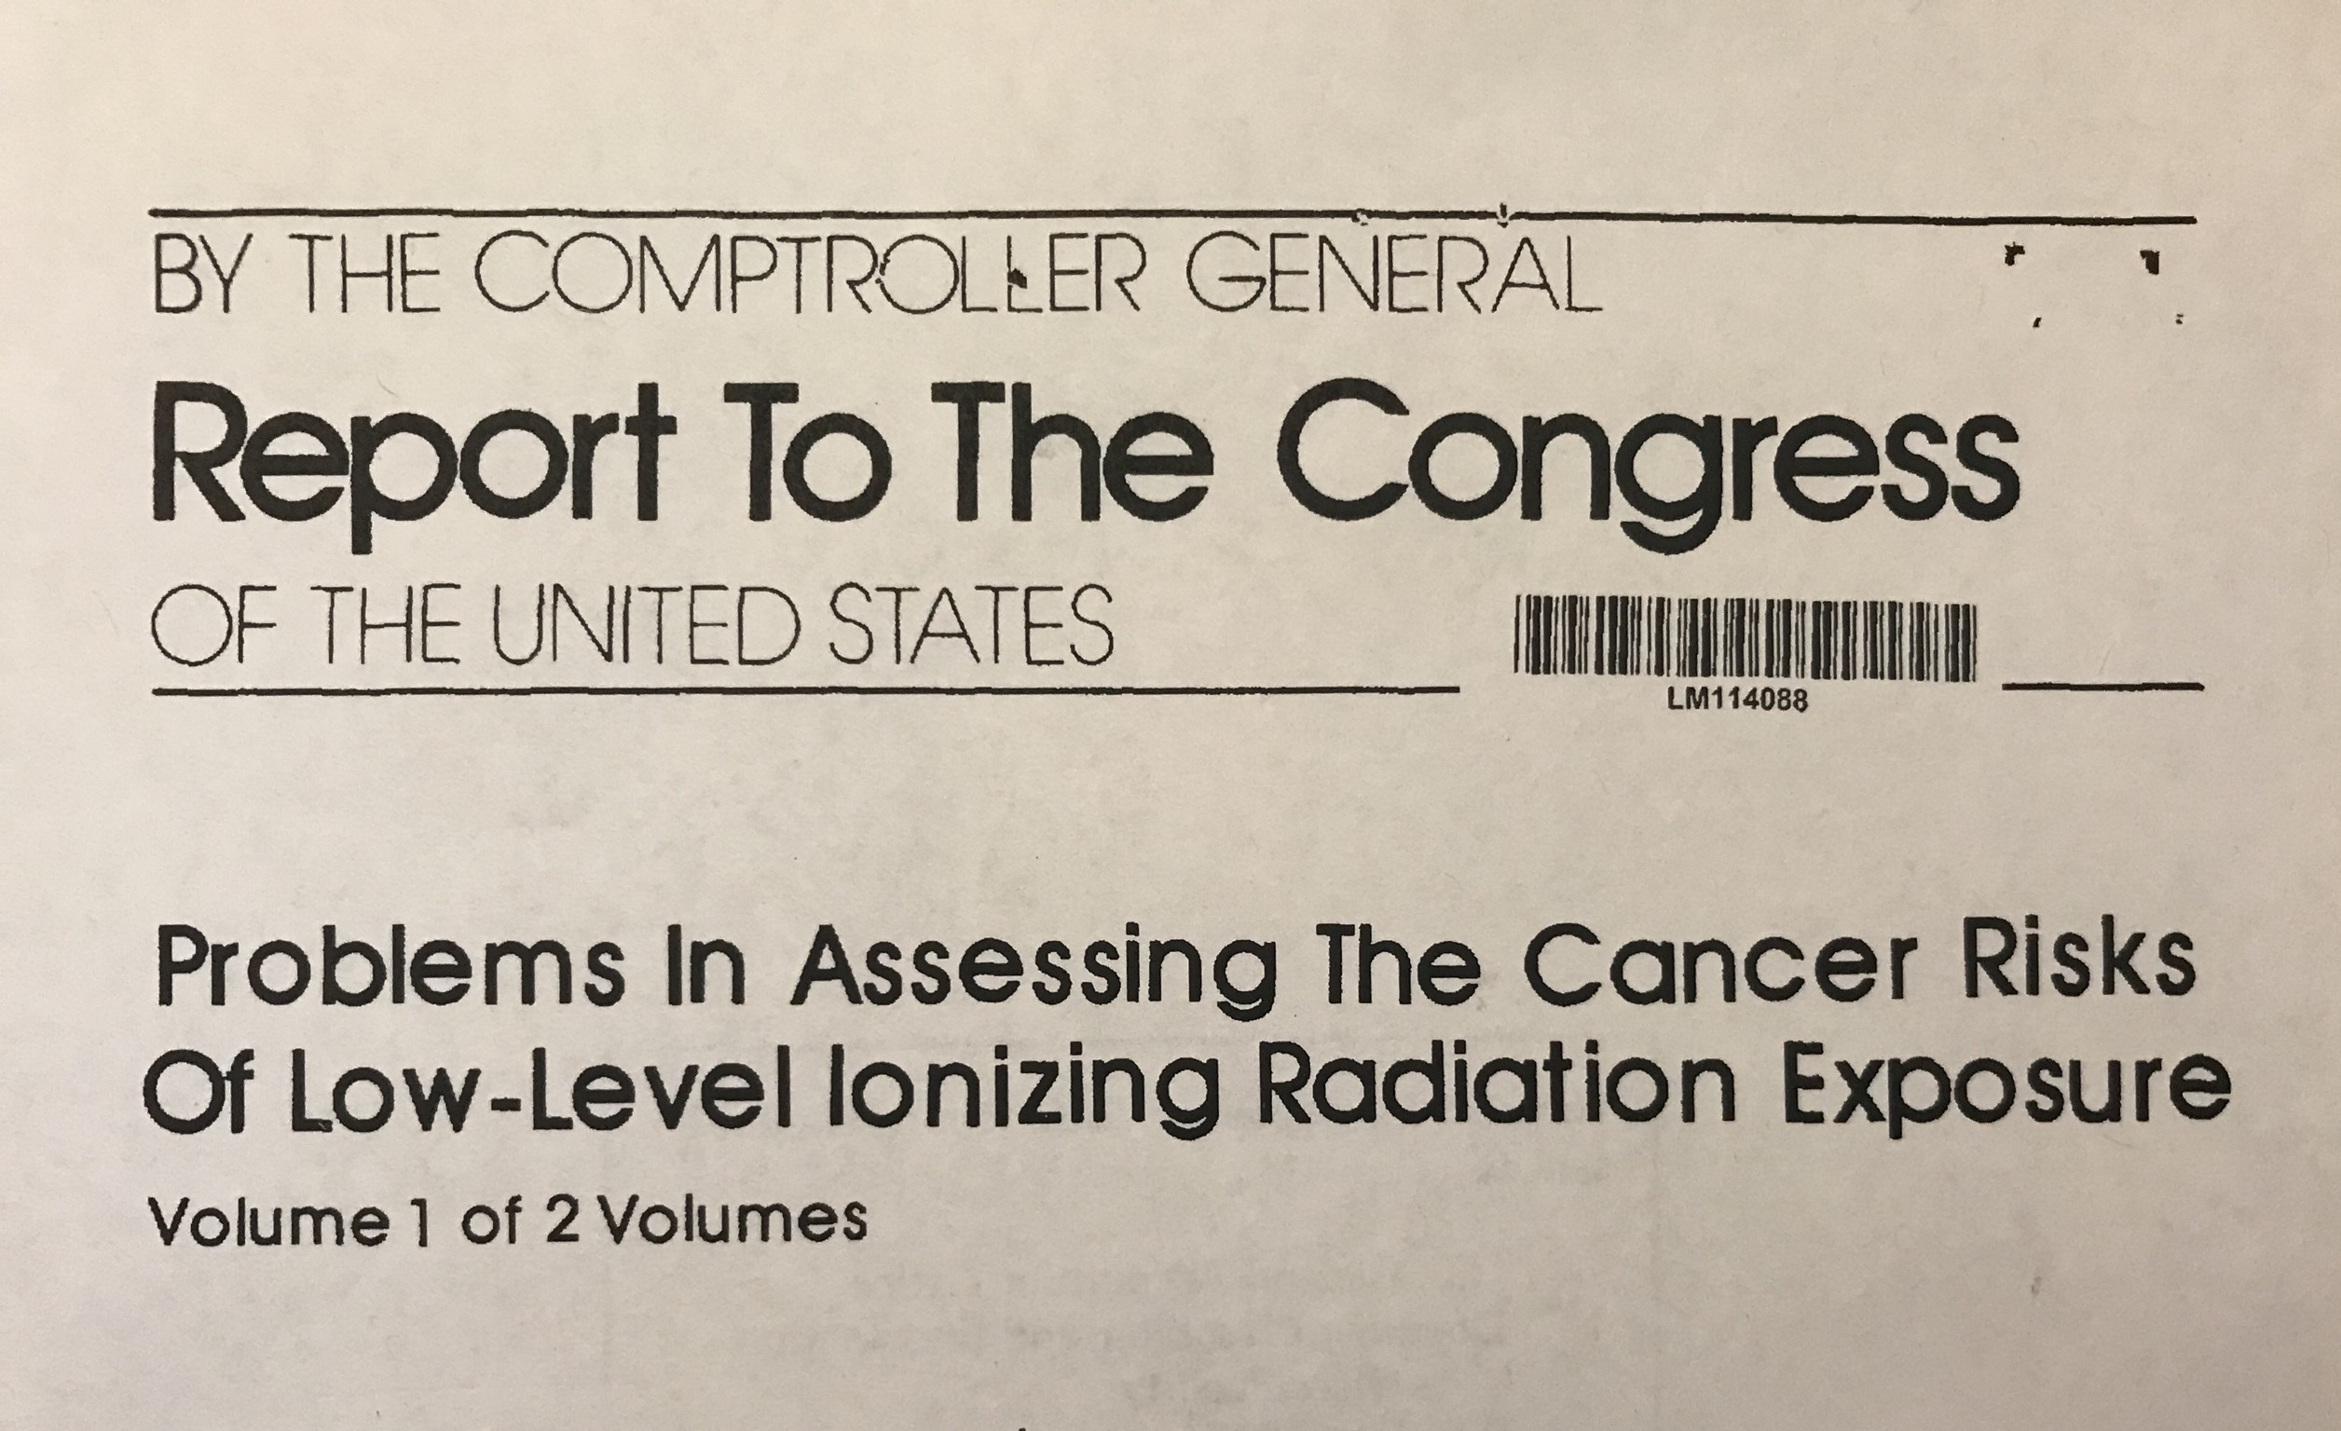
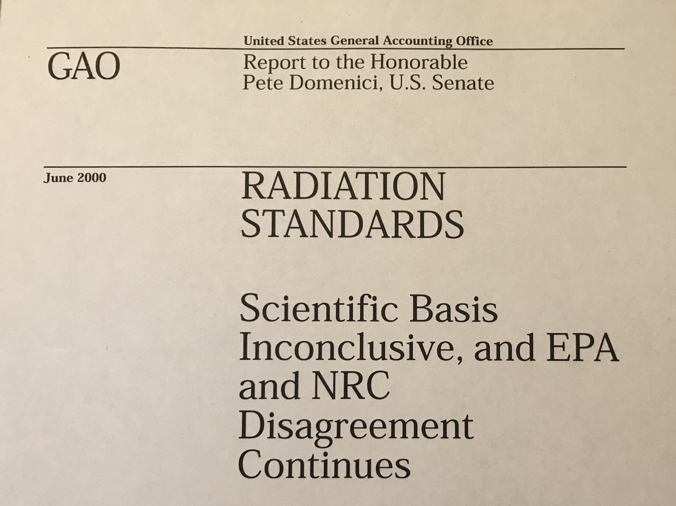
Past GAO Reports

Slide 14
GAO Recommendation
Recommendation:
Secretary of Energy lead development of interagency collaboration mechanism to determine roles and responsibilities for addressing priorities for low-dose radiation research
DOE did not concur, but recently informed GAO that National Science and Technology Council (NSTC) within the White House will work with agencies to align low-dose radiation research with a government-wide strategy to be developed by an interagency working group.
Next steps: GAO will conduct at least annual recommendation follow-up with DOE.

Slide 15
Questions?
For copies of GAO reports: http://www.gao.gov

