Slide 1
Radiation Hormesis and Radiation Protection
Mohan Doss, PhD, MCCPM
Medical Physicist,
Professor, Diagnostic Imaging,
Fox Chase Cancer Center, Philadelphia, PA, USA
E-mail: mohan.doss@fccc.edu
Presentation at:
ANS-HPS Topical Meeting on
Applicability of Radiation-Response Models to Low Dose Protection Standards
Pasco, WA
Oct 1-3, 2018
Copyright © 2018 by Mohan Doss.
Disclaimer: Opinions expressed in this presentation are my own professional opinion, and do not necessarily represent those of my employer.

Slide 2


Disclosures
I am one of the founding members of
Scientists for Accurate Radiation Information (SARI)
http://radiationeffects.org/
&
President, XLNT Foundation
https://www.x-lnt.org/
These organizations aim to reduce the harmful consequences due to the LNT model.
SARI and XLNT Foundation have an exhibit booth. Please view the SARI & XLNT poster for more information regarding these organizations.

Slide 3
Top Three Diseases of Concern
Cardiovascular Disease
Cancer
Alzheimer’s Disease
The LNT Model presents a major obstacle for performing investigative studies of prevention and treatment of these diseases using low-dose radiation, in spite of available evidence.
Change to a radiation protection paradigm based on radiation hormesis can facilitate and enable progress in tackling these and other diseases.

Slide 4
The Best of the Best Evidence Supporting the LNT Model
4

Slide 5
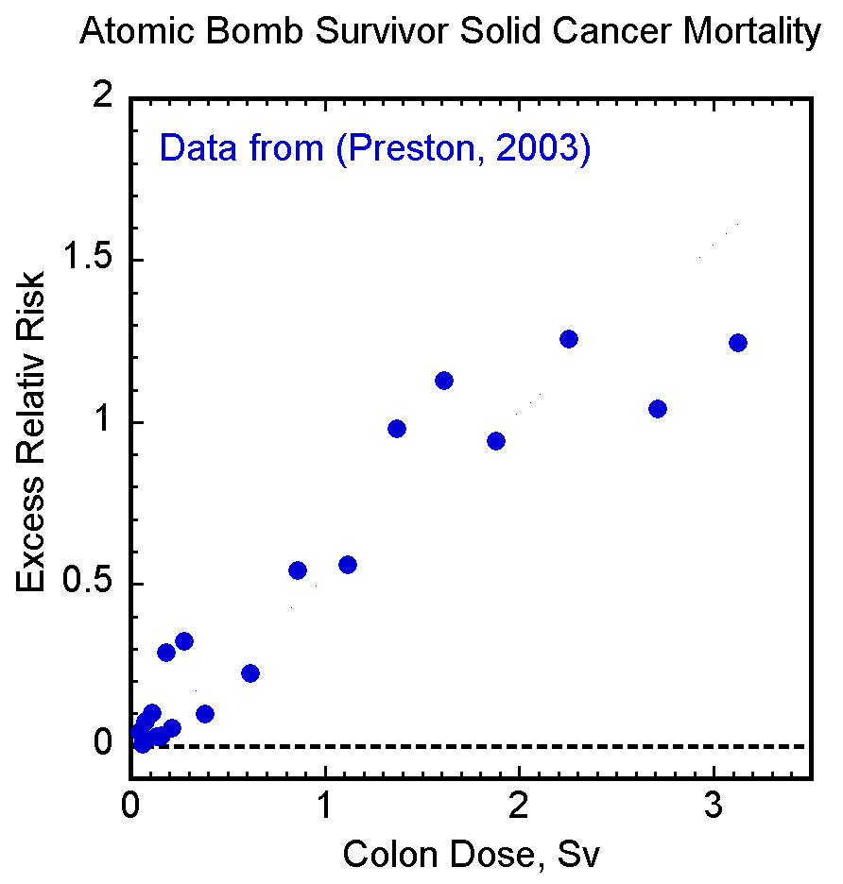
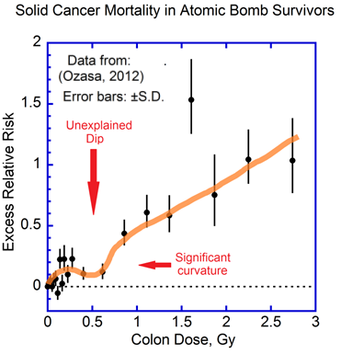
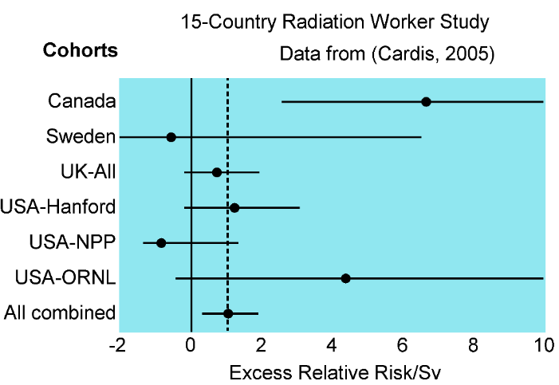
Evidence Quoted by the BEIR VII Report
for the LNT Model No Longer Support It
As colon dose increases from ~0.25 Gy to ~0.5 Gy, cancers decrease.
Significant curvature in dose-response contradicts the LNT model
CNSC withdrew the Canadian data citing major problems with the data (CNSC, 2011).
Without these data, the 15-Country study would no longer show significantly increased cancer risk in the radiation workers.
These data do not support the LNT model.

Slide 6
NCRP Commentary No. 27.
Top 3 epidemiologic studies providing strong support for the LNT Model:
Cancer Incidence in the Atomic Bomb Survivors (Grant, 2017).
INWORKS Study of Nuclear Industry Workers 1945-2005.
Breast Cancer in Massachusetts TB Patients Fluoroscopied Frequently.

Slide 7
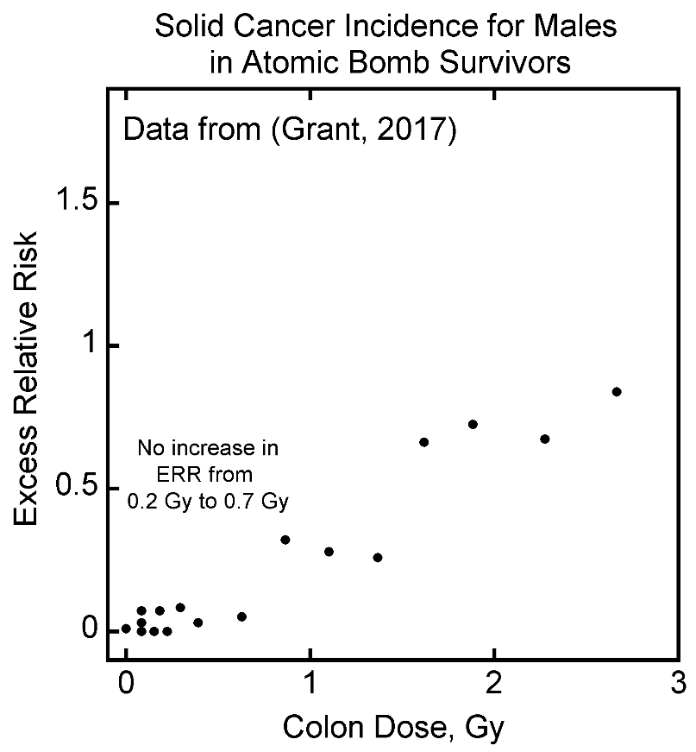
1. Cancer Incidence in the Atomic Bomb Survivors
The (Grant, 2017) publication stated that there is too much uncertainty in these data to guide radiation protection policies.
This is not support for the LNT model.
LNT model would not be able to explain the lack of increase in cancers when the radiation dose increased from 0.2 to 0.7 Gy.
Does this study support the LNT model?

Slide 8
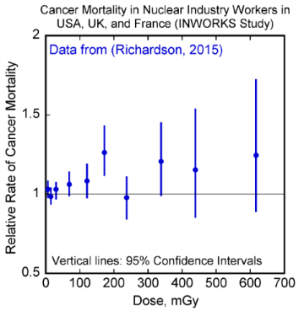
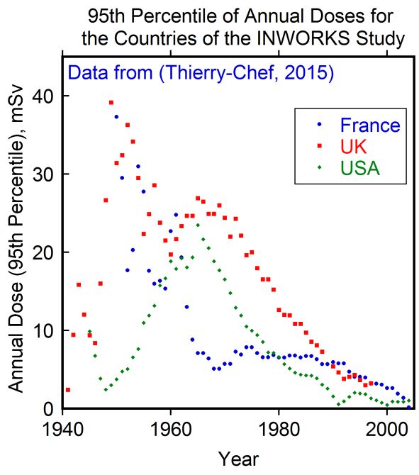
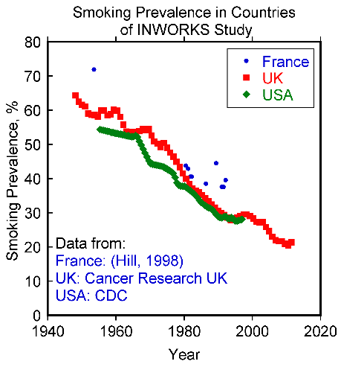
2. INWORKS Study of Nuclear Industry Workers 1945-2005
Highest doses were in the earlier years 1940-1970 when smoking prevalence was high compared to later years.
Smoking increases lung cancer risk and all cancer risk.
Therefore, there would be major confounding of data by smoking.
With smoking-related cancers excluded, according to INWORKS study, ERR/Sv is not significantly increased.
Does this study support the LNT model?

Slide 9
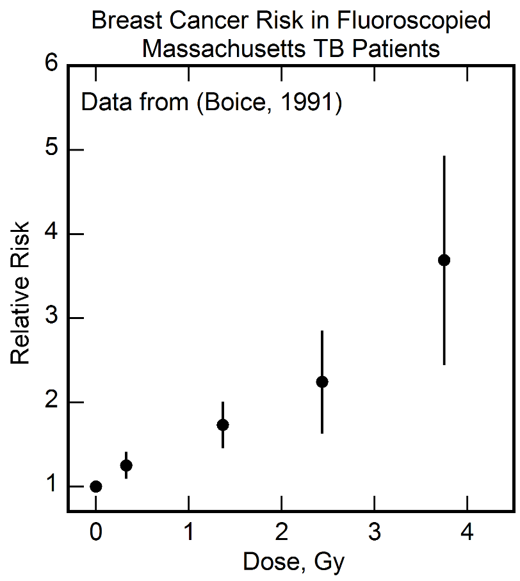
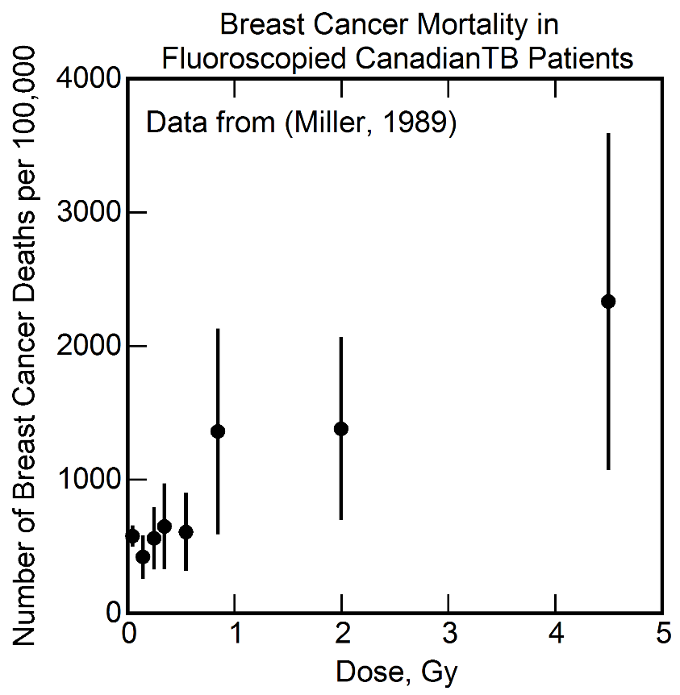
3. Breast Cancer in Massachusetts TB Patients Fluoroscopied Frequently (Little & Boice, 2003)
3. Breast Cancer in Massachusetts TB Patients Fluoroscopied Frequently (Little & Boice, 2003)
Coarse binning at low doses (lowest dose bin was 1 to 99 cGy) can make it impossible to see a threshold or hormetic dose response.
The Canadian study with finer binning shows a threshold type of dose response and a hint of radiation hormesis.
Does this study support the LNT model?

Slide 10
Other studies claimed by NCRP to support the LNT model, on closer scrutiny, were found to not support the LNT model.
Doss M. Are We Approaching the End of the LNT Model Era? J Nucl Med. Published ahead of print on Sep 27, 2018 as doi:10.2967/jnumed.118.213264.

Slide 11
Radiation Hormesis
11

Slide 12
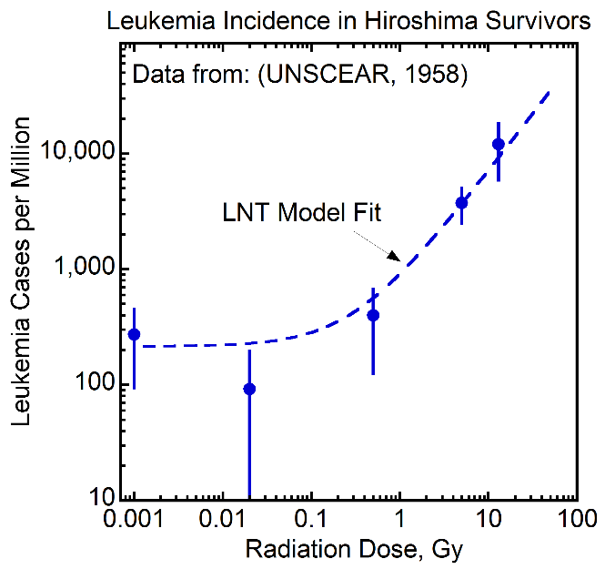
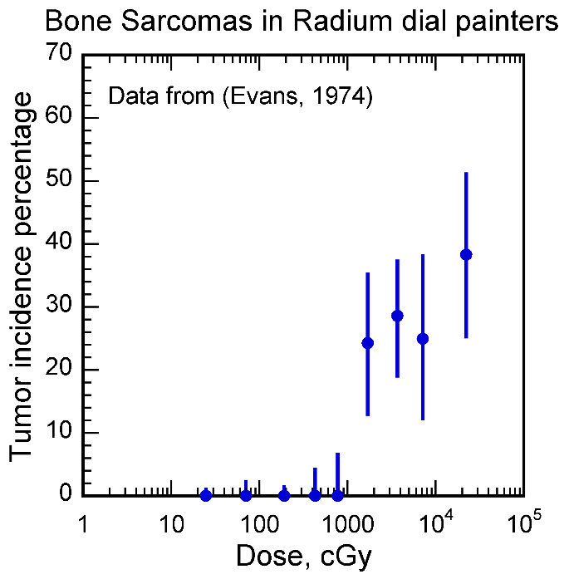
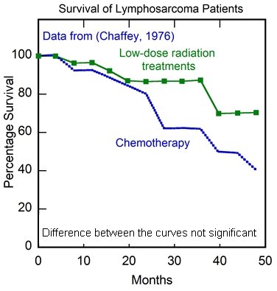
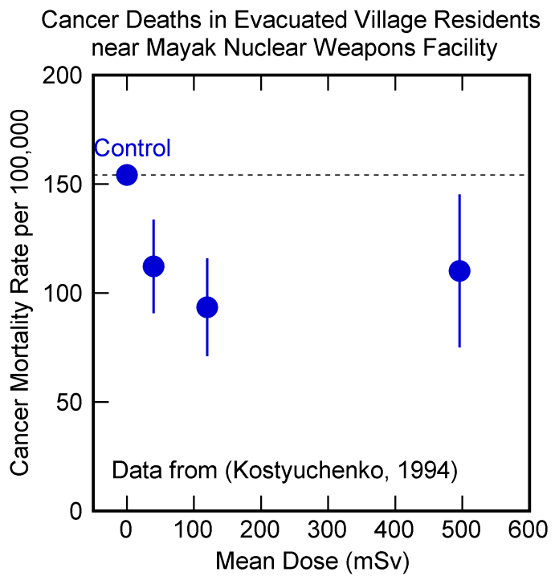
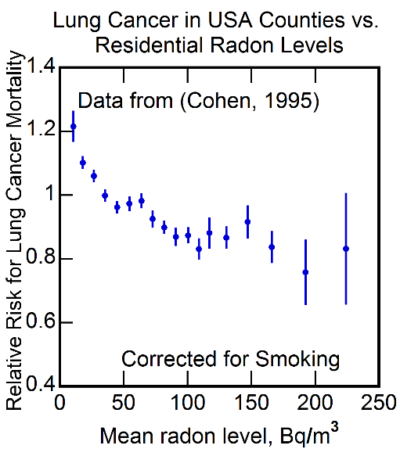
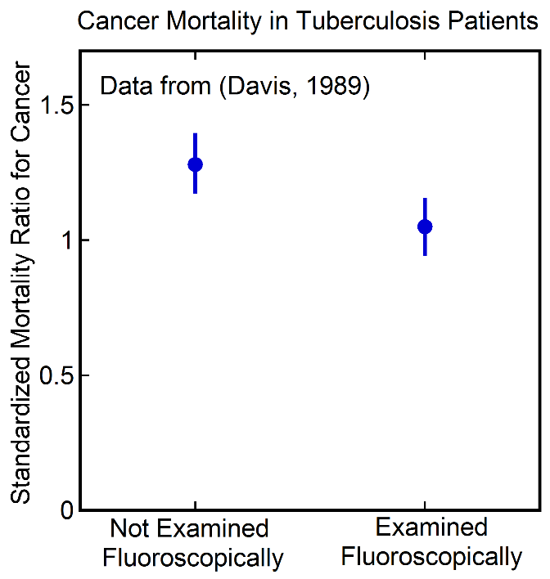
Evidence Against the LNT model and/or for Radiation Hormesis
1.5 Gy over 5 weeks
10 Gy over many years
No increase in cancers
Cancer Therapeutic effect - Survival equivalent to Chemotherapy
Reduced
cancers
Reduced cancers
Reduced
cancers
Reduced
cancers
Dose to lungs, breast, esophagus ~ 0.8 Gy over 2.5 years

Slide 13
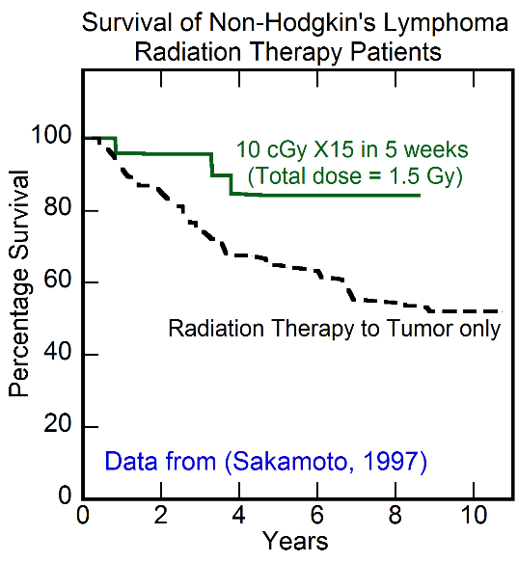
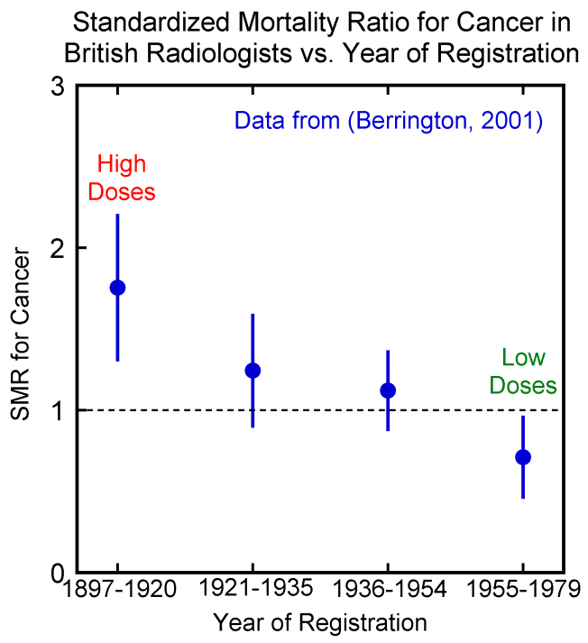
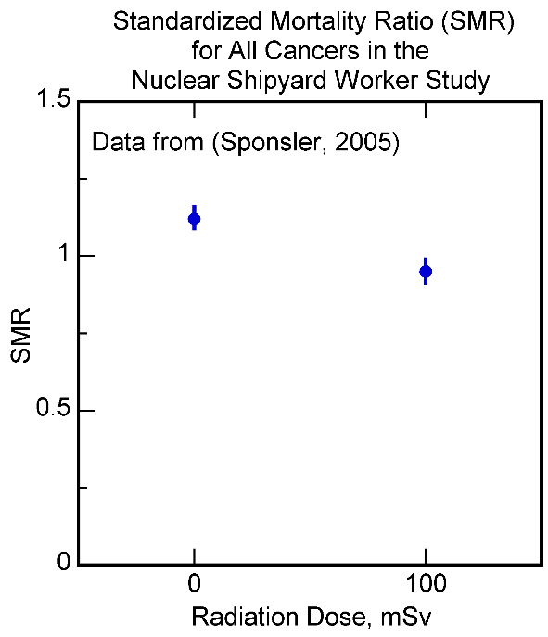
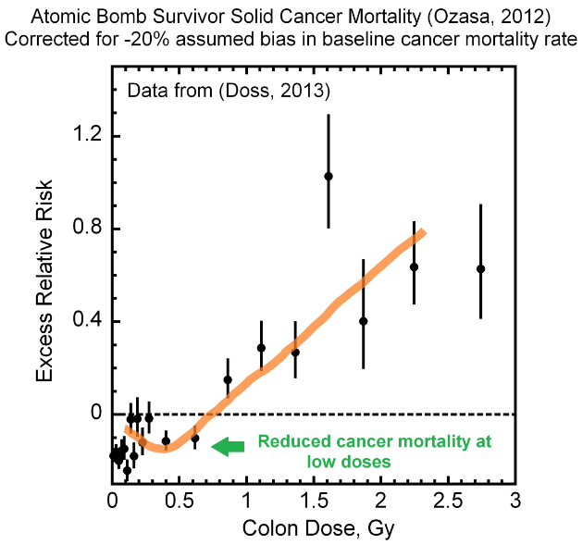
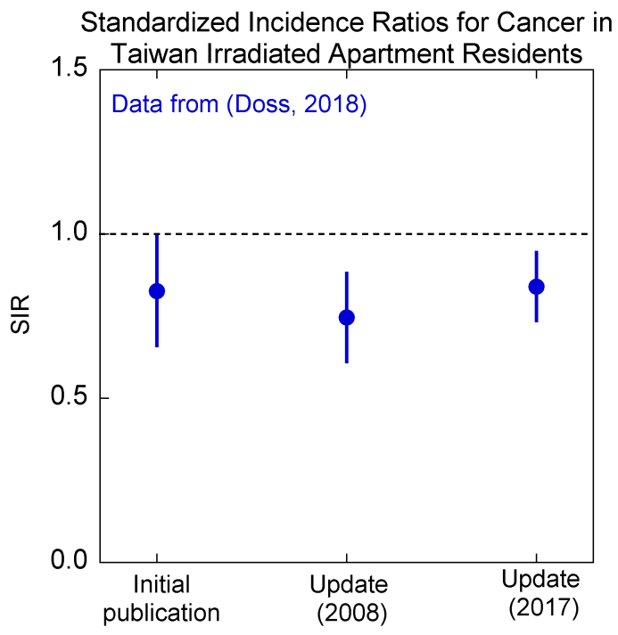
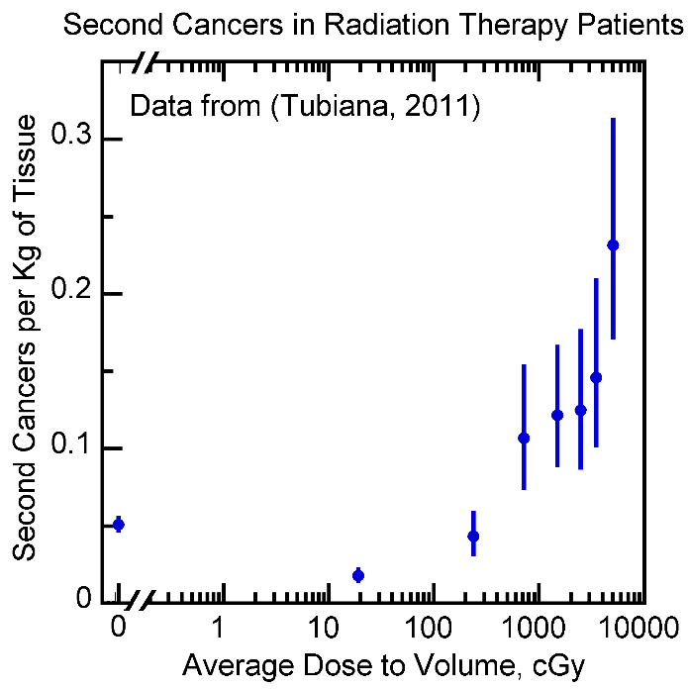
Evidence Against the LNT model and/or for Radiation Hormesis
Improved
survival
Reduced
cancers
1.5 Gy
Reduced
cancers
Reduced
cancers
Reduced
cancers
Reduced
cancers

Slide 14
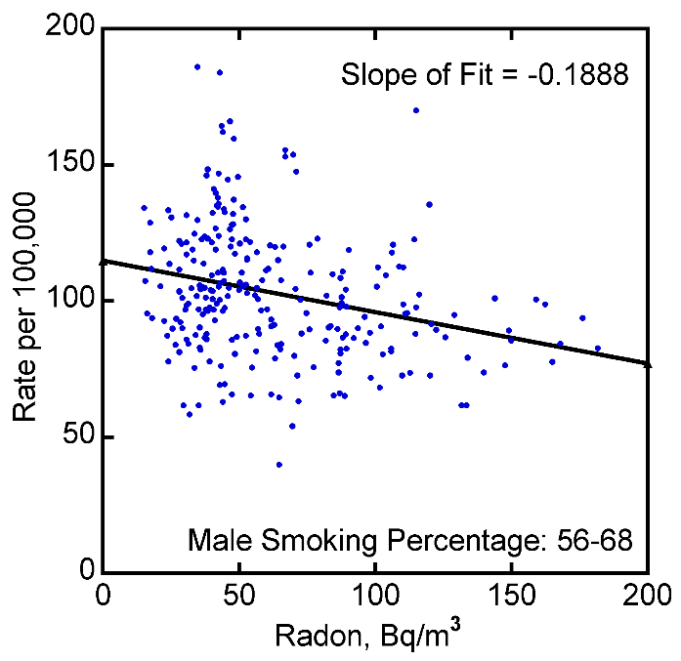
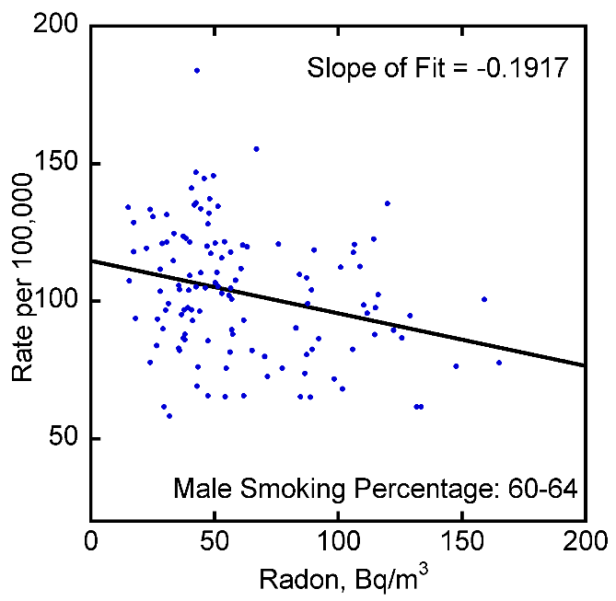
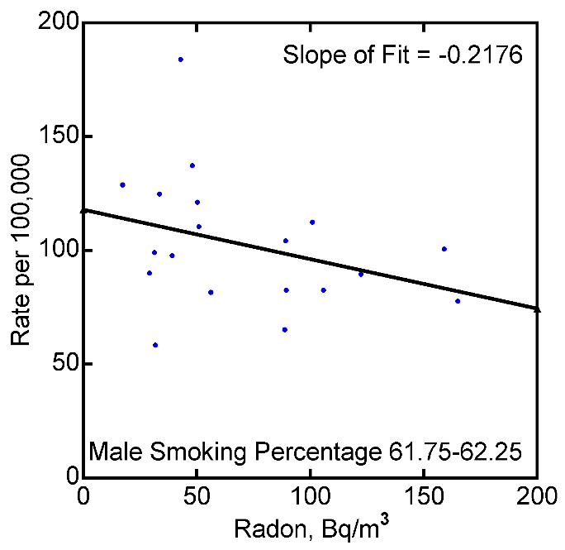
Lung Cancer (Males) vs Radon in USA Counties
for Narrow Ranges of Elevation and Smoking
Data from (Simeonov and Himmelstein, 2015)
Elevation varies from 0 to 3.5 km
Male smoking percentage ranges from ~45 to ~70
Elevation: 0.225-0.275 km
Confounding by smoking would not explain the observed negative slope in radon-lung cancer data – Cohen’s conclusion is indeed valid.

Slide 15
Additional Ecological Studies on
Radon and Lung Cancer
Bogen KT, Cullen J. Residential Radon in U.S. Counties V Lung Cancer in Women Who Predominantly Never Smoked. Environmental Geochemistry and Health 2002;24:229-47.
Significant negative Lung cancer mortality vs. radon trends were found
U-shaped dose-response relationship between lung cancer mortality risk and residential radon
Haynes RM. The Distribution of Domestic Radon Concentrations and Lung Cancer Mortality in England and Wales. Radiation Protection Dosimetry 1988;25:93-6.
A negative association is found between radon levels and lung cancer mortality, when smoking variation was controlled.

Slide 16
Chronic Radiation Exposures to Single Organs
Reference and Cohort | Cumulative Dose and Time Period | Cause of Death | SMR | 95% CI
(Villeneuve, 2007) Newfoundland Fluorspar Miners | High levels of radon 378 WLM Lung Dose =1.9 Gy, Effective Dose = 4.5 Sv over 5.5 Y | Lung Cancer | 3.1 | 2.66,3.56
 |  | Circulatory System Diseases | 0.8 | 0.69-0.87
 |  | Mental and Nervous System Diseases | 0.5 | 0.26-0.82
 |  | All Causes | 1 | 0.95-1.09
(Franklyn, 1999) Radioioidine Treatment for Hyperthyroidism | 300 MBq of I-131, Effective Dose = 7.2 Sv over a few weeks | Cancer of Bronchus and Trachea | 0·78 | (0·62–0·97)
 |  | Thyroid Cancer | 2·78 | (1·16–6·67)
 |  | All Cancers | 0·90 | (0·82–0·98)
High dose to a few organs but low doses to other organs
➔ Increase in some cancers but
decrease in other cancers and other diseases
Exclusive attention to increase in a few cancers without recognizing the reduction in other cancers/diseases would misrepresent the health effect of the radiation exposure.

Slide 17
Which One is Supported by Evidence?
Radiation Hormesis
Or
The LNT Model?

Slide 18
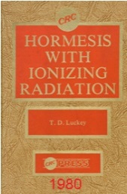
Major Harms From the Use of the LNT model
Impact on the War on Cancer
LNT Model and ALARA blocked the study of radiation
hormesis when it was proposed by T D Luckey in 1980.
Number of worldwide cancer deaths in 2018 ~ 9.6 M
Based on evidence, there can be 20% reduction in cancer mortality rates from the use of radiation hormesis.
Number of worldwide cancer deaths in 2018 attributable to
the use of the LNT model would be ~ 1.92 M
Impact on the War on Alzheimer’s Disease
Low-dose radiation proposed for the prevention and/or therapy of Parkinson's disease and Alzheimer's disease
(Kojima, 1997), (Doss, 2014)
No clinical trials yet, due to the LNT model. Recent case reports are promising (See Jerry Cuttler’s Poster)

Slide 19
Radiation Hormesis & Radiation Protection
19

Slide 20
Legal Basis for Radiation Safety Regulations in USA
Section 161(b) of the Atomic Energy Act of 1954 authorized the Atomic Energy Commission to establish by rule, regulation, .…….. to protect health or to minimize danger to life…..
This authority was inherited by EPA, NRC, etc.
Since there is no harm and no danger to life from low-dose radiation, EPA, NRC have no authority for their regulations regarding low radiation doses.
Radiation safety regulations at low doses are not legal.

Slide 21
Low-dose Radiation is Like Medicine
With the validity of radiation hormesis established, low-dose radiation should not be considered to be a poison. It should be considered to be similar to medicine and should be regulated to prevent harm from an overdose.
Dose rate does matter:
1 caplet per day x 100 days ≠ 100 caplets at one time.
If your study indicates otherwise, your study is likely wrong.

Slide 22
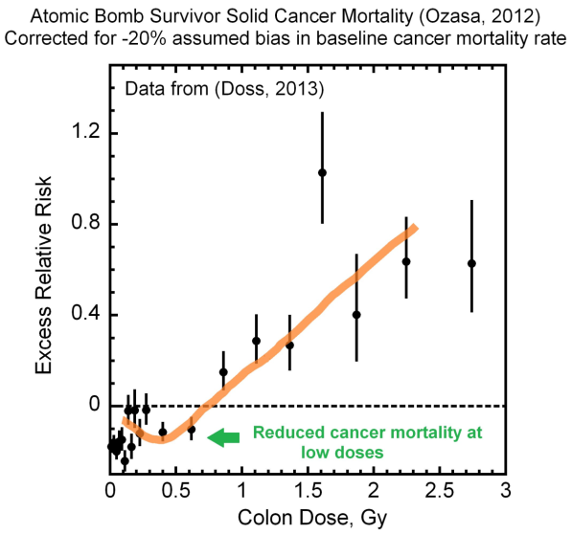
Acute Radiation Exposures
Atomic bomb survivor data →
Threshold dose is ~70 cGy.
In view of uncertainties,
Acute dose of 10 cGy would be well below the threshold dose and so safe.
Suggested Dose Guidance :10 cGy for Acute Exposure
This is not a dose limit, as it would be in the hormetic zone. The guidance is to not exceed this level by a large amount.

Slide 23
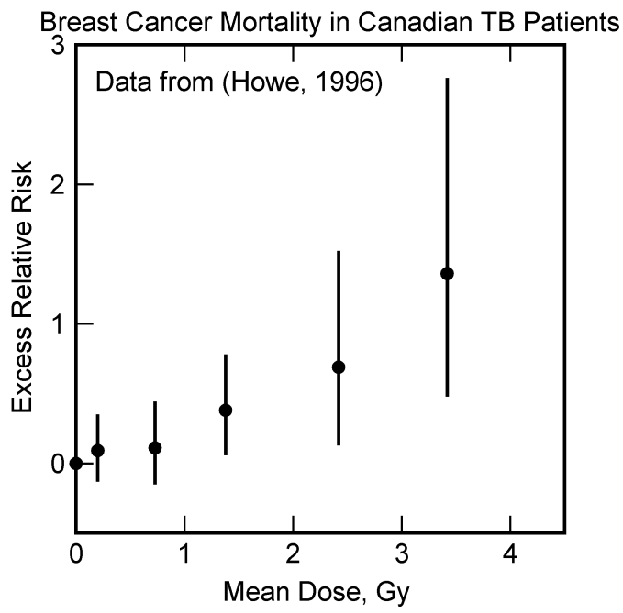
Radiation Exposures over Extended Periods of Time
Canadian TB patients (Howe, 1996)
Threshold dose 1 Gy in 3 years
➔ ~30 cGy in 1 year
Using a safety factor of 3
Suggested Dose-Rate Guidance for Chronic Exposure:
10 cGy per year
This is not a dose-rate limit, as it would be in the hormetic zone. The guidance is to not exceed this level by a large amount.

Slide 24
New Paradigm of Radiation Protection
For acute exposures:
Guidance dose: ~ 10 cGy.
For chronic exposures:
Guidance dose rate ~ 10 cGy per year
These are not limits but rather safe hormetic levels.
Regulation: - Do not to exceed these by a large amount.
- No ALARA
These guidance values should be revised by examining other publications and as more data on becomes available.

Slide 25
Effect of the New Paradigm
The new paradigm would:
Enable study of low-dose radiation for controlling cancer & non-cancer diseases, improving health.
Reduce concerns regarding nuclear power; renaissance of nuclear power → an era of prosperity.
Avoid casualties due to unsafe energy sources.
Eliminate panic evacuations for nuclear events.
Eliminate concerns regarding diagnostic imaging and ensure quality images.
Reduce regulatory costs for all users of radiation.

Slide 26
Summary
LNT Model – No justification, No valid evidence
Radiation Hormesis – Justifiable
– Plenty of evidence to support it
No need to regulate low radiation doses.
Guidance Dose:10 cGy Acute and 10 cGy per year chronic.
Regulation: Do not exceed these by a large amount.
The new paradigm would:
Improve health and prosperity
Avoid panic evacuations
Reduce costs
The current paradigm does the opposite, and so should be discarded and the new paradigm adopted promptly.

