Slide 1
Lessons learned in communication from the Fukushima accident
Jacques Lochard
Department of Health Risk Control
Atomic Bomb Disease Institute
Nagasaki University
ICRP Vice Chair
American Nuclear Society & Health Physics Society Joint Topical Conference
September 30 – October 3, 2018
Tri-Cities, Washington, USA

Slide 2
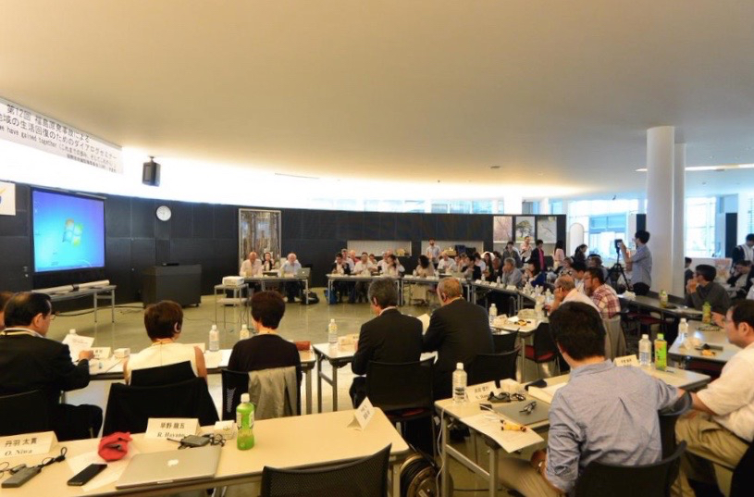
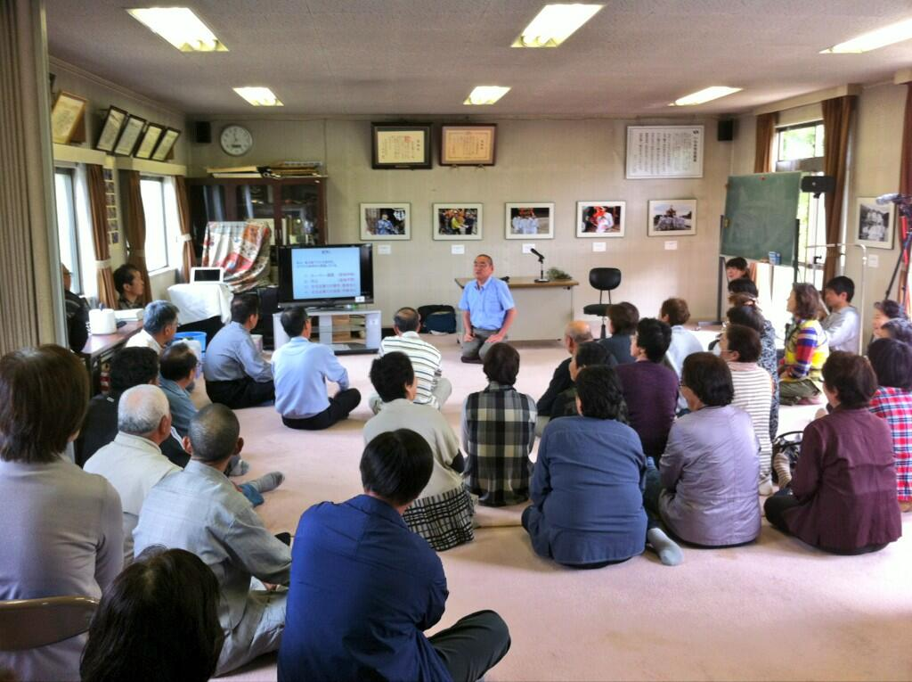
Background
The dialogue meetings on the rehabilitation of living conditions after the Fukushima accident
The experience of the Suetsugi community
The focus here is on communication with people living in the affected territories and in particular after the accident
The 12th ICRP Dialogue meeting
Date City, Fukushima Prefecture, 2015
http://www.fukushima-dialogues.com
The co-expertise process
Suetsugi village, Fukushima Prefecture, 2013
2

Slide 3
What is at stake in the management
of nuclear accidents?
The irruption of radioactivity into people's everyday lives and its long term persistence create an unprecedented complex situation which profoundly upsets daily life, raises many questions and concerns, generates numerous views, and exacerbates conflicts
What is at stake is to protect the population against radiation risk but also to preserve as much as possible decent working conditions on accident site and living conditions for the affected people off site
These objectives are part of the overall ethical perspective shared of all ethical theories which is to ensure at the same time:
the well-being of individuals and
the quality of the living together
3

Slide 4
The human dimension of nuclear accidents
The testimonies of the Fukushima residents have confirmed what had already been observed in the affected areas after the Chernobyl accident, namely:
the collapse of trust in authorities and experts
the loss of control over everyday life
the disintegration of family and social ties and the breakdown of the economic fabric
the apprehension about the future, particularly that of children
the threat on the autonomy and dignity of affected people
the fear to be abandoned
They also revealed the total lack of radiological protection culture within the population and the deep footprint of Hiroshima-Nagasaki (among others the fear of genetic effects)
4

Slide 5
Why communication
about radiation risk is a challenge?
There is no direct sensorial relationship with radiation. Everything passes through language, hence the importance of trust in the word of the others
Experts and professionals use of the scientific language to communicate. As a consequence they are not understood by laypeople and there are very few words in the common language to speak about radiation
The perception of radiation risk is largely dominated by the images and narratives of Hiroshima-Nagasaki, as well as of the Cold War
The inevitable and recurring debate among experts on the effects of low levels of radiation and issues surrounding nuclear energy maintains confusion in the minds of people
As a result, this situation leaves the vast majority of people in ignorance and voiceless, and polarizes an acting minority on irreconcilable antagonistic positions
5

Slide 6
Why communication
about radiation risk is a challenge?
In the context of a nuclear accident, the loss of trust in the authorities and experts combined with the lack of radiological protection culture, the images of the past, and the avalanche of conflicting views of the media and experts, makes conventional communication about radiation risk inoperative
As a reminder, the key stages of risk communication:
Get the numbers right
Tell key publics what the numbers mean
Explain what the numbers mean
Show publics they have accepted similar risks before
Explain how risk benefits outweigh the costs
Treat publics with respect
Make publics partners with risk communicators
Do all the above
According Baruch Fischhoff
6

Slide 7
Lessons learned in communication (1)
Experience shows that the most effective way of communicating the risk of radiation in a post-accident situation is to engage affected people in the characterization of their individual radiological situation in relation to their daily concerns and to help them interpret the results together with people in their community
The keys factors for successful risk communication:
Listening and understanding the concerns expressed by the affected people
Engaging them in measurements to understand where when and how they are exposed
Proceeding step by step starting from source to effects through exposure pathways and the exposures conditions
Using as much as possible common language and narratives
And never forgetting that risk communication only works if there is trust
7
Notes:
02/10/2018
7

Slide 8
Lessons learned in communication (2)
When communicating about radiological risk, experts should:
Adopt a prudent approach for managing risk based on the ALARA principle
Promote protective actions improving the well being of individuals and the quality of the living together of the community they belong to
Respecting their individual decisions while preserving their autonomy of choice
Keep in mind that the issue at stake is not to make people accepting the risk but allowing them to make informed decisions about their protection and their life choices
All of the above lessons have led to gradually develop the process that we have called ‘co-expertise process’ (cooperation in expertise) to communicate effectively with people residing in affected areas after a nuclear accident
8
Notes:
02/10/2018
8

Slide 9
The co-expertise process
The co-expertise process emerged in the late 1990s in Belarus in the context of the rehabilitation of living conditions in the territories affected by the Chernobyl accident. It has been enriched and refined in recent years through the experience gained in communities in Japan affected by the Fukushima accident particularly in Suetsugi
This process is consistent with the Trust, Confidence and Cooperation model developed by experts in risk perception and communication
Shared
values
Trust
Cooperation
Performance
Confidence
Timothy Earle and Heinz Gutscher
https://understandingsocialtrust.wordpress.com
9

Slide 10
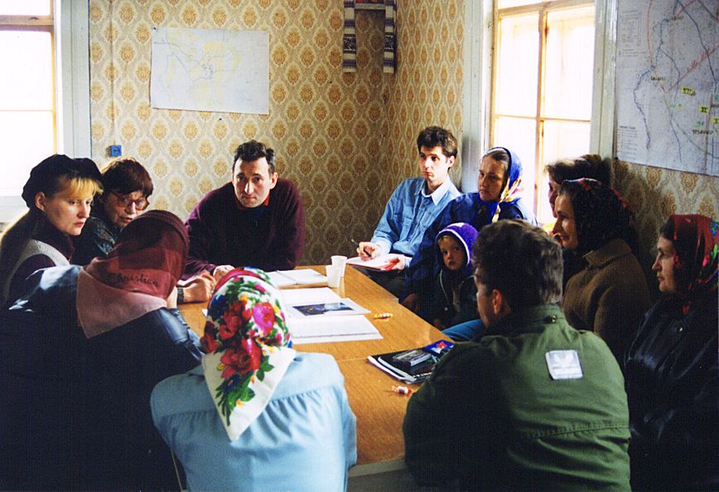
The co-expertise process ETHOS Project, Olmany village, Belarus, 1996-2001
10

Slide 11
The co-expertise process (1)
Establishing dialogues
to share experience and knowledge
Engaging affected people in measurements
and sharing results
Identifying self-help protective actions
and organizing collective vigilance
Implementing local projects
with the support of experts
11
Notes:
Considerations about the risk to future generations…. « Can we leave to
the future generations the problem of somehow adjusting themselves to
an environment of higher radiation levels? »
The benefit of radiation increase life expectancy by also senility….

Slide 12
The co-expertise process (2)
Co-expertise
Process
Practical
radiological protection
culture
Self-help
protective actions
Community
projects
12

Slide 13
Practical radiological protection culture
The co-expertise process allows to develop a practical radiological protection culture allowing people:
To interpret the results of the measurements of radiation
To build their own benchmarks in relation to the radioactivity present in their daily life
To make their own decisions to protect themselves and their loved ones
To judge the effectiveness of the protective actions implemented by authorities, organisations or by themselves
This culture presents features that are common to all exposures situations, but it is implemented with different means at work, in the medical domain and in everyday life
The knowledge and skills enabling citizens to make well-informed choices and behave wisely in situations involving potential or actual exposures to ionising radiation. ICRP Glossary under developement
ICRP Glossary under developement
13

Slide 14
The ethical dimensions of the co-expertise process
Experience from Chernobyl and Fukushima has shown that to be credible experts must:
Master the scientific basis of radiological protection and its practical implementation - Accountability
Share openly all information they own and recognize limitations - Transparency
Listen carefully to the stakeholders to understand their individual situations - Empathy
Deliberate and decide together with stakeholders- Inclusiveness
Act in accordance with the ethics of radiological protection, that is to say prudently and equitably
Do not to lose sight of the fact that what is ultimately at stake is the dignity of people
14

Slide 15
Concluding remarks
The experience of Chernobyl and Fukushima has shown that it is possible to communicate effectively about radiation and radiological protection with the affected people
This requires the mobilization of specific skills, adapted means of measuring radiation and the support of authorities. It also take times…
The key of success is:
to put science and technology at the service of resolving the concrete problems people are facing
to ensure respect for people's freedom of choice without manipulating them in any way, but also not to abandon them on their own
To work with people and not work for people
15

Slide 16
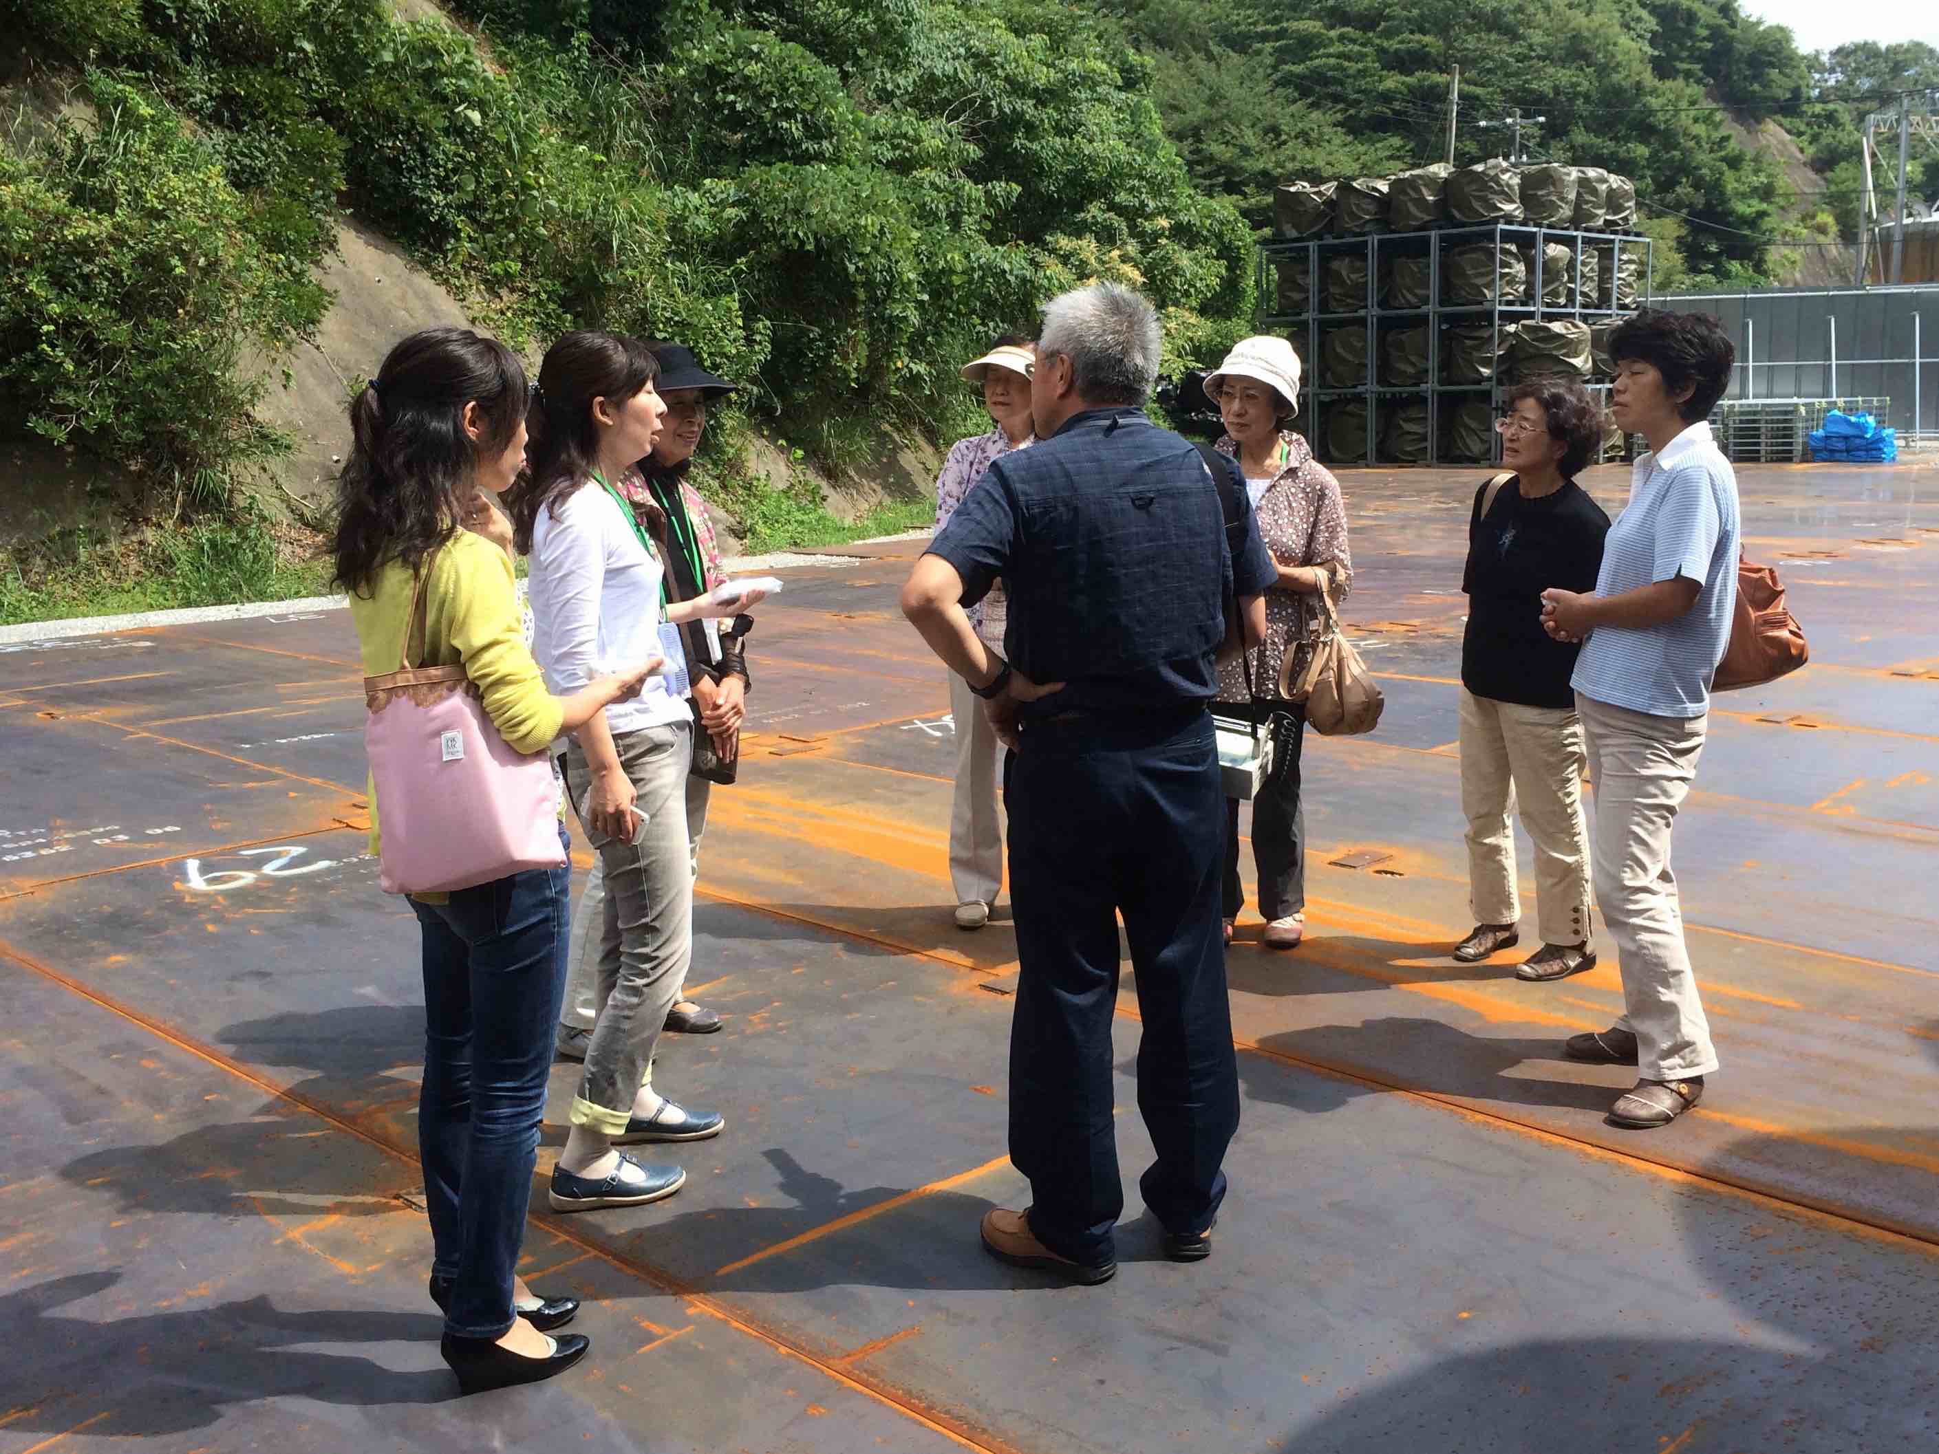
Thank you for your attention
Inspection visit by villagers of the Suetsugi decontamination waste storage site
16

