Slide 1
Risk Tradeoffs in Radiation Policymaking
Tom Hansen, CHP, PMP
Ameriphysics, LLC
tom@ameriphysics.com
Joint Topical Meeting on the Applicability of Radiation-Response Models to Low Dose Protection Standards October 3, 2018

Slide 2
Professional Background
Certified Health Physicist with more than 30 years of nuclear field experience
Highlights
Placed more than 100 million pounds of mostly innocuous waste into transit (3 accidents)
Burned tens of thousands of gallons of diesel fuel
Destroyed hundreds of acres of ecosystem
Witnessed a dozen or more friends and coworkers get hurt at work
Probably haven’t prevented a single solid cancer in a real person
The good news is that I’m killing it with the critical group!

Slide 3
Professional Background
“What is a health physicist?”
I protect imaginary people from exaggerated hazards, and in the process I create real hazards for real people, so I protect those people too, but not nearly as well

Slide 4
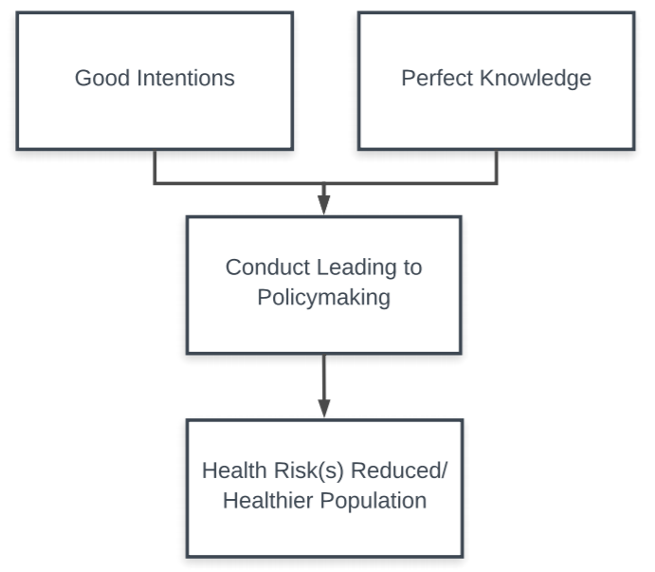
Ideal [Radiation] Policymaking

Slide 5
The Radiation Paradigm
0 1 mSv 50 mSv 100 mSv 0.25 mSv

Slide 6
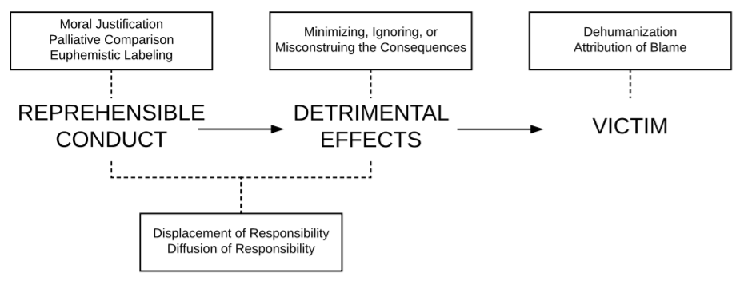
Moral Disengagement (Bandura)

Slide 7
Risk Tradeoff
Trading one risk for another is a phenomenon encountered in everyday decision-making
The risks unintentionally or unknowingly fostered are called countervailing risks
Countervailing risks are described by familiar terms such as side effects, collateral damage, and unintentional consequences
Choosing to manage one risk in light of countervailing risks is called a risk tradeoff
Comparative Risk Analysis is used to analyze the risks associated with decision alternatives

Slide 8
Risk Tradeoff Analysis
A framework for comparative analysis proposed by Graham and Weiner in 1995
Differs from cost benefit analysis in that it is risk vs. risk rather than risk vs. monetary benefit
Operationally, consists of
identifying risk tradeoffs
weighing the comparative importance of target and countervailing risks, and
exploring opportunities to reduce overall risk (i.e., a “whole patient approach”)

Slide 9
Measures for Weighing Risk
Magnitude | When used in RTA, the magnitude of a risk is its probability
Size of Population | Considering the size of the population exposed to the risk is important in order to avoid transferring risks onto larger populations
Certainty of Estimates | Some outcomes are consistently and concisely defined while others are speculated or assumed (symmetrical reporting is needed)
Types of Adverse Outcomes | Often involves value judgements rather than comparisons along a unidimensional scale (i.e., how does death by cancer compare against living with decades of permanent disability?) Some risks are felt to be controlled by the individual and voluntary, while others seem outside of one’s control and involuntary
Distributional Considerations | Who incurs the risks, are they equally distributed among the population, and is one or more groups disproportionately affected?
Timing | Concerned with the ethics of which group should bear the risks and when Considers the time it takes the risk to pose an imminent threat An outcome that presents after a protracted latency may be perceived as a smaller risk than an imminent one (e.g., cancer may not express itself for years or decades, whereas trauma is proximately distressing) Considers whether the risks impact current or future generations

Slide 10
Risk Tradeoff Analysis
Some of the nation’s laws already require some form of RTA as a means of resolving risk tradeoffs
1990 Clean Air Act Amendment
1996 Safe Drinking Water Act Amendment
Office of Management and Budget has used RTA in its analysis of policymaking and in one instance suspended its review of OSHA rulemaking until that agency considered the risk tradeoffs of proposed regulations
RTA is used to examine pesticides, building codes, estrogen therapy, transportation, lead recycling, fish consumption, global environmental protection, elderly drivers, chlorine in drinking water, etc.

Slide 11
Sources of Risk Tradeoff
Omitted Voice | Members of society may be underrepresented Risks borne by nonhuman life forms, ecosystems, and future generations that are unable to advocate for themselves
Heuristics | Cognitive tools humans use to sort through vast amounts of information to expedite decision-making The tendency is to focus on immediate concerns, leaving side effects of decisions to be managed later Recent events or crises are viewed as important issues Heuristics is responsible for relative risk-ranking that occurs innately in humans (e.g., cancer risk may be ranked higher than non-cancer risks)
Old Technology Bias | Change is difficult Existing, off-the-shelf technologies and methods are easier to come by and garner support around It can be difficult to introduce new or competing alternatives

Slide 12
Sources of Risk Tradeoff
Bounded Roles | An unfortunate consequence of specialization Structurally, agencies are organized into pools of particular expertise Countervailing risks are not likely to respect the functional boundaries of agency jurisdictions Organizations will accomplish decision-making according to their expertise Result is a fragmented patchwork of regulations from varying organizations that do not seek common health outcomes Specialized groups are likely to hear from the same actors, share similar viewpoints on the seriousness of avoiding the target risk, and collectively disregard countervailing risks
Human Behavioral Responses | Public health interventions are almost always aimed at influencing behavior, and sometimes such influences will have unintended consequences The target group may not perform the desired behavior, or the desired behavior may lead other unintended behaviors

Slide 13
Risk Tradeoff Typology
Compared to the target risk, the countervailing risk affects: | Compared to the target risk, the countervailing risk is:
 | SAME TYPE | DIFFERENT TYPE
SAME POPULATION | Risk offset | Risk substitution
DIFFERENT POPULATION | Risk transfer | Risk transformation

Slide 14
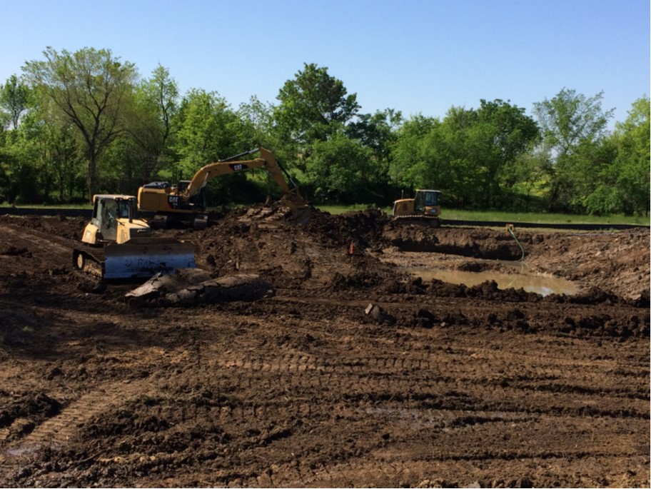
Risk Mitigation or Aggravation?
- 14 -

Slide 15
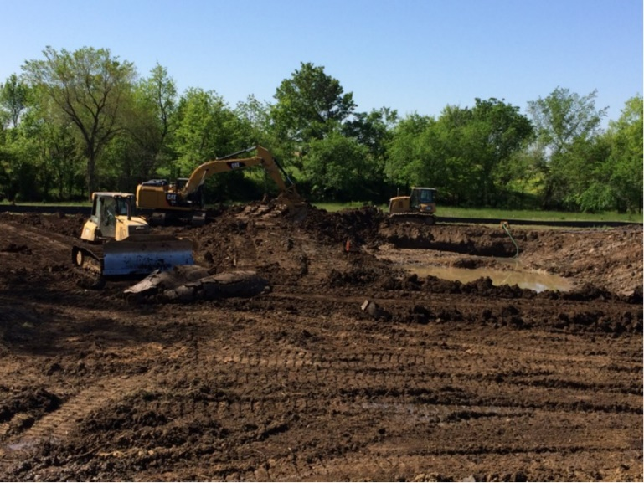
Radiation Policy and Tradeoffs
Target Risk | Countervailing Risk | Risk Transfer Typology
Radiation-induced cancer in (theoretical) critical group | Radiation-induced cancer in actual workers | Transfer
 | Occupational injuries in workers | Transformation
 | Non-radiation cancer from burning fuel (exhaust fumes) | Offset/Transfer -or- Substitution/ Transformation
 | Transportation accidents | Substitution/ Transformation
 | Ecosystem/natural resource degradation | Substitution/ Transformation

Slide 16
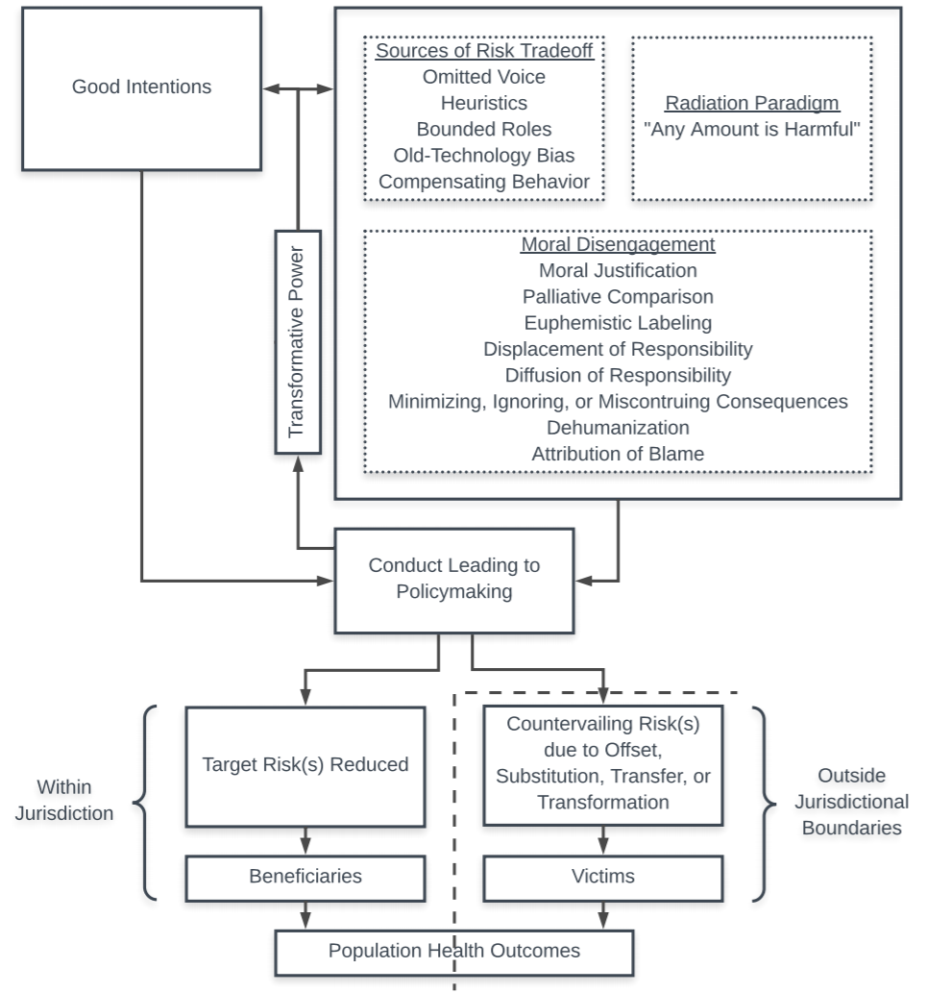
Draft Conceptual Model

Slide 17
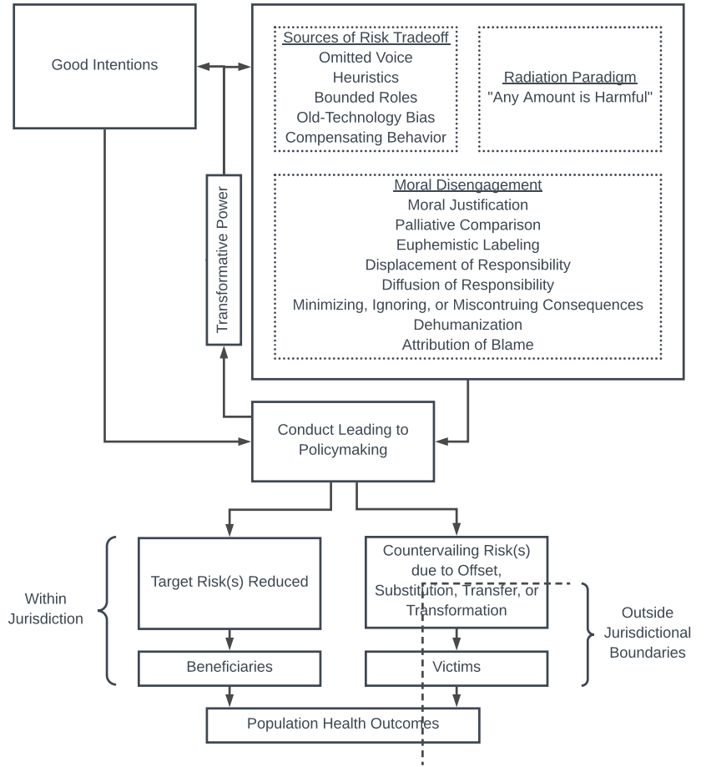
Draft Conceptual Model

Slide 18
Summary
Risk tradeoffs are a normal consequence of everyday decisionmaking
Radiation policymaking is conducted in a manner leading to important risk tradeoffs
There has been some talk in this room about “moving forward” with recommendations, maybe as soon as this afternoon
Yet this meeting is characterized by many of the same sources that are already responsible for tradeoffs in radiation policymaking (omitted voice, heuristics, old technology bias, bounded roles, human behavioral responses)

Slide 19
Summary
Rigid dose limits prohibit considerations of risk vs. risk, “flexible” dose limits would not (i.e., graded approach)
Dose limits should reflect risks in a manner that can be weighed against other risks (i.e., magnitude, size of population, certainty of estimates, types of adverse outcomes, distributional outcomes, and timing)
Research on tradeoff analysis is needed
Application of the framework to radiation
Quantification of weighing measures

Slide 20
References
National Research Council of the National Academies. Health Risks From Exposure To Low Levels Of Ionizing Radiation, BEIR VII, Phase 2. 2006.
U.S. Government Accountability Office. Radiation Standards. Washington, DC; 2000.
Hofstetter, P., et al., Tools for Comparative Analysis of Alternatives: Competing or Complementary Perspectives? Risk Analysis, 2002. 22(5): p. 833-851.
Graham, J.D. and J.B. Wiener, Risk Versus Risk: Tradeoffs in Protecting Health and the Environment. 1995, Cambridge, MA: Harvard University Press.
Rascoff, S.J. and R.L. Revesz, The Biases of Risk Tradeoff Analysis: Towards Parity in Environmental and Health-and-Safety Regulation. University of Chicago Law Review, 2002. 69: p. 1763-2057.
U.S. Environmental Protection Agency, The Ecological Impact of Land Restoration and Cleanup. 1978, Washington, D.C.: Environmental Protection Agency, Office of Radiation Programs, Criteria and Standards Division.
Burger, J., M. Gochfeld, and C.W. Powers, Integrating Long-Term Stewardship Goals into the Remediation Process: Natural Resource Damages and the Department of Energy. Journal of Environmental Management, 2007. 82(2): p. 189-199.
Bandura, A., Selective Moral Disengagement in the Exercise of Moral Agency. Journal of Moral Education, 2002. 31(2): p. 101-19.
10 C.F.R. § 20.1201, Occupational Dose Limits for Adults. 2017.
10 C.F.R. § 20.1301, Dose Limits for Individual Members of the Public. 2017.

