Slide 1
Low-Dose Radiobiology: Current Issues, Gaps and Needs
Dmitry Klokov
Joint Topical ANS & HPS
Tri-Cities, WA
Sept 30 – Oct 3, 2018

Slide 2
LDR research trends: overview
US: DOE LDRP
EU: NOTE
EU: MELODI
Interest
DOREMI
EUROMED
EURADOS
1990 2000 2010
CANADA: AECL/CNL LOW DOSE RP
JAPAN: RERF,QST…
INDIA: BHABHA ATOMIC RESEARCH CENTRE
RUSSIA: …
Tri-Cities, Oct 2, 2018
By Dmitry Klokov

Slide 3
LDR research trends: upward drivers
adaptive responses
bystander effects
genomic instability
controversy over the LNT
Interest
proteomics
genomics
1990 2000 2010
Tri-Cities, Oct 2, 2018
By Dmitry Klokov

Slide 4
Research Outputs of 1990-2000s
Radioadaptive responses
common, but not universal
Bystander effects
cell interactions
microenvironment
Genomic Instability
Wealth of data generated
mechanistic knowledge
-omics data
Acknowledgment of the complexities of biological responses to LDR
Tri-Cities, Oct 2, 2018
By Dmitry Klokov

Slide 5
LDR research trends: why decline?
why?
Interest
1990 2000 2010
Tri-Cities, Oct 2, 2018
By Dmitry Klokov

Slide 6
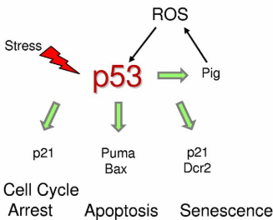
Causes for LDR decline: biological complexity
Tri-Cities, Oct 2, 2018
By Dmitry Klokov

Slide 7
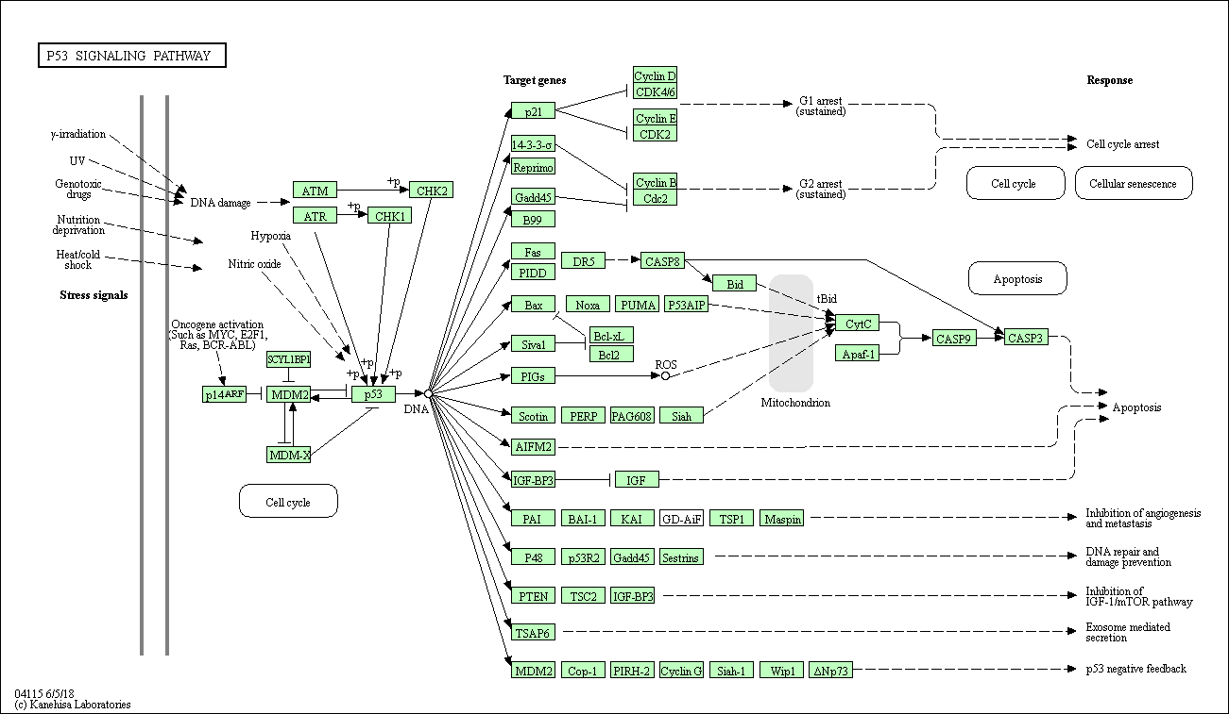
Causes for LDR decline: biological complexity
Tri-Cities, Oct 2, 2018
By Dmitry Klokov

Slide 8
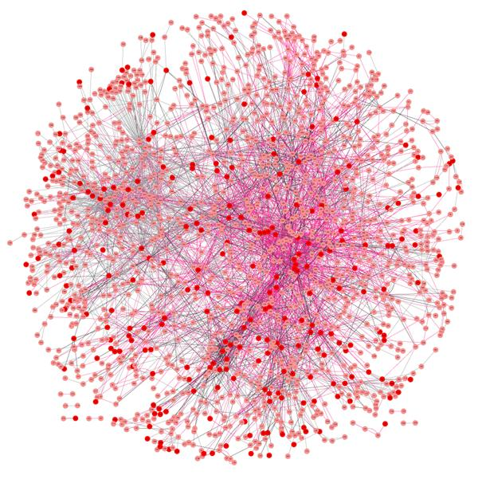
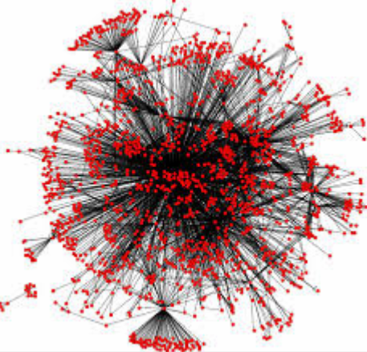
Causes for LDR decline: biological complexity
Tri-Cities, Oct 2, 2018
By Dmitry Klokov

Slide 9
Causes for LDR decline: biological complexity
molecules
cells
tissues
organism
DNA damage
DNA repair
signalling
gene expression
protein modifications
epigenetics
mutations
aberrations
cell death
senescence
survival
communication
ECM
microenvironment
exosomes
immune system
tumor
metastasis
non-cancer disease
death
Tri-Cities, Oct 2, 2018
By Dmitry Klokov

Slide 10
Causes for LDR decline: biological complexity
molecules
cells
tissues
organism
Dependent on:
Cell type
Tissue type
Organism
Dose-rate
Radiation quality
Collaboration is key!
DNA damage
DNA repair
signalling
gene expression
protein modifications
epigenetics
mutations
aberrations
cell death
senescence
survival
communication
ECM
microenvironment
exosomes
immune system
tumor
metastasis
non-cancer disease
death
Tri-Cities, Oct 2, 2018
By Dmitry Klokov

Slide 11
LDR research trends: downward drivers
epidemiological studies
biological complexity
Interest
controversy over the LNT
1990 2000 2010
Tri-Cities, Oct 2, 2018
By Dmitry Klokov

Slide 12
LDR research trends: downward drivers
Interest
1990 2000 2010
Tri-Cities, Oct 2, 2018
By Dmitry Klokov

Slide 13
LDR research trends: upward drivers 2.0
New tools + need for mechanistic understanding (in vivo)
Need for synthesis of current knowledge acknowledged
Appreciation of long-term relationship of human and anthropogenic LDR (energy, medical, space)
Public concerns and pressure continue and grow
Tri-Cities, Oct 2, 2018
By Dmitry Klokov

Slide 14
Research needs: science
Real low dose and low dose rate studies
responsible and ethical researcher communication
effective use of limited LDR facilities
In vivo studies
systemic and holistic approaches - collaboration
mouse-to-human transition
Direct, well planned epi-studies on medical LDR exposed cohorts
millions of people (100x over A-bomb)
avoidance of co-founders/biases
requires long-term commitment , e.g. 50+ years, and privacy issues
Individual radiosensitivity (iRP?)
LNT argument “let’s protect a few even though we know most are OK”
epi- + mechanistic studies, e.g. CRISPR-Cas9
Tri-Cities, Oct 2, 2018
By Dmitry Klokov

Slide 15
Research needs: high level
Strategic global agreement on research agenda
Global collaboration
No tissue wasted, no assay missed
Funding and publication policies and guidelines
Public license for research
Individual researcher interests vs. what people are concerned with
Constant contact and interaction with regulators
Tri-Cities, Oct 2, 2018
By Dmitry Klokov

Slide 16
Thank You!

