Slide 1
NEEDS IN COMMUNICATION
Nick Priest
October 2018

Slide 2
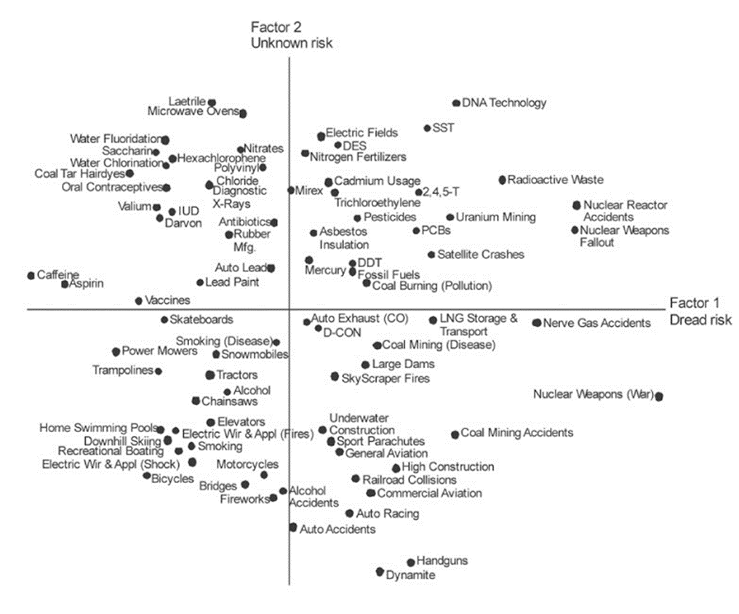

Highest
Concern
Lowest
Concern

Slide 3
RISK ACCEPTANCE INVOLVES A BALANCE BETWEEN PERCEIVED BENEFIT AND PERCEIVED HAZARD
THE PUBLIC IS PREPARED TO IGNORE RISKS WHEN THEY PERCEIVE BENEFIT FROM A TECHNOLOGY

Slide 4
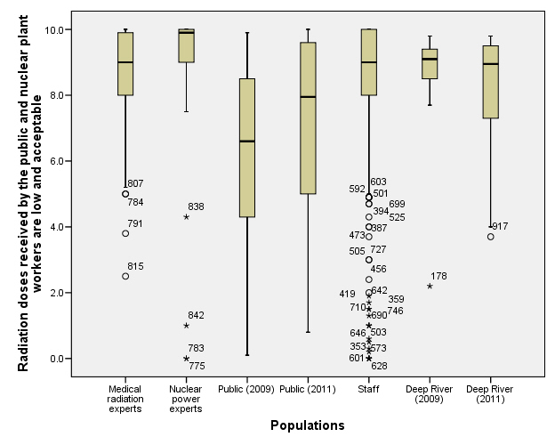

Slide 5
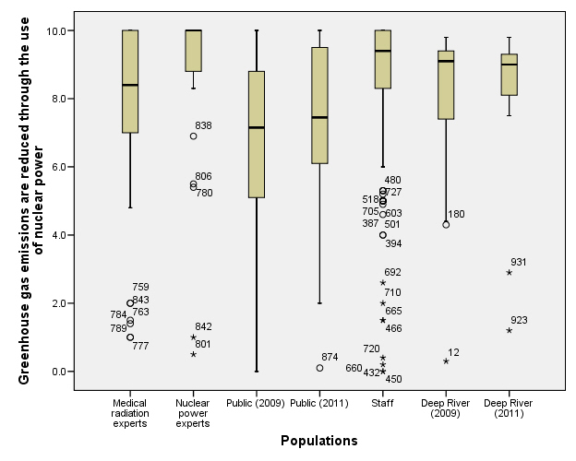

Slide 6
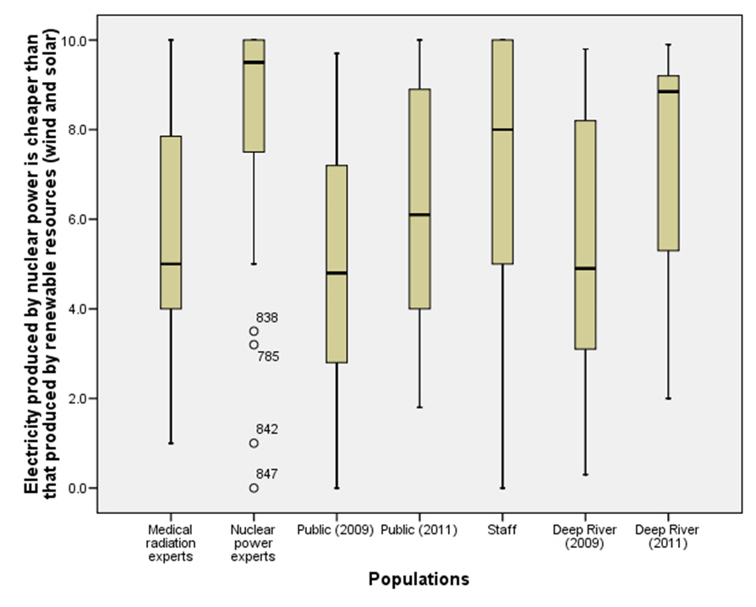

Slide 7
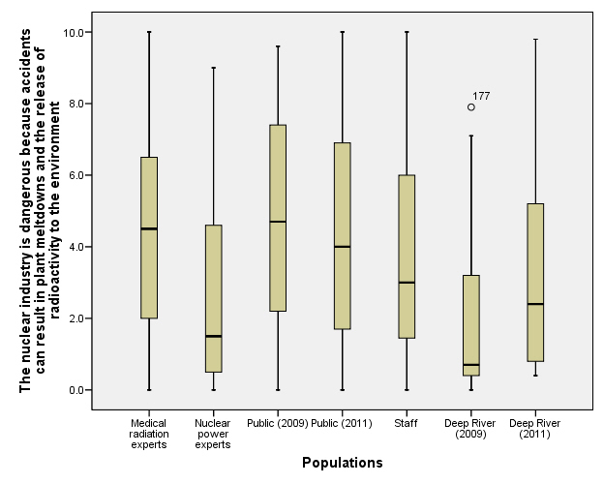

Slide 8
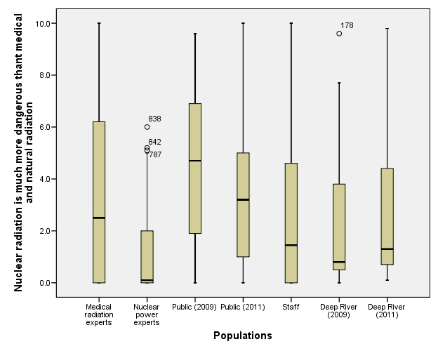

Slide 9
Summary of the mean deviations from the opinions of the nuclear experts by population group.

Slide 10

NUCLEAR RADIATION MEDICAL RADIATION
PERCEIVED BENEFIT
ACTUAL
BENEFIT
PERCEIVED
BENEFIT
ACTUAL
BENEFIT
WILLINGNESS TO ACCEPT RISK
WILLINGNESS TO ACCEPT RISK
PERCEIVED
DETRIMENT
ACTUAL DETRIMENT
PERCEIVED DETRIMENT
ACTUAL DETRIMENT

Slide 11
MESSAGES
Public generally supportive of benefits
Much less certain of detriments
But tend to have an exaggerated perception of detriments
Overall balance negative to nuclear but not for medical
Media attention to detriments a driver
To start to correct bias:
We need to educate our workers
We need to educate the medical community
Educate media to overcome media bias

Slide 12
INFORMATION SOURCES (Takebayashi et al 2017)
Post Fukushima biggest worries were concerned with the perceived risk of genetic effects and of delayed health effects. “Where people obtained their information was important in determining their degree of risk aversion. In general the impacted populations trusted communications from neither central government nor national newspapers, but were more likely to trust information from friends, on-line information from researchers, other on-line information, rumours, regional newspapers and the radio.”

Slide 13
THE MESSENGER (William Hendee, 1991)
“because people respond emotionally rather than intellectually to risk information, the risks of radiation exposure: at best communicated by someone who is knowledgeable, is recognised as a health expert, is trustworthy, but has no conflict of interest but a stake in the community, such as a community physician. Such a person should first respond to perceptions of risk and underlying emotions, since use of only facts often fails to counteract fears. With trust established, a rational discussion of risks and benefits can begin.”

Slide 14
You can train good communicators to make them better communicators, but it is very difficult to train a bad communicator to be good

Slide 15
EMPATHETIC
COMMUNICATE
Tell the people what they want to know. Not what we want them to know nor what we think they want to know.
NEED TO START YOUNG

Slide 16

Radioactive processes in the sun produce the heat and light that allows plants and animals to live.

Slide 17
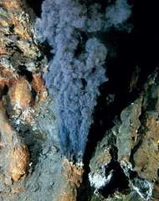
Simple life may have started deep in the sea close to water spouts heated by radioactivity where sun and oxygen are not needed. The bugs getting their energy from sulphur.

Slide 18
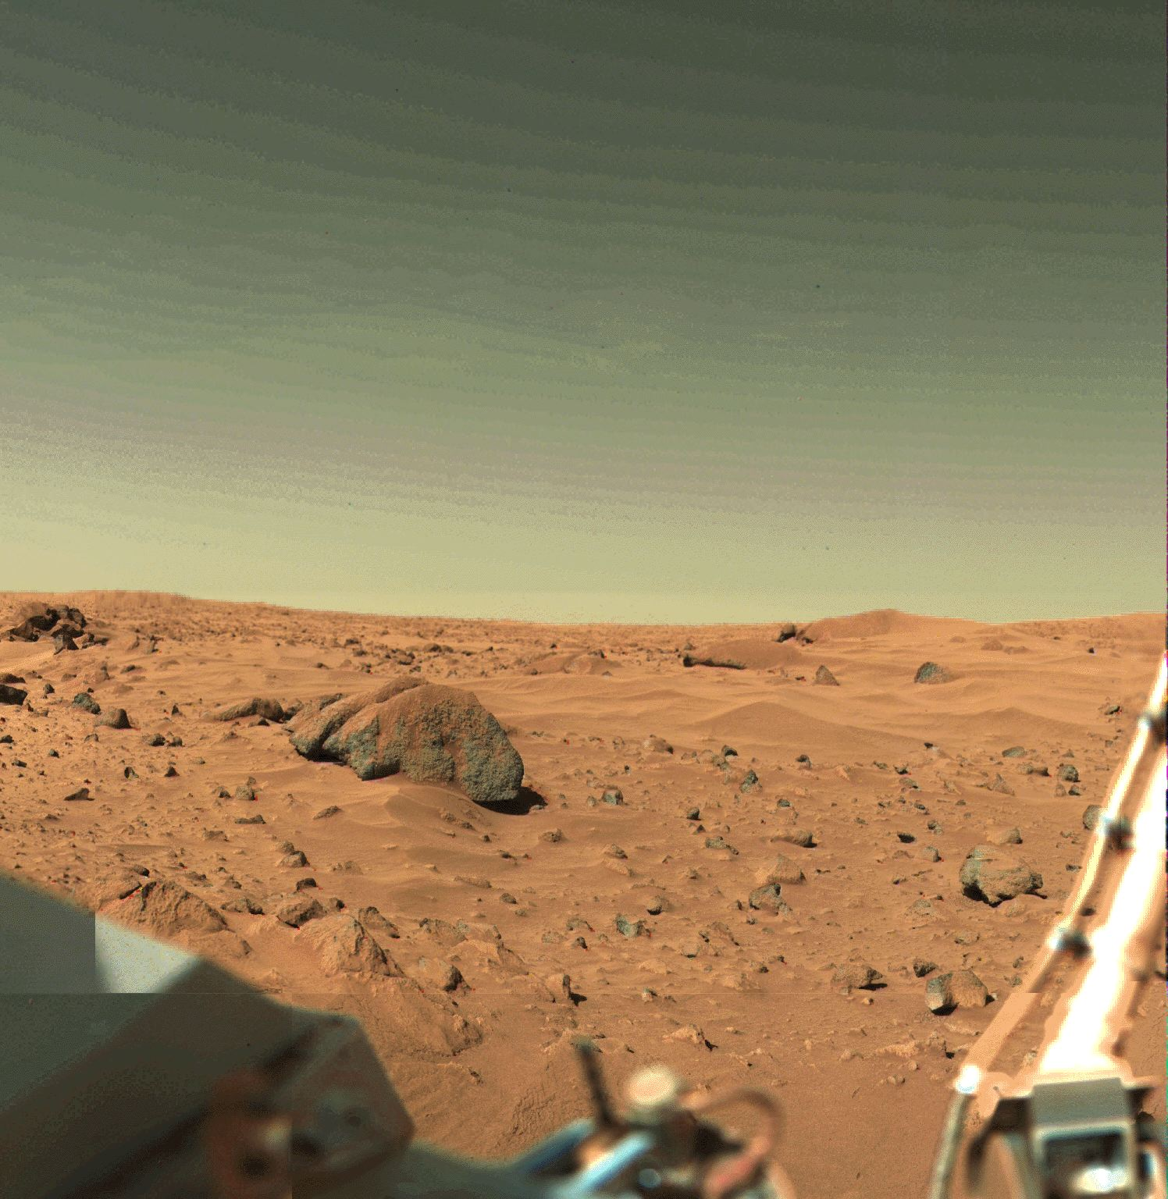

Without radioactivity in the Earth’s core it would be a dead planet like Mars
This Photo by Unknown Author is licensed under CC BY-NC

Slide 19
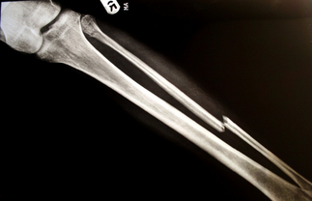
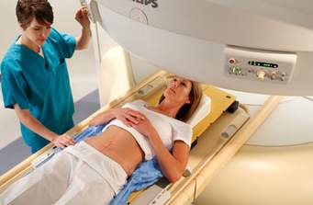
Radiation needed in medicine to find broken bones and to treat cancer

Slide 20


No floating party balloons without gas produced by radioactivity in the ground

