Slide 1
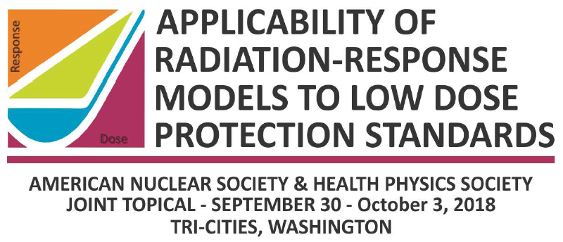
ICRP Views on Radiation Risk at Low Doses through the Lens of Fukushima
Applicability of Radiation-Response Models to Low Dose Protection Standards
Tri-Cities, Washington, USA
October 2018
Christopher Clement
ICRP Scientific Secretary
sci.sec@icrp.org

Slide 2
ICRP
international, independent group of scientists, practitioners, policy-makers, and specialists
working in the public benefit
to protect people and the environment from ionising radiation
without unduly limiting associated benefits

Slide 3
Evacuation Orders in Fukushima
March 11 and 12: initial evacuations to 20 km were not based on specific numerical dose criteria
Decision makers faced great uncertainty and the possibility of terrible consequences
April 22: after better characterization
Evacuation ordered for an area NW of the 20 km zone
To avoid people receiving doses > 20 mSv during the coming year

Slide 4
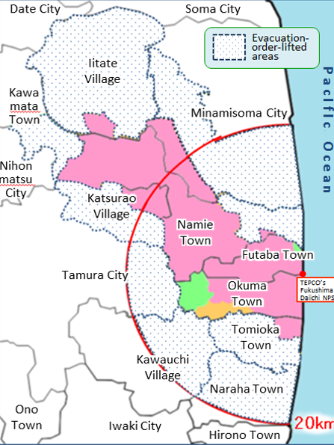
Lifting evacuation orders
Evacuation orders have been lifted in many areas, based on several criteria including avoiding doses > 20 mSv/y
As of April 2017

Slide 5
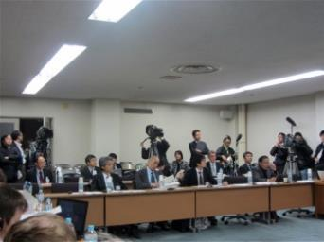
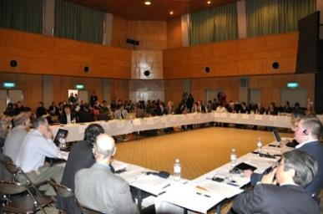
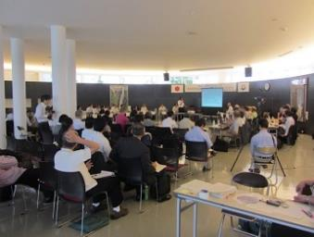
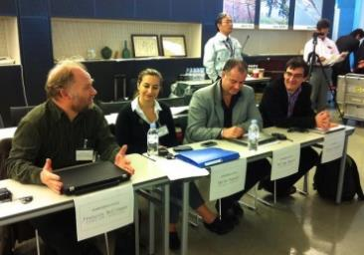
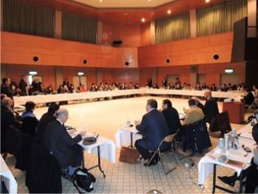
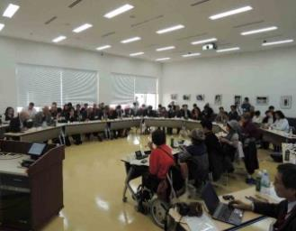
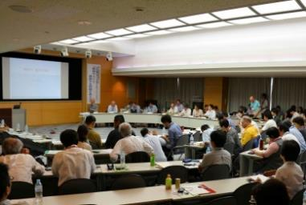
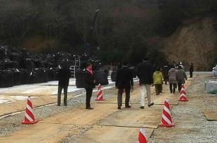
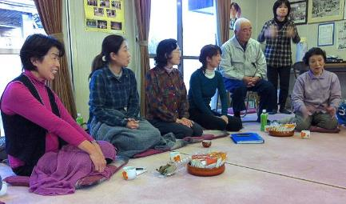
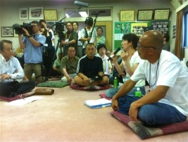
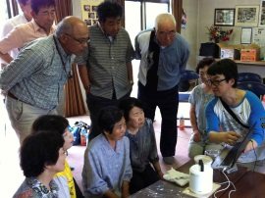
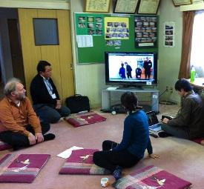
Fukushima Dialogue

Slide 6
Fukushima Dialogue
For Communities and Residents:
Promoting practical radiological protection culture
For Authorities:
ICRP advice on the system of radiological protection
For ICRP:
Learning from those directly involved, to improve recommendations on post-accident recovery

Slide 7
Fukushima Dialogue
I: ICRP Dialogue Initiative (2011 – 2015)
12 Dialogue Meetings + International Symposium
II: Continuing the Dialogue with ICRP (2016 – 2018)
7 Dialogue Meetings
III: Fukushima Dialogue (2018 – )
Next Dialogue Meeting December 2018

Slide 8
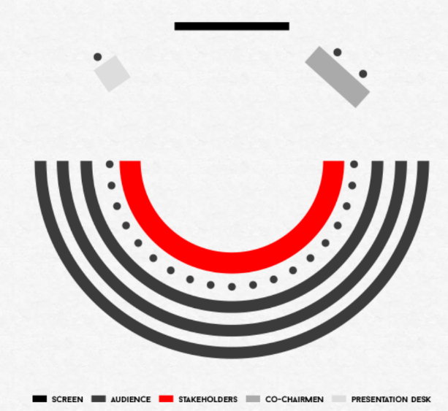
Fukushima Dialogue
Invited stakeholder participants
Local and international observers
ICRP as facilitator
Open to the media
Common language
Presentations and structured dialogue
Stakeholders express their views without interruption
Stakeholder express views again in light of what they have heard
Main points summarised by a rapporteur followed by general discussion

Slide 9
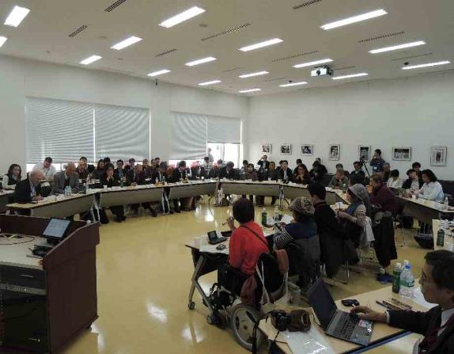
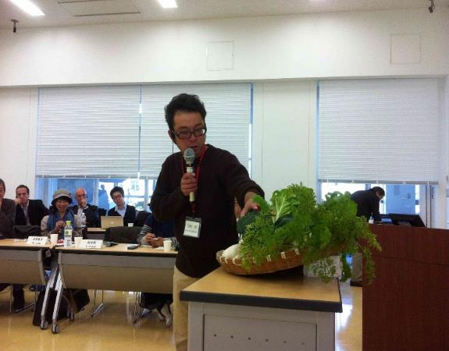
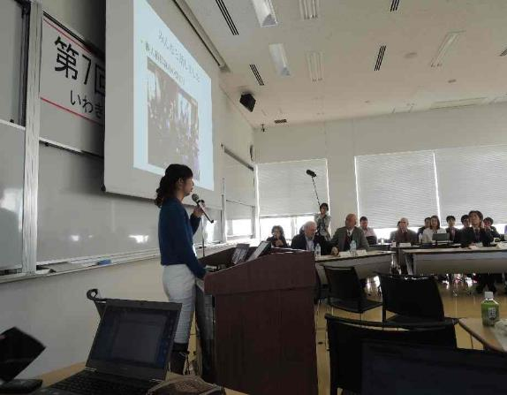
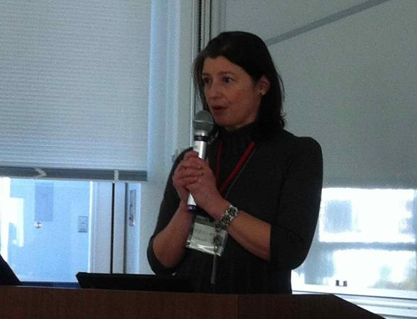
7th Dialogue: November 2013, Iwaki City
Self-Help Actions: People working with Experts
Notes:
.

Slide 10
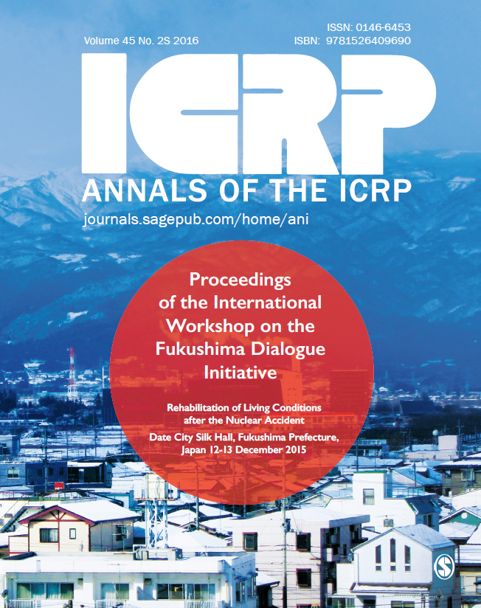
Proceedings of the International Workshop on the Fukushima Dialogue Initiative
December 2015
Free to download

Slide 11
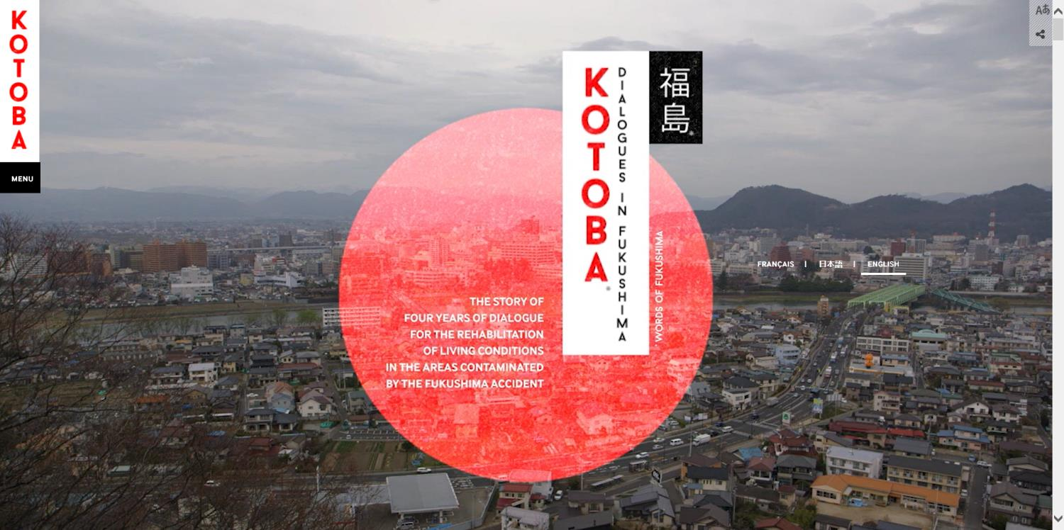
www.fukushima-dialogues.com

Slide 12
Fukushima Dialogue
Key points
Success depends on combination of actions by authorities and by affected people and communities
Co-expertise: experts working with (not only for) residents
Focus on individuals:
Practical RP culture reduces doses and increases a feeling of security
Individual monitoring (internal and external) and self-measurement of land and foodstuff are essential, and requires outside support
LNT was never raised during any of the dialogue meetings

Slide 13
Aim of Radiological Protection
Primary Aim of RP
“an appropriate level of protection for people and the environment against the detrimental effects of radiation exposure without unduly limiting the desirable human actions that may be associated with such exposure” (P103 §26)
Human Health Objective: “manage and control exposures to ionising radiation so that deterministic effects are prevented, and the risks of stochastic effects are reduced to the extent reasonably achievable” (P103 §29)
Prevent effects that are, in principle, preventable
Manage risks that are not fully preventable

Slide 14
ICRP Models for Protection
Tissue Reactions (Deterministic)
Below threshold: no clinically observable effect
Above threshold: increasing dose → increasing severity
Cancer and Heritable Effects (Stochastic)
Increasing dose → increasing probability
No threshold
“LNT”
THIS CLASIFICATION IS A SIMPLIFICATION FOR PROTECTION PURPOSES

Slide 15
LNT
Is NOT promoted as a precise biological model to describe dose-response
Should NOT be used as an assumption in scientific studies on low-dose / low-dose-rate response
Is used as “a prudent basis for radiological protection at low doses and low dose rates” (P103 §36)
Is a SIMPLIFICATION FOR PROTECTION PURPOSES

Slide 16

Regardless of the exact biological dose-response
High doses of radiation increase the risk of cancer
Lower doses = lower risks
At very low doses the risk, if any, is very small
Zero additional dose = zero additional risk

Slide 17
LNT as “a prudent basis for radiological protection”
Makes summation of doses possible
Drives optimisation of protection
At high doses risk is higher -- at low doses risk is lower
Action should be commensurate with dose/risk
At low doses, action, if any, should be modest
Publication 104: Scope of Radiological Protection Control Measures

Slide 18
So where is the problem?
An over-abundance of conservatism
Mis-interpreting OPTIMISATION OF PROTECTION:
“ALARA principle”
As low as reasonably achievable
More than just dose (don’t forget “economic and societal factors”)
Optimimisation must consider the “relative importance of different kinds of risk and about the balancing of risks and benefits” (P103 §27)

Slide 19
Conclusions – Way Forward
Encourage & support low-dose and low-dose-rate research
Improve messaging about risks at very low doses
Promote reasonableness in optimisation of protection, avoiding over-conservatism, in:
Standards
Regulations
Practice (including regulatory practice)

Slide 20

www.icrp.org
www.icrp.org
UK Registered Charity 1166304

