Slide 1
OFFICE CORP
Office Supply Store Data Analysis
Umut Cemal Yetgin

Slide 2








Agenda
Background
Objectives
Analysis (customer profile)
Approach
Recommendations
Appendix
Analysis (modeling)

Slide 3


Background
Initiated telemarketing campaign with 16k customers
Campaign
Had sales with around 4k customers during campaign
Recorded details about each customer that contacted during the campaign
Financials
Gross margin on sales: 22%
Campaign cost: $45.65 per business contacted
Transaction cost: $8.40 per transaction

Slide 4
Objectives
Profile the customers that were contacted during the campaign
Develop models to target customers efficiently in future campaigns
Provide expected value of the models with financial benefits

Slide 5

Approach
Retrieved data are cleaned up with respect to the assumptions mentioned in Appendix A
Customers are profiled with exploratory data analysis (EDA)
Most important features are picked as predictor variables in models
Best performing models are selected for classification (purchase probability) and regression (estimated transaction size)
Profitability is estimated for each customer for future campaigns and illustrated with a lift chart
Customers are divided into percentiles with respect to estimated benefit and most profitable percentiles are addressed
Target customers and recommendations on new campaign are shared as a conclusion

Slide 6
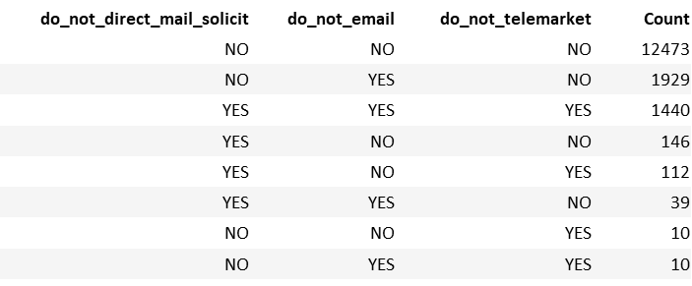
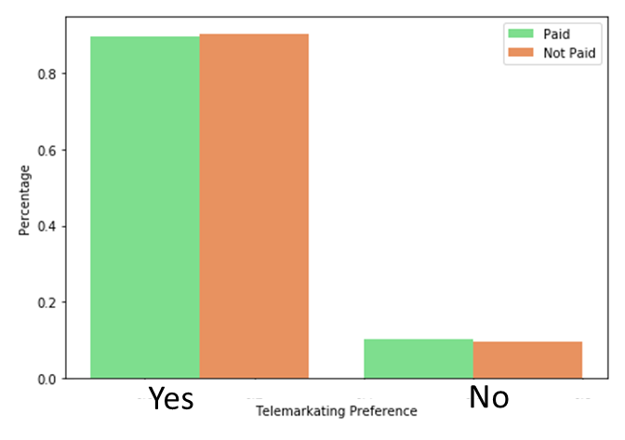
EDA – Communication Preferences
Most of the customers prefer to be communicated through any channel
If a customer prefers not to be communicated, rejects all communication channels usually
For specific channel selection, email is the least preferred
Customers who purchased during the campaign has similar telemarketing preference with the ones that did not purchase during the campaign

Slide 7
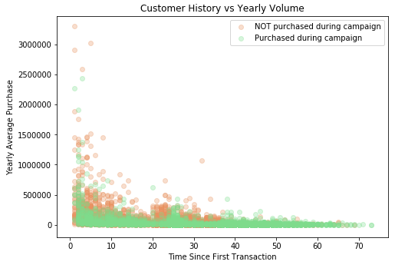
EDA – Historical Patterns
Yearly average purchase vs customer age can indicate customer attitude
New Customers with Intention to Expand Rapidly
Loyal and Profitable Customers
Old Customers with Less Profit
1
2
3

Slide 8
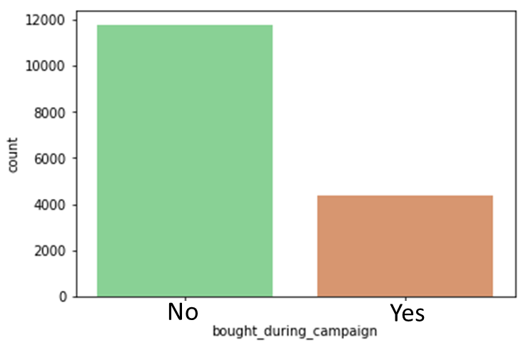
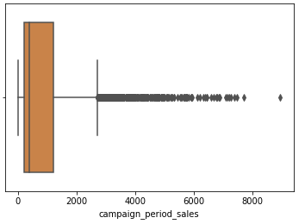
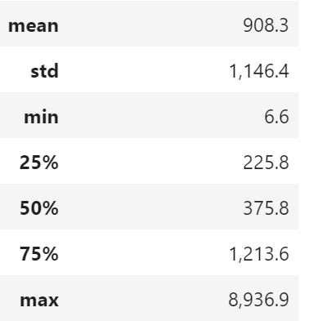
EDA – Campaign Period Sales
Sales Volume for Paying Customers
27% of the customer purchased during the campaign
Some significant volumes, yet sales mostly below $1,200

Slide 9
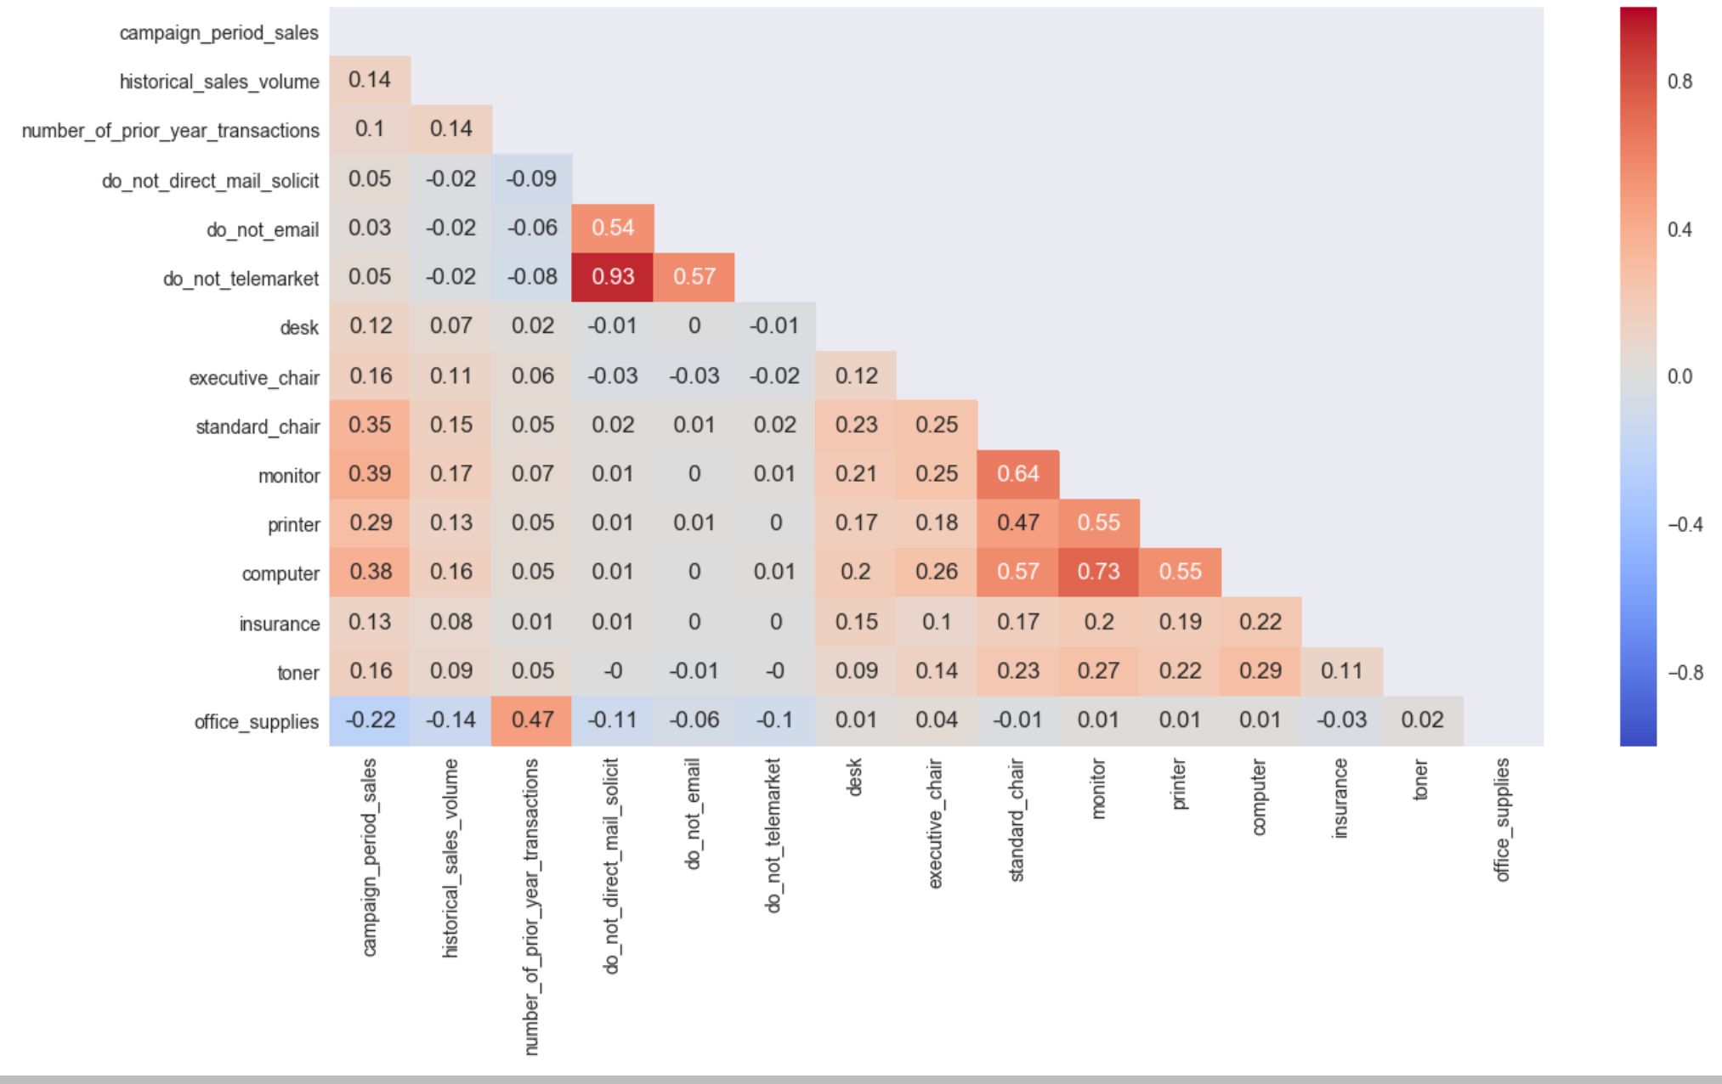
EDA – Correlations
Customers communication preferences mostly match for each channel
Computer, printer, monitor and standard chair are purchased together
These four items have a positive correlation with campaign period sales, too
Number of prior year transactions are positively correlated with office supplies purchase

Slide 10
Classification – Predicting Purchase Probability
Independent Variables Selected as Input to the Model
Years Past since First Transaction (FI = 0.64)
Yearly Average Purchase (FI = 0.13)
Historical Sales Volume(FI = 0.11)
Number Of Prior Year Transactions (FI = 0.10)
Employee Count (FI = 0.02)
FI = Feature Importance
More details under Appendix B

Slide 11
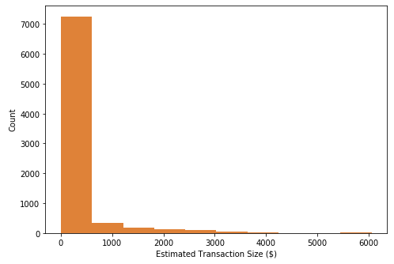
Regression – Predicting Transaction Size
Independent Variables Selected as Input to the Model
Historical Sales Volume
Number Of Prior Year Transactions
Standard Chair Purchase
Monitor Purchase
Office Supplies Purchase
Years Since First Transaction
Repurchase Method
Last Transaction Channel
Employee Count
Language Unknown or Not
Yearly Average Purchase
More details under Appendix B

Slide 12
Lift Chart
Decile | Number of Customers | Actual Profitabilty per Customer | Lift over Average | Total Profit | % of Profit | Incr Proj Profit 100k Cust Base($K) | Total Proj Profit 100k Cust Base($K) | Cuml Incr Proj Profit 100k Cust Base($K) | Cuml Total Proj Profit 100k Cust Base($K)
1 | 808 | $ 168.62 | $ 187 | $ 136,242 | -93% | $ 1,868 | $ 1,686 | $ 1,868 | $ 1,686
2 | 808 | $ (7.30) | $ 11 | $ (5,895) | 4% | $ 109 | $ (73) | $ 1,976 | $ 1,613
3 | 808 | $ (28.09) | $ (10) | $ (22,694) | 15% | $ (99) | $ (281) | $ 1,877 | $ 1,332
4 | 808 | $ (40.42) | $ (22) | $ (32,657) | 22% | $ (223) | $ (404) | $ 1,655 | $ 928
5 | 807 | $ (44.27) | $ (26) | $ (35,723) | 24% | $ (261) | $ (443) | $ 1,394 | $ 486
6 | 808 | $ (45.48) | $ (27) | $ (36,747) | 25% | $ (273) | $ (455) | $ 1,121 | $ 31
7 | 808 | $ (45.81) | $ (28) | $ (37,018) | 25% | $ (276) | $ (458) | $ 844 | $ (427)
8 | 808 | $ (46.01) | $ (28) | $ (37,178) | 25% | $ (278) | $ (460) | $ 566 | $ (888)
9 | 808 | $ (46.20) | $ (28) | $ (37,329) | 25% | $ (280) | $ (462) | $ 285 | $ (1,350)
10 | 808 | $ (46.69) | $ (29) | $ (37,727) | 26% | $ (285) | $ (467) | $ - | $ (1,816)
Total | 8,079 | $ (18.16) | $ - | $ (146,726) | 100% | $ - |  | $ -

Slide 13
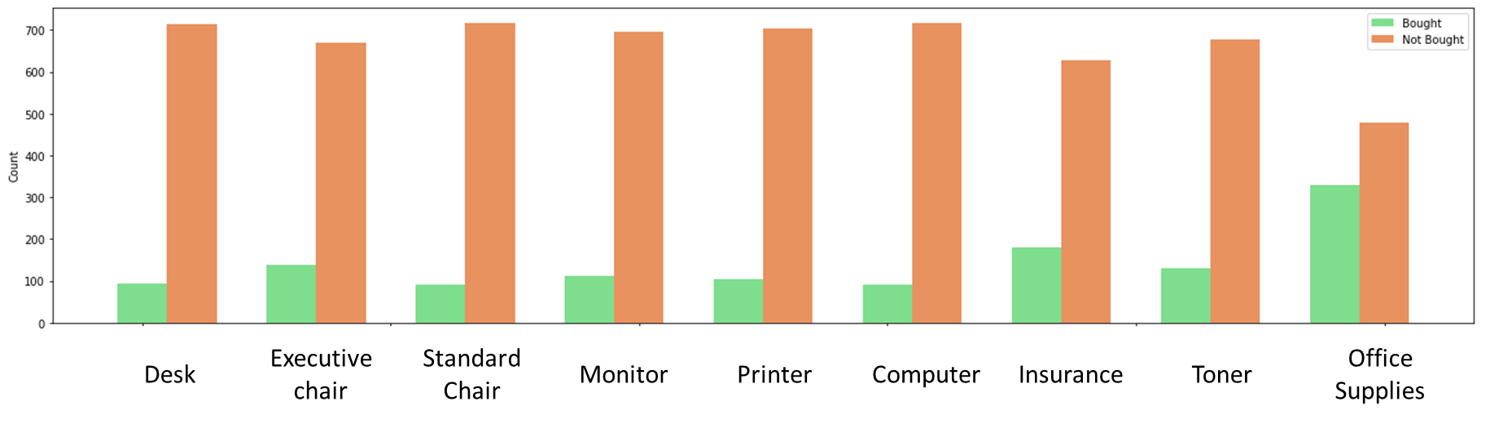
Decile Analysis – Purchased Items
Desk | Executive chair | Standard Chair | Monitor | Printer | Computer | Insurance | Toner | Office Supplies
Office supplies has significantly higher purchase rate; whereas, insurance, executive chair and toner have slightly higher purchase rate compared to other items

Slide 14
Recommendations
Company should target customers in first percentile for the maximum profitability
Company should proactively offer a pack of computer, printer, monitor and standard chair in case that a customer orders at least one of these items
Next campaign can focus on office supplies primarily
There should be new campaigns customized as per the history of the customer:
New Customers with Intention to Expand Rapidly: Offer discounts on high volume purchases
Loyal and Profitable Customers: Sustain relations
Old Customers with Less Profit: Offer renewal packages
The company should consider continuous engagement of a data science team to further enhance profitability of such campaigns

Slide 15
Thank You

Slide 16
Appendix A - Preprocessing
Payment plan row is dropped from repurchase method since there is only a single entry
Below column nan values are included in analysis as ‘Unknown’
last_transaction_channel, number_of_employees, language
Below column nan values are dropped from the analysis
campaign_period_sales, historical_sales_volume, date_of_first_purchase, number_of_prior_year_transactions, do_not_direct_mail_solicit, do_not_email, do_not_telemarket, repurchase_method, desk, executive_chair, standard_chair, monitor, printer, computer, insurance, toner, office_supplies
YY values are updated as Y with the assumption that they stand for the same meaning
Excluded negative campaign sales (product returns) and negative historical sales volume
Excluded wrong date value (later than today)

Slide 17
Appendix B – ML Activities
Classification - Key Actions
Data split with 50/50 ratio for training and testing data
Model performance evaluated with accuracy score (0.86)
Used Random Forest algorithm with Grid Search for the best performance
Regression - Key Actions
Data split with 50/50 ratio for training and testing data
Model performance evaluated with mean squared error (255k)
Used Random Forest Regressor algorithm with Recursive Feature Elimination

