Slide 1
A Project to Investigate and Produce Solutions to the Electricity Waste in Bilkent Dormitory 78
Umut m. köksaldı

Slide 2
Overview
Introduction
Problem Definition
Proposed Solutions
Criteria for Assessing Solutions
Research Methodology
Results and Analysis
Conclusion and Recommendations
References

Slide 3
Introduction
Dorm 78
586 students, 236 rooms [1]
Consuming 1582 kWh / day energy
Stanford University Dorms: 1.04 kWh / day for each person [2]
Dormitory 78: 2.69 kWh / day for each person
~2.5 x more electricity used by the average dormitory resident

Slide 4
Problem Definition
Excessive electrical energy consumption inside Dormitory 78
Root cause 1:
Lack of control mechanisms in the building
Root cause 2:
Out-dated and worn-out lightbulbs
Root cause 3:
Unplanned design and installation of the building’s light fixtures

Slide 5
Proposed Solutions
Solution 1:
Installing sensors
Solution 2:
Increasing the efficiency of the light bulbs
(Replacing with more efficient LED light bulbs)
Solution 3:
Optimizing the layout of the building’s lighting fixture

Slide 6
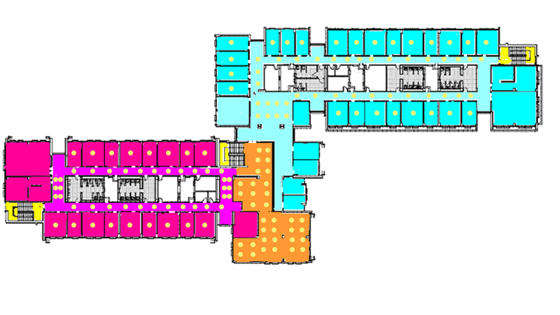
Optimizing the lighting layout

Slide 7
Taking into account:
The lighting intensity of LED lights should they be installed
Positioning the bulbs closer to walls to benefit from the reflection
Maximize efficiency of one lightbulb while minimizing the quantity of lightbulbs

Slide 8
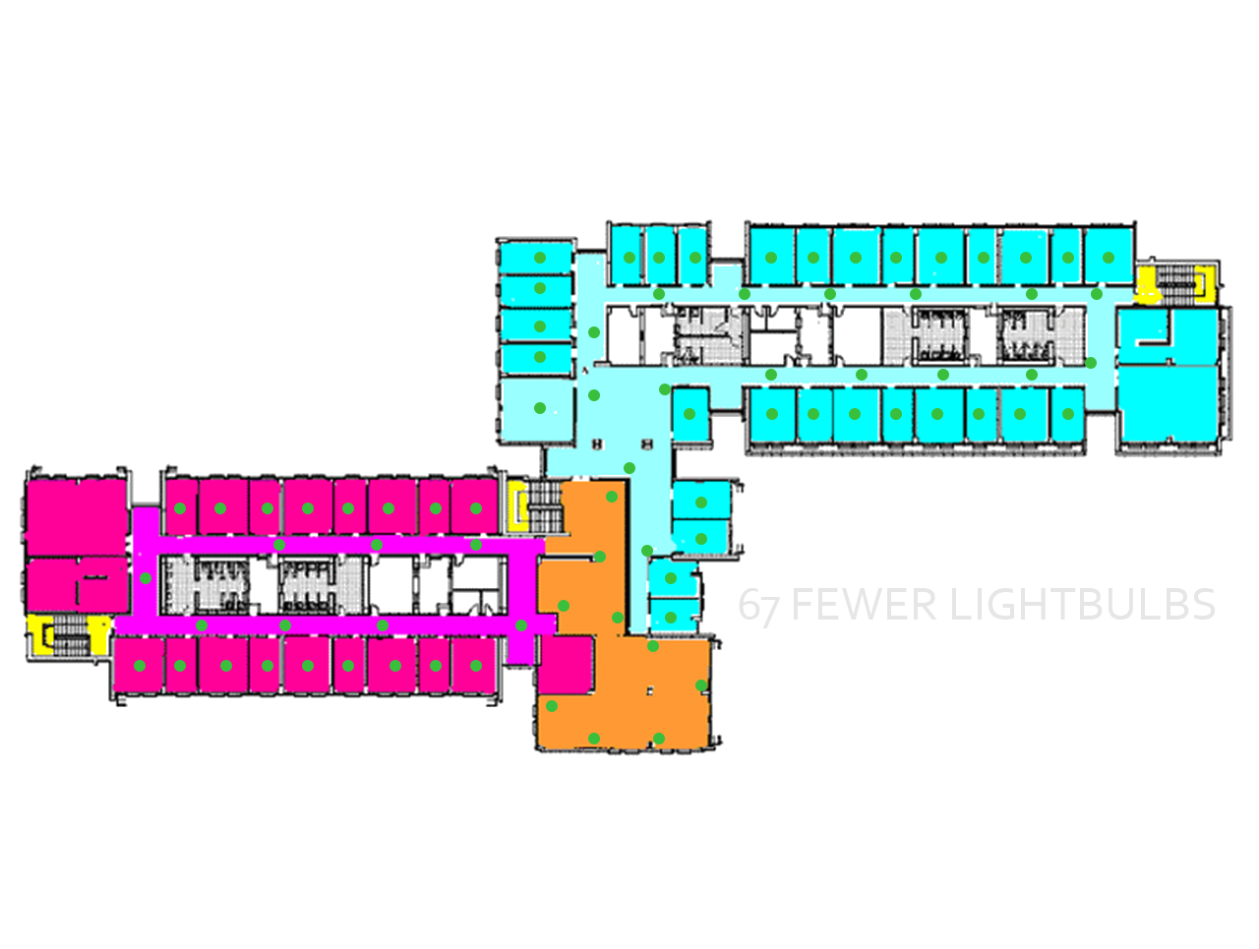
Optimized Layout

Slide 9
Criteria for Assessing Solutions
Cost-effectiveness
There should be a reasonably satisfactory value (savings) returned from the implemented solutions in relation to the monetary cost of realizing such systems (Return on investment)
Acceptability
The proposed solutions need to be easy for the students to adapt to, and they should not interfere with the students’ day-to-day life
Feasibility
The solutions should be technically rational and suitable for the building’s condition (e.g. redesign of the light bulb layout should be possible given the building’s construction)

Slide 10
Installing sensors | Cost-effectiveness | Calculations of the installment cost and the savings sensors would provide
 | Acceptability | Survey for students, building management interview
 | Feasibility | Interview with Chief Electrical Engineer Türesin Özpineci
Increase efficiency of bulbs | Cost-effectiveness | Calculations and comparisons between fluorescent and LED bulbs
 | Acceptability | Interview with Dormitories Manager Zeki Samatyalı
 | Feasibility | Examining previous similar work
Layout optimization | Cost-effectiveness | Interview with Chief Electrical Engineer Türesin Özpineci
 | Acceptability | Survey for students, building management interview
 | Feasibility | Interview with Türesin Özpineci and Financial Manager Ali Mehmet Kılınç

Slide 11
Results & Analysis

Slide 12
Cost-effectiveness of sensors
Approximately 612 lightbulbs for sensors to be installed
Cost of a sensor is 17 ₺, total cost: 10,404 ₺ [3]
Labor cost: approximately 1000 ₺
Expecting a 40% cut on uptime of bulbs
1kWh of energy worth ~0.41 ₺ [4]
Total savings: 2594.48 ₺ per month, break even: 4-5 months

Slide 13
Acceptability of sensors
Dormitory Management: Partially acceptable
Can be implemented alongside other solutions or modificaitons

Slide 14
Feasibility of sensors
Interview with İbrahim Türesin Özpineci
There are no big adjustments to the electrical grid for the sensors
Enough technical personnel to realize the system
The solution is feasible as long as the supply of sensors is ensured

Slide 15
Cost-effectiveness of LED lightbulbs
Cost of an LED lightbulb: 15 ₺ [6]
Total cost of replacing 612 bulbs: 9180 ₺
LEDs use up to 50% less energy compared to fluorescent [7]
Total savings: 9729 ₺ per month
Break even: ~1 month

Slide 16
Acceptability of LED lightbulbs
Interview with Zeki Samatyalı
The process is simple and does not require too much work
Can be done overnight
Deemed LED lights ‘the most appropriate solution’
Dormitories Management is on board with the solution

Slide 17
Feasibility of LED lightbulbs
Case: Stanford University
Stanford has managed to reduce campus-wide electrical energy usage by 25% as a result of LED lights [5]
The process is simple and does not require technical expertise

Slide 18
Cost-effectiveness of lightbulb layout optimization
~400 lights to be removed and 122 lights to be reinstalled into the ceilings
Labor cost: ~15,000 ₺
Approximately 280 lights removed
Total savings: 7783 ₺ per month
Break even: 2 months

Slide 19
Acceptability of lightbulb layout optimization
Dormitory management does not accept the solution
Management states that the proposed solution is too obstructing for both the students and the dorm staff
Could be implemented if the electrical infrastructure of the building was already being changed

Slide 20
Feasibility of lightbulb layout optimization
Interviews with Electrical Engineer Türesin Özpineci and Financial Manager Ali Mehmet Kılınç
The proposed solution is too costly from an economic standpoint
Too big of an overhaul of the building’s construction
The solution is not feasible

Slide 21
Conclusion & Recommendations
Sensors
LED lightbulbs
Layout optimization
Cost-effectiveness
Acceptability
Feasibility
Total

Slide 22
Recommended action plan
Combination of solution 1 and solution 2
LED lights should be installed primarily and during the construction process sensors should also be implemented into the new lighting fixtures

Slide 23
References
[1] Bilkent University, ‘Hizmet ve Olanaklar’, 2013. [Online]. Available: http://www.yurt.bilkent.edu.tr/78a.html [Accessed: 26-Jun-2017]
[2] Stanford University, ‘Fact Sheet: Student Housing’, 2016. [Online]. Available: https://sustainable.stanford.edu/sites/default/files/FactSheet_StudentHousing.pdf [Accessed: 23-Jul-2017]
[3] Elektrikmarket.com, ‘Tavan Hareket Sensörleri’, 2017. [Online]. https://www.elektrikmarket.com.tr/Sensor-180-Derece-Beyaz-Horoz-088-001-0003,PR-50780.html [Accessed: 24-Jul-2017]
[4] Gazelektrik.com, ‘Mesken Elektrik kWh Fiyatları’, 2016. [Online]. http://gazelektrik.com/faydali-bilgiler/1-kwh-elektrik-kac-tl [Accessed: 24-Jul-2017]
[5] Stanford University, ‘Advancements in Energy Efficiency’, 2016. [Online]. Available: https://sustainability-year-in-review.stanford.edu/2016/features/advancements-in-energy-efficiency/ [Accessed: 23-Jul-2017]
[6] Vatan Computer, ‘Goldmaster LED AMPUL E27’, 2017. [Online]. http://www.vatanbilgisayar.com/la-127-bl2-led-ampul-e27-duylu-10w-75w-akkor-220v-3000k-sicak-beyaz.html [Accessed: 24-Jul-2017]
[7] Lowes.com, ‘Lightbulb Buying Guide’, 2016. [Online]. https://www.lowes.com/projects/decorate-and-entertain/Lightbulb-Buying-Guide/project [Accessed: 25-Jul-2017]

