Slide 1
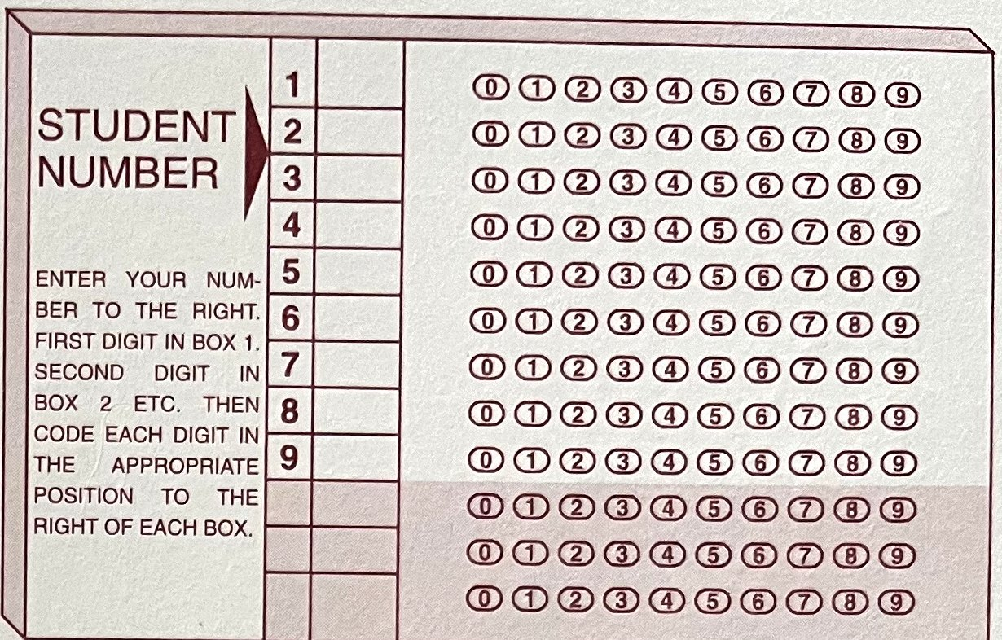
How to fill in your bubble sheet
BEFORE THE EXAM STARTS
Pencil, version letter, student number, and your answers.
Notes:
Welcome. Before the exam starts, take two minutes to see how to fill in the bubble sheet correctly. Mistakes on the sheet are the easiest points to lose.

Slide 2

Use a pencil
THE BASICS
For your name, your version letter, your student number, and every answer.
No pens.
Notes:
Pencil only, for everything on the sheet and the exam booklet. The scanner reads pencil marks, and pencil can be erased if you change an answer.

Slide 3
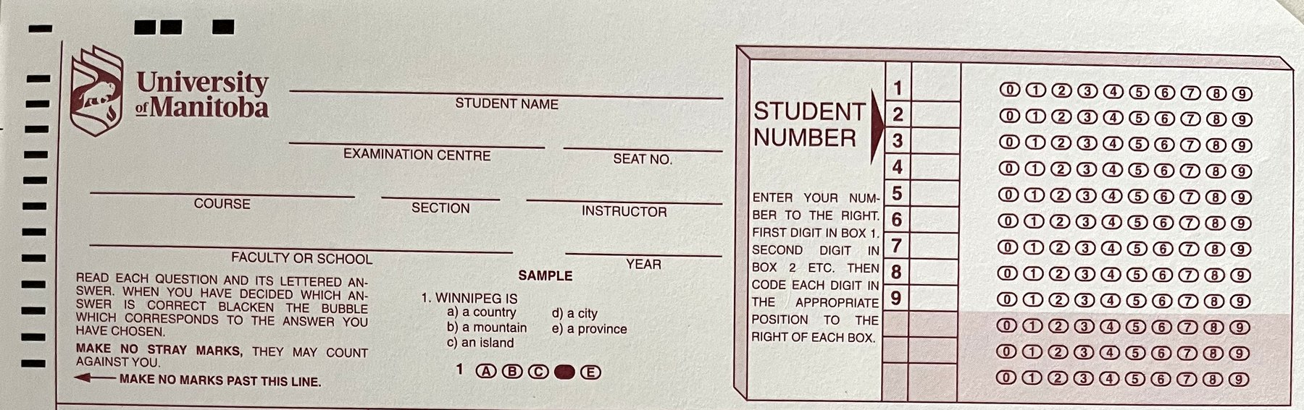
Write your version letter and name
TOP OF THE SHEET
1
2
1
Version letter
2
Your name
Write your exam's version letter in the empty space at the top.
Print your name clearly and correctly on the Student Name line.
Notes:
The version letter goes in an empty space at the top of the sheet, and your name goes on the Student Name line. The highlighted boxes show where. Print your name so it can be read.

Slide 4
Fill in your student number
STUDENT NUMBER
You have 2 options:
7 digits
Your student ID in boxes 1 to 7. Leave boxes 8 and 9 empty.
9 digits
Add 0 0 at the start, then your 7-digit ID, in boxes 1 to 9.
Fill in the bubble beside each box too. Writing the digits is not enough.
Notes:
Either format works: the seven-digit student ID, or the ID with two zeros in front to make nine digits. The key point is to fill in the bubbles to the right of each box, one bubble for each digit.

Slide 5
Example with the made-up ID 1234567
STUDENT NUMBER
7-digit ID
9-digit ID: 0 0 + your ID
0
1
2
3
4
5
6
7
8
9
0
1
2
3
4
5
6
7
8
9
1
1
2
2
3
3
4
4
5
5
6
6
7
7
8
8
9
9
Boxes 1 to 7 hold your ID. Boxes 8 and 9 stay empty.
Boxes 1 and 2 are 0 0. Boxes 3 to 9 hold your ID.
Notes:
Here is what the bubbles look like for a made-up ID, 1234567. On the left, the seven-digit version: one bubble per row for rows 1 to 7, rows 8 and 9 left empty. On the right, two zeros first, then the seven digits, using all nine rows. One filled bubble per row either way.

Slide 6
Fill each bubble dark and full
YOUR ANSWERS
Don't
Don't
Do
Too faint
Only a dot
Dark and full
Press firmly so the mark is dark, not light.
Fill in the whole bubble, not just part of it.
Fill the whole bubble with a firm, dark mark.
Notes:
Three examples. A faint mark, a mark that only covers part of the bubble, and the right way: a dark mark that fills the whole bubble. Press firmly with the pencil.

Slide 7
Made a mistake? Erase it
YOUR ANSWERS
Don't
Do
Cross it out
Erase it completely
A
B
C
D
E
A
B
C
D
E
Crossing out leaves a mark in the old bubble.
Erase the old mark fully, then fill in your new answer.
Notes:
If you change your mind, erase the old answer completely. Do not cross it out. Then fill in the bubble for your new answer.

Slide 8
Only one answer per question
YOUR ANSWERS
Don't
Do
Two bubbles filled
One bubble filled
A
B
C
D
E
A
B
C
D
E
Never fill in more than one bubble for a question.
Choose your single best answer and fill in that one bubble.
Notes:
One bubble per question. If you are torn between two answers, pick the one you think is best.

Slide 9

Your bubble sheet checklist
BEFORE YOU BEGIN
Pencil only
Version letter
For your name, version letter, student number and answers.
Written in the empty space at the top of the sheet.
Name
Student number
Printed clearly and correctly on the Student Name line.
7 digits, or 0 0 plus 7 digits, with every bubble filled.
Dark, full bubbles
Mistakes
Press firmly and fill the whole bubble.
Erase completely. Never cross out.
One answer
Clean sheet
Only one bubble filled for each question.
No stray marks. The sheet says they may count against you.
Notes:
A quick checklist to run through before you start. Take a moment to check each item on your own sheet.

