Slide 1
U-Trade
Mehmet umut öksüz
2016400096

Slide 2
What is U-Trade
With U-Trade you can create leveraged, short positioned purchases from stock markets without actually buying the stock.
You create an offer according to your expectations. Selecting LONG, SHORT positions and 1x, 2x, 3x leverages.
After another user accepts this and counteroffers your offer, it is approved.

Slide 3
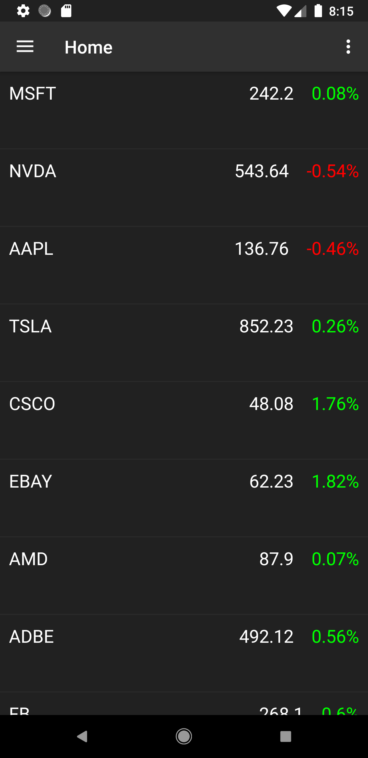
See current prices
Using U-Trade you can see current prices of NASDAQ stocks and create offers.

Slide 4
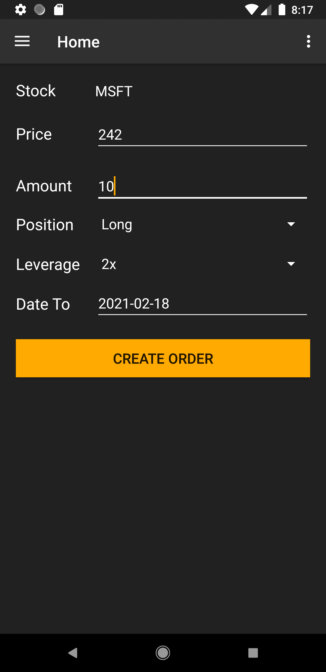
Create your offer
You can create your offers by selecting price, amount, position,
leverage and due date.
Then you wait for someone to accept it.

Slide 5
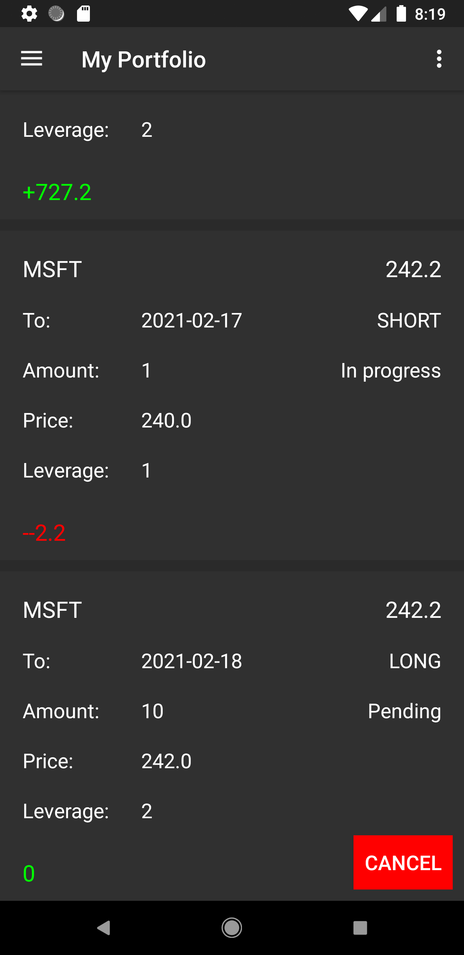
See your positions
At your portfolio see your current positions with profits.
You can cancel an offer if it is not taken by another user.

Slide 6
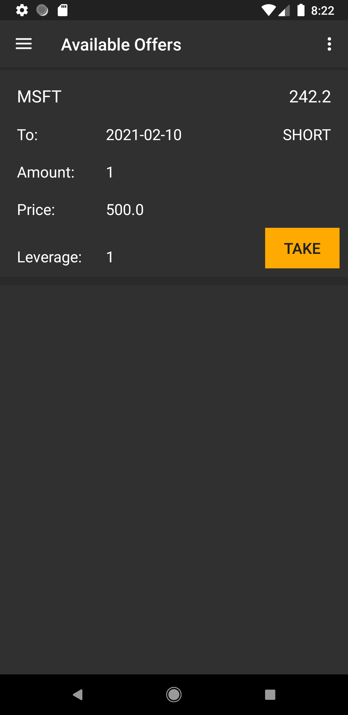
See available offers ans take
You can see offers created by other people and take opposite place of this
offer if you want.
After due date passed, according to last price of stock you get your profit.

Slide 7
System
I have used TCP sockets to implement communication between server and client. Server can accept multiple clients simultaneously and client client initiates connection whenever a request is send to server.
To store data, for each object a .txt file is created at server which contains a json array of objects.
Semaphores are used to ensure concurrency in the system.

Slide 8
Further Details
Github repo: https://github.com/umutoksuz/U-Trade
APK https://drive.google.com/file/d/1qnPNNEDWPiKvRhw2cnMwec727w0BNEBE/view?usp=sharing

