Slide 1
Analyzing Location Based Spenditure Data
Umut Cavit Sandıkçı 29434
DSA210 project

Slide 2
The Dataset
My personal location history is collected via Google maps «timeline».
My spenditure is collected through banking application (Garanti BBVA, credit card statement)
Both datasets cover 2025 first quarter.

Slide 3

Hypothesis Question
Will my total spending be higher on days when I visit more locations throughout 2025?

Slide 4
Null Hypothesis (H0)
Total spending on days with fewer locations visited is the same or less than on days with more locations visited.

Slide 5
Alternative Hypothesis (H1)
Total spending is higher on days when fewer locations are visited.

Slide 6
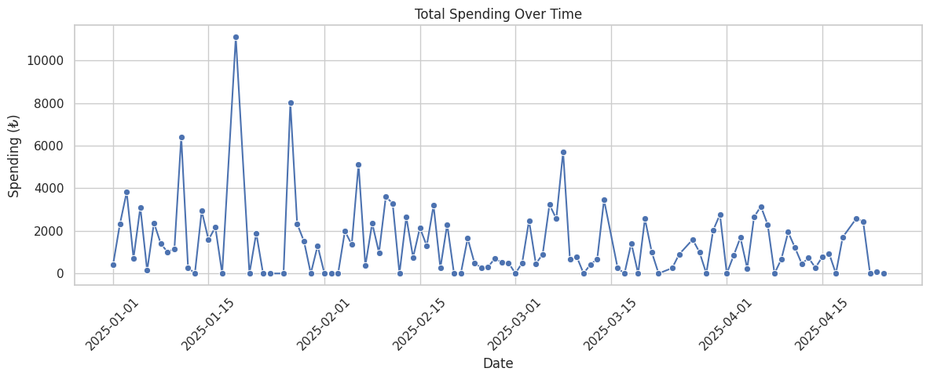
Total Spenditure Over Time
This is the line plot of my Daily spending.
At the first weeks of each month, we can see that there is a peak in spenditure. A strong reason for that could be monthly payment I get in the first week of every month .

Slide 7
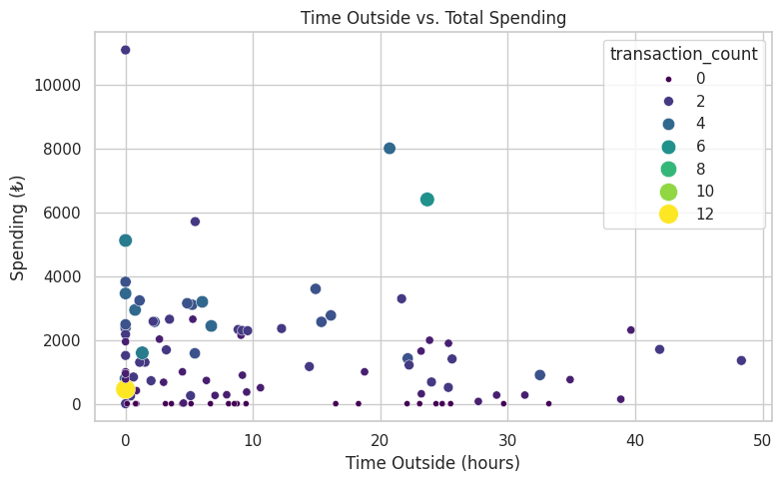
Time Outside vs Total Spending
This is the scatter plot of my spenditure related to my time spend outside and transaction count.
There is no clear corellation since on days when I was outside for a long time, sometimes the expenses were high and sometimes low.
Some examples show that, even in low outside times, my spenditure was high. (quick shopping like supermarkets)

Slide 8
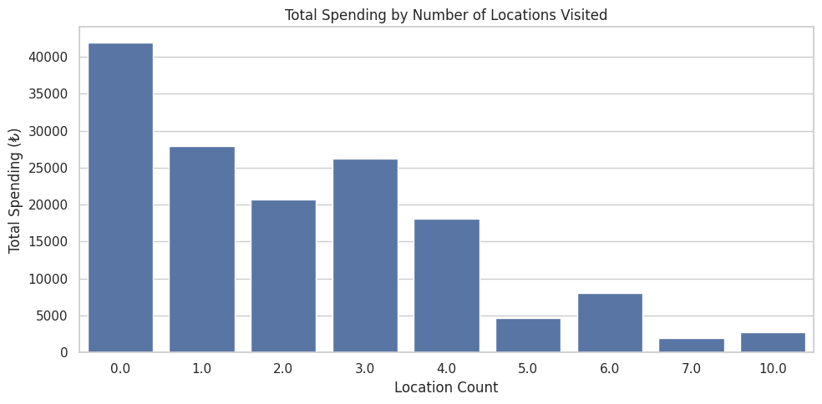
Total Spending by Number of Locations Visited
This is the barplot of total expenses according to the number of places visited.
This shows that most of my spending were made in the days that I visited less locations, especially when I was at home.
The trend of the plot is clear and it shows that the more places I visit, the lesser my spenditure becomes.
This is the most important comparison for my hypothesis.

Slide 9

Analysis
By analyzing the last graph, there is a big difference in total amount spent in days with lower visits and higher visits.
Total spent on the low-group (visits <= 4) 135.070,78
Total on the high-group (visits > 4) 17.368,46

Slide 10
Conclusion
After analysing the results, I concluded to reject the null hypothesis.
The alternative hypothesis appears to be true:
«Total spending is higher on days when fewer locations are visited.»

