Slide 1
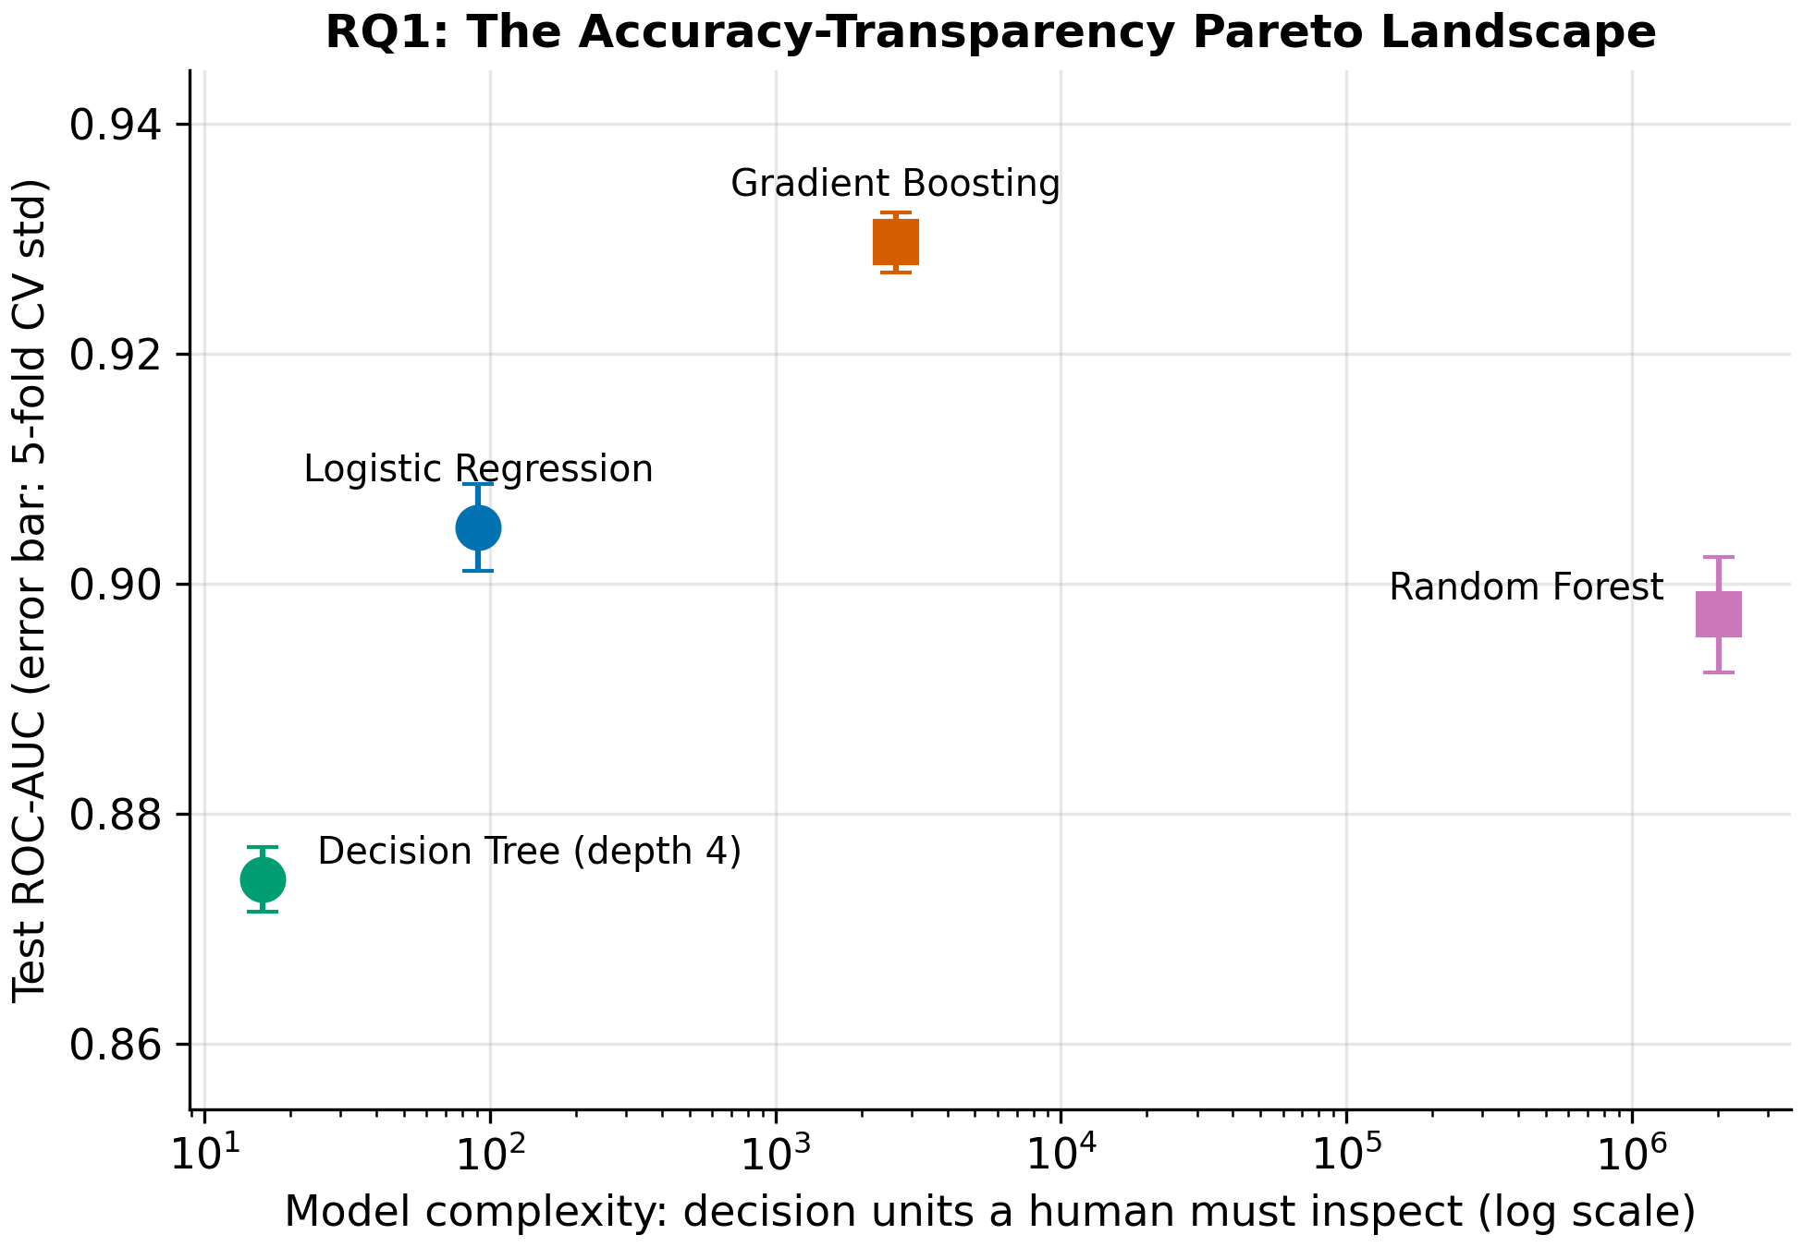
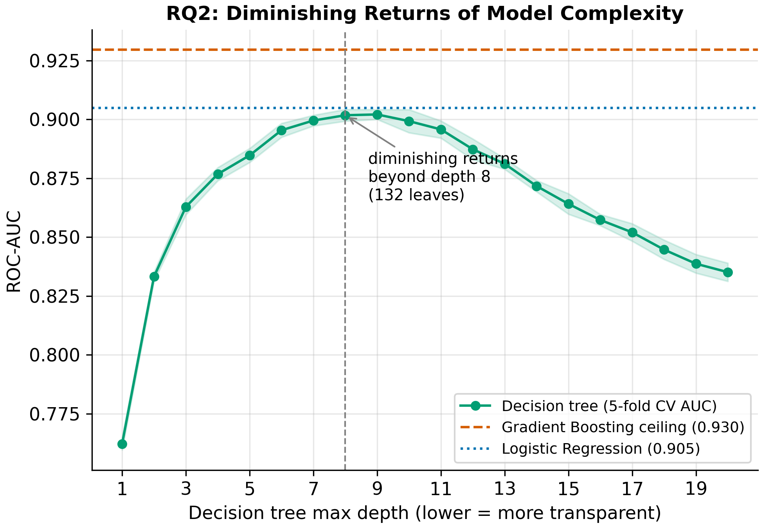
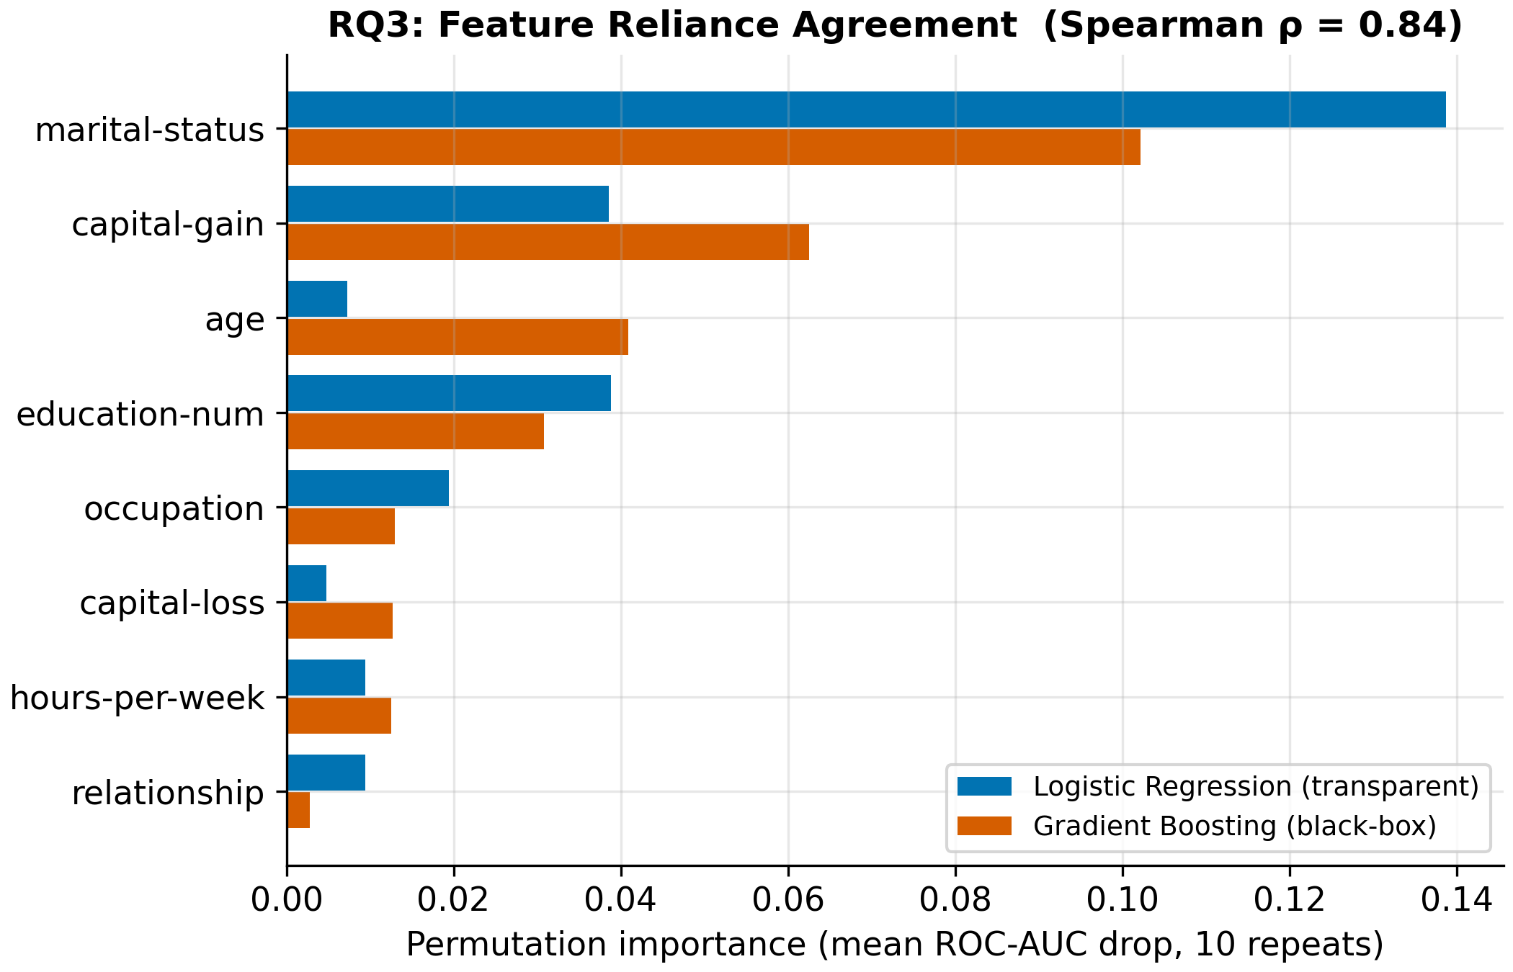
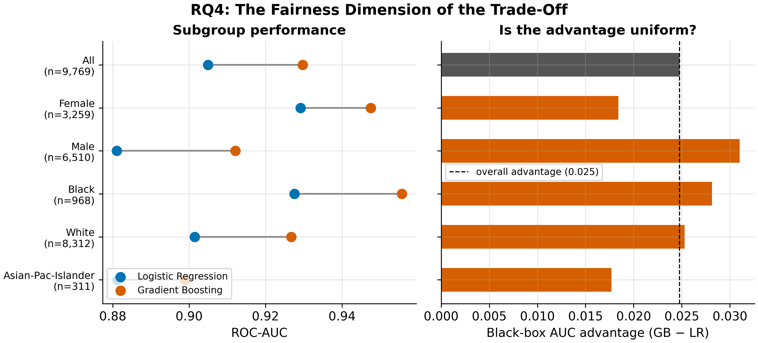
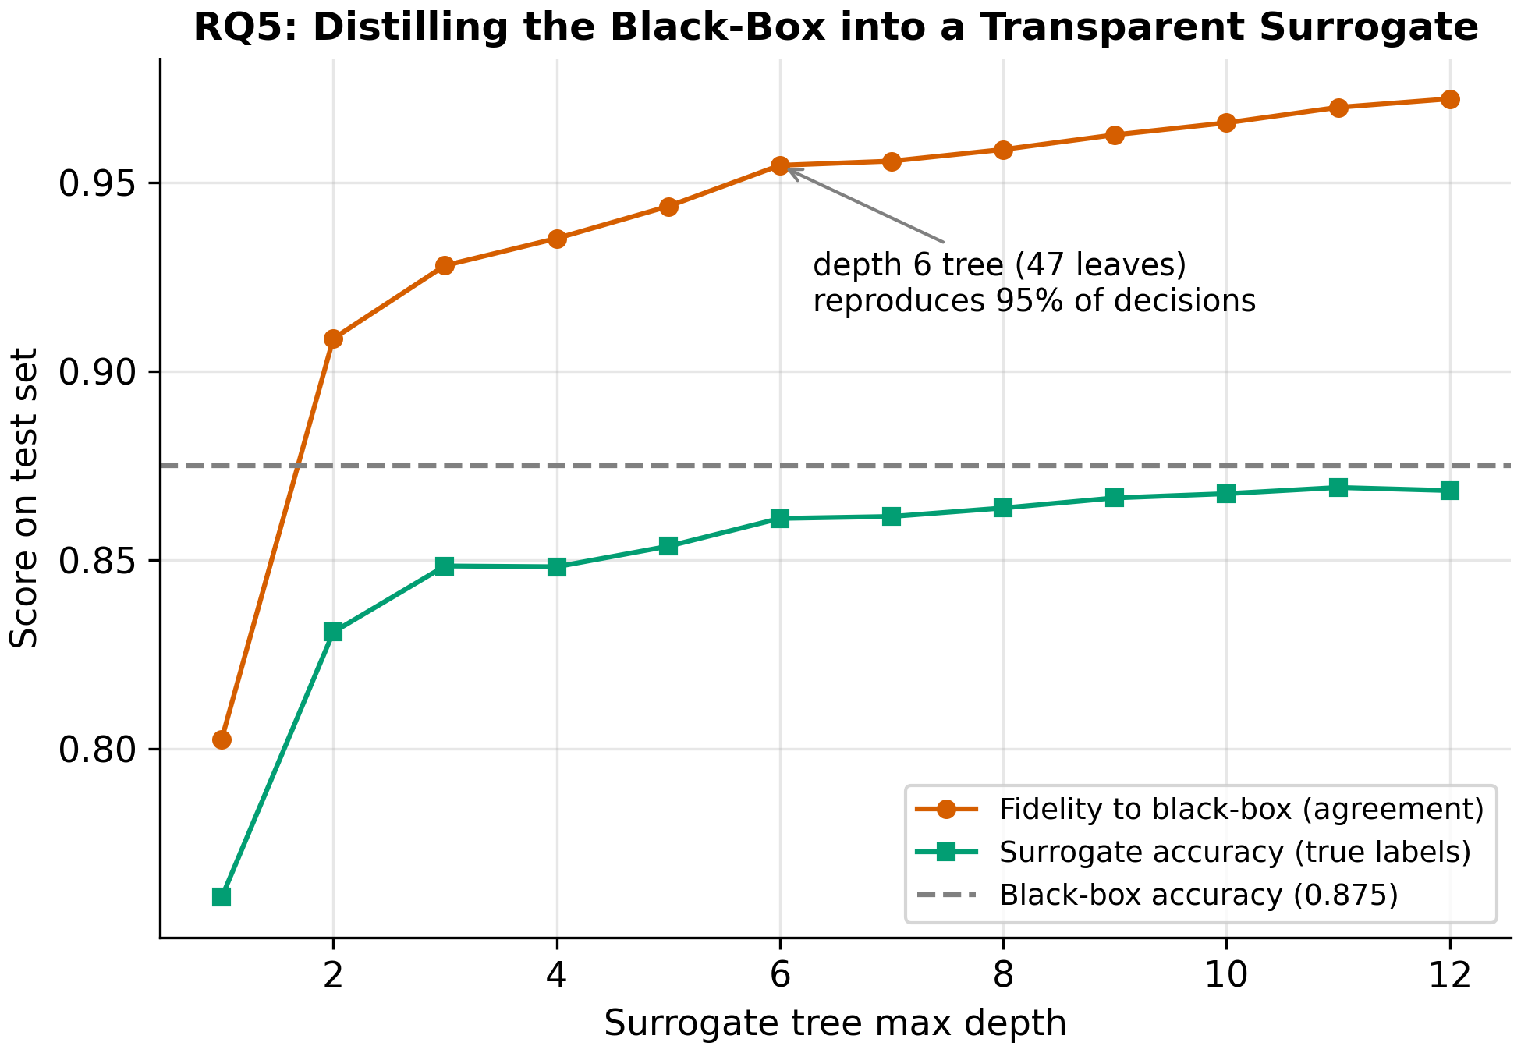
The Accuracy–Transparency Trade-Off in Responsible AI
Umut Türklay · 49848742 · Governing Intelligent Systems for Sustainability
1
Motivation
2
Dataset
3
Research Questions
High-stakes automated decisions — credit, hiring, risk scoring — increasingly rely on machine learning.
Regulations such as the EU AI Act and the GDPR right to explanation demand transparency, which sits in tension with more accurate but opaque black-box models.
This project measures how real, how large, and how fair that trade-off actually is on real data.
UCI Adult Census Income
• 48,842 records, 12 features (after cleaning)
• Target: income > 50K (positive rate 23.9%)
• Source: OpenML / Kaggle (public)
• Dropped fnlwgt (sampling weight) and duplicate education column
• Sensitive attributes available: sex, race
RQ1 How large is the accuracy gap between interpretable and black-box models?
RQ2 Where do added complexity and lost transparency stop paying off?
RQ3 Do the models rely on the same features?
RQ4 Is the black-box advantage uniform across demographic subgroups?
RQ5 How faithfully can a compact surrogate mimic the black-box?
4
Methodology Pipeline
1 Data
UCI Adult Census 48,842 × 12
2 Preprocessing
clean · impute one-hot · scale
3 Train / Test
stratified 80/20 seed = 42
4 Model Training
LogReg · Tree Random Forest · GB
5 Evaluation
answer RQ1–RQ5 AUC · fairness
6 Interpretation
figures · tables conclusions
5
Key Results
RQ1 · Accuracy vs Transparency
RQ2 · Diminishing Returns
RQ3 · Feature Agreement
Black-box edge is real but small: GB AUC 0.930 vs LogReg 0.905 (+2.5 pts). Random Forest uses ~2M leaves yet trails — complexity ≠ accuracy.
A depth-8 tree (132 leaves) already matches LogReg; beyond it accuracy falls while transparency keeps degrading.
Both model types rely on largely the same features (Spearman ρ = 0.84); GB mainly differs by exploiting the non-linear age effect.
RQ4 · Fairness Dimension
RQ5 · Surrogate Distillation
Table 1 · Model Performance
Model | AUC | Acc. | Units
Decision Tree (d4) | 0.874 | 0.846 | 16
Logistic Regression | 0.905 | 0.855 | 91
Random Forest | 0.897 | 0.852 | 2,013,240
Gradient Boosting | 0.930 | 0.875 | 2,635
The advantage is NOT uniform: +0.031 AUC for men vs +0.018 for women. Choosing transparency costs subgroups differently.
A depth-6 surrogate (47 leaves) reproduces 95.4% of black-box decisions at 0.861 accuracy vs the teacher's 0.875 — an auditable middle ground.
Units = learned elements a human must inspect to fully understand the model (transparency proxy). Test set, seed 42.
6
Contributions
Discussion
7
Conclusion
• A measurable transparency axis (decision units)
• Quantified trade-off size on real data (~2.5 AUC pts)
• Evidence that complexity alone ≠ accuracy
• A fairness-aware view of the trade-off
• Distillation as a practical, auditable remedy
The black-box gain is modest and, under default settings, Random Forest even trails logistic regression — accuracy is not a simple function of complexity.
Because the advantage is unequal across groups, switching to a black-box is also a governance decision, not only a technical one.
Limitations: one dataset, default hyperparameters, a single transparency proxy.
The accuracy–transparency trade-off is real but small (~2.5 AUC points), it is not distributed equally across demographic groups, and it can be largely closed by distilling the black-box into a compact, auditable surrogate.

