Slide 1
THESIS PROGRESS REVIEW
From model screening
to the final thesis experiment
01
month to a
decision-complete
thesis
M1 evidence · Turkish corpus decision · one-month closure plan
14 AUGUST 2026
TRANSFER VS. RELEARNING
Notes:
Open with the change in emphasis: the project now has enough M1 evidence to stop broad model search and close the causal Turkish-adaptation experiment.
[Sources]
- Local: documentation/144_SUPERVISOR_FEEDBACK_AND_SCIENTIFIC_REALIGNMENT_TR.md
- Local: documentation/145_LITERATURE_FIRST_M1_MODEL_AND_TURKISH_ADAPTATION_ROUTE_TR.md

Slide 2
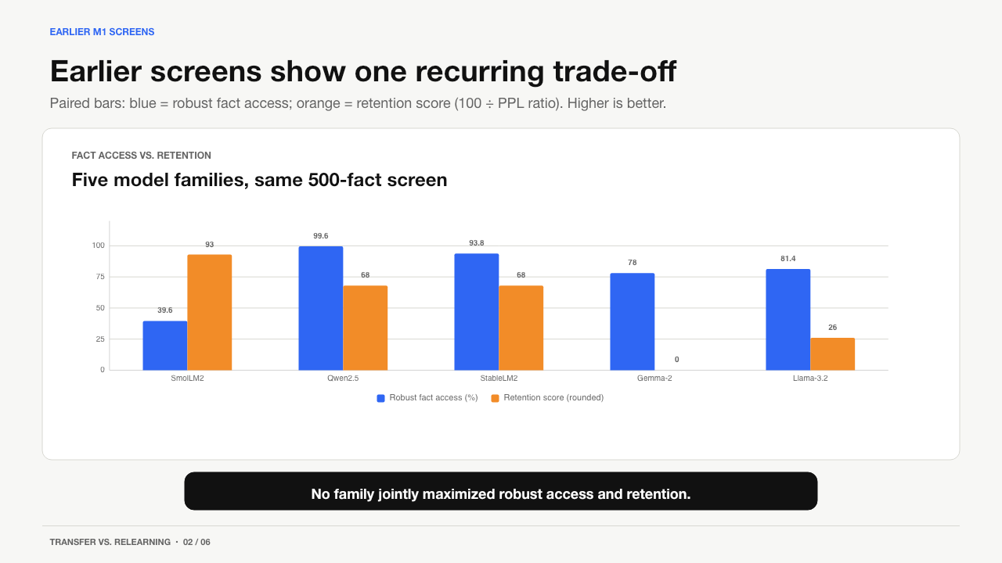
EARLIER M1 SCREENS
Earlier screens show one recurring trade-off
Paired bars: blue = robust fact access; orange = retention score (100 ÷ PPL ratio). Higher is better.
FACT ACCESS VS. RETENTION
Five model families, same 500-fact screen
No family jointly maximized robust access and retention.
TRANSFER VS. RELEARNING • 02 / 06
Notes:
The earlier screen was useful because it ruled out the idea that exact memorization alone is enough. SmolLM retained English but generalized poorly; stronger robust access came with much larger retention cost.
[Sources]
- Local: documentation/106_M1_CROSS_FAMILY_MODEL_SCREENING_RESULT.md
- Local: documentation/130_TR.md

Slide 3
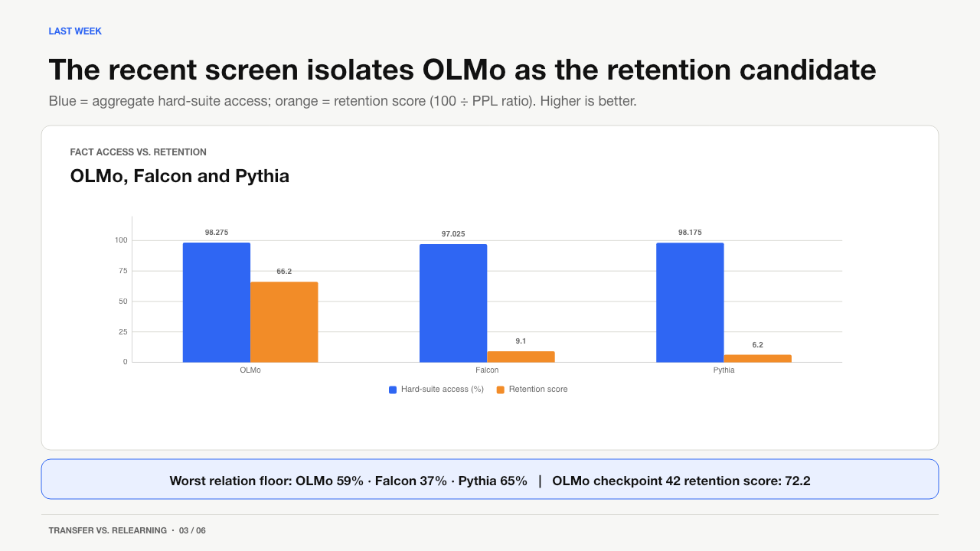
LAST WEEK
The recent screen isolates OLMo as the retention candidate
Blue = aggregate hard-suite access; orange = retention score (100 ÷ PPL ratio). Higher is better.
FACT ACCESS VS. RETENTION
OLMo, Falcon and Pythia
Worst relation floor: OLMo 59% · Falcon 37% · Pythia 65% | OLMo checkpoint 42 retention score: 72.2
TRANSFER VS. RELEARNING • 03 / 06
Notes:
Aggregate hard-suite scores were 97–98%, so the decisive differences are the relation floor and retention. OLMo is not a PASS, but it is the only model worth one precommitted early-stop decision rather than more open-ended recipe search.
[Sources]
- Local: documentation/158_PYTHIA_REPAIR_POST_EXECUTION_AND_THREE_MODEL_GATE_TR.md
- Local: documentation/160_M1_DOSE_PARETO_OLMO_BF16_EXECUTION_AND_FAMILY_STATUS_TR.md
- Local: documentation/176_M1_DOSE_PARETO_POST_FALCON_AUDIT_PERSISTENT_RECOVERY_GATE_TR.md

Slide 4
CORPUS DECISION
Why vngrs is the strongest corpus candidate
Public, paper-backed, source-tagged Turkish web text — broad enough to replace Wikipedia-only adaptation.
WHO USED WHAT?
WHY VNGRS
VBART
vngrs: OSCAR + mC4
arxiv.org/abs/2403.01308
84.9 GB
50.3M source-tagged rows
OSCAR + mC4 web text
TURNA
vngrs + academic text
aclanthology.org/2024.findings-acl.600
MODA
Qwen2.5 CPT on vngrs
aclanthology.org/2026.sigturk-1.17
• Used in Turkish CPT papers
• Broader than Wikipedia
• Manageable on HU scratch
• Auditable source labels
• No instruction-mixture confound
LlamaTurk
Turkish Wikipedia
aclanthology.org/2024.mrl-1.3
SambaLingo-TR
CulturaX TR + English
hf.co/sambanovasystems/SambaLingo-Turkish-Base
ModernBERT-TR
FineWeb2-TR + BERTurk
cosmos-ytu.github.io/modernbert-tr-1k
Caveat: noisy web data — manual quality audit is mandatory.
TRANSFER VS. RELEARNING • 04 / 06
Notes:
vngrs is not selected because it is clean by assumption. It is selected because it has the strongest combination of precedent, manageable scale, broad domain coverage and auditable source labels. The caveat is precisely why the next stage begins with human inspection.
[Sources]
- https://huggingface.co/datasets/vngrs-ai/vngrs-web-corpus
- https://arxiv.org/abs/2403.01308
- https://aclanthology.org/2024.findings-acl.600/
- https://aclanthology.org/2026.sigturk-1.17/
- https://huggingface.co/vngrs-ai/Kumru-2B-Base
- https://aclanthology.org/2024.mrl-1.3/
- https://huggingface.co/sambanovasystems/SambaLingo-Turkish-Base
- https://cosmos-ytu.github.io/modernbert-tr-1k/
- Local: documentation/148_CROSS_LINGUAL_LANGUAGE_ADAPTATION_LITERATURE_MATRIX_TR.md

Slide 5
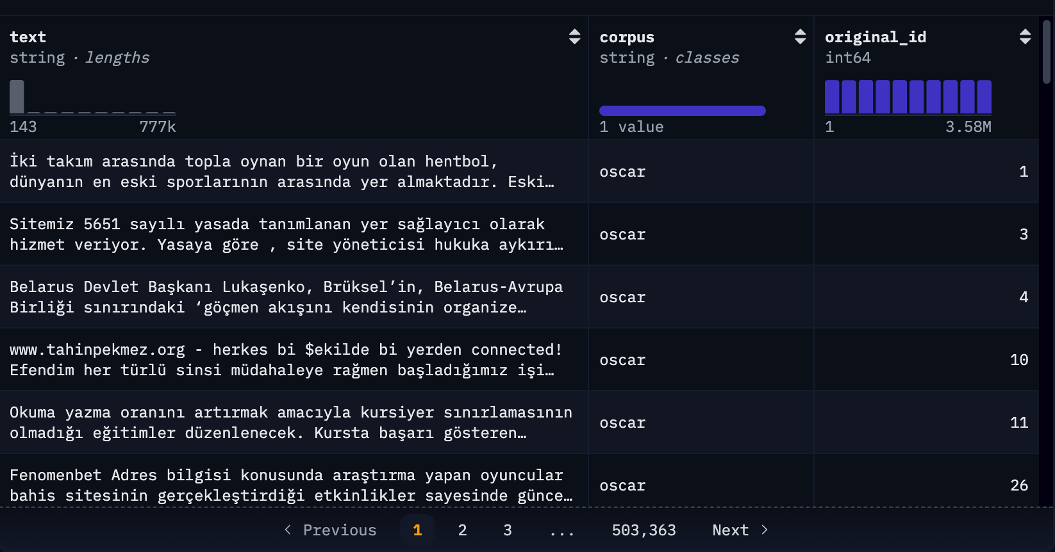
CORPUS WORKFLOW
vngrs: inspect first, then train
The public release already exposes source labels and raw web-text variation.
1
Download
Full 85 GB release to HU scratch
2
Inspect
Stratified human sample by source
3
Freeze
Filters, splits and exact hashes
4
Verify
Turkish gain + English retention, then M2-A/M2-B
REAL VNGRS SAMPLE
Source labels make OSCAR / mC4 strata directly auditable.
TRANSFER VS. RELEARNING • 05 / 06
Notes:
The corpus stage is a scientific gate, not just preprocessing. We must show that the Turkish dose genuinely changes Turkish capability while preserving enough English competence; otherwise a null factual result remains uninterpretable.
[Sources]
- https://huggingface.co/datasets/vngrs-ai/vngrs-web-corpus
- Local: documentation/145_LITERATURE_FIRST_M1_MODEL_AND_TURKISH_ADAPTATION_ROUTE_TR.md
- Local: documentation/151bq_VNGRS_CLUSTERED_WINDOW_SAMPLE_DESIGN_AND_EXECUTION_CONTRACT_TR.md

Slide 6
NEXT FOUR WEEKS
Four focused weeks can close the core experimental loop
Priority order: model decision → corpus freeze → causal comparison → thesis integration.
WEEK 1
WEEK 2
WEEK 3
WEEK 4
Decide M1 + acquire vngrs
Audit + freeze corpus
Run M2-A / M2-B
Analyze + write
Precommit OLMo early checkpoint decision. Download, hash and stratify the full corpus.
Human quality audit, filters, contamination checks, train/val/test and dose subsets.
Matched Turkish adaptation arms; manipulation checks; two seeds if compute permits.
Bootstrap contrasts, retention analysis, artifact freeze, near-final Results and Discussion.
Stop rule: if OLMo still misses retention, freeze it as a negative — no open-ended model fishing.
TRANSFER VS. RELEARNING • 06 / 06
Notes:
This plan is deliberately linear. The main risk is GPU access, not an unresolved scientific decision. The stop rule protects the month from becoming another optimization loop.
[Sources]
- Local: documentation/159_M1_THREE_MODEL_DOSE_PARETO_REMEDIATION_CONTRACT_TR.md
- Local: documentation/160_M1_DOSE_PARETO_OLMO_BF16_EXECUTION_AND_FAMILY_STATUS_TR.md
- Local: documentation/145_LITERATURE_FIRST_M1_MODEL_AND_TURKISH_ADAPTATION_ROUTE_TR.md

