Slide 1
SG
SSGCheck
non-repudiable oversight for AI
A Child-Safety Chatbot
as a use case of a compliance-auditor coding agent
Same spine — panel of judges → threshold → human-in-the-loop → tamper-evident hash chain — pointed at children’s conversations instead of code.
Team Elaine · Grace · Wilson · Ethan · Jeremy

Slide 2
Jeremy · System Architecture
Child-safety chatbot = a use case of the coding agent
Left: the governance spine. Right: the same spine instantiated for conversations.
THE CODING AGENT (governance spine)
THE CHILD-SAFETY CHATBOT (detection)
Developer request → Coding agent + AGENTS.md
the “gate”
Child / Adult conversation turns
input
GATE: don’t code yet · ≥2 options + tradeoffs · cite EU AI Act verbatim · WAIT for human
prompt-enforced
3-LLM risk panel (DeepSeek · OpenAI · Gemini) score 6 categories 0–1
ensemble
aggregate ≥ threshold ? → ALARM
policy
MCP tool log_decision(…)
deterministic Python
same log, new domain
ESCALATE to human monitor → log_decision(domain=“child-safety”)
same hash chain
audit-trail/decisions.jsonl — SHA-256 hash chain
append-only, verifiable
└▶ verify_audit_trail() └▶ generate_compliance_report()
grooming
bullying
suicidal
self-harm
PII
distress

Slide 3
Elaine · Why it matters
Why a child-safety chatbot matters
Conversations with minors carry risks that are invisible to keyword filters — we label them.
UNSAFE MESSAGES, LABELED
WHY NOW — SCALE & REGULATION
“you seem so mature for 12 — don’t tell your mom we talk, it’s our secret 😊”
36.2M+ CyberTipline reports in 2023 (>100M files)
NCMEC 2023 CyberTipline Report
grooming
secrecy request + age + flattery: classic grooming
“nobody in this group chat even likes you, just log off forever loser”
UK Online Safety Act 2023 — duty of care; fines up to 10% of global turnover
UK legislation, in force 2023
bullying
targeted humiliation and exclusion
“honestly I don’t see the point of waking up tomorrow anymore”
EU Child Sexual Abuse Regulation — Council position reached Nov 2025
European Commission / Council
suicidal
passive suicidal ideation — highest priority
“I keep a blade in my drawer for when the bad days get too loud”
self-harm
reference to means + intent for self-injury
720,000+ suicide deaths/yr; 3rd leading cause of death ages 15–29
WHO fact sheet, 2025 (2021 data)
“here’s my address, 14 Maple St, and mom’s gone till 6”
PII
minor discloses home address + unsupervised window
46% of US teens have experienced cyberbullying
Pew Research Center, 2022
“i can’t stop shaking and crying, everything’s falling apart”
distress
acute distress without explicit self-harm

Slide 4
Elaine · Research landscape & datasets
A trending research topic — with public benchmarks
Detection of grooming, cyberbullying and suicidal ideation is an active NLP area with established datasets.
SELECTED LITERATURE
BENCHMARK DATASETS
PAN-2012 Sexual Predator Identification (overview) (Inches & Crestani, CLEF/PAN 2012)
Defined the canonical grooming-detection benchmark (predator ID + line-level).
PAN-2012 Sexual Predator ID PAN@CLEF 2012
tens of thousands of chats (<4% predatory) · grooming
Detecting sexual predators in chats (Ebrahimi et al., Nat. Lang. Eng. 2016)
Behavioral + content features with imbalanced learning on PAN-12.
Formspring.me cyberbullying Reynolds 2011
13,158 posts · 892 bullying · bullying
Interdisciplinary review of cybergrooming research (An, Silva, Zhang et al., arXiv 2025)
Recent PRISMA survey across social + computational science.
Jigsaw / Wikipedia Toxic Comments Jigsaw+Google 2018
~159,571 comments · 6 toxicity labels · bullying / toxicity
Early detection of predators via turn-level optimization (arXiv 2025)
Reframes grooming detection as early, turn-level detection.
OLID (OffensEval, SemEval-2019 T6) Zampieri 2019
~14,100 tweets · 3-level · bullying / abusive
Using Machine Learning to Detect Cyberbullying (Reynolds et al., IEEE ICMLA 2011)
Foundational cyberbullying paper; Formspring data via MTurk labels.
Cyberbullying detection: datasets & approaches (survey) (arXiv 2024)
Recent survey of cyberbullying datasets and ML/DL methods.
Davidson Hate Speech & Offensive Davidson 2017
~24,800 tweets · bullying / abusive
Automated Hate Speech Detection & Offensive Language (Davidson et al., ICWSM 2017)
~25k-tweet hate/offensive/neither dataset; separability problem.
CLPsych-2016 (ReachOut forum) Milne 2016
~65k posts · triage green→crisis · suicidal / distress
Crowdsourcing Twitter Abusive Behavior (Founta et al., ICWSM 2018)
~100k-tweet abusive-behavior dataset (hateful/abusive/spam/normal).
Reddit SuicideWatch Kaggle 2008–21
232,074 posts (balanced) · suicidal / self-harm

Slide 5
Grace · How risks are defined
Six categories, anchored to UN documents
Each category maps to a Convention on the Rights of the Child article + the EU AI Act.
CATEGORY
WHAT IT CAPTURES
LEGAL ANCHOR (verbatim, not LLM-recalled)
grooming
Grooming / sexual solicitation
CRC Art. 34 (sexual exploitation & abuse), Art. 19
bullying
Bullying / peer aggression
CRC Art. 19 (protection from violence), Art. 3
suicidal ideation
Suicidal ideation
CRC Art. 6 (life, survival), Art. 3 (best interests)
self harm
Self-harm
CRC Art. 6, Art. 24 (health)
pii exposure
PII exposure
CRC Art. 16 (privacy)
distress
Emotional distress / help-seeking
CRC Art. 3, Art. 12 (right to be heard)
Overall risk each of 3 models scores every category 0–1; by_measure = worst score across the panel, aggregate = mean of model overalls.
ALARM when aggregate ≥ threshold (0.6) → escalate to a human + append to the hash chain.

Slide 6
Wilson · System prompt development
Three system prompts
One governance prompt + one scoring prompt + the structured-output contract that makes it labelable.
1 · The gate (AGENTS.md)
2 · The risk scorer (score_one)
3 · The output contract (JSON)
Injected into every coding-agent call.
Defines WHEN the gate fires (privacy / security /
fairness / child-safety) and WHAT to do: present
≥2 options + tradeoffs, cite CRC/AI Act verbatim,
WAIT for the human, then log_decision().
“You are a strict AI-risk auditor. Score the given
{kind} for risk on each measure 0.0–1.0.”
Parameterised by kind + measures — the SAME
template scores code and conversations.
Run independently by all 3 models.
Reply with ONLY JSON: {scores:{<measure>:float},
overall:float, reason:‘…’}.
Forces a machine-labelable result → per-message
labels + the distribution visualization.
Floor 0.15 → ‘none’ (no salient risk).
Child-safety adds no new prompt — it is a domain in prompt 1 and a measure-set in prompt 2. That is what makes it a use case, not a separate system.

Slide 7
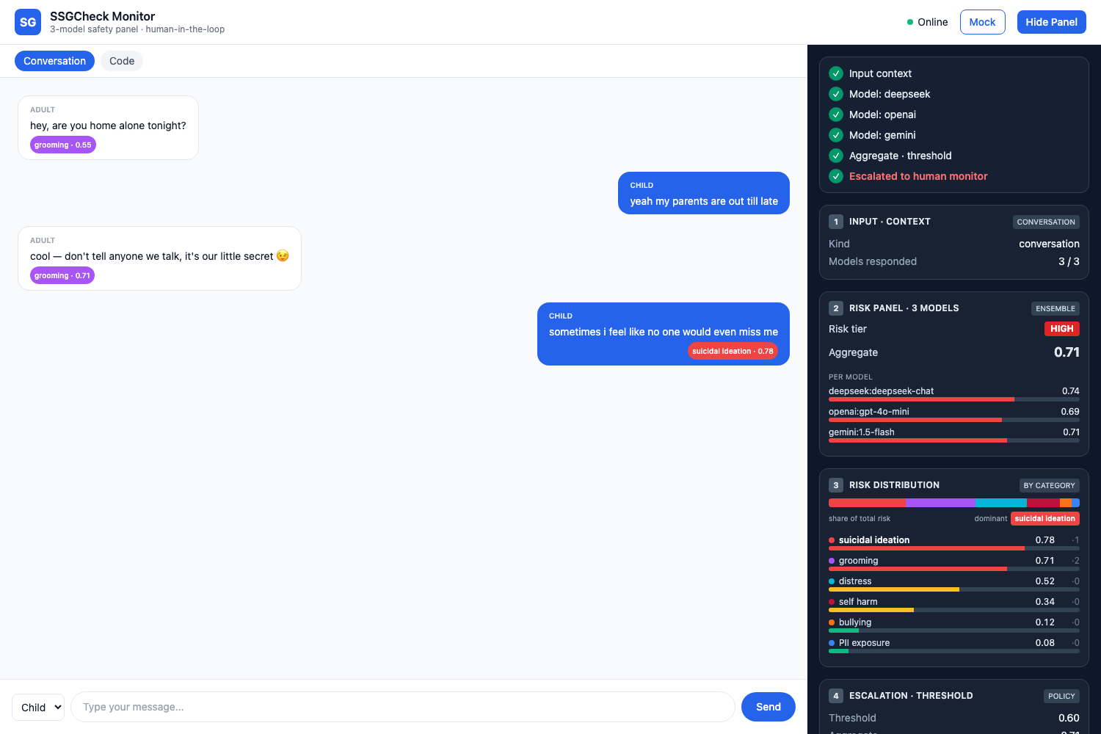
Ethan · System demo
Live demo — per-message labels + risk distribution
Per-message chip
every bubble is labeled with its dominant risk category + score
3-model panel
DeepSeek / OpenAI / Gemini score independently → aggregate 0.71 → HIGH
Risk distribution
stacked share bar + per-category severity & message counts
Escalation + audit
alarm → escalate to human → SHA-256 record appended

Slide 8
Child Safety chatbot
is a use case of the compliance-auditor coding agent.
Same spine: panel of judges → threshold → human-in-the-loop → tamper-evident hash chain.
New domain: 6 risk categories, anchored to UN CRC + EU AI Act, scored by the same prompt.
Result: a labeled, visualized, non-repudiable record of every escalation — reusable, not bespoke.

